Slide 1



Slide 2
Optimization of Distributed Propulsion
In Long Heavy Vehicle Combinations
Karthik Venkataraman and Nikhil Acharya
Applied Mechanics, Chalmers University of Technology
Notes:
2

Slide 3
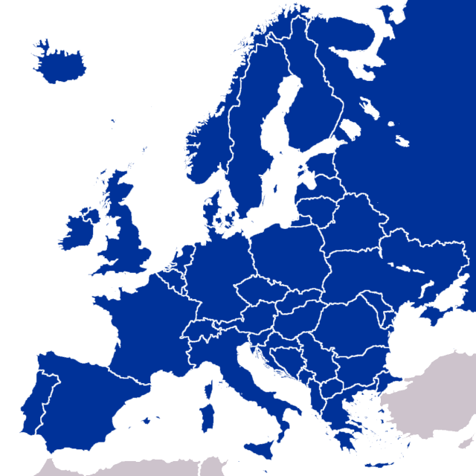
Freight transport in Europe
30%
27%
2020
EU directive 96/53
2010
Transported
Tonnes
Vehicle
Kilometres
Notes:
Tonnage – 31%
Miles – 27%
Overall freight – 26% in 10 years from 2010 to 2020
3

Slide 4
Move to longer vehicle combinations
+
Lesser traffic & road space occupied
Lower fuel consumption & emissions
One driver instead of two
2014
Notes:
Tonnage – 31%
Miles – 27%
Overall freight – 26% in 10 years from 2010 to 2020
4

Slide 5
Move to longer vehicle combinations
EMS
EU directive 96/53
2014
Notes:
Tonnage – 31%
Miles – 27%
Overall freight – 26% in 10 years from 2010 to 2020
5

Slide 6
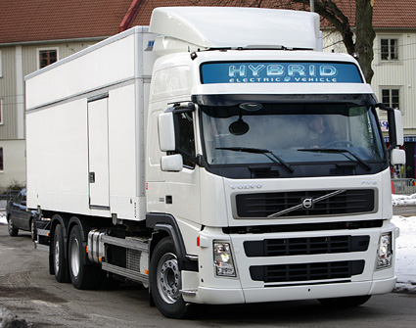
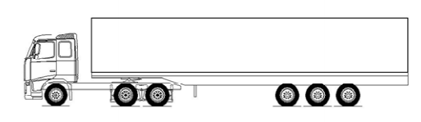
The way ahead
Technology
Reduced fuel consumption and emissions
Higher energy efficiency
Improved time efficiency
Sustainability
2014
2015
Notes:
Disadvantages – Still more traffic (more trucks on the road), higher operating costs, fleet management, maintenance etc higher

Slide 7


Requirements, Society
Performance Based Characteristics
Longitudinal
1 § Startability at x % slope.
2 § Gradeability with 70 km/h at x % slope.
3 § Downhill capability with 70 km/h at x % slope.
4 § Acceleration capability 0 to 100 m with x seconds.
5 § Stopping distance, from 70 to 0 km/h on x m.

Slide 8
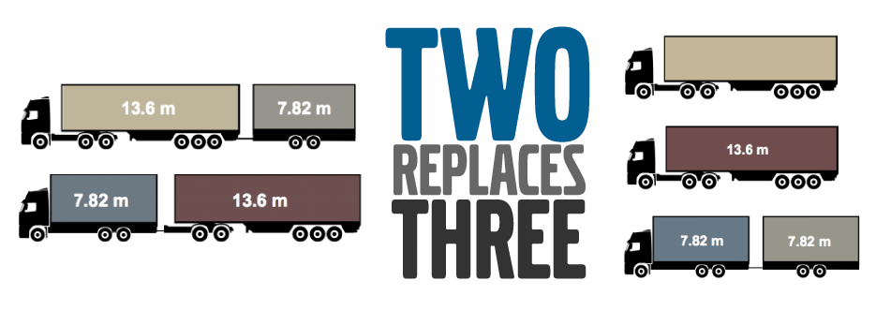
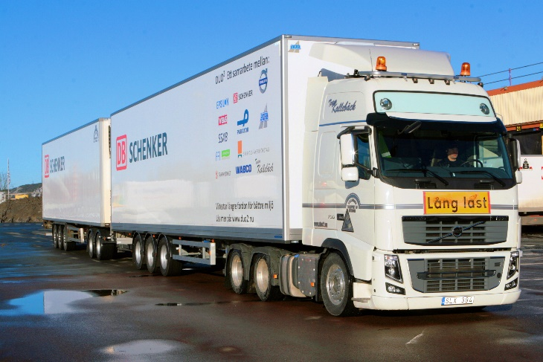
The way ahead
Policy
Reduced fuel consumption and emissions
Higher energy efficiency
Reduced traffic and congestion
Safer corridors
2014
2015
Notes:
Disadvantages – Lower gradeability, lower average speeds, lower manoeuvring control

Slide 9
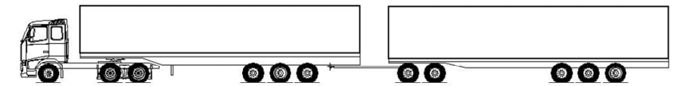

The way ahead
?
?
2014
2015
2020
2025
2030

Slide 10
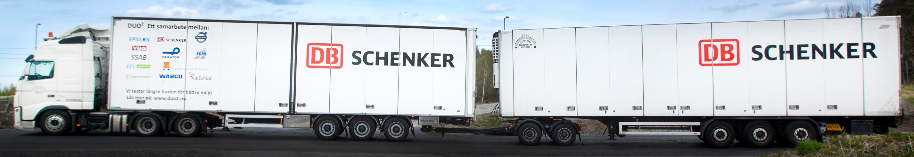
What combinations are possible?
D13

Slide 11
What combinations are possible?
D13
D11

Slide 12
What combinations are possible?
D13
D11
3 Engine Sizes X 3 Buffer Sizes X 3 Motor Sizes X 11 possible axles = 55296 combinations

Slide 13
How is each combination evaluated?
?
2014
2015
2020
2025
2030

Slide 14
How is each combination evaluated?
What is the best combination for the mission?
?
2014
2015
2020
2025
2030

Slide 15
Concept Design Tool
How is each combination evaluated for the specific transport mission?
Include the important parts which defines transport mission
Way of extracting the most viable combination?
GA for optimizaiton
2014
2015
2020
2025
2030

Slide 16
How is each combination evaluated?
What is the best combination for the mission?
ProdCALC
2014
2015
2020
2025
2030

Slide 17
How is each combination evaluated?
What is the best combination for the mission?
ProdCALC
ProdOPT
2014
2015
2020
2025
2030

Slide 18
Transport Mission
Vehicle
Driver
Mission
Route
Payload

Slide 19







ProdCALC - Mission Productivity
Lifetime Revenues
Total cost of Operation

Slide 20





ProdCALC - Mission Productivity
Lifetime Revenues
Total cost of Operation
delete

Slide 21


ProdCALC - Mission Productivity
Lifetime Revenues
Total cost of Operation

Slide 22
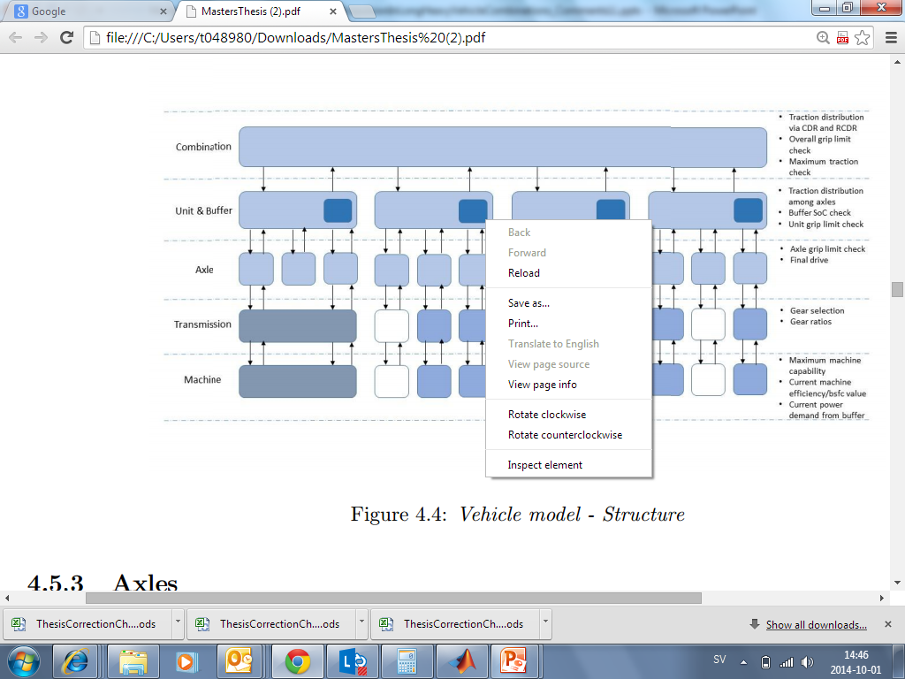
Vehicle Model in the Concept Design Tool
Cruise speed
Traction
demand
Traction
output
Road Gradient
Notes:
Simple cruise control

Slide 23
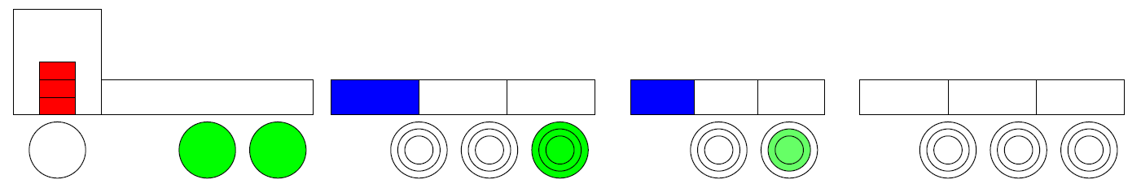
Vehicle Model in ProdCALC
Traction achieved
Engine traction
Electric traction
Longitudinal vehicle dynamics

Slide 24
Vehicle Model in ProdCALC
Traction achieved
Engine traction
Electric traction
Longitudinal vehicle dynamics
Rule-based hybrid power management

Slide 25
Vehicle Model in ProdCALC
Traction achieved
Engine traction
Electric traction
Longitudinal vehicle dynamics
Rule-based hybrid power management
Distributed propulsion – energy buffers on each unit

Slide 26
Vehicle Model in ProdCALC
Traction achieved
Engine traction
Electric traction
Longitudinal vehicle dynamics
Rule-based hybrid power management
Distributed propulsion – energy buffers on each unit
Control allocation based on buffer availability

Slide 27
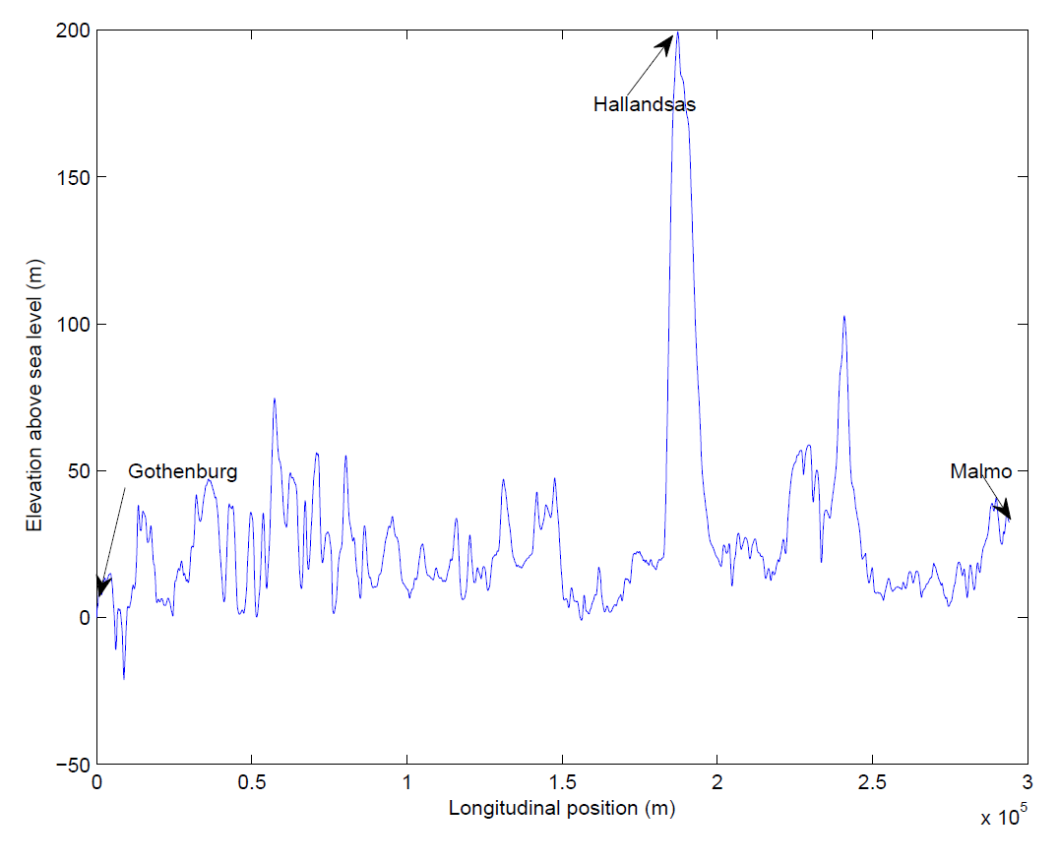
Vehicle Model in ProdCALC
Predictive Battery Energy Management

Slide 28
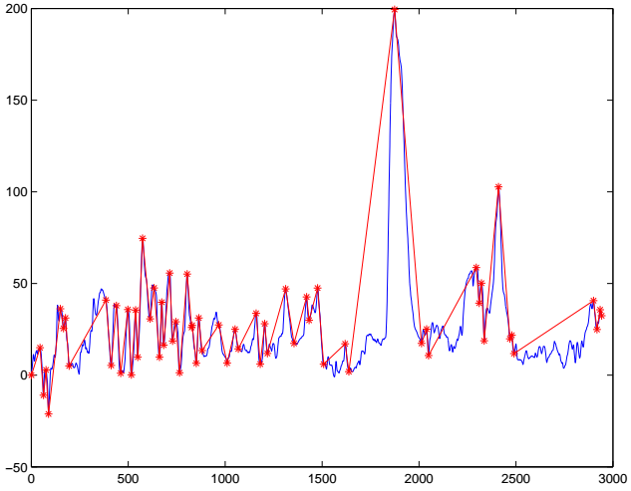

Vehicle Model in ProdCALC
Predictive Battery Energy Management
Longitudinal position (data points)

Slide 29
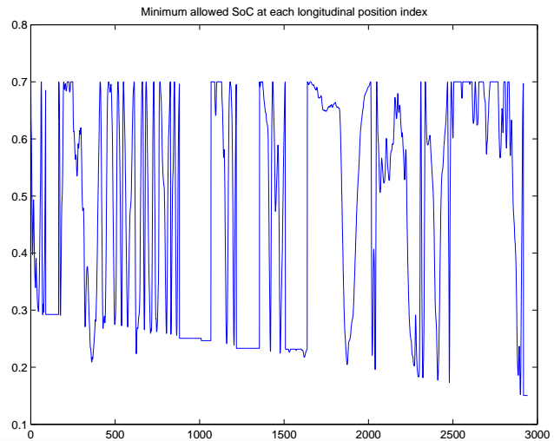
Vehicle Model in ProdCALC
Battery Energy Management - Predictive

Slide 30
ProdCALC
Vehicle
Lifetime Revenues
Mission
prodCALC
Mission Productivity =
Driver
Route
Total cost of Operation
Payload

Slide 31
ProdOPT
Optimization Tool
Productivity

Slide 32
ProdOPT
Optimization Tool - Evolutionary Algorithm

Slide 33
ProdOPT
Optimization Tool - Evolutionary Algorithm

Slide 34
ProdOPT
Optimization Tool - Evolutionary Algorithm

Slide 35
Concept Design Tool
Evolutionary Algorithm Optimization Based
Flow chart to the left and simplified vehicle combination showing what happens during GA

Slide 36
ProdOPT
Optimization Tool - Evolutionary Algorithm

Slide 37
ProdOPT
Variants
3 different engines – D11, D13 and D16
3 electric buffer sizes – 5 kWh, 50 kWh and 91 kWh
3 electric motor sizes – 125kW, 230 Nm;
175kW, 400 Nm and
175kW, 800 Nm
Electric propulsion on any / all trailer axles

Slide 38
Transport Mission Göteborg - Malmö
Already quite optimal vehicle combination A-double
Lifetime 3 years
Number of runs 2 per day
Basic price settings 2015 2020 2025 2030 and Trendes

Slide 39
Results Göteborg – Malmö (2015)
Lifetime 3 years
Number of runs 2 per day
Basic price settings 2015 2020 2025 2030 and Trendes

