Slide 1



Slide 2
Optimization of Distributed Propulsion
In Long Heavy Vehicle Combinations
Karthik Venkataraman and Nikhil Acharya
Applied Mechanics, Chalmers University of Technology
Notes:
2

Slide 3
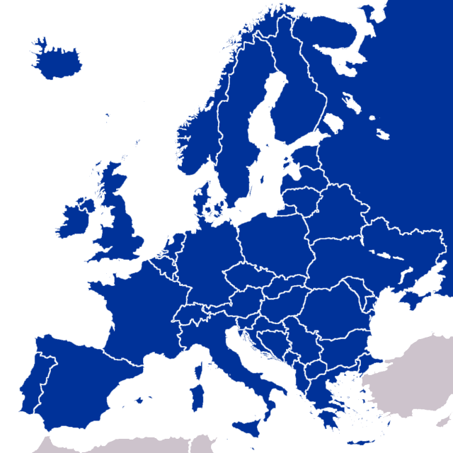
Freight transport in Europe
30%
27%
2020
EMS- EU directive 96/53
2010
Transported
Tonnes
Vehicle
Kilometres
Notes:
Tonnage – 31%
Miles – 27%
Overall freight – 26% in 10 years from 2010 to 2020
3

Slide 4
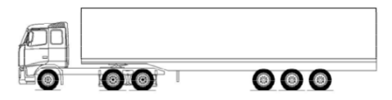
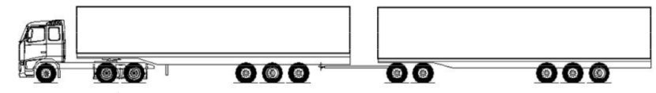
Move to longer vehicle combinations
40t
+
40t
40t
40t
Lesser traffic & road space occupied
Lower fuel consumption & emissions
One driver instead of two
Swedish introduction of EMS+ in 2016
Notes:
Tonnage – 31%
Miles – 27%
Overall freight – 26% in 10 years from 2010 to 2020
4

Slide 5
Long combination performance
Low gradeability, startability
Lower average speeds
Reduced maneuverability
Improved gradeability & startability
Improved vehicle control possibility (lateral, stability)
Notes:
Tonnage – 31%
Miles – 27%
Overall freight – 26% in 10 years from 2010 to 2020
5

Slide 6
Additional propulsion in long combinations
On which axles must propulsion be added?
How much additional propulsive power is required?
If electric propulsion, how should the batteries be sized?
How should the tractor powertrain be sized?
Notes:
Tonnage – 31%
Miles – 27%
Overall freight – 26% in 10 years from 2010 to 2020
6

Slide 7
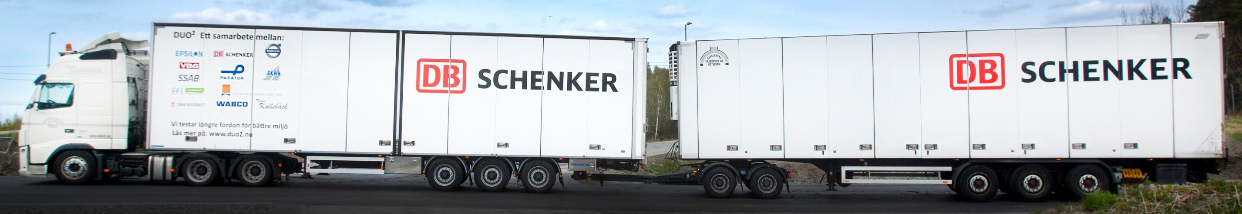
What combinations are possible?
D13
D11
3 Engine Sizes X 3 Buffer Sizes X 3 Motor Sizes X 11 possible axles = 55296 combinations

Slide 8
Key Thesis Outcomes
For a specific transport mission
Develop a concept evaluation model for each long vehicle combination
Develop a concept selection / design tool to extract the most viable vehicle combination

Slide 9
Concept Evaluation Model
Vehicle
Driver
Route
Payload
Specific mission defined by
Route – Road coordinates and gradient
Driver – Driving behavior, wages
Payload – Load, density, revenues per ton
Vehicle combination simulated to execute mission
Numeric fitness measure derived from mission outputs

Slide 10
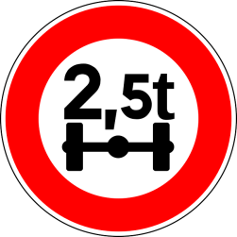
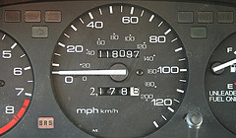


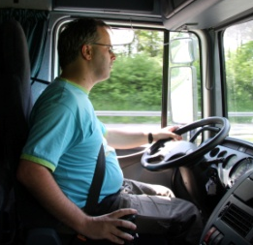




Concept Evaluation Model
Fitness Measure – Vehicle Lifetime Productivity
Lifetime Revenues
Total cost of Operation

Slide 11
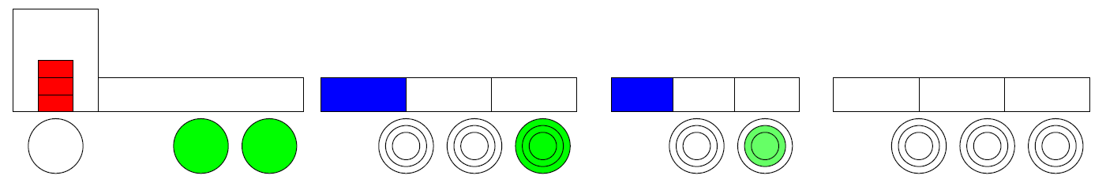
Concept Evaluation - Vehicle Model
Cruise speed
Traction
demand
Traction
output
Engine traction
Electric traction
Road Gradient
Plugin hybrid model
Longitudinal vehicle dynamics
Rule-based hybrid power management
Control allocation based on buffer availability

Slide 12
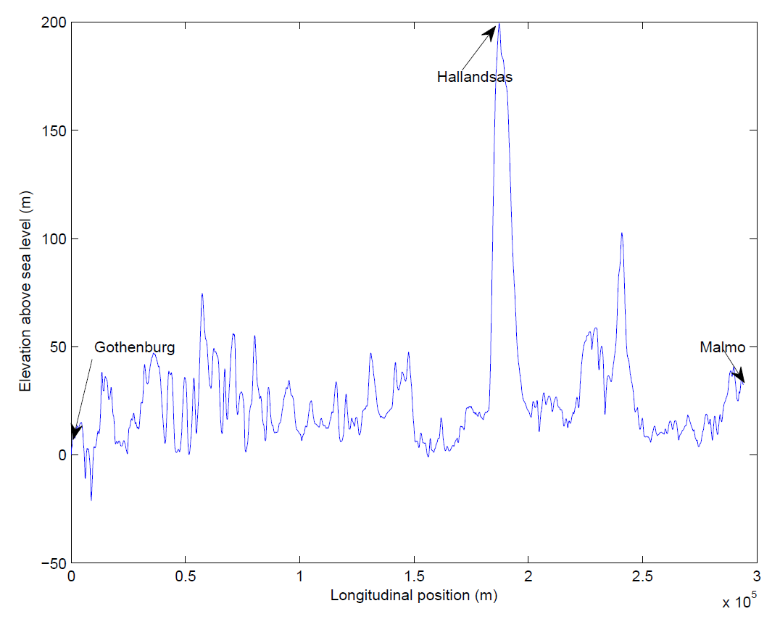
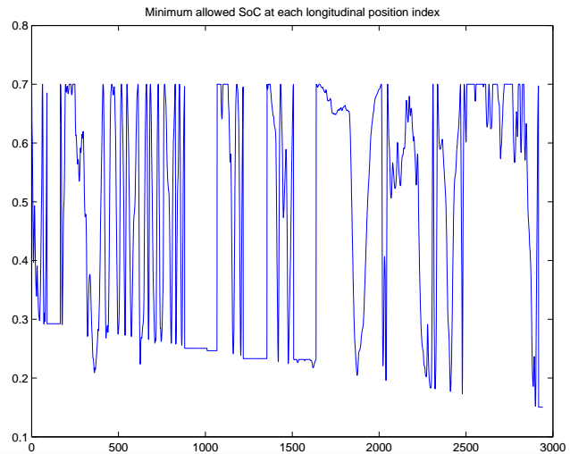
Concept Evaluation - Vehicle Model
Predictive Battery Energy Management

Slide 13
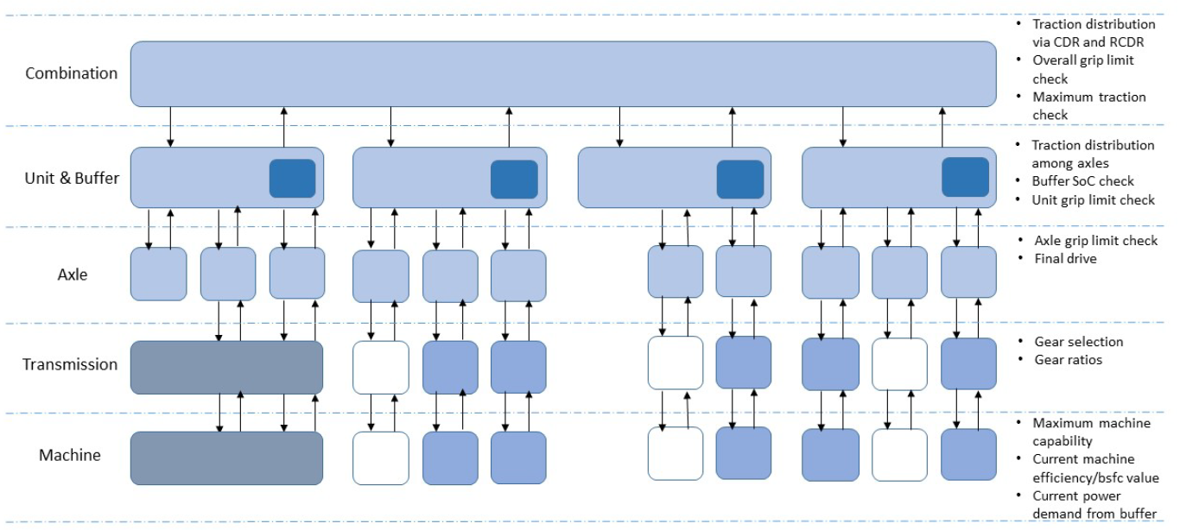
Concept Evaluation - Vehicle Model Software Architecture

Slide 14
Concept Evaluation Model - Summary
Mission Data
Mission Outputs
Vehicle Model
Route / Driving Cycle
Driver Model
Payload
Fuel consumption
Mission time
Battery energy used
Vehicle Lifetime
Productivity

Slide 15
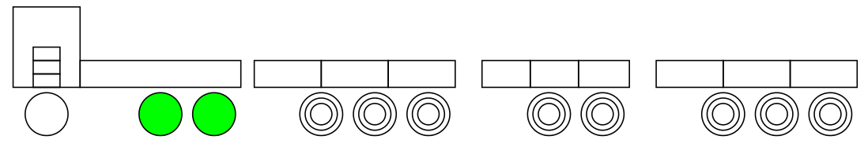
Concept Design – Optimisation Problem
For a specific mission,
Find the combination that
Maximizes Vehicle Productivity
Design Variables
Number of propelled axles in the combination
Position of propelled axles in the combination
Size of tractor powertrain (engine size)
Size of electric buffer on each trailing unit
Size of electric motor on each propelled trailer axle

Slide 16
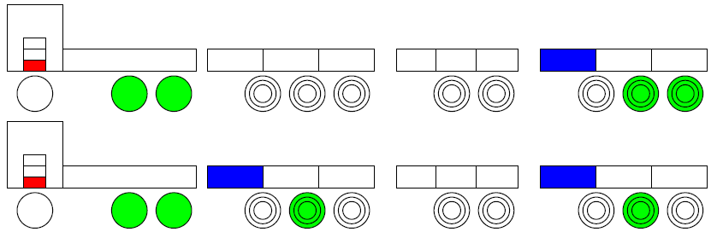
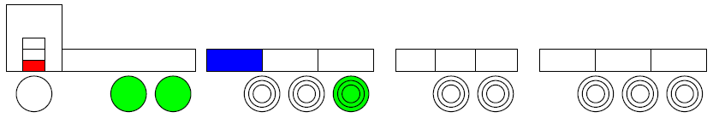
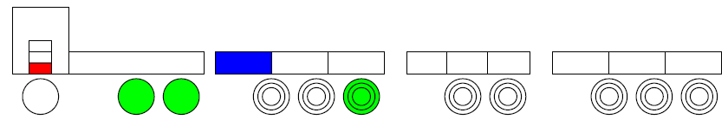
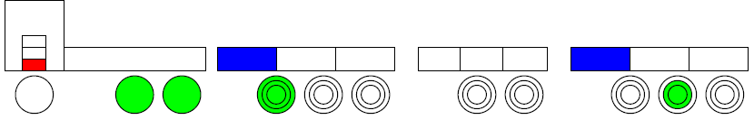
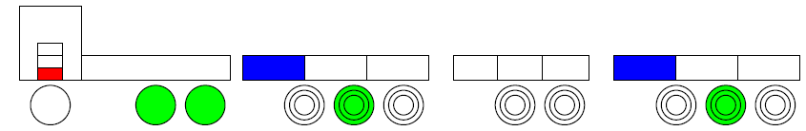
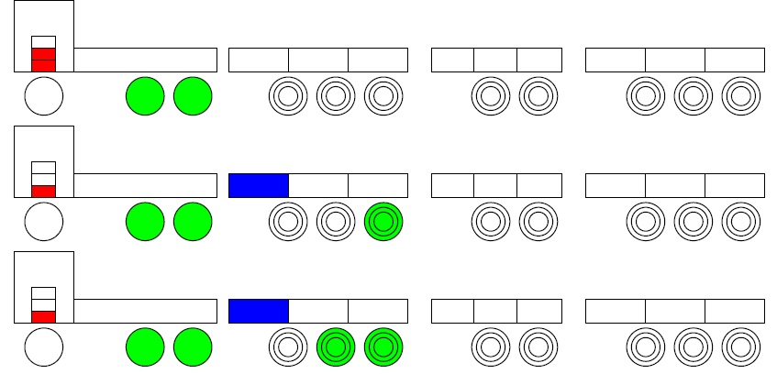
Concept Design – Optimisation
Evolutionary Algorithms
Initial Population
VP₁
VP₂
Evaluate Population
.
.
.
Selection
Crossover
VP_{N-2}
VP_{N-1}
Mutation
VP_{N}
N different ‘individuals’ created
All N individuals evaluated

Slide 17
ProdOPT
Variants
3 different engines – D11, D13 and D16
3 electric buffer sizes – 5 kWh, 50 kWh and 91 kWh
3 electric motor sizes – 125kW, 230 Nm;
175kW, 400 Nm and
175kW, 800 Nm
Electric propulsion on any / all trailer axles

Slide 18
Transport Mission Göteborg - Malmö
Already quite optimal vehicle combination A-double
Lifetime 3 years
Number of runs 2 per day
Basic price settings 2015 2020 2025 2030 and Trendes

Slide 19
Results Göteborg – Malmö (2015)
Lifetime 3 years
Number of runs 2 per day
Basic price settings 2015 2020 2025 2030 and Trendes

