Slide 1
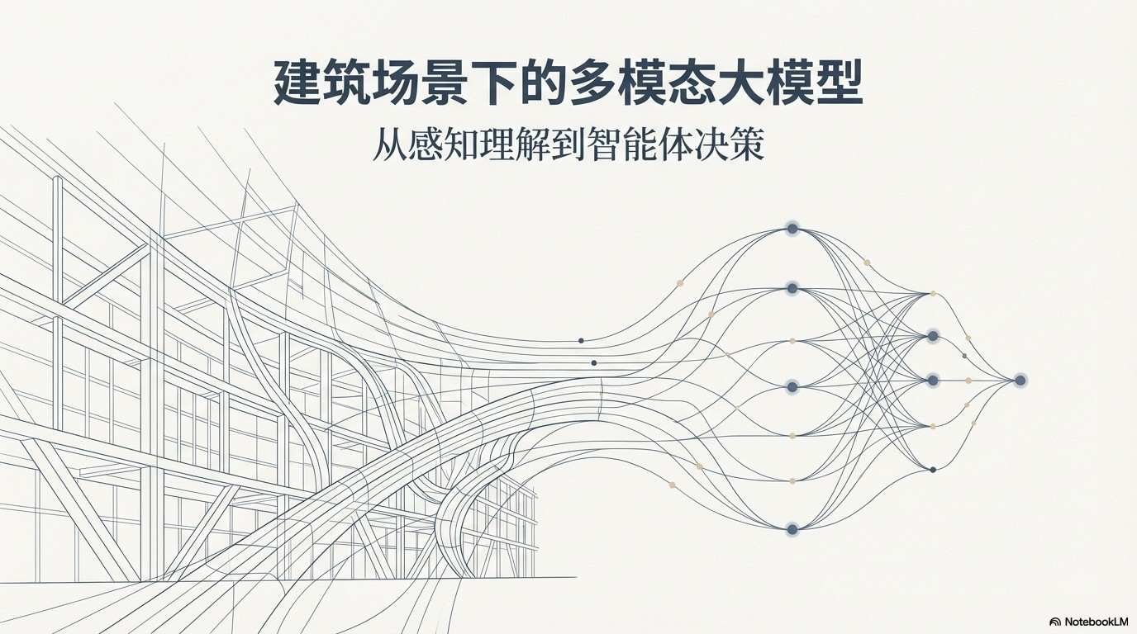

Slide 2
RašžVBAfiD, ï łs tøA1P•NRP17a
¥. 6 .mskea&AP, Ł tż›säż t7ëtsz6
NLP
CV

Slide 3
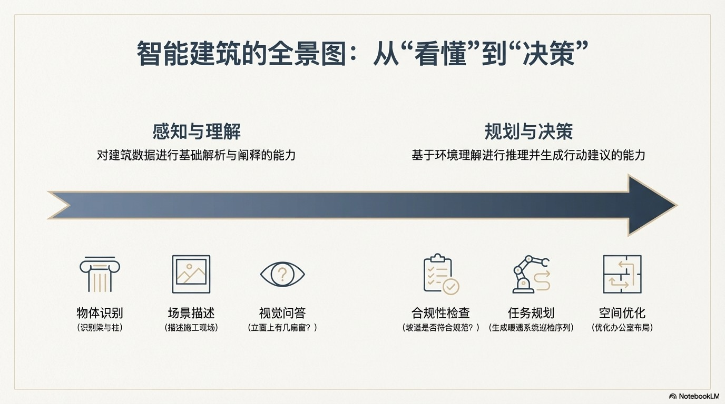

Slide 4
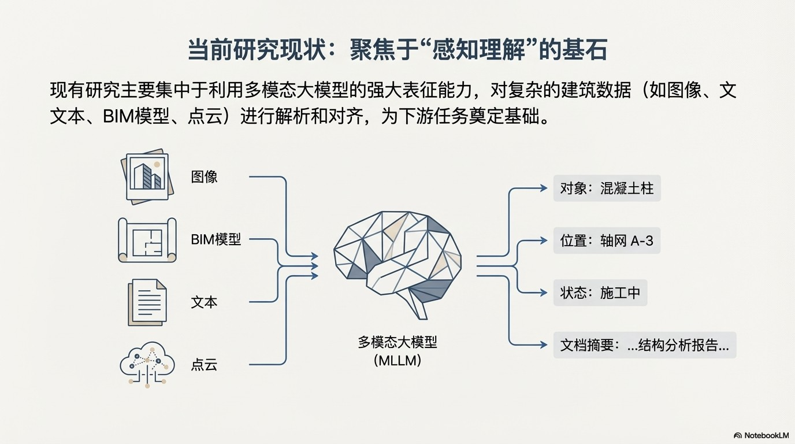

Slide 5

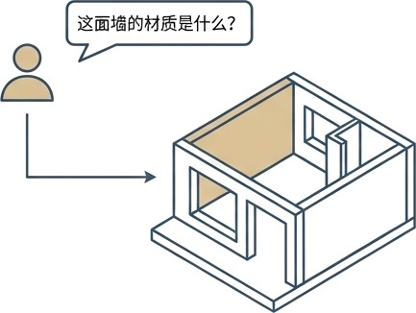
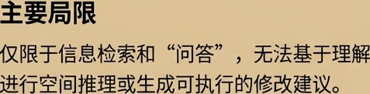
z: BiféBIM@i!?j2Ié%@%
, iéA: StructVQA: A Framework for VQA on Building Information Models, fictional Conference, 2023

Slide 6

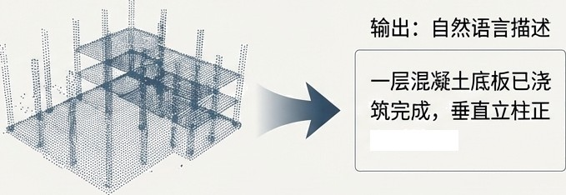

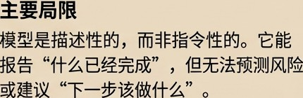

2:
C¿€@: Scan2Text: End-to End Scene Description for Construction Monitoring, Fictional Journal, 2024
G NotebookLM

Slide 7
(The So What)
(The What)
(Lack of Agency)

Slide 8
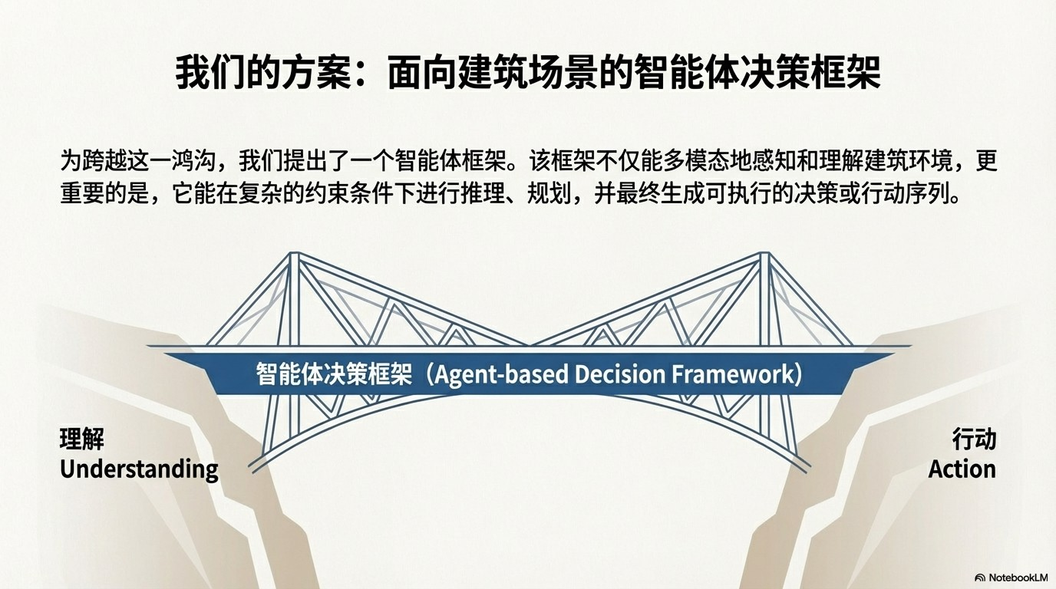

Slide 9
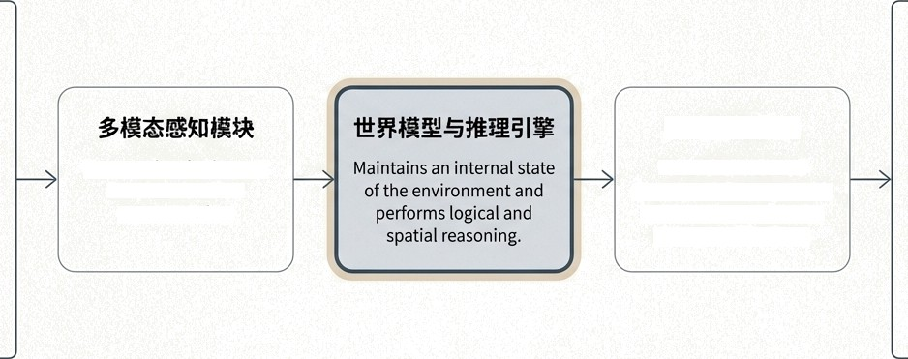















Fuses and embeds input data into a unified representation.
Takes the reasoned output and decomposes it into a concrete plan or a
sequence of actions.
BI

Slide 10
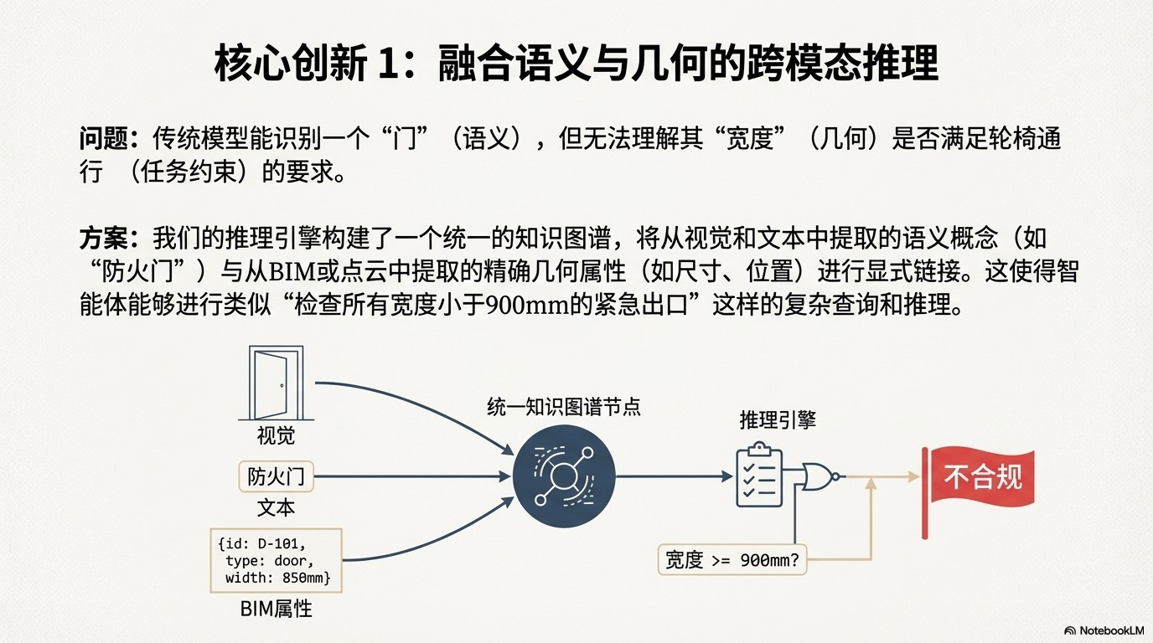

Slide 11
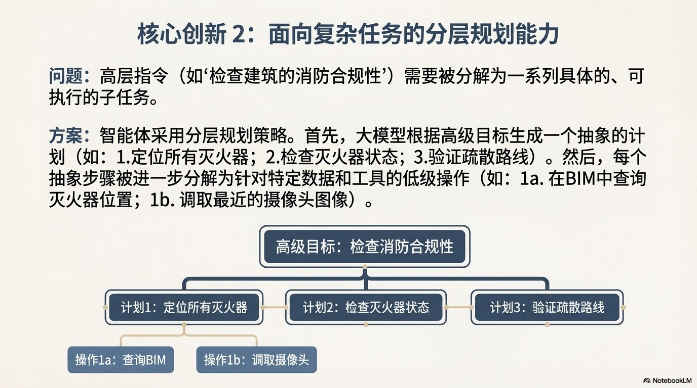

Slide 12
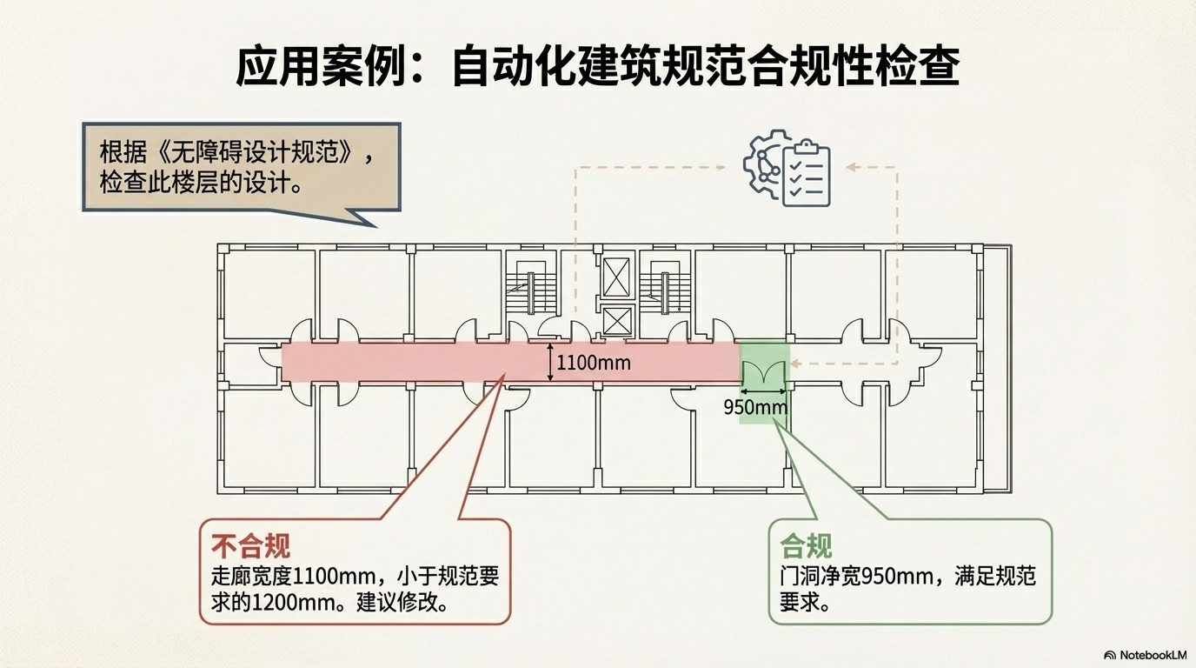

Slide 13





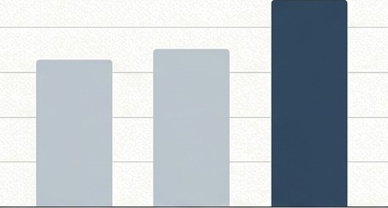



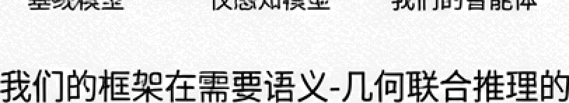
Agent Chain-of-Thought
100%
GOAL: Check corridor C-3 for accessibility.
THOUGHT: I need to find the corridor's width and compare it to the regulation minimum.
ACTION: QueryBIM(ID="C-3", property=”width”)
OBSERVATION: ll0Bmm
THOUGHT: The regulation states m1n1mum u1dth is 1208mm. 1108mm is less than 1280mm.
COIJCLUSION: Corridor C-3 is non-compliant .
40°4
This qualitative example makes the agent's reasoning process transparent and interpretable.
KSL› .$0T&ZtXTfPifiXfi
G
NotebookLM

Slide 14
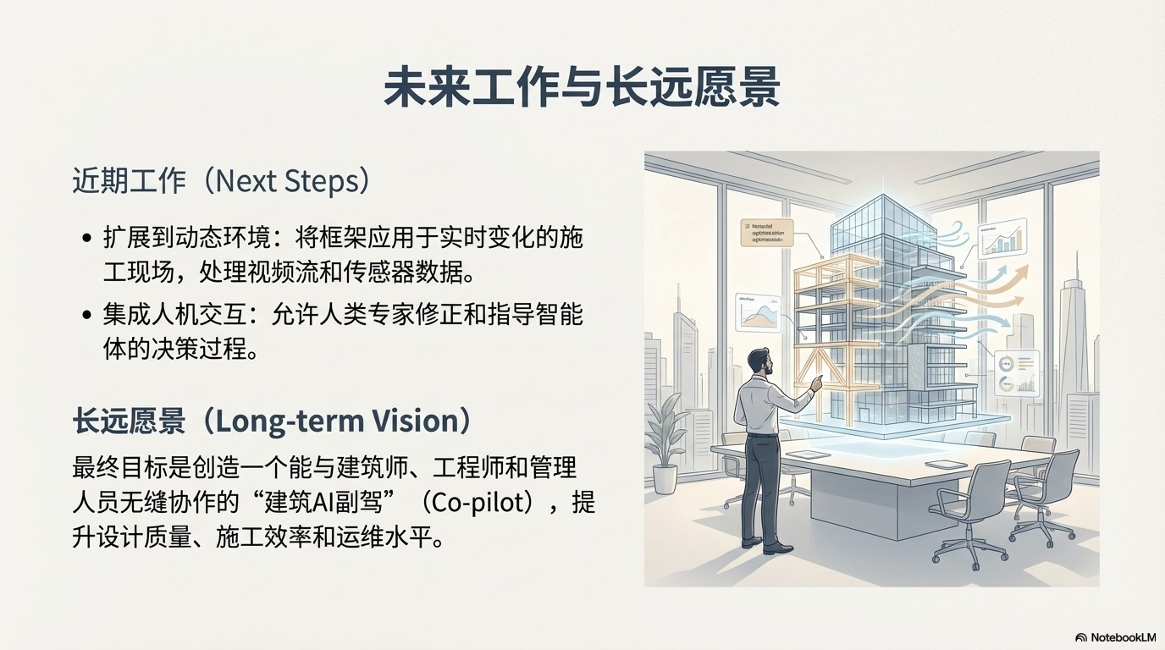

Slide 15
