Slide 1
Project Proposal
Carter Nabors, Gage Lemaster

Slide 2
Key Focus Area

Slide 3
College Sports Realignment
Changing of athletic conferences
SEC, Big 10, ACC, Pac-12
Affect on players, teams, and schools

Slide 4
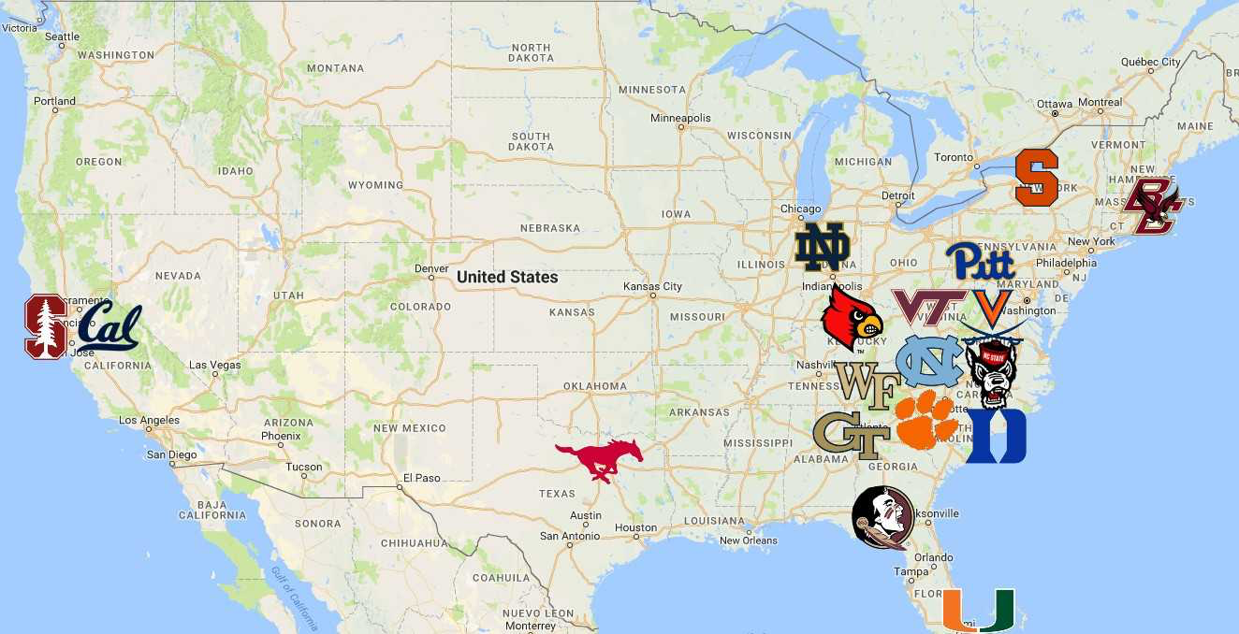
Topics
Recruitment Changes
Injury Rates
Academic Impact

Slide 5
Data Sources
NCAA Records, team win-loss, athletic schedules
ESPN, 247sports, Rivals
Sports Reference, NFL

