Slide 1
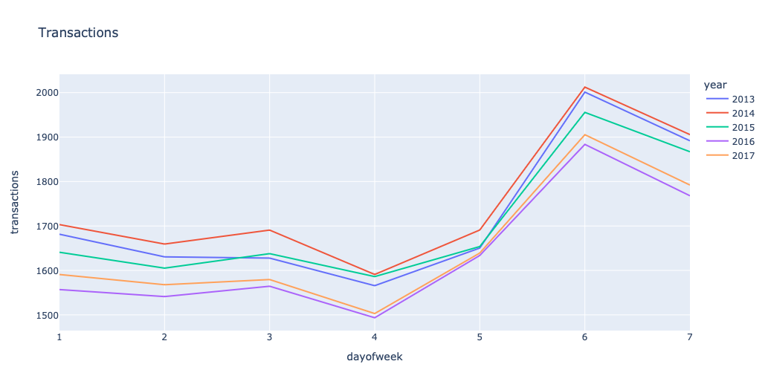
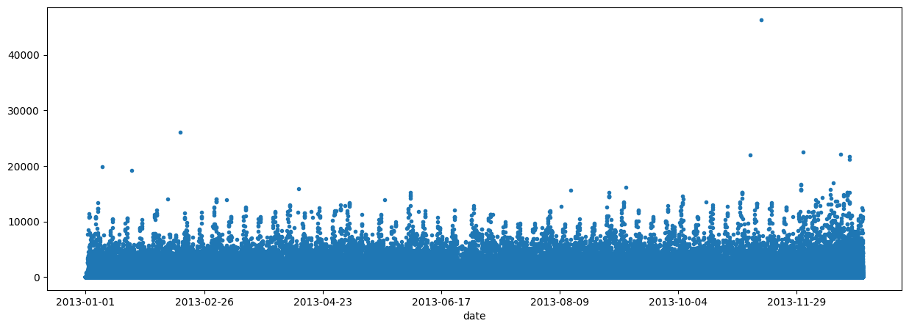
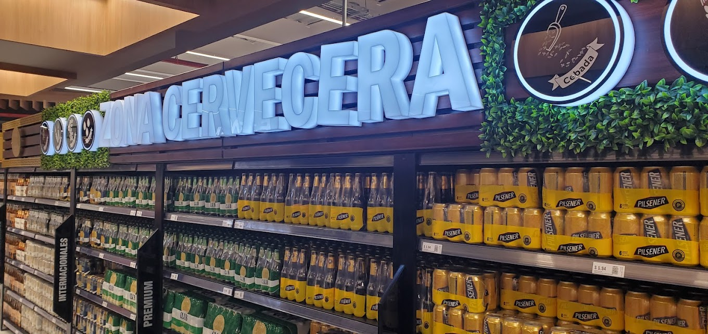


Store Sales - Time Series Forecasting
Group: PSW --- ID: B4
Introduction
The retail industry faces challenges with outdated forecasting methods. This project aims to revolutionize this with machine learning. Here's the quick rundown:
Implications:
Better inventory management for retailers
Improved product availability for consumers
Economic benefits through efficient resource use
Goals and Hypothesis:
Develop a machine learning model for accurate retail demand forecasting
Hypothesize that this model will surpass traditional methods in dynamic retail settings
This work isn't just technical; it's about reshaping retail to meet customer needs more effectively. Our poster highlights these key points, underscoring the real-world impact of this machine learning innovation.
Total Transactions by Day
Results
Kaggle scores are Root Mean Squared Logarithmic Error.
CV scores are regular CV scores.
Based on Kaggle scores our best performing model was XGBoost.
Model | Kaggle Score | CV Score
Dummy | 3.23779 | 0.006974
Linear Regression | 1.89678 | 0.552296
Ridge* | 1.90115 | 0.484366
Decision Tree | 2.40676 | 0.717528
XGBoost* | 1.8205 | 2.0300*
Sales Data over a year for all products
Notes
We’ve tuned the Ridge and XGBoost models via hyper parameter optimization.
The XGBoost CV score is RMSLE.
Data Exploration
The following files were used to engineer useful features and train the models:
Train.csv – wealth of data relating to the type of product sold, how much of it was sold, how many items are on sale, and what store sold it
Stores.csv – information about the individual stores and what stores are similar
Oil.csv – daily oil price (Ecuador is oil dependent)
Holidays.csv – details about Ecuadorian holidays
Feature Engineering
We refined feature engineering for efficiency. We added lag and rolling window features to 'onpromotion' for capturing short-term trends. Rate of change calculations and handling of missing values were included for data robustness. Key features like 'days_since_last_payday' and 'is_weekend' were added to reflect consumer behavior patterns. This focused approach to feature engineering aims to bolster our model's accuracy in forecasting product demand.
Future Work
The biggest area for improvement is in feature selection and data refinement. There is always more work to be done in generating new and useful features
We could also try more models, specifically others made for time series data. This would help a lot as most of the models we tested struggled with time series data specifically
Photo of a grocery store in Ecuador
Carter Watson | Utah State University
Spencer Potter | Utah State University
Ben Smith | Utah State University
Link to Data
Link to Code

