Slide 1
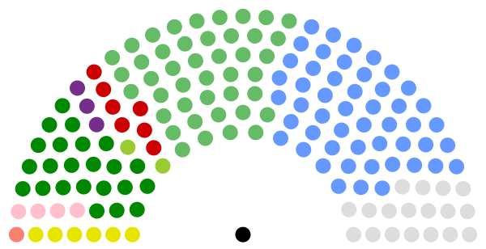
Replication Paper: Are Irish Voters Moving to the Left? Journal of Irish Political Studies
Stefan Müller & Aidan Regan

Slide 2
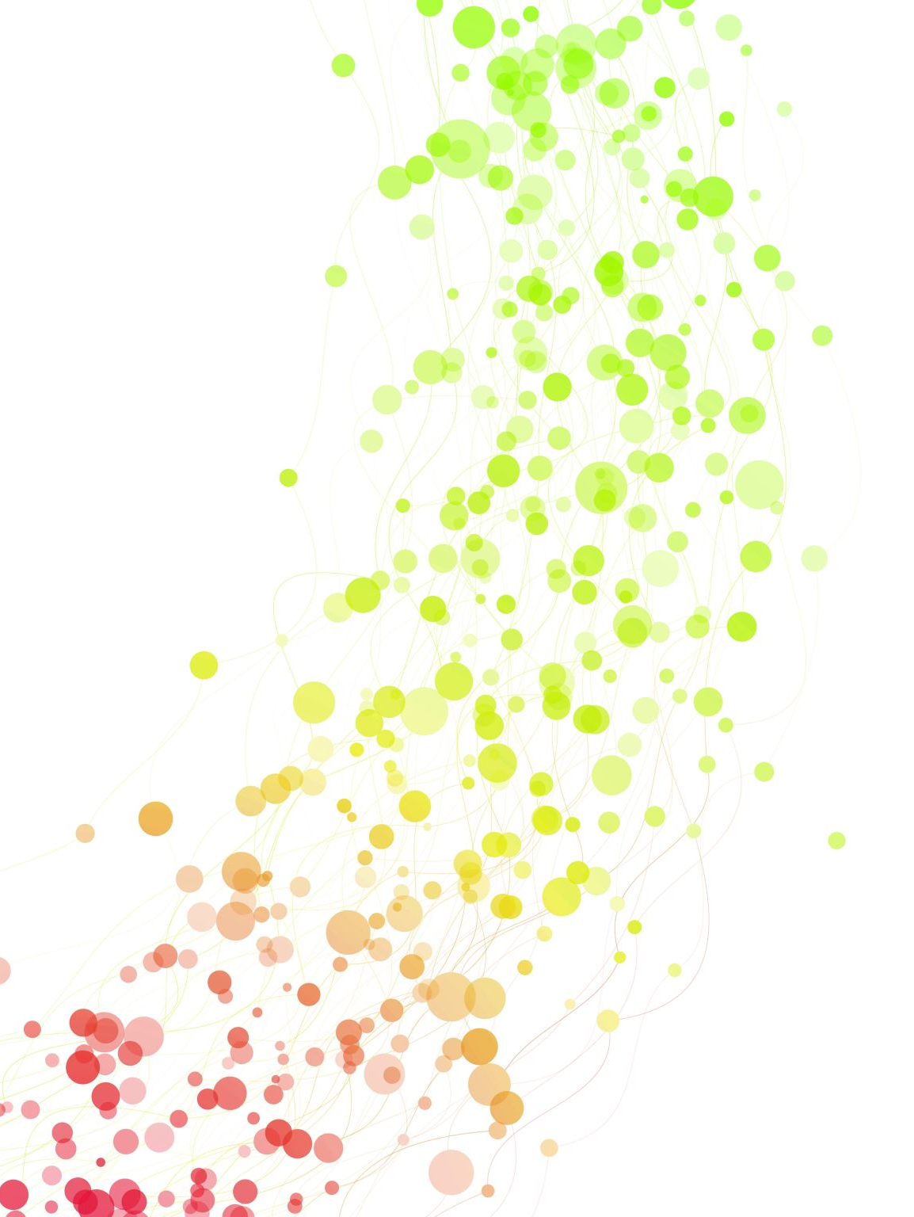
Abstract
“The Irish party system has been an outlier in comparative politics…the absence of an explicit left-right divide in party competition suggested that Irish voters, on average, occupy centre-right policy preferences.
Combining survey data since 1973 and all Irish election studies between 2002 and 2020, the study shows that the average Irish voter now leans to the centre-left. It also shows that income has recently emerged as a predictor of left-right self-placement, and that left-right positions increasingly structure vote choice.
These patterns hold when using policy preferences on taxes, spending, and government interventions to reduce inequality as alternative indicators.”

Slide 3
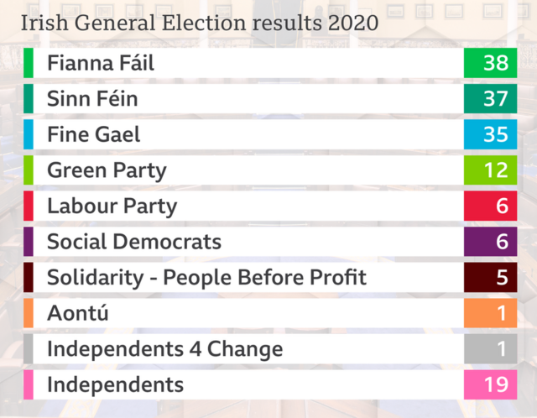
Methodology
“First, from a purely descriptive perspective, we compare left-right self-placements in publicly available surveys between 1973 and 2020...
Second, we limit the focus on Irish election studies and run linear regression models with the left-right self-placement and attitudes towards taxation and spending as the dependent variables....
Third, using multinomial logistic regression models we test whether self-identification on the left, policy preferences on taxes and spending, and government interventions to reduce inequality predict vote choice in elections between 2002 and 2020.”

Slide 4
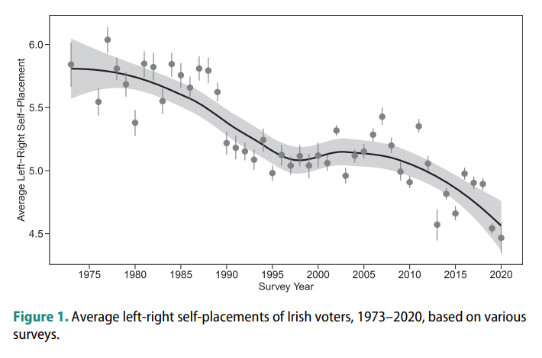
Left-right self-placements by Irish voters, 1973–2020
47 years of survey data and 152,344 responses of left-right self-placements by eligible Irish voters.
With values of 5.8 and 6, the average left-right placements in 2007 and 2011 are very similar
Irish voters moved to the left since 2012.

Slide 5
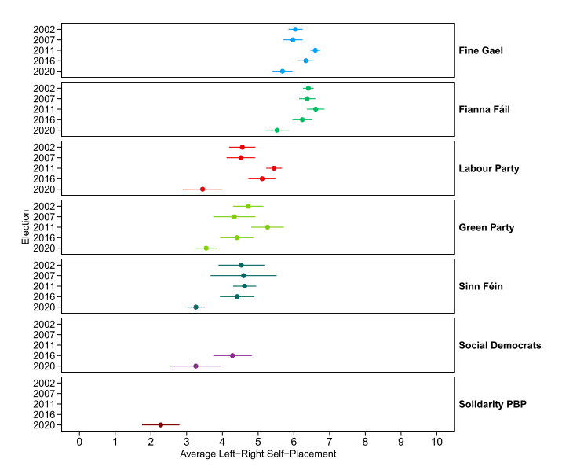
Is this shift driven by supporters of specific parties?
Divide sample by the first-preference vote choice for each election and estimate the average left-right positions, along with 95 per cent confidence intervals, for voters of each party.
The lowest average left-right values for voters from all parties occurred in 2020.

Slide 6
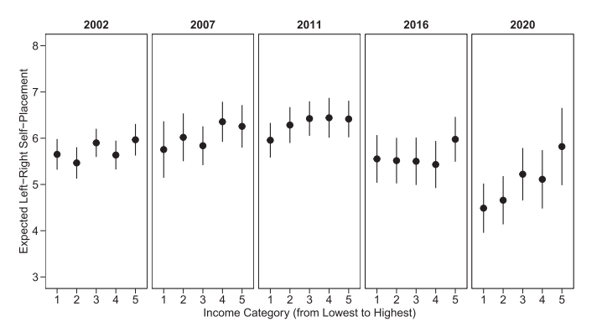
Does income correlate with left-right self-placements?
Figure 3 shows the expected values of left-right self-placement for the five income categories, based on regression models (next slide).
The coefficients for income in elections between 2002 and 2016 are small and do not reach conventional levels of statistical significance.
However, in the 2020 election, income does predict left-right self-placement.

Slide 7
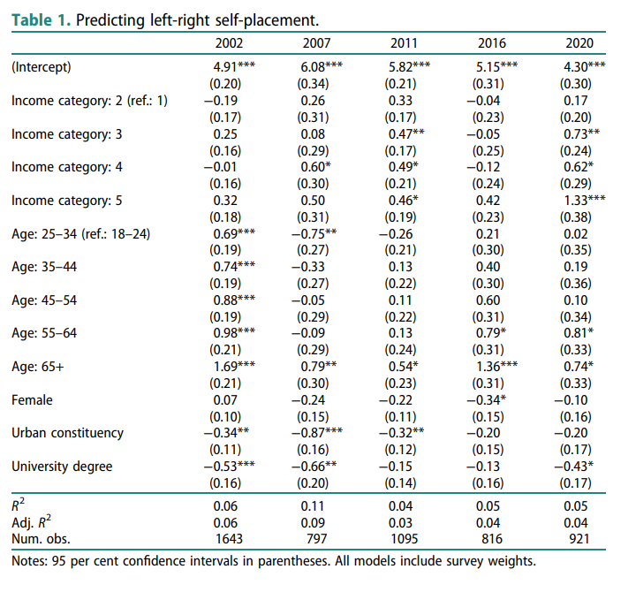
Predicting left-right self-placement
Respondents in lower income categories tend to place themselves more to the left than high income earners, and there is a shift of low-to-middle earning voters to the left in 2020.
Age is an important predictor of left-right self-placement: older voters tend to place themselves more to the right than younger voters.
Voters in urban constituencies tend to be slightly more on the left, but this difference is not statistically significant in 2016and 2020.
In line with evidence from other countries, respondents with a university degree tend to place themselves more to the left.
In 2020, female respondents were not more likely to identify themselves on the left.

Slide 8
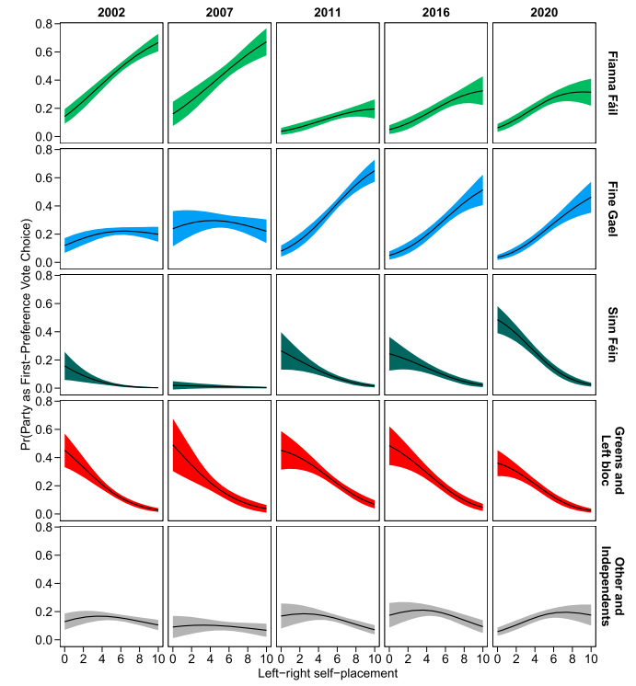
Probability of voting for a party conditional on respondents’ left-right self-placement.
In all elections since 2002, left-right self-placement is a strong predictor of casting the first-preference vote for a Fianna Fáil or FineGael candidate.
Voters who place themselves on the left or centre-left (values between 0and 4) rarely vote Fianna Fáil and Fine Gael.
A different pattern emerges for Sinn Féin, the Greens, and parties from what we call the ‘Left bloc’ (Social Democrats, Labour, and People Before Profit).
In 2020, respondents who placed themselves on the far-left were very likely to cast their first-preference vote for a Sinn Féin candidate.
This is also evident in 2011 and 2016, even though the probabilities are lower given that Sinn Féin received – overall – less support than in 2020.

Slide 9
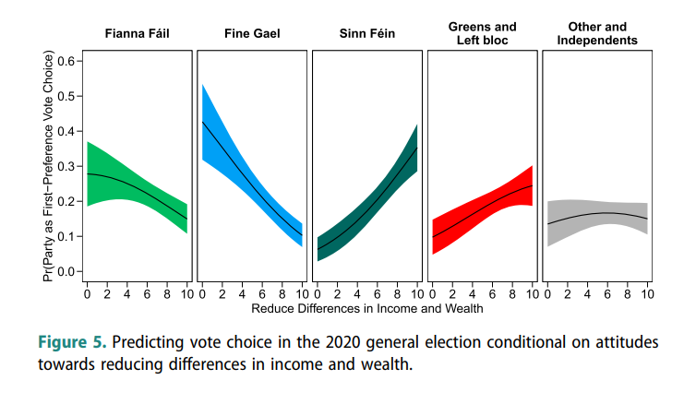
Attitudes towards reducing differences in income and wealth (2020)
Test of whether these patterns are consistent with alternative indicators of left/right socio-economic preferences. The multinomial logistic regression models are rerun.
For the 2020 election, left-right self-placement are replaced with support for the statement that the ‘government should reduce differences in income and wealth’ (Figure 5) and attitudes towards ‘more taxes and spending’ (next slide).
Figure 5 indicates a clear divide between Fianna Fáil and Fine Gael on the one side, and Sinn Féin, the Greens and the Left bloc on the other side.

Slide 10
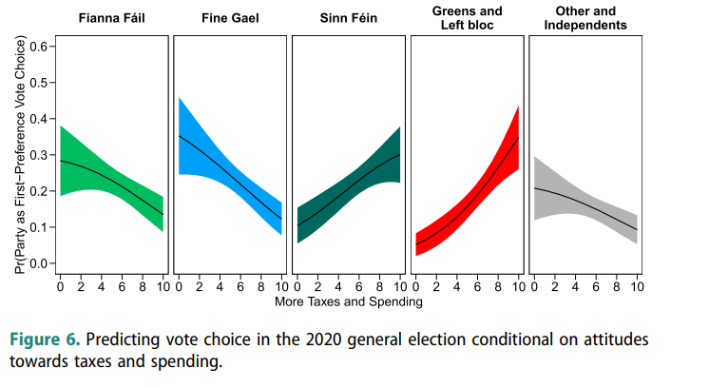
Attitudes towards taxes and spending (2020)
.The findings on taxes and spending are somewhat less clear, but strong levels of support appear to increase the probability of voting for the Left bloc and reduce the probability of voting for Fine Gael

Slide 11
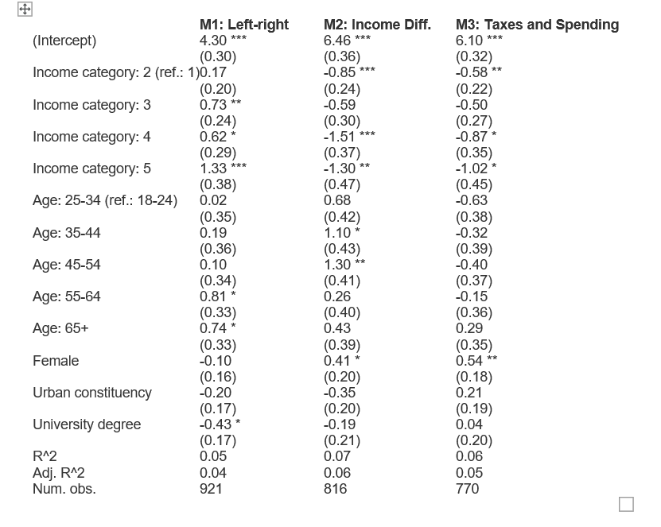
Rerun the model with new dependent variables
In Table A1, the model for 2020 is rerun using different dependent variables:
attitudes towards reducing income and wealth, and
increasing taxes and public spending.
As expected, voters with higher incomes tend to disagree with the statement that the government should act to reduce differences in income and wealth.
Lower-income voters tend to agree more that the government should increase taxes a lot and spend much more on health and social services

Slide 12
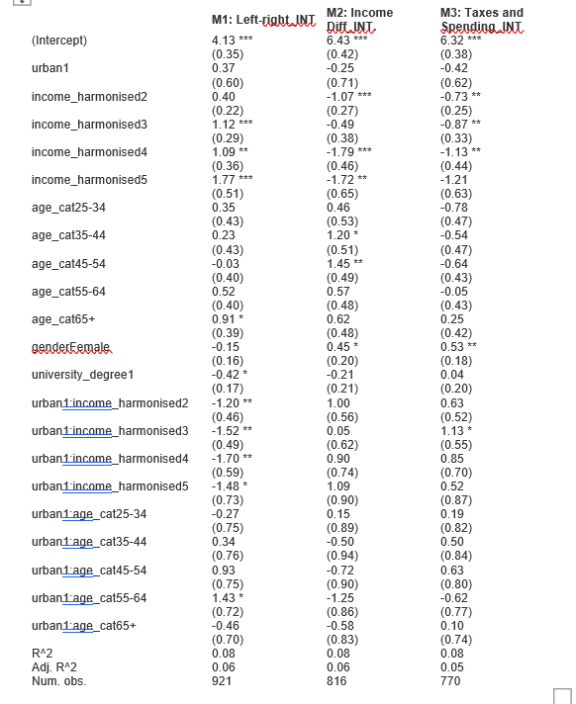
Twist: Added “Urban” as an interaction term to each of the linear regression models for 2020.
“Urban cities with a concentration of high-growth multinationals tend to have rapidly growing house prices, high levels of market income inequalities, and very unequal access to housing wealth”
In the case of Left-Right preferences, it appears to have a significant effect with regard to left wing preferences, and also for the 55-64 year old age category.

Slide 13
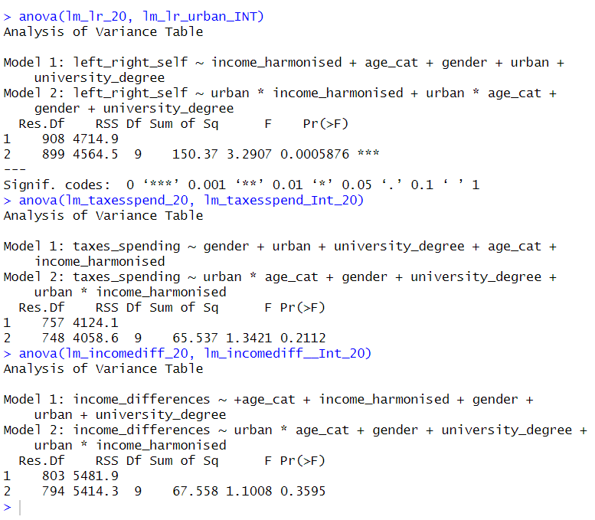
Anova Test for new interaction models

Slide 14
Thank you

