Slide 1
NVVG (Non-Violent Violent Game)
Colby Russell
Patricia Anderson
Julia Layne

Slide 2
Overview
Hide and Seek / Treasure Hunt
3 Types of Silos
“Ghosts”
“Enemy”
“Friendly”
Timed
Penalties

Slide 3
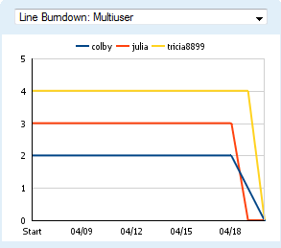
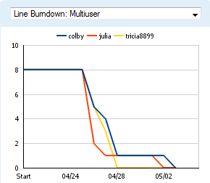
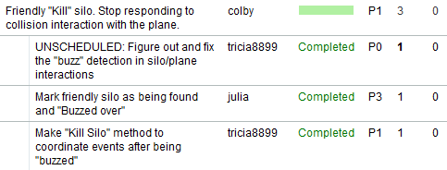
Development Process
SCRUM
Programmed in same room
Tested each others “stories”
Used github for source control

Slide 4
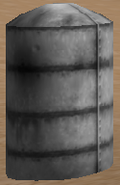
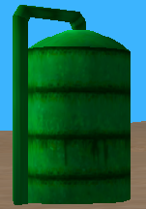
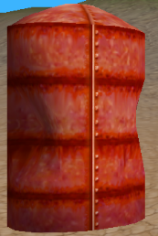
Code
Used existing code
Demo 05
Silo child classes
Constructor and “kill” actions
Example
Ned3DObjectManager class
Interactions
Game class
Timer functionality
Setup
Modified model .s3d
Changed colors silo types
SiloObject
Ghost Silos
Friendly Silos
Enemy Silos

Slide 5
Problems
Issue | Problem | Solution
Marking Friendly Silos | Wrong coordinate system | Use y-up!
Saving Textures | Incorrect file format | Photoshop to save to correct format
Console output for debugging | Unknown/Unfixed ☹ | Write better code

Slide 6

Gameplay
Object: To “handle” all ten silos in as fast of a time as possible.
Ghost Silos
- Fly through
Friendly Silos
- Buzz over
Enemy Silos
- Shoot*
Penalties:
1) Flying into non-ghost silo: 30 seconds
2) Shooting a friendly silo: 10 seconds
*Can also run into for a penalty.

Slide 7
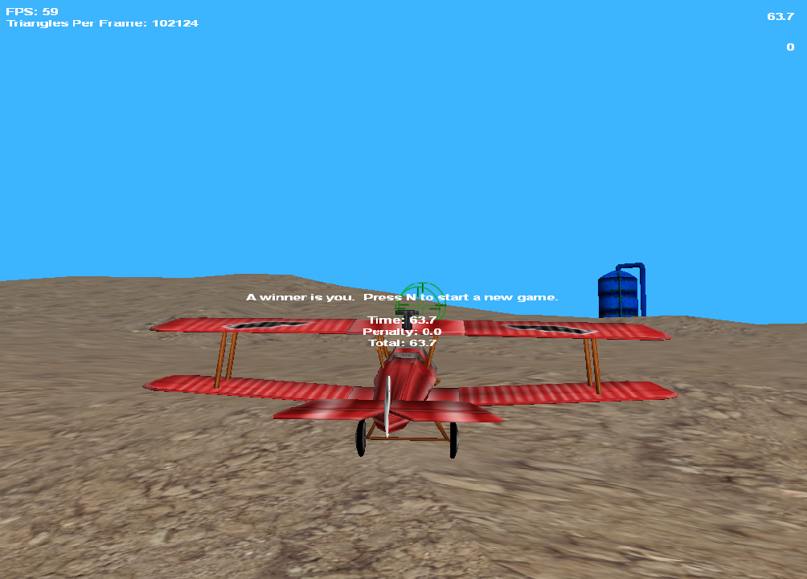
Demo

Slide 8
Future Improvements
Data Persistence
Save high scores
Improved Assets
Look for something other than silos
Realistic Plane Movement
Currently can stop and hover
Turning is physically impossible as animated

Slide 9
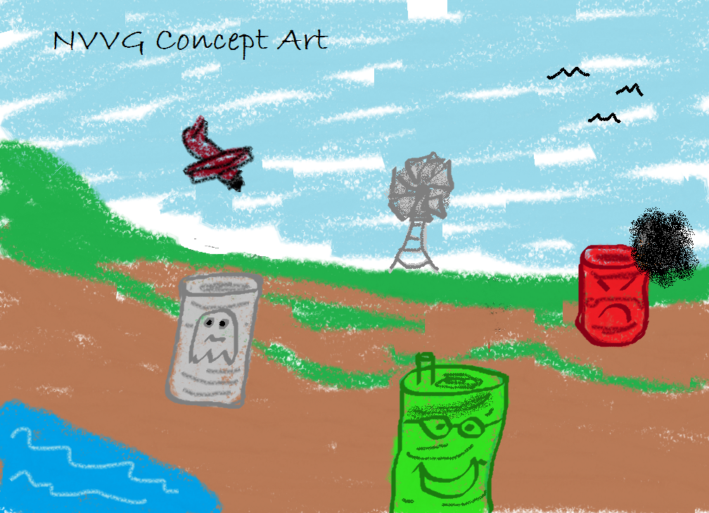
Questions

