Slide 1
NVVG (Non-Violent Violent Game)
Colby Russell
Patricia Anderson
Julia Layne

Slide 2
Overview
Hide and Seek / Treasure Hunt
3 Types of Silos
“Ghosts”
“Enemy”
“Friendly”
Timed
Penalties

Slide 3
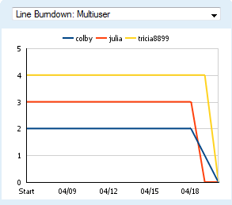
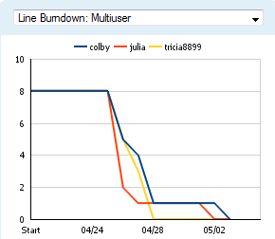
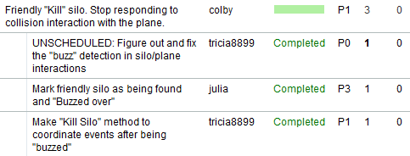
Development Process
SCRUM
Programmed in same room
Tested each others “stories”
Used github for source control

Slide 4
Code
Used existing code
Demo 05
Silo child classes
Constructor and “kill” actions
Example
Ned3DObjectManager class
Interactions
Game class
Timer functionality
Setup
Modified model .s3d
Changed colors silo types

Slide 5
Problems
Issue | Problem | Solution
Marking Friendly Silos | Wrong coordinate system | Use y-up!
Saving Textures | Incorrect file format | Photoshop to save to correct format
Console output for debugging | Unknown/Unfixed ☹ | Write better code

Slide 6
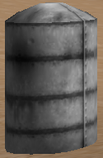
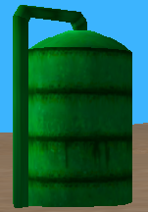
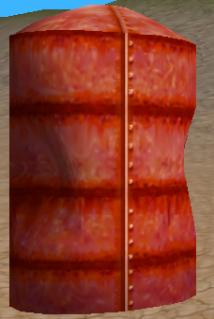
Gameplay
Object: To “handle” all ten silos in as fast of a time as possible.
Ghost Silos
- Fly through
Friendly Silos
- Buzz over
Enemy Silos
- Shoot*
Penalties:
1) Flying into non-ghost silo: 30 seconds
2) Shooting a friendly silo: 10 seconds
*Can also run into for a penalty.

Slide 7
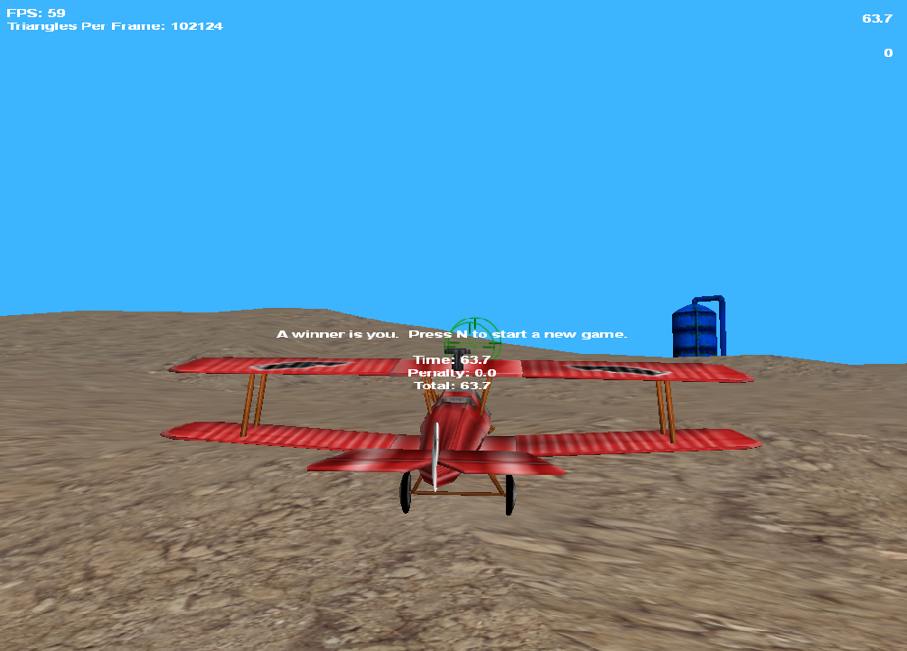
Demo

Slide 8
Future Improvements
Data Persistence
Save high scores
Improved Assets
Look for something other than silos
Realistic Plane Movement
Currently can stop and hover
Turning is physically impossible as animated

Slide 9
Questions

