Slide 1

Comparison of rural and city appartments of ZH

Slide 2


Summary

Slide 3


Boxplot of prices per m2

Slide 4


Boxplot of areas

Slide 5
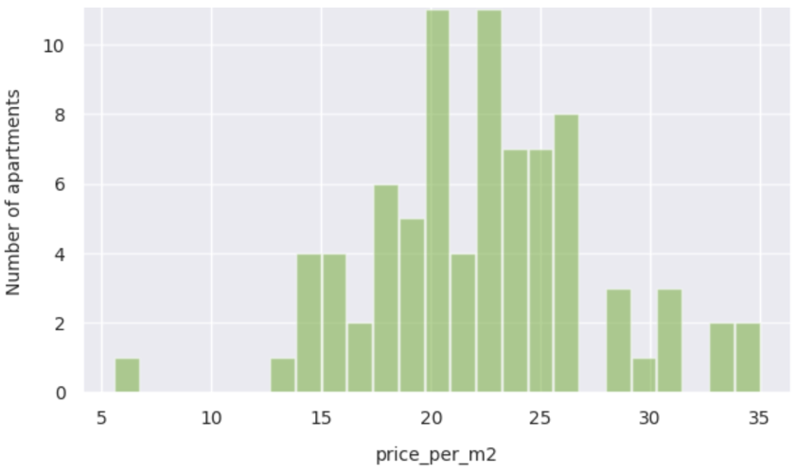
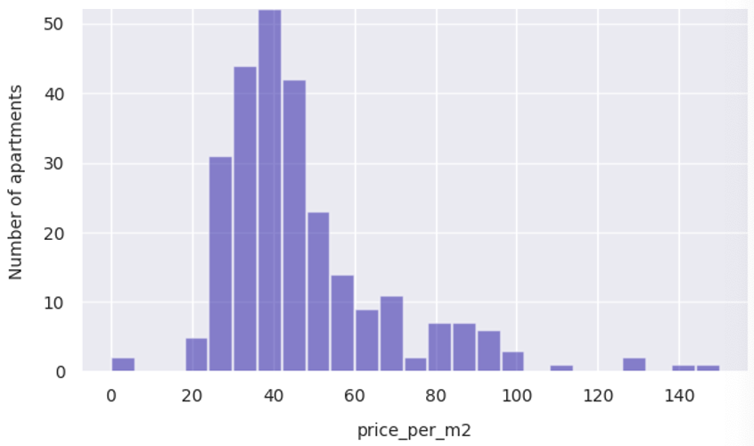
Histogram of prices per m2

Slide 6
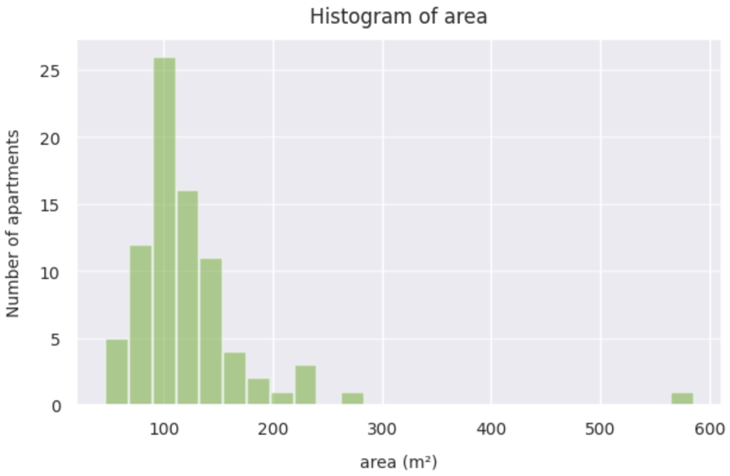
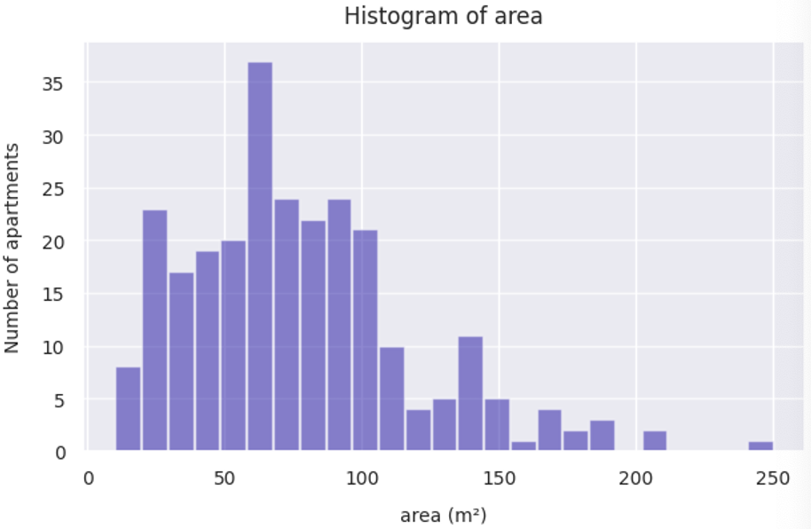
Histogram of areas

