Slide 1
RISKSIM
Simulation walkthrough
Operation Steel Viper — ACME Corp, Medical Devices
A compound ransomware scenario across a global manufacturing topology

Slide 2
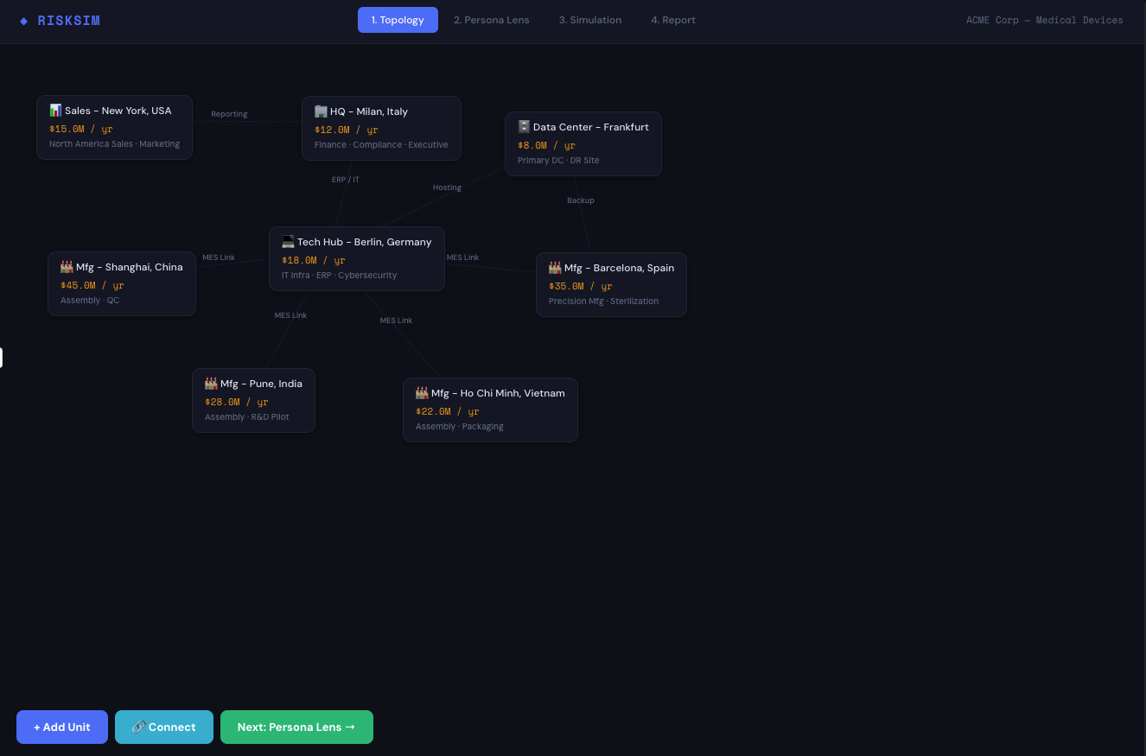
TOPOLOGY
Define the organizational topology
Map business units, infrastructure, dependencies, and financial exposure across all sites

Slide 3
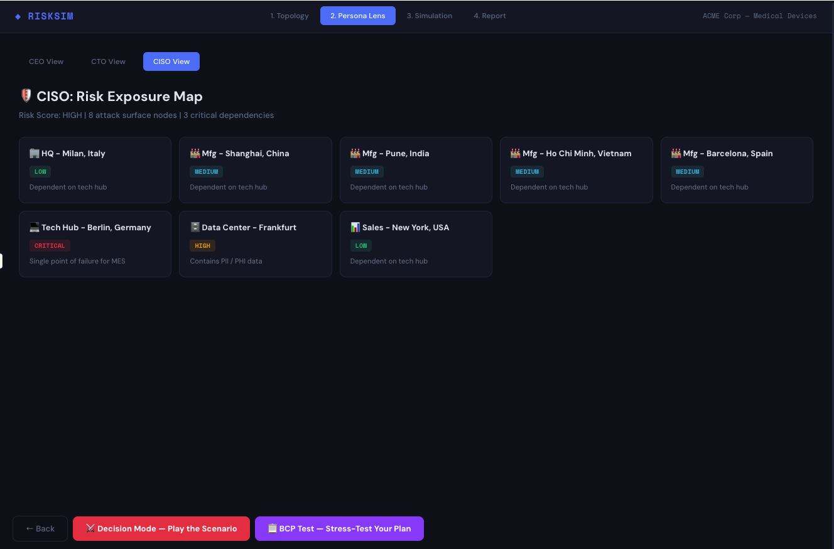
PERSONA LENS
CISO risk exposure map
8 attack surface nodes, 3 critical dependencies — Berlin Tech Hub identified as single point of failure

Slide 4
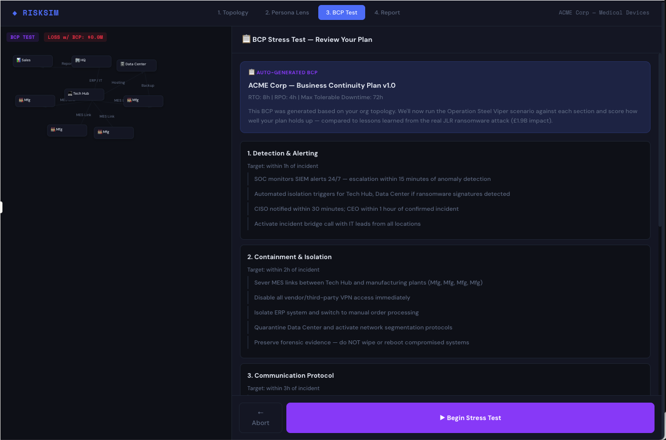
BCP TEST
Review auto-generated business continuity plan
BCP generated from topology — RTO: 8h, RPO: 4h, Max Tolerable Downtime: 72h — benchmarked against JLR attack

Slide 5
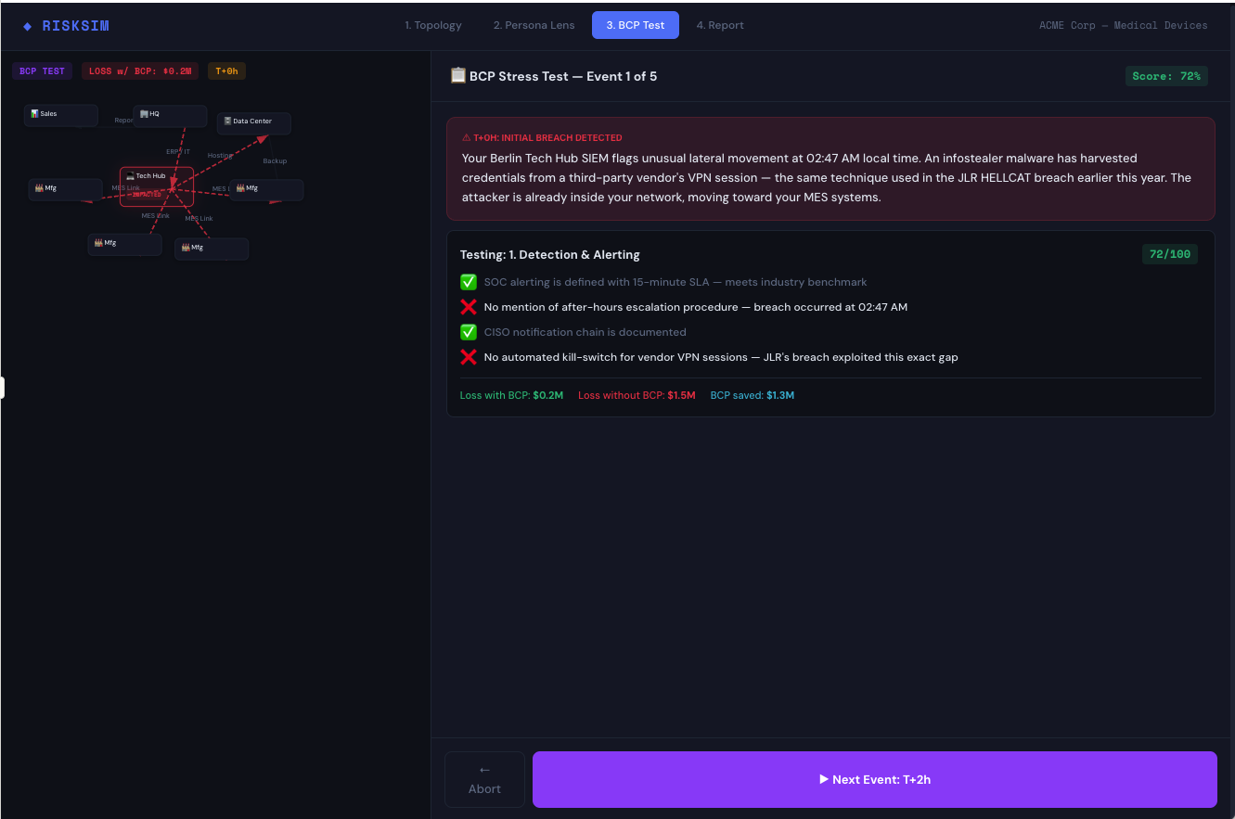
BCP TEST
Event 1 of 5 — T+0h: Initial breach detected
Berlin Tech Hub SIEM flags lateral movement. Infostealer harvests vendor VPN credentials. Testing: Detection and Alerting (72/100)

Slide 6
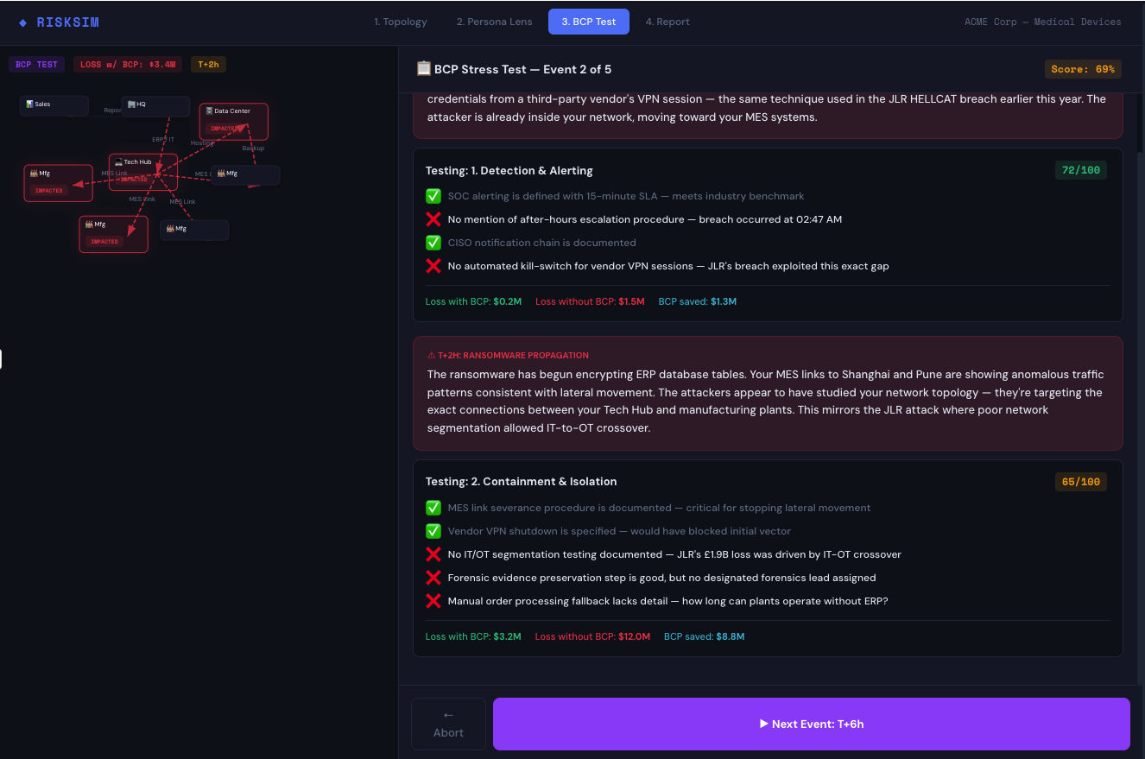
BCP TEST
Event 2 of 5 — T+2h: Ransomware propagation
ERP encryption begins. MES links showing anomalous traffic toward manufacturing plants. Testing: Containment and Isolation (65/100)

Slide 7
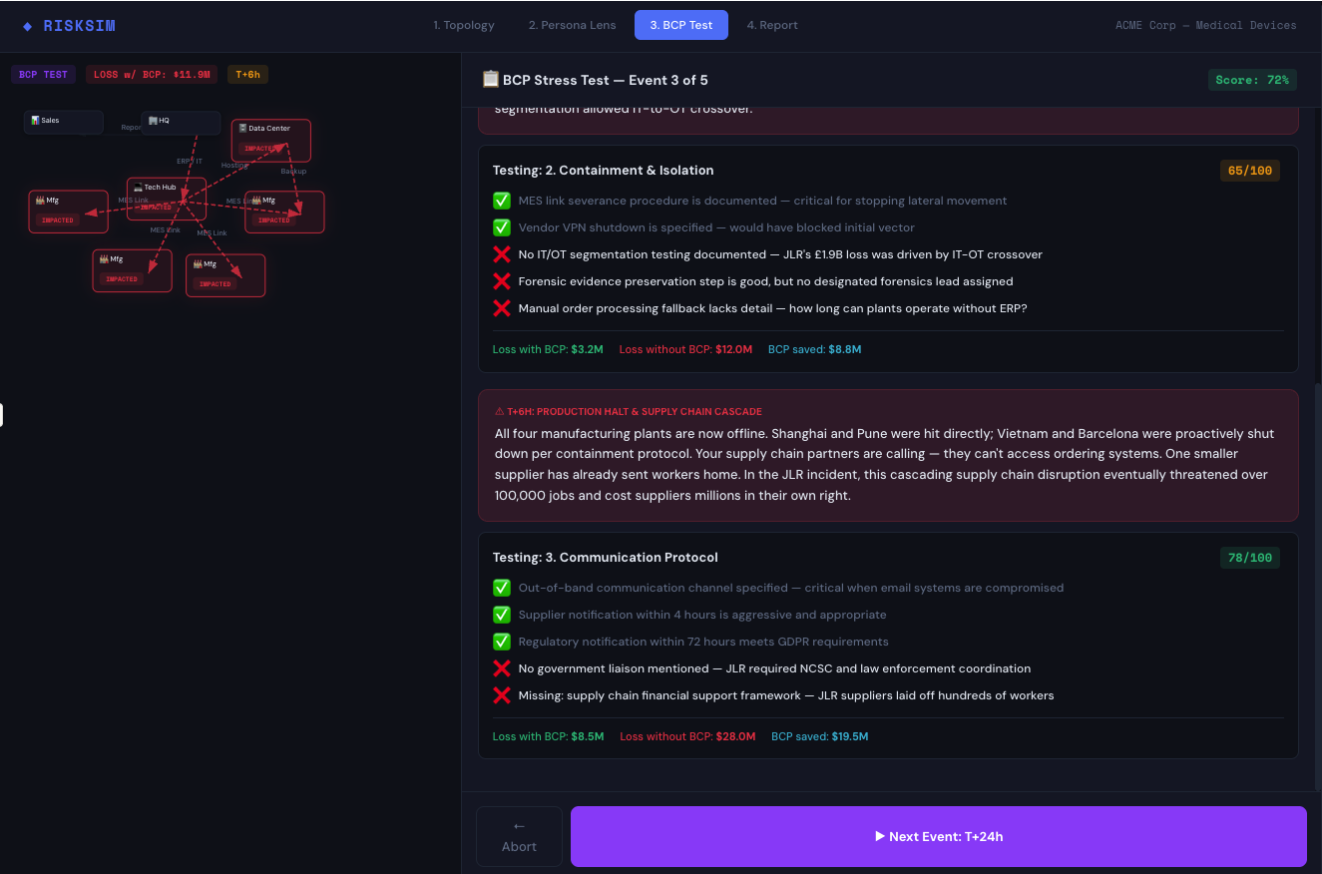
BCP TEST
Event 3 of 5 — T+6h: Production halt and supply chain cascade
All four manufacturing plants offline. Suppliers sending workers home. Loss with BCP: $11.9M. Testing: Communication Protocol (78/100)

Slide 8
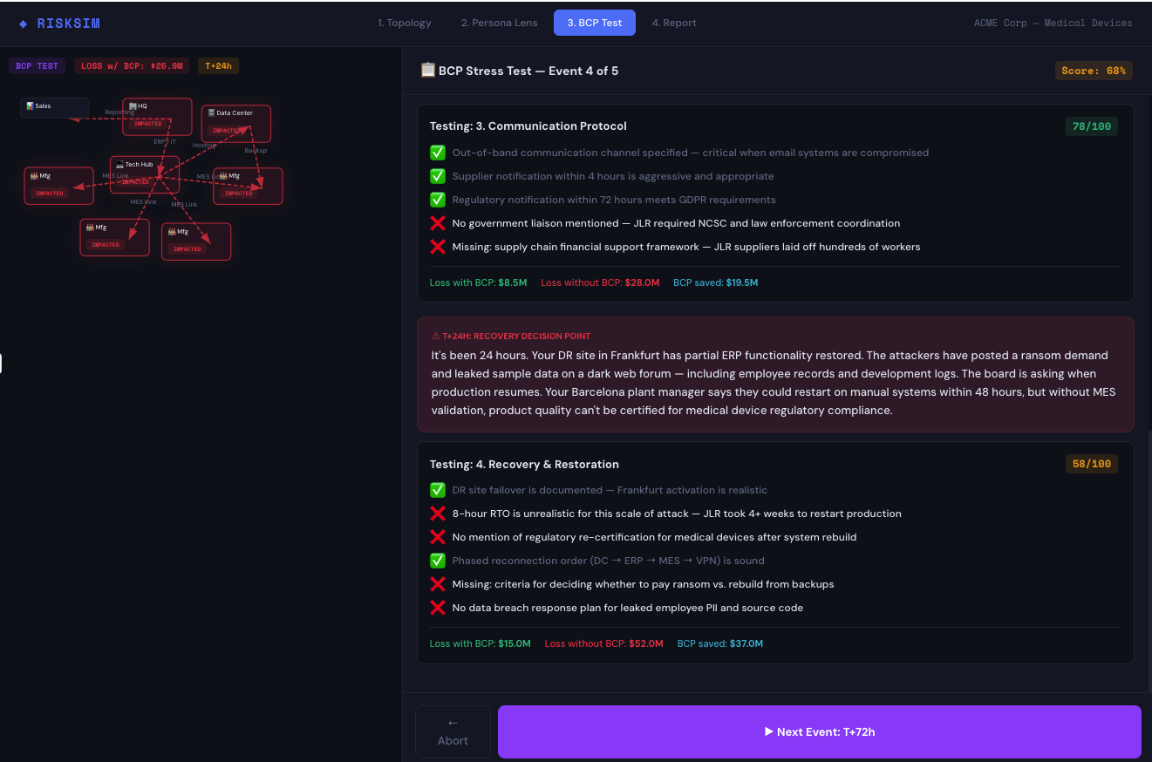
BCP TEST
Event 4 of 5 — T+24h: Recovery decision point
Attackers leak data on dark web. Barcelona says 48h to restart on manual. Testing: Recovery and Restoration (58/100)

Slide 9
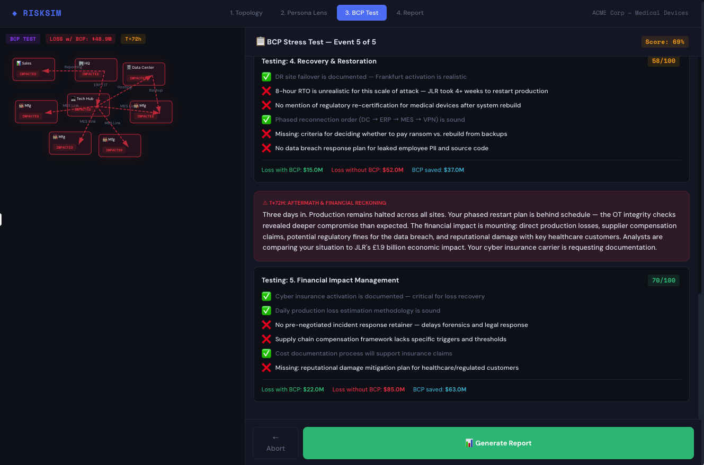
BCP TEST
Event 5 of 5 — T+72h: Aftermath and financial reckoning
Production halted across all sites. OT integrity checks reveal deeper compromise. Testing: Financial Impact Management (70/100)

Slide 10
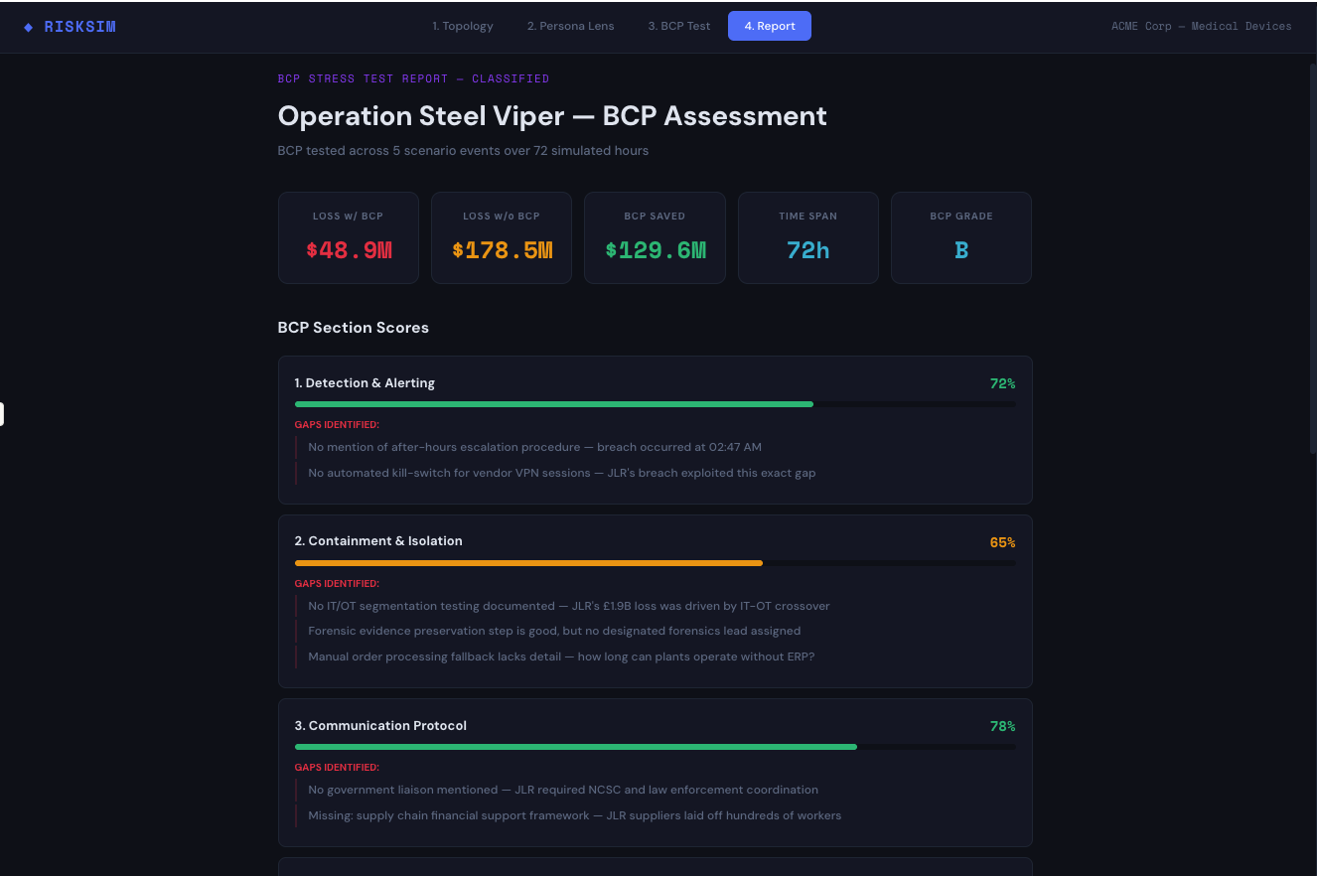
BCP REPORT
BCP assessment — overall score and section gaps
BCP Grade: B — Loss with BCP: $48.9M vs. Loss without: $178.5M — BCP saved $129.6M across 72 simulated hours

Slide 11
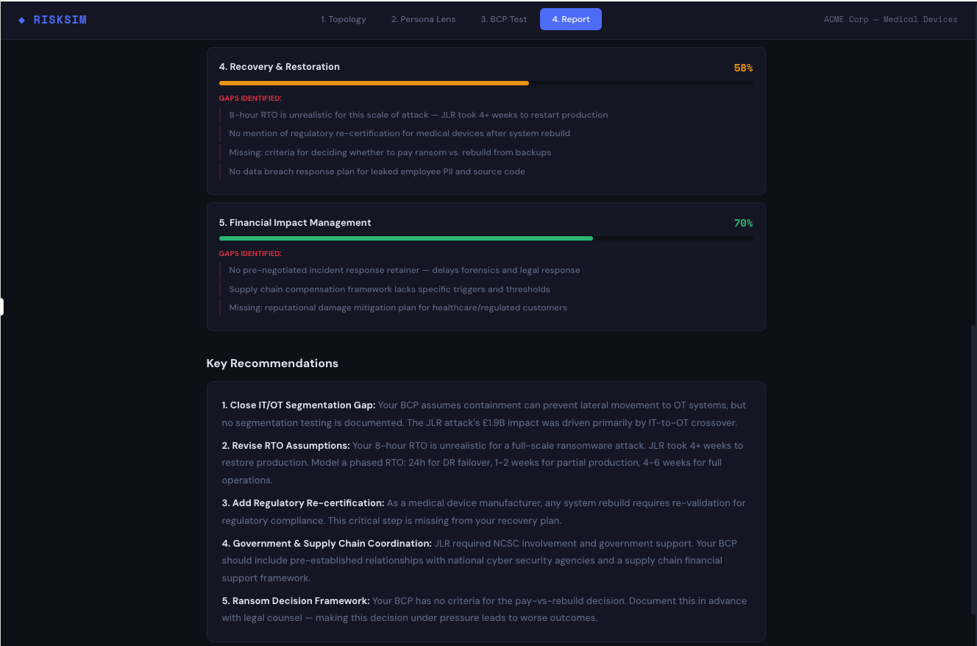
BCP REPORT
Key recommendations from stress test
Close IT/OT segmentation gap, revise RTO assumptions, add regulatory re-certification, establish ransom decision framework

Slide 12
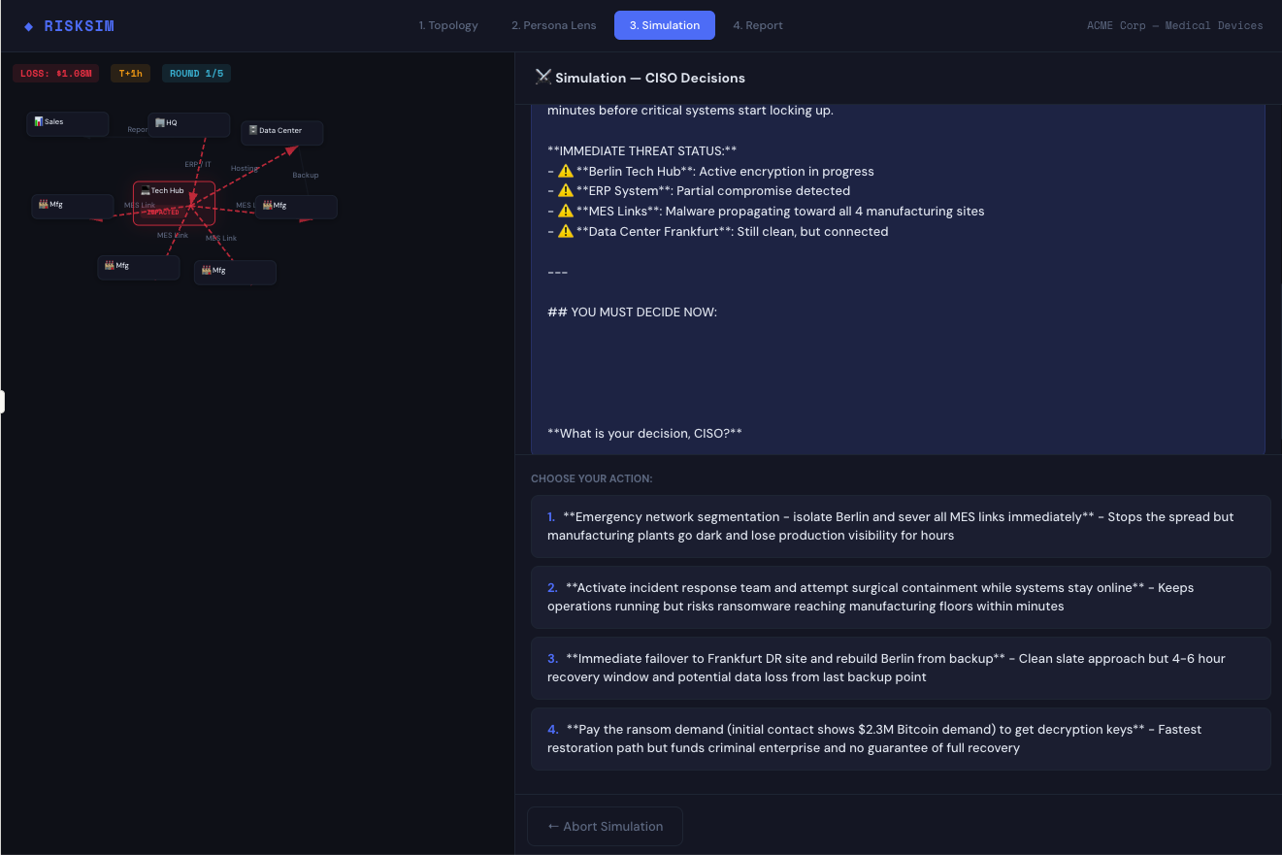
SIMULATION
Round 1 of 5 — CISO first decision
Active encryption in progress. Choose: emergency segmentation, surgical containment, failover to Frankfurt, or pay ransom ($2.3M)

Slide 13
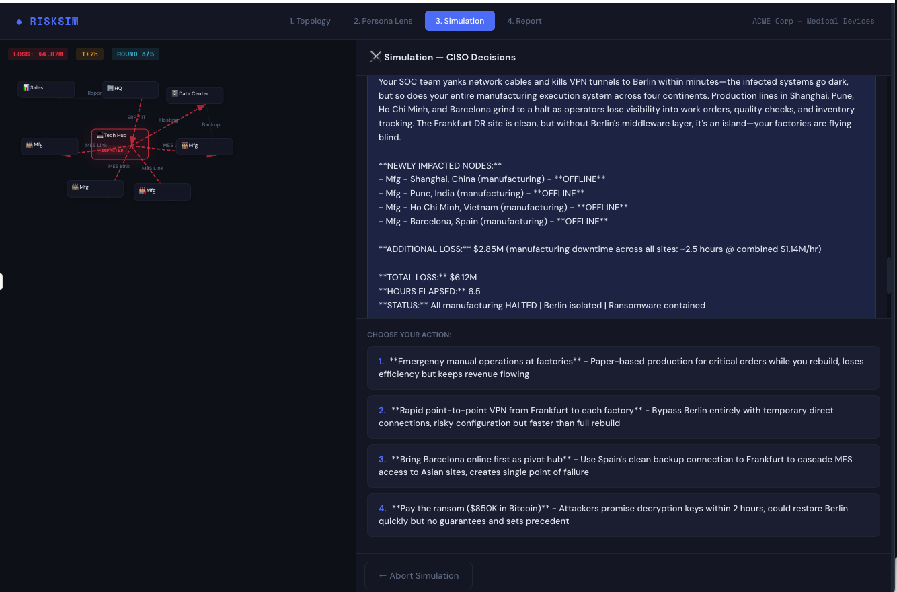
SIMULATION
Round 3 of 5 — Cascading manufacturing failure
SOC isolates Berlin but manufacturing halts across 4 continents. Total loss: $4.87M. Barcelona as pivot hub vs. emergency cloud MES

Slide 14
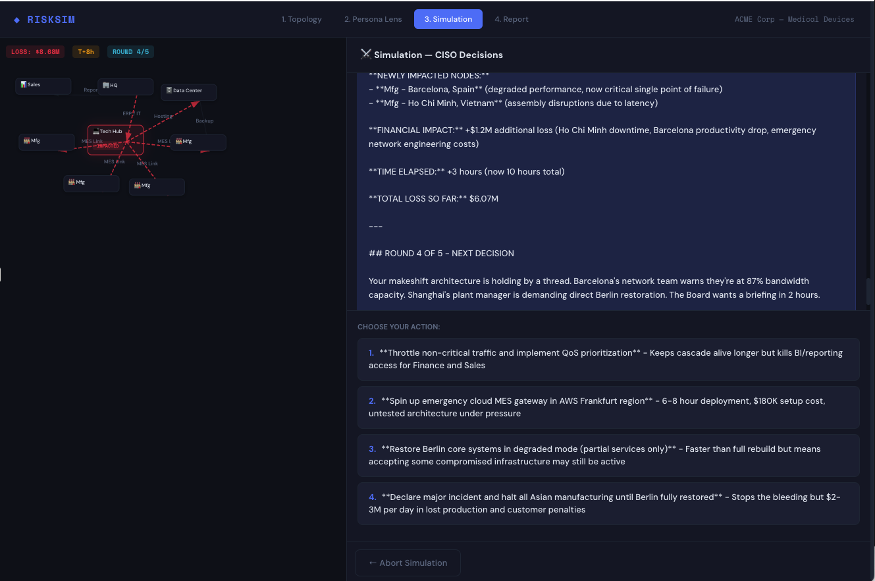
SIMULATION
Round 4 of 5 — Barcelona at 87% capacity
Makeshift architecture holding by a thread. Shanghai plant demands Berlin restoration. Board wants briefing in 2 hours. Total loss: $8.68M

Slide 15
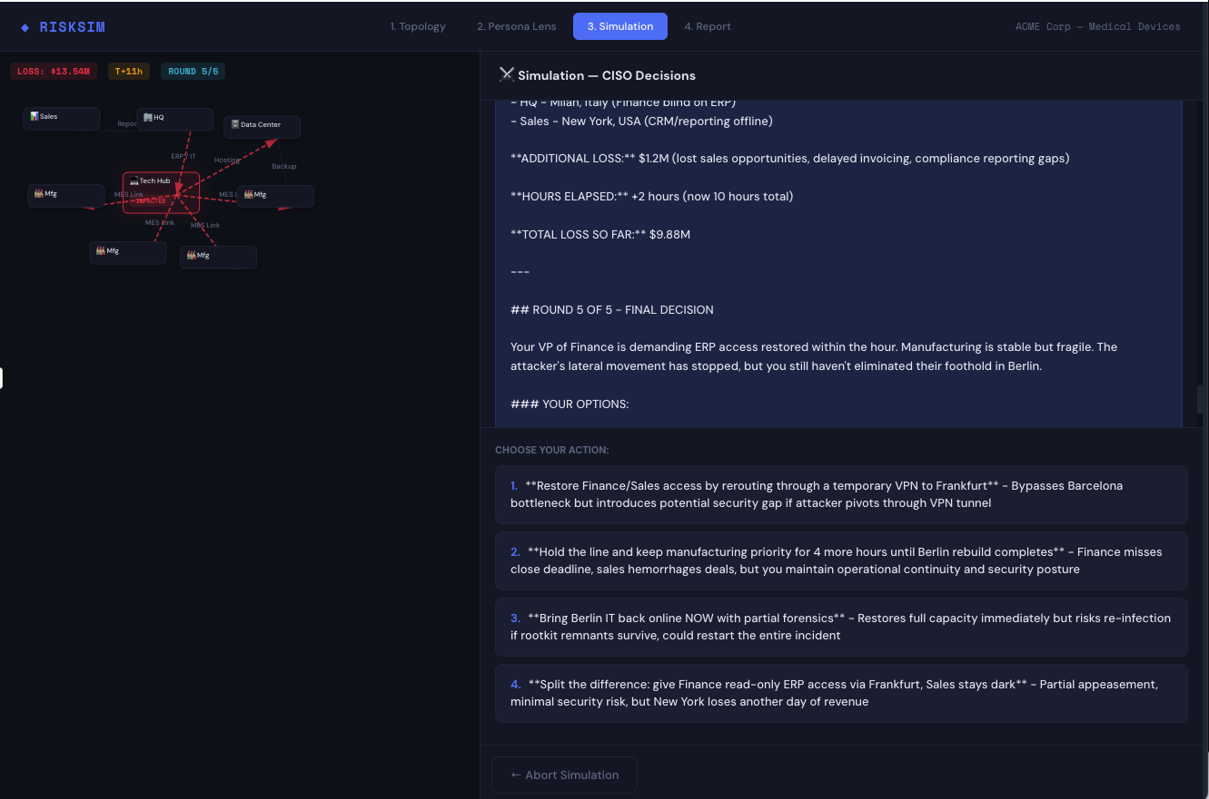
SIMULATION
Round 5 of 5 — Final decision
VP Finance demands ERP access. Manufacturing stable but fragile. Attacker foothold still in Berlin. Total loss: $13.54M

Slide 16
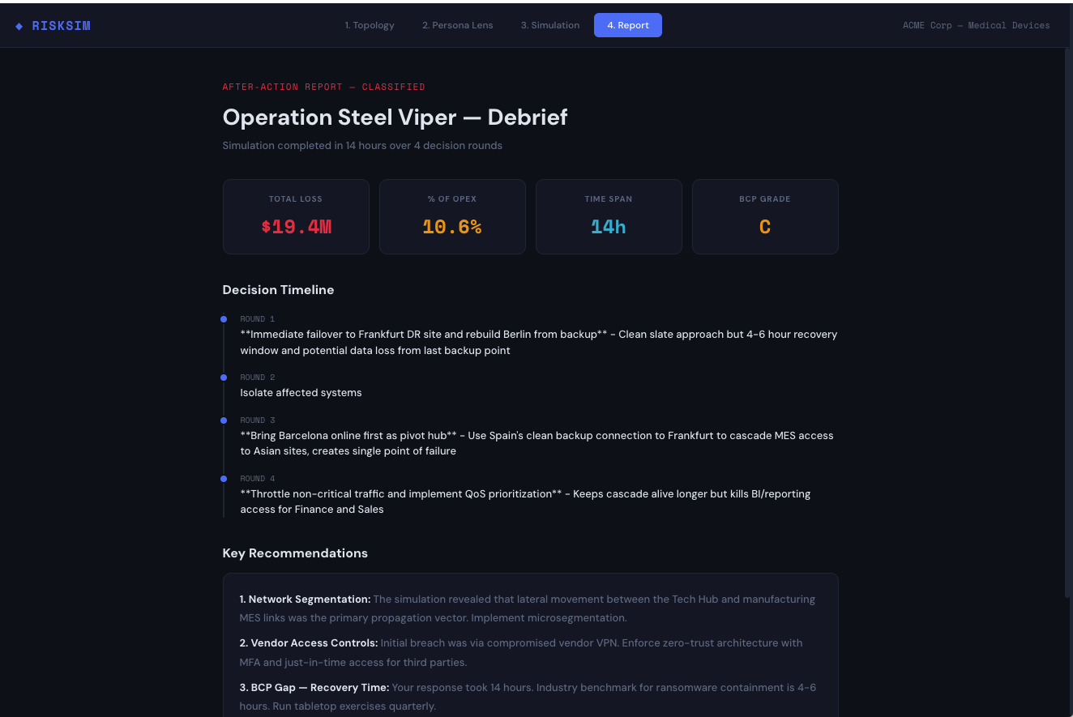
AFTER-ACTION REPORT
Operation Steel Viper — Debrief
Total loss: $19.4M (10.6% OPEX) over 14 hours, 4 decision rounds. BCP Grade: C. Key gaps in network segmentation, vendor access, recovery time.

