Slide 1

Layerwise Relevance Propagation - Implications for Feature Extraction
Carwyn Collinsworth | Gopi Sumanth Sanka | Akhil Arradi
Introduction
Neural Networks are simultaneously scalable and tunable function optimizers capable of seemingly endless applicability. and black boxes which provide no introspection about their decisions. However, recent methods such as Layer-wise Relevance Propagation (LRP) have made strides in bringing explainability to NNs. LRP is employed after training a model, at which point it finds out the input features the network learned.

Slide 2
Layerwise Relevance Propagation - Implications for Feature Extraction
Carwyn Collinsworth | Gopi Sumanth Sanka | Akhil Arradi
Learning the contribution of each layer of the network and each part of the given input to the final output will help in
Data Augumentation
Better Feature Selection Methods
Creating better Neural Network Architectures.
Motivation
Implementation
Set up a pre-trained MNIST Classifier
Build a wrapper for the built-in PyTorch classify function call such that we perform LRP subsequent to a classification
Use various LRP rules to test relevant decision features.
LRP-0
LRP-𝝐
LRP-𝛾
LRP-Composite
Test areas of importance

Slide 3
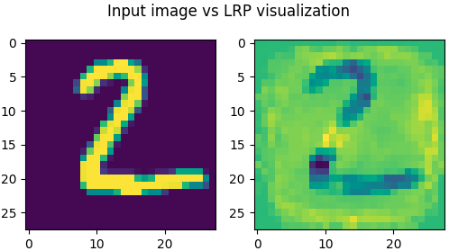
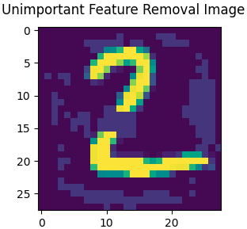
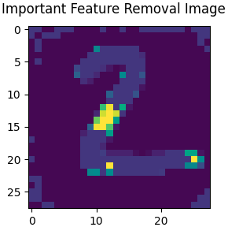
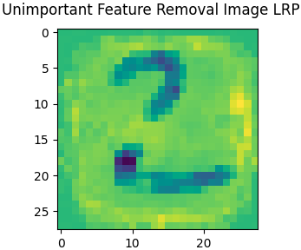
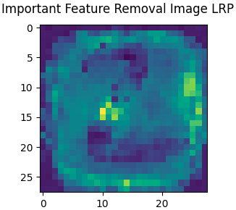
Layerwise Relevance Propagation - Implications for Feature Extraction
Carwyn Collinsworth | Gopi Sumanth Sanka | Akhil Arradi
Feature Removal
Original Confidence: 0.5657
Confidence: 0.4547
Confidence: 0.2009
and misclassified as 6
Confidence Formula: (Max - 2nd-Max)/Max where max and 2nd max refer the the argmax of predicted class values and second argmax respectively.

Slide 4

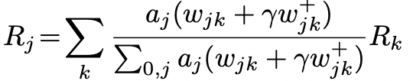
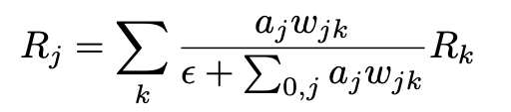
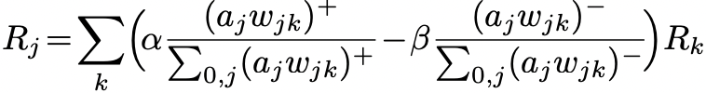
Layerwise Relevance Propagation - Implications for Feature Extraction
Carwyn Collinsworth | Gopi Sumanth Sanka | Akhil Arradi
LRP Rules
LRP-0
LRP-𝛾
LRP-𝝐
LRP-Composite

Slide 5
Layerwise Relevance Propagation - Implications for Feature Extraction
Carwyn Collinsworth | Gopi Sumanth Sanka | Akhil Arradi
 | Strongest Correct Classification | Strongest Incorrect Classification
LRP - 0 | 0.94473 | 0.07645
LRP-𝝐 | 0.96633 | 0.09543
LRP-𝛾 | 0.89288 | 0.08678
Composite LRP | 0.79616 | 0.08536

Slide 6
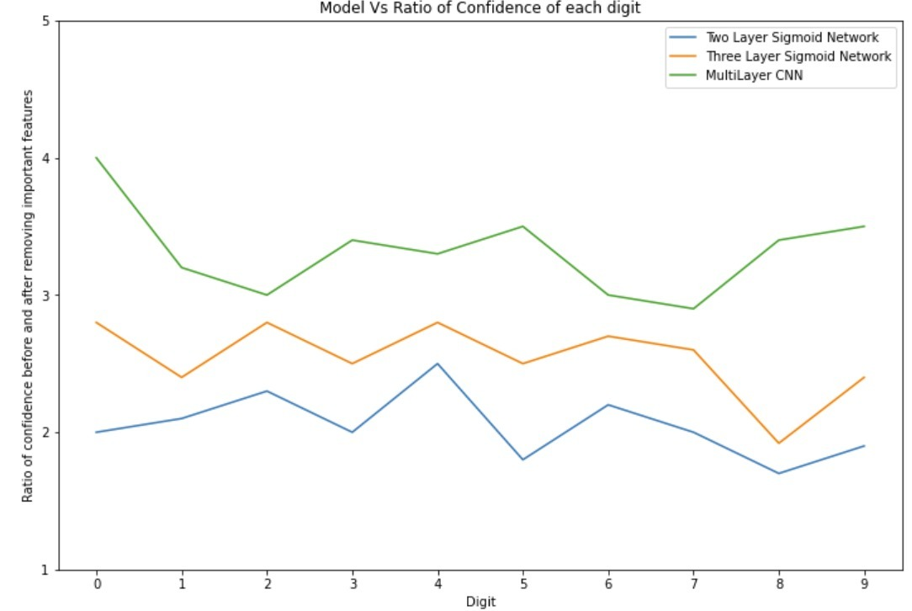
Layerwise Relevance Propagation - Implications for Feature Extraction
Carwyn Collinsworth | Gopi Sumanth Sanka | Akhil Arradi
Generalized Network Structure
2 Layer ReLu DNN vs 2 Layer ReLu DNN vs CNN

Slide 7

Layerwise Relevance Propagation - Implications for Feature Extraction
Carwyn Collinsworth | Gopi Sumanth Sanka | Akhil Arradi
Future Work
Scan the QR code for more details
Will be generalizing the model further by automating the neural network architecture for any kind of dataset.
Auto tuning the hyperparameters
Applying the same solution to detect different things like handwriting, objects , etc,. by making the model more generalized

