Slide 1
FINAL REVIEW
SG Guard
From prototype to a trust-first defence against AI-personalised scams — an honest look at what we built, fixed, and still don't know.
Carwyn Yeo
AI, COMPUTING & THE CITY — FINAL REVIEW
Notes:
Good morning / afternoon, everyone. We're Carwyn and Yan Yee — this is our final review for SG Guard. Since the midterm, we've kept building, but more importantly, we've gone back and fixed things a closer look told us were wrong. That honesty is really the throughline of today's talk.

Slide 2
TODAY'S WALKTHROUGH
What we'll cover, mapped to the review criteria
01
The problem
02
Research & analysis
…and why it's now an AI-vs-AI contest
Evidence, stakeholders, the gap that shaped everything
03
Design process
04
Development
What we tested, dropped, and learned since the midterm
How the front end and back end actually work
05
Final outcome
06
Strengths & limitations
What's built, working, and demoable today
An honest account, not a highlight reel
SG GUARD — FINAL REVIEW
01
Notes:
Here's how we'll walk through it — and we've deliberately mapped it to the six things this review is actually graded on: the problem, our research, the design process, how we built the intervention, what it does today, and an honest look at strengths and limitations.

Slide 3
1
THE PROBLEM
A city built for those who can keep up
A 74-year-old widow in a one-room rental flat manages her own CPF and bills online. A message arrives sounding exactly like a CPF officer, warning her account freezes within the hour. There's no counter to walk up to — just her, a voice she can't verify, and minutes to decide.
S$37,053
average loss per elderly victim — highest of any age group
81.8%
Partial digital fluency, met by AI that can now personalise deception at scale — producing deception fatigue and a retreat from digital life exactly when Singapore needs everyone online.
of cases where victims transferred money themselves — manipulated, not hacked
SG GUARD — FINAL REVIEW
02
Notes:
Quick recap for anyone who wasn't at the midterm: the core problem is partial digital fluency among seniors, met by AI that can now personalise deception at scale. The numbers are stark — S$37,053 average loss per elderly victim, and 81.8% of cases where the victim transferred the money themselves. They weren't hacked. They were manipulated.

Slide 4
02 — THE AI ARMS RACE
DESIGN LENS — ADVERSARIAL + SPECULATIVE DESIGN
AI got the scammer here first
THEIR AI
OUR AI
Scaling deception
Supporting judgement
— Harvests leaked data & social media to profile one target
— Reads for manipulation tactics, not keyword blacklists
— LLMs draft a personalised script in seconds
— Multimodal: checks typed text, photos, and speech alike
— ~3 seconds of audio clones a real voice convincingly
— Answers warning / unsure / safe — never fakes certainty
— "Scam-as-a-service" kits rent for US$60/month
— Explains each tactic in plain language, then hands off to a person
Static blacklists lose this race by design — they defend yesterday's scam. We don't try to out-race generative AI on speed; we change what the contest is about, from detection speed to trust and judgement support.
SG GUARD — FINAL REVIEW
03
Notes:
This is the framing we want to add for the final review. What's actually happening is an arms race between two uses of AI. On one side, generative AI lets scammers harvest data, personalise a script, and clone a voice from three seconds of audio — cheaply, at scale. On our side, we're using AI too, but for a different job: not to move faster than them, but to read for manipulation and support judgement, with an honest three-way verdict instead of false certainty. Static blacklists lose this race by design. We're trying to change what the race is about.

Slide 5
3
RESEARCH & ANALYSIS
What the evidence — and the silence — told us
S$913.1M
+124%
17
lost to scams in 2025 — the largest reported crime category
rise in government-impersonation cases year-on-year
transnational scam networks dismantled in 2025 — losses stayed high anyway
THE GAP THAT SHAPED THE DESIGN
Our stakeholder map put scam syndicates, government agencies, banks/telcos, family, and PA/grassroots networks all in the picture — but one voice was largely absent from how these tools get designed in the first place: seniors' own voice. Blacklist tools like ScamShield can't keep pace with messages an AI rewrites per-target in seconds (Roy & Nilizadeh, 2024) — which is exactly why detection alone was never going to be the whole answer.
DESIGN LENS — DATA COLONIALISM
SG GUARD — FINAL REVIEW
04
Notes:
On the research side, the scale is real — S$913.1 million lost in 2025, a 124% rise in government-impersonation cases, and seventeen scam networks dismantled without losses actually dropping. But the finding that shaped our design most wasn't a number — it was a gap. Every stakeholder we mapped had a voice in this system except seniors themselves.

Slide 6
4
DESIGN PROCESS
What we tested, dropped, and carried forward
1
2
3
We tested a hard block
We borrowed physical trust infrastructure
We still haven't closed the loop
A “reject” screen was tried first and dropped — seniors disengage the moment a tool feels like it's taking judgement away, not supporting it (Zhai et al., 2025).
Pioneer Generation priority queues and PA grassroots networks became the model for a digital “priority lane” — infrastructure, not a personal gadget.
No formal session with seniors at an Active Ageing Centre yet — the biggest open gap in an otherwise participatory-minded process, addressed honestly in limitations.
DESIGN LENS — PARTICIPATORY DESIGN
DESIGN LENS — CREATIVITY
DESIGN LENS — POSTHUMAN DESIGN
SG GUARD — FINAL REVIEW
05
Notes:
Our design process has had some honest failures in it. We tested a hard-blocking reject screen and dropped it, because both participant feedback and the literature pointed the same way: seniors disengage the moment a tool feels like it's taking judgement away from them. We also leaned on physical infrastructure seniors already trust — priority queues, PA networks — as the model for a digital equivalent. And we're naming directly that we haven't closed the participatory loop yet — no formal testing session with seniors has happened.

Slide 7
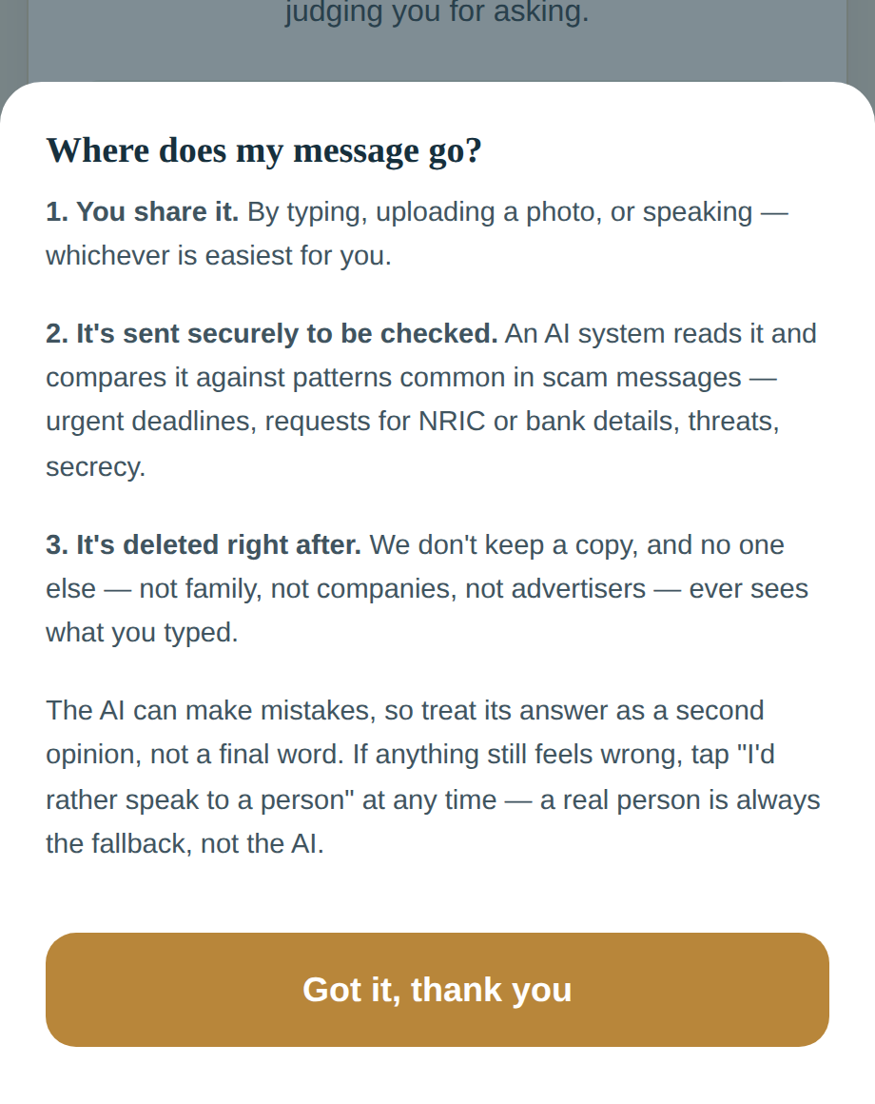
5
BUILDING AN ENVIRONMENT OF TRUST
Trust isn't a tone. It's the truth, said plainly.
✓
State the promise upfront
✓
Zero jargon
Said before anything else, not buried in settings.
“On-device AI” becomes “checked right here.” No security-speak.
✓
No blame, ever
✓
A human exit, always
“You did the right thing by checking” — shame stops people asking next time.
“I'd rather speak to a person” on every single screen.
THE SIXTH PRINCIPLE, ADDED THIS PHASE
Honesty about the data itself
Our midterm prototype told seniors their message “never leaves this screen.” It does — it's sent to an AI model to be checked. For a tool whose entire premise is trust, a false privacy claim isn't a copy bug, it's the failure mode itself. We rewrote it: what's sent, why, and that it's deleted right after — shown, not just promised.
SG GUARD — FINAL REVIEW
06
Notes:
Hand to Yan Yee here. Trust was central at the midterm too — state the promise upfront, cut the jargon, never blame the user, keep a human exit on every screen. What's new this phase is the honest realisation that one of those promises was actually false. We told seniors their message never leaves the screen. It does — it's sent to an AI model to be checked. For a tool that's entirely about trust, that's not a copy bug, it's the exact failure mode we're trying to prevent. We rewrote it to say what's actually true, and it's still reassuring — just honestly so.

Slide 8
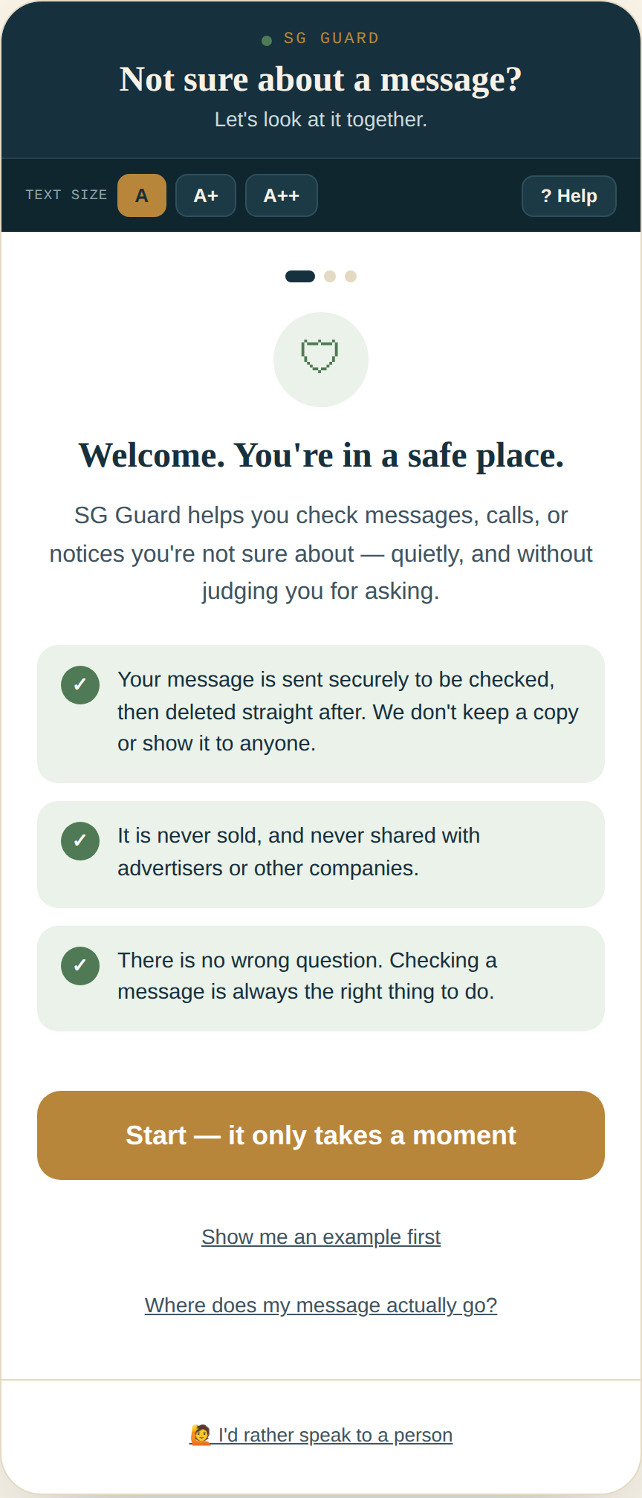
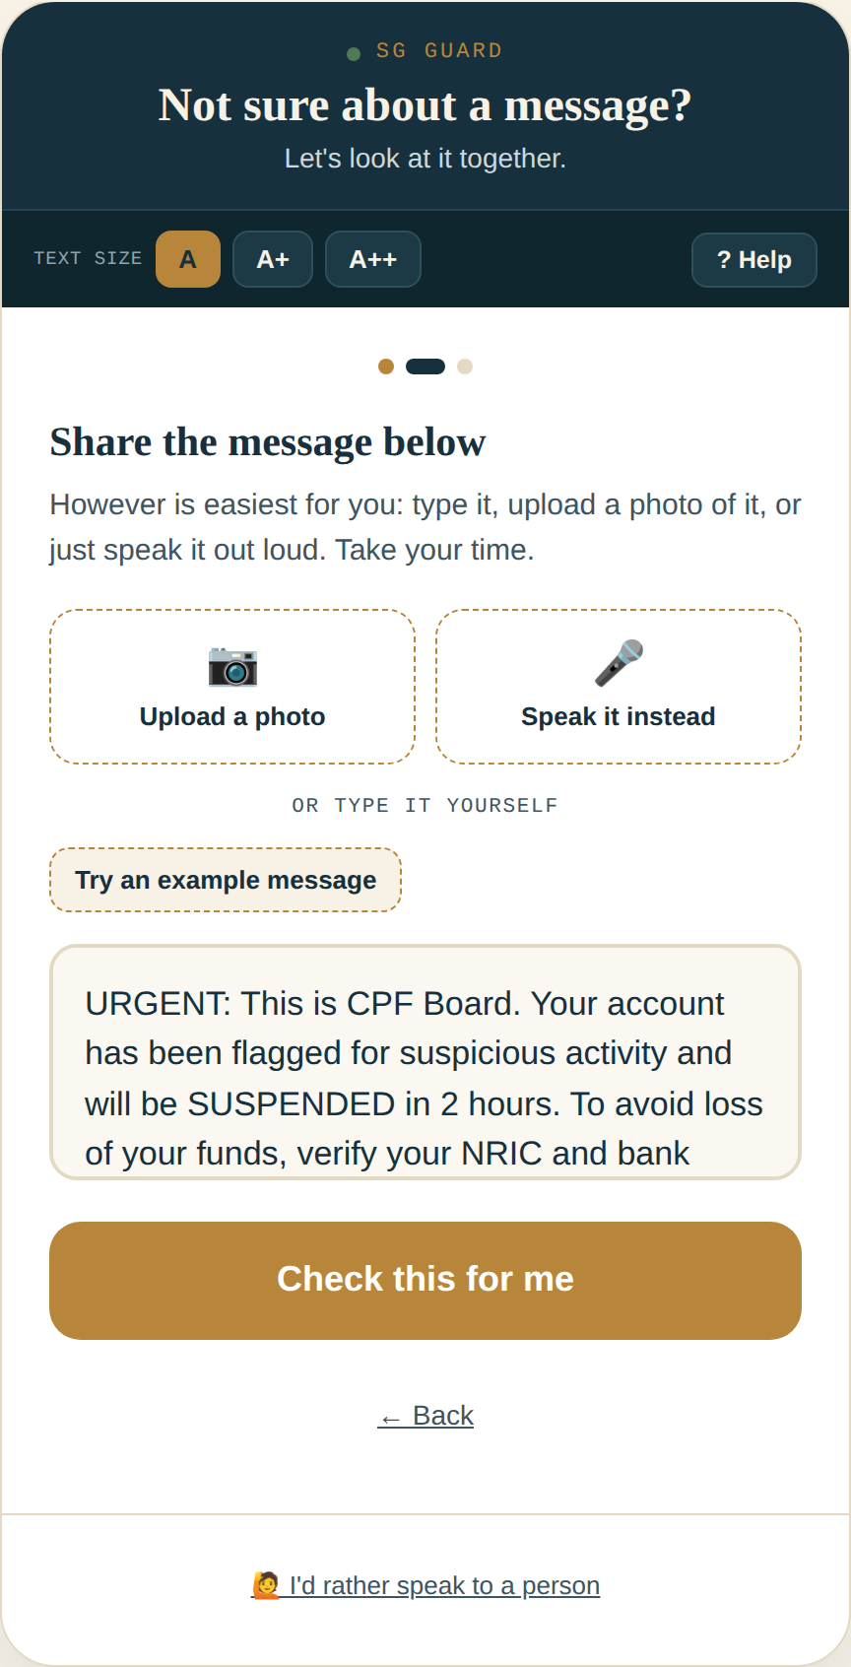
6
DEVELOPMENT OF THE INTERVENTION
Front end — what the senior actually sees
Three ways in
Type, upload a photo, or speak it — never forcing a senior into the one input method they're least comfortable with.
Progress that's visible
Step dots answer “how much is left” — open-ended flows breed anxiety on a first try.
Text size & read-aloud, up top
Accessibility controls sit in a permanent strip, not three taps deep in a settings menu.
SG GUARD — FINAL REVIEW
07
Notes:
On the front end: three ways to share a message, so no one's forced into the input method they're least comfortable with. Visible progress throughout, because open-ended flows create anxiety on a first try. And accessibility controls sit in a permanent strip at the top, not three taps deep.

Slide 9
7
DEVELOPMENT OF THE INTERVENTION
DESIGN LENS — AI FAIRNESS + PRIVACY & SURVEILLANCE
Back end — Express, Gemini, and a schema that won't bend
Senior shares
a message
→
Express server
(server.js)
→
Gemini API
+ system prompt
→
Structured JSON
(schema-locked)
→
Plain-language
result on screen
SCHEMA-LOCKED, NOT PROMPT-HOPED
PRIVACY IN PRACTICE
Gemini's structured-output mode hard-constrains the response to a fixed JSON shape. verdict is an enum — warning / unsure / safe — not free text the model could drift on. That's what makes a calibrated three-way verdict actually reliable, not just requested in a prompt and hoped for.
The server holds the Gemini API key and forwards only the one message, photo, or clip being checked, for that one request. Nothing is stored server-side, nothing is logged with identity attached — the honesty fix on the front end describes a pipeline that's actually true on the back end.
SG GUARD — FINAL REVIEW
08
Notes:
On the back end: an Express server holds the Gemini API key, so it never touches the browser. The most important change here is that Gemini's structured-output mode hard-constrains the verdict field to an enum — warning, unsure, or safe — so a calibrated third answer is actually reliable, not just requested in a prompt and hoped for. And the privacy promise on the front end is backed up here — the server forwards only the one message being checked, and nothing is stored.

Slide 10
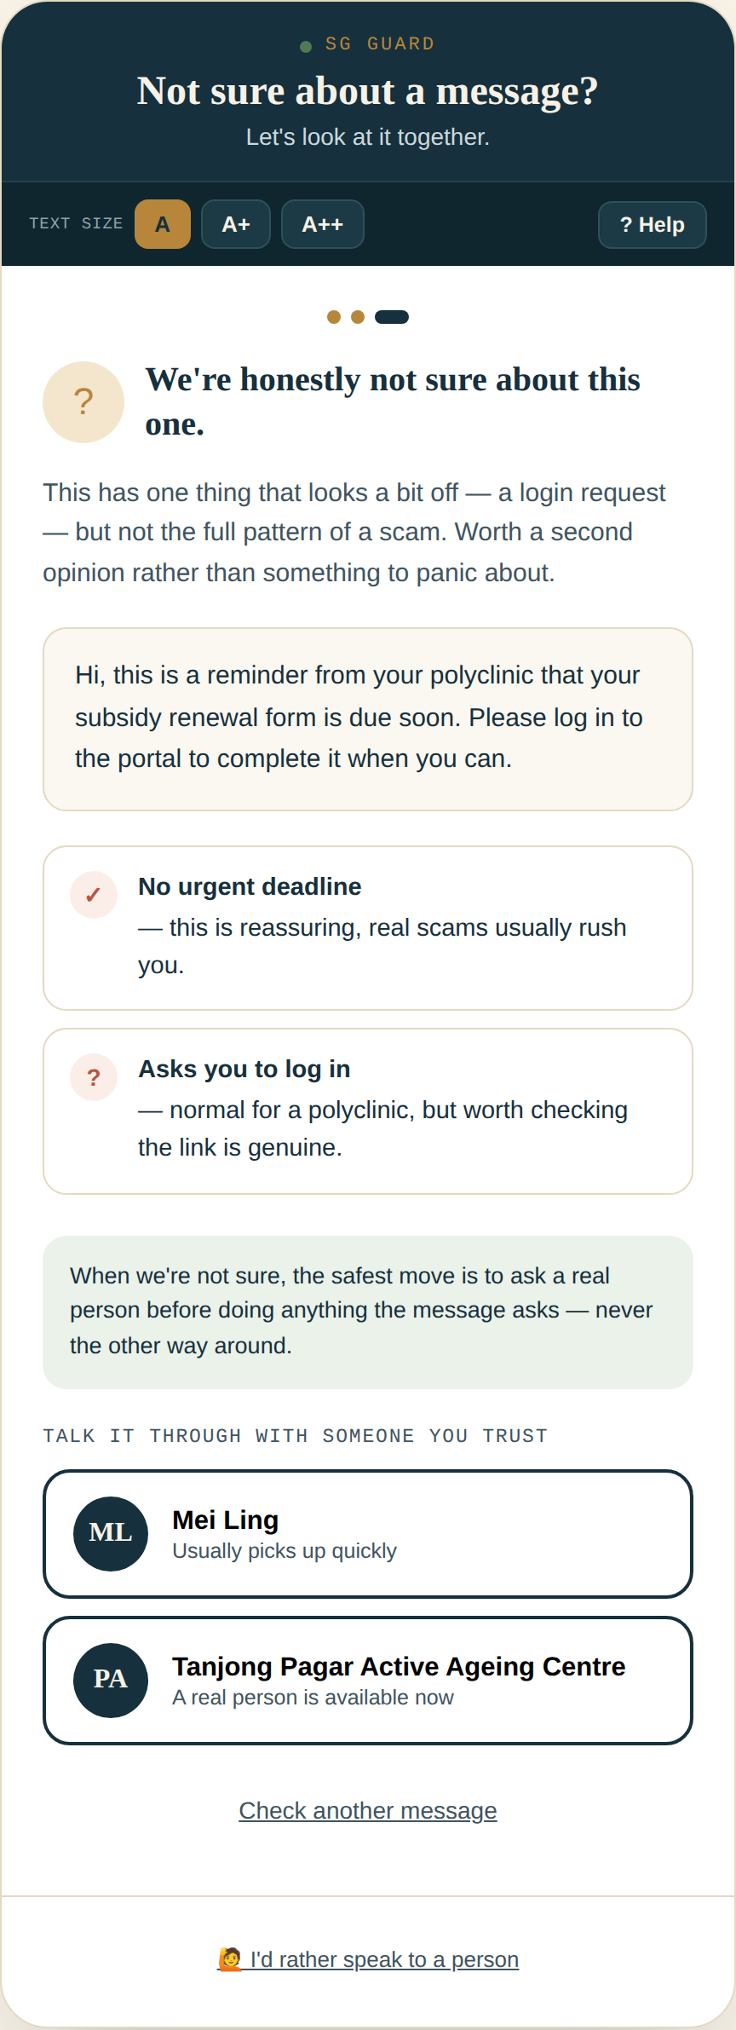
8
AI FAIRNESS IN PRACTICE
DESIGN LENS — AI FAIRNESS
Why we built a third answer: “we're not sure”
A binary verdict is a fairness problem
Warning/safe forces false confidence onto genuinely ambiguous messages — and the cost of being confidently wrong falls entirely on the senior.
Uncertainty, shown honestly
“Unsure” lists both what looks concerning and what looks reassuring — the model's actual confidence, made legible instead of hidden.
The model has to earn each verdict
A hard-constrained schema (previous slide) is what makes offering a third state safe to ship — it can't silently collapse into “safe” on a parsing hiccup.
SG GUARD — FINAL REVIEW
09
Notes:
This slide is worth dwelling on because it's an AI-fairness point as much as a UX one. Forcing a binary warning/safe verdict onto a genuinely ambiguous message means the model has to fake confidence it doesn't have — and the senior pays the cost of a confidently wrong answer. “Unsure” makes that uncertainty visible instead, and lists both what looks concerning and what looks reassuring.

Slide 11
9
IMPROVEMENTS SINCE MIDTERM
Three fixes that came directly from critique
1
2
3
Fixed a false privacy claim
Added a calibrated “unsure” verdict
De-gendered the trusted-contact default
“Never leaves this screen” became an honest, still-reassuring account of what actually happens to a message.
The model can now say it's genuinely uncertain, instead of being forced into a confident right/wrong answer.
Dropped the fixed “(Daughter)” label and added an editable “add someone you trust” slot, so caregiving isn't assumed to be one role's job.
PRIVACY & SURVEILLANCE AI
AI FAIRNESS
FEMINIST DESIGN
SG GUARD — FINAL REVIEW
10
Notes:
To be concrete about what changed since the midterm: three fixes, all critique-driven. We fixed a false privacy claim. We added the calibrated unsure verdict. And we de-gendered the default trusted contact, so the tool doesn't quietly assume caregiving is one family role's job.

Slide 12
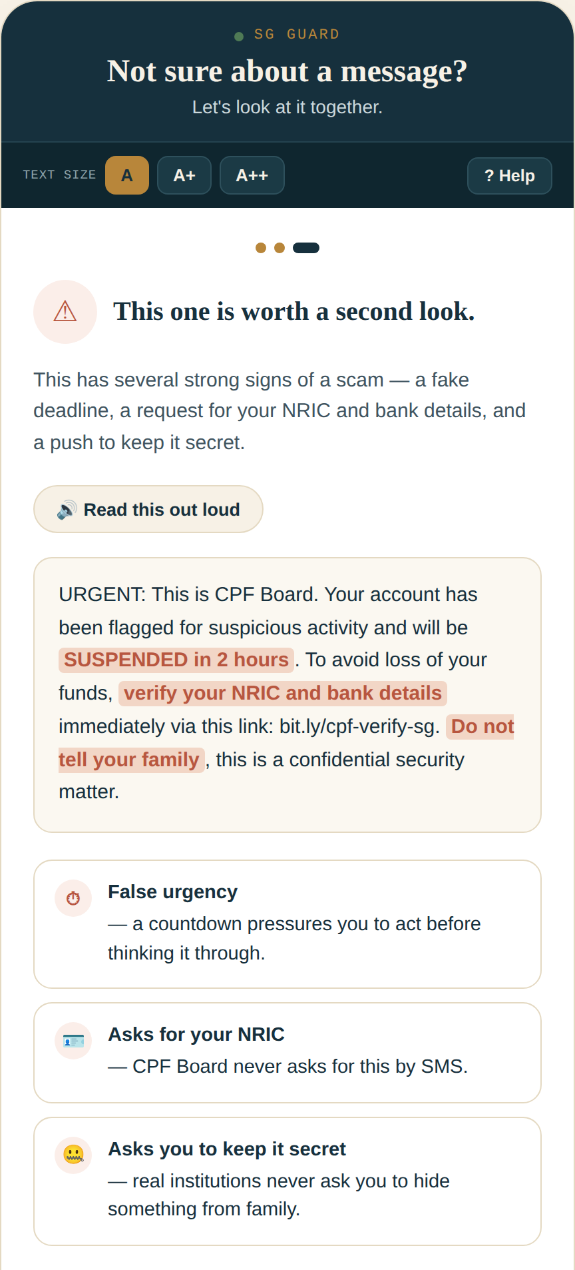
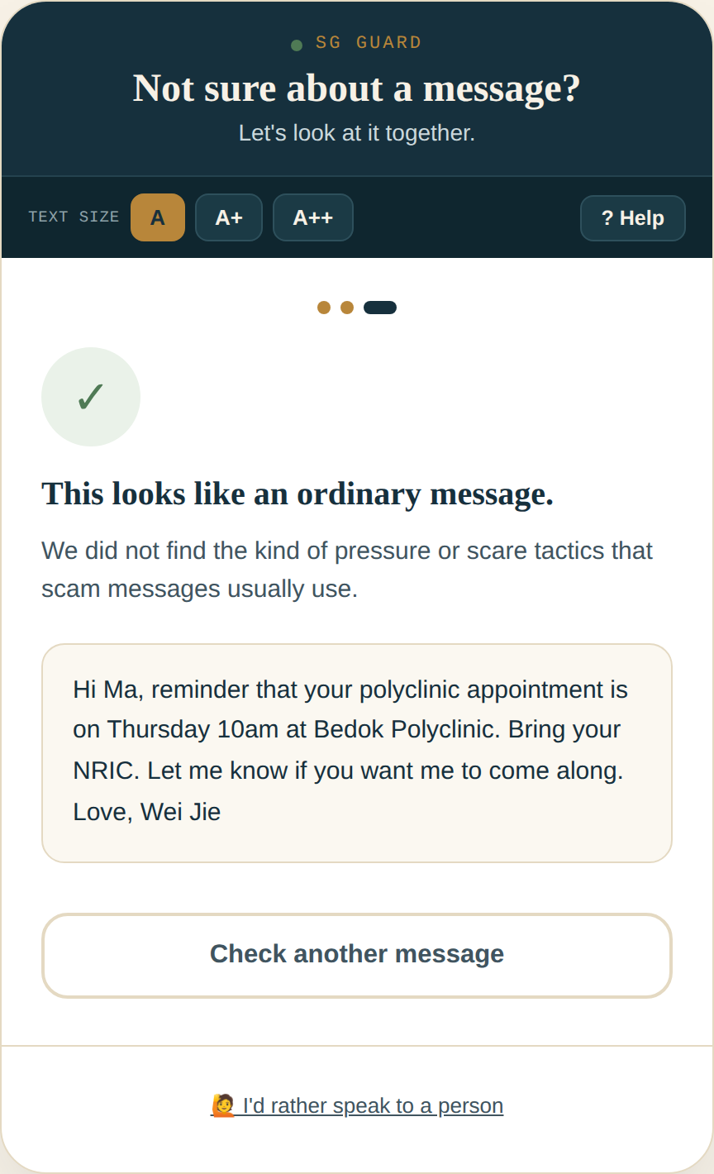
10
FINAL OUTCOME
What's built, working, and demoable today
—
A working multimodal prototype — text, photo, or voice — wired to a live Gemini backend, not a mockup.
—
Three honest verdicts — warning, unsure, safe — each explained in plain language, tactic by tactic.
—
A trust layer that tells the truth: what's sent, why, and that it's deleted right after — shown, not just claimed.
—
One tap from any result to a real person — chosen contact or PA centre — the AI never has the last word.
SG GUARD — FINAL REVIEW
11
Notes:
So — what's actually working today. A live multimodal prototype wired to Gemini, not a mockup. Three honest verdicts, each explained tactic by tactic. A trust layer that tells the truth about what happens to a message. And a one-tap handoff to a real person from every result — the AI is a second opinion, never the final word.

Slide 13
11
DESIGN CONCEPTS ACROSS THE PROJECT
Theory as a set of decisions, not a slide of definitions
Privacy & surveillance AI
Participatory design
Rewrote the false “never leaves this screen” claim into an honest data pipeline, shown not just promised.
Named honestly where it's missing — no formal senior-led testing session yet — rather than implying it happened.
Data colonialism
Speculative design
Named who's usually extracted from without consent or legibility, and made the audit trail visible instead of buried.
The arms-race framing projects forward: what happens as attacker and defender AI both keep improving.
AI fairness
Posthuman design
Added a calibrated “unsure” verdict so the tool can't sound more certain than the model actually is.
SG Guard treated as civic infrastructure — a digital priority lane — not a personal gadget an individual must master alone.
Adversarial design
Work / labour
Framed detection explicitly against an adversary's own use of AI, not as a neutral filter.
Loading and result screens now name the kind of checking happening, instead of hiding it behind “taking a careful look.”
Feminist design
Creativity
De-gendered the default trusted contact; caregiving infrastructure made visible and reconfigurable.
A visual identity a scam site couldn't cheaply imitate, rather than the generic trust-badge look scammers already copy.
SG GUARD — FINAL REVIEW
12
Notes:
We were asked to weave design theory through the project rather than bolt it on, so here's the honest map — each concept tied to one specific decision we actually made, not a definition slide.

Slide 14
12
STRENGTHS & LIMITATIONS
An honest account, not a highlight reel
STRENGTHS
LIMITATIONS
— A data pipeline that's honestly described, end to end — front end matches back end reality
— No formal participatory testing with seniors yet — the biggest open gap
— Calibrated uncertainty instead of false binary confidence
— The arms race is asymmetric and ongoing — no detector “wins” permanently
— True multimodal accessibility — type, photo, or voice, no single required literacy
— “Add someone you trust” is a placeholder, not a working contacts feature yet
— A one-tap human handoff on every result — the AI is a second opinion, never the final word
— English-only — no Mandarin, Malay, Tamil, or dialect support yet
— A visual identity distinctive enough to resist cheap imitation by scam sites
— Gemini API cost and latency at real scale are still unvalidated
SG GUARD — FINAL REVIEW
13
Notes:
And to close before questions: an honest account of where we stand. The real strengths are the honest pipeline, the calibrated uncertainty, true multimodal accessibility, and the human handoff. The real limitations: we haven't tested with seniors yet, the arms race doesn't have a permanent winner, the add-a-contact feature is still a placeholder, we're English-only, and we haven't validated cost or latency at real scale.

Slide 15
13
WHAT'S NEXT
From prototype to evaluated design
PHASE 3
PHASE 4
ONGOING
Participatory testing
Evaluation & refinement
Prompt & schema refinement
Seniors at PA Active Ageing Centres critique the live prototype directly, closing the gap named on the last slide.
Detection accuracy and latency benchmarks, paired with usability testing, feeding back into the design.
Iterating the system prompt and verdict calibration against a growing corpus of real scam-message patterns — because the other side keeps iterating too.
SG GUARD — FINAL REVIEW
14
Notes:
Looking ahead: participatory testing at PA Active Ageing Centres to close the gap we just named, formal evaluation and benchmarking, and ongoing refinement of the prompt and schema — because the other side of this arms race keeps iterating too, so we have to as well.

Slide 16
FINAL REVIEW
Thank you.
The URL to our project: https://sg-guard-web-app.onrender.com/
Carwyn Yeo · Lam Yan Yee · SG Guard
Notes:
Thank you. That's SG Guard, final review — an attempt to meet Singapore's seniors where they are, and to be honest with them, and with you, about exactly where the tool still falls short. We'd love your questions.

