Slide 1
BuzzLock 9000
By Kairui Zhang

Slide 2
Problem
input component to trigger the alarm.
output component to alert people.
The user can activate and deactivate (turn on and off) the device as needed.

Slide 3
Idea
Use a magnetic system, but I don’t have a magnectic detector , alternate idea : use ultrasonic sensor as a way to detect if a way to know if the door is opened or not
Use a Buzzer/Bell, since a buzzer is smaller I decided to use that.
Use a switch to turn the thing on/off, use a button and add t flip flop, or just code it to act as a switch

Slide 4
How it works
Arduino powered lock
Lock using a servo
Alarm using buzzer
Using a infrared receiver and controller

Slide 5
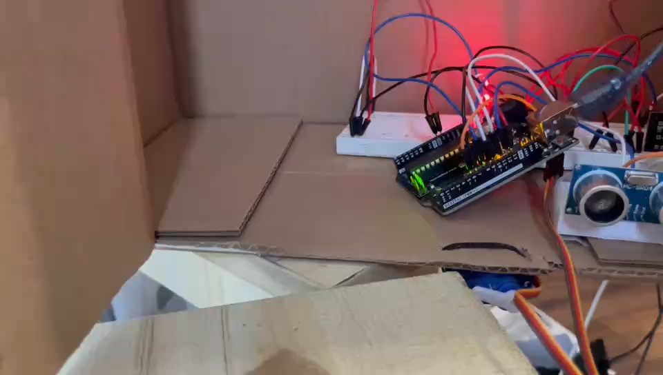
Video Demo
VOLUME WARNIG (BUZZER HIGH FREQUENCY SOUND)

Slide 6
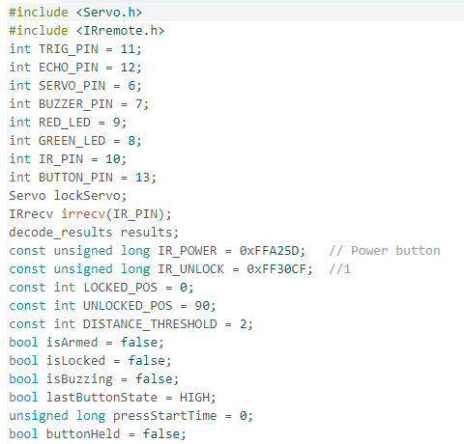
Code showcase/explanation
Declare variable, pins and status

Slide 7
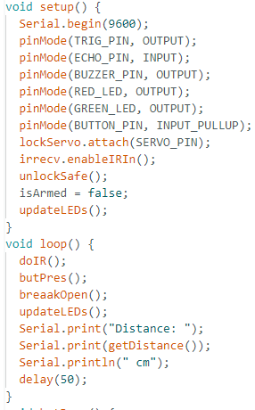
Setup pin modes and set default status, when first run I set it to unarmed and unlocked
Debug ultrasonic senor, and some functions you see in next couple pages

Slide 8
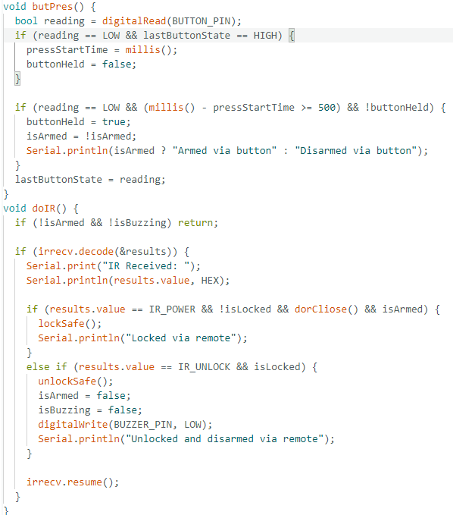
Check if button is pressed, decided to compare to last status and use a delay, because when I just did == HIGH, there was some glitches and the LED was flicking
infrared stuff, detects signals, send signal to open/close door

Slide 9
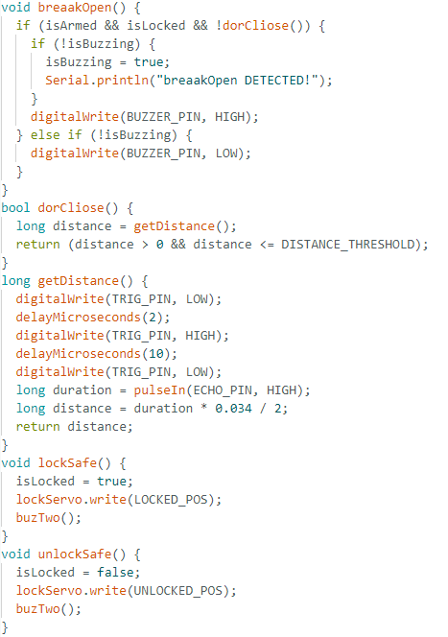
When door is locked and door got open, let it buzz
Added the else if because when it was not used sometimes to suddenly stops
Too late to realize there is a library for the ultra sonic sensor,
But heres an explaination of on how I know the distance
Speed of sound = 343 meters/second
= 0.0343 cm/microsecond
Because the echo thing give microseconds,
And the devided by 2 is because it go to object and go back, so double the time

Slide 10
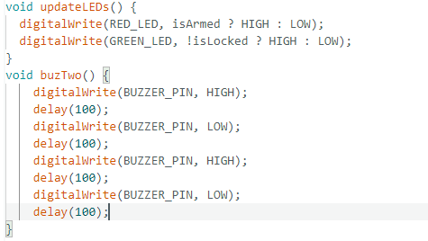
Arm check LED indicate
Buzz twice

Slide 11
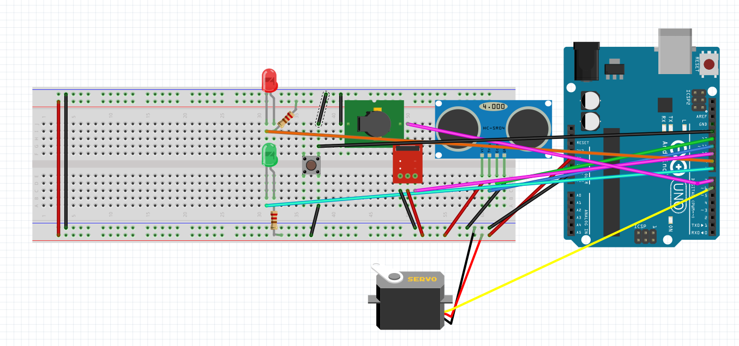
A schematic of my Prototype using Fritzing
It ended up being waaayyy more messier than the schematic

Slide 12
Cost & Location
If being bulk
Microcontroller $2–3
Ultrasonic sensor $1–1.50
IR receiver module $0.30–0.50
buzzer $0.10–0.20
Servo $2–5.00
LEDs, button, wiring < $1
Board(PCB) $0.50–2
Case $1.50–2
Assembly $1–2
Shipping $1- 5
Profit $1 - 2
AVERGE : ~ $17.5
Since this is a safe lock mechanism it would be sound in hardware store, retail store electronic section

Slide 13
Questions?

Slide 14
Thanks for listening

