Slide 1
raw csvs
load_and_concat_csvs
df_raw
df_raw
clean_raw_csv
df
df[‘job description’]
series_of_interest
term_fixes
series_of_interest
clean_terms_for_nlp
terms_for_nlp
additional_stopwords
additional_stopwords
nlp_skill_lists
skill and subtopic lists
…
terms_for_nlp
nlp_count_n_grams
n_grams
df
viz_indeed_metdata
<direct visualization>
series_of_interest
viz_word_clouds
<direct visualization>
terms_for_nlp
n_grams
viz_n_grams
df_jobs_raw

Slide 2
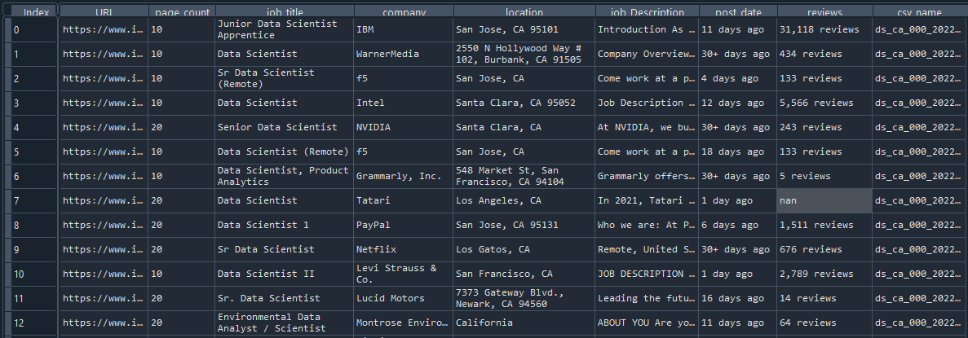
df_raw
**Data is exactly what is brought in from the CSVs

Slide 3
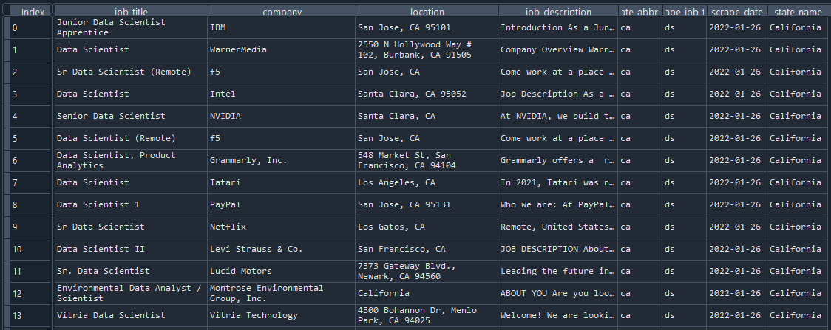
df
**Unnecessary fields are dropped, and csv_name field is parsed

Slide 4
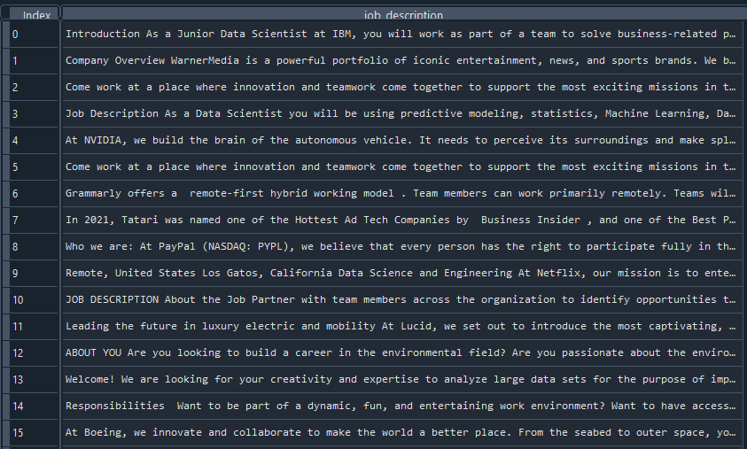
series_of_interest
**Isolated the job description (usually) text into its own series

Slide 5
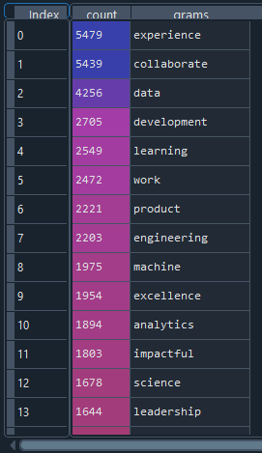
n_grams
**Dataframe containing the top n count of terms, bag of words style. Counted from terms_for nlp.

Slide 6
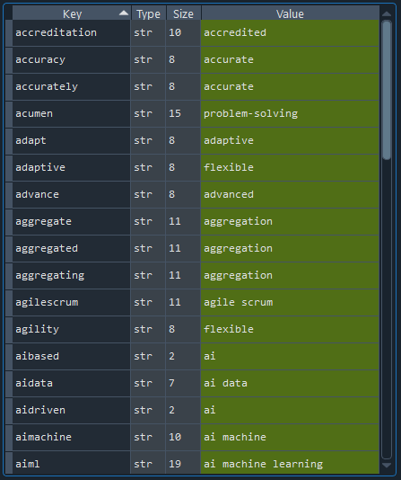
term_fixes
**Dictionary to do a final correction of misspellings, ambiguities or term consolidations. This is the last time the text is modified prior to nlp processing.

Slide 7
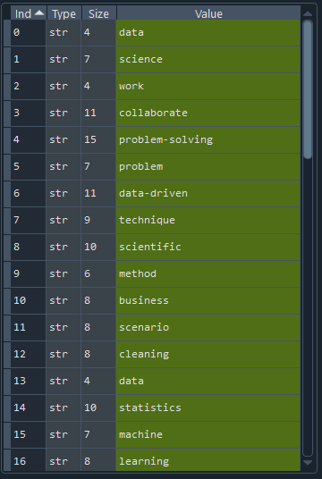
terms_for_nlp
**A huge list of each term from every cleaned job description. The key starting point for a bag of words analysis.

Slide 8
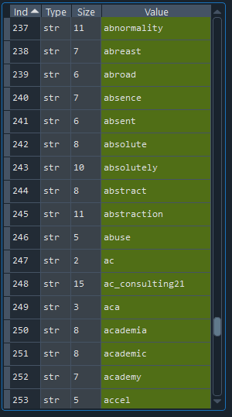
additional_stopwords
**A huge list containing hand-curated, industry-specific stopwords and additional stopwords not caight by the default NLTK stopwords list

Slide 9
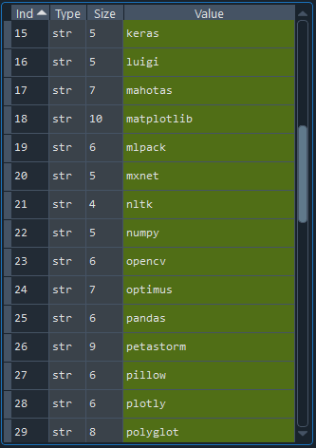
skill and subtopic lists
**Lists containing terms specific to the skill (e.g., technical, professional, etc.) or subtopic (e.g., python, aws, etc.) of interest.

