Slide 1
aws
nltk, genism, spacy, polyglot, regex
TensorFlow
pandas
numpy
keras
pytorch
ml algorithms
gcp
azure
tableau

Slide 2
raw csvs
load_and_concat_csvs
df_raw
df_raw
clean_raw_csv
df
df[‘job description’]
series_of_interest
term_fixes
series_of_interest
clean_terms_for_nlp
terms_for_nlp
additional_stopwords
additional_stopwords
nlp_skill_lists
skill and subtopic lists
…
terms_for_nlp
nlp_count_n_grams
n_grams
df
viz_indeed_metdata
<direct visualization>
series_of_interest
viz_word_clouds
<direct visualization>
terms_for_nlp
viz_n_grams
df_jobs_raw

Slide 3
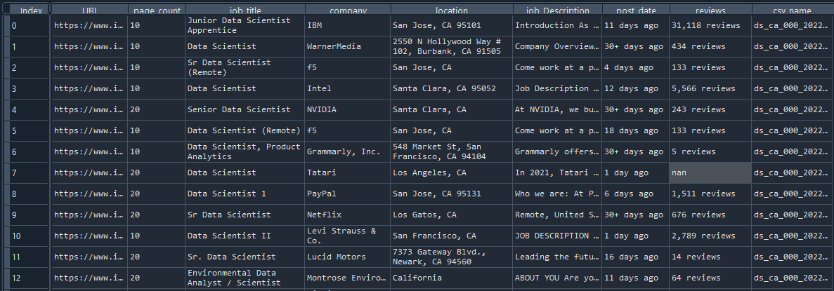
df_raw
**Data is exactly what is brought in from the CSVs

Slide 4
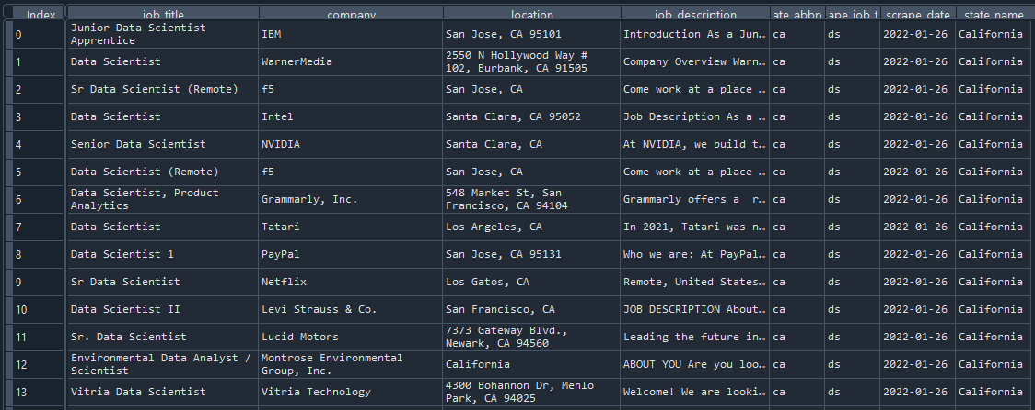
df
**Unnecessary fields are dropped, and csv_name field is parsed

Slide 5
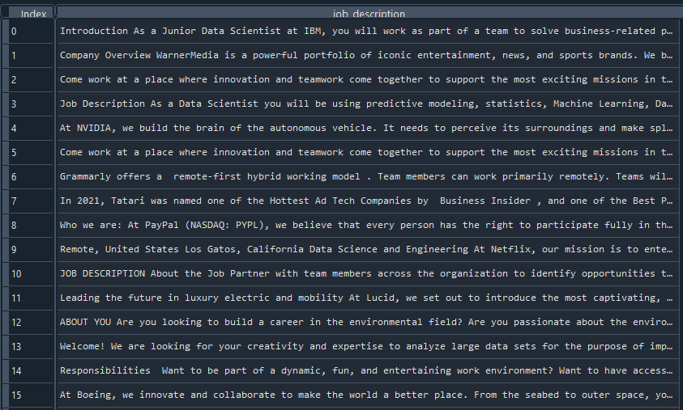
series_of_interest

Slide 6
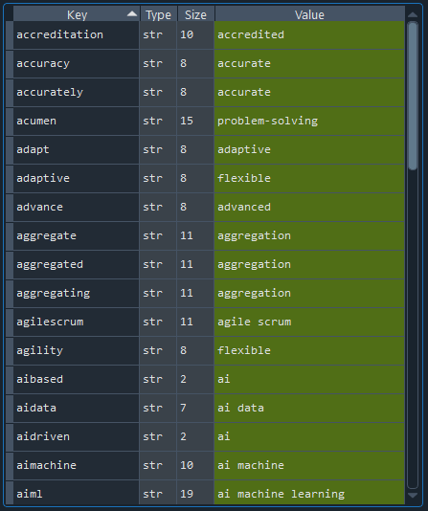
term_fixes

Slide 7
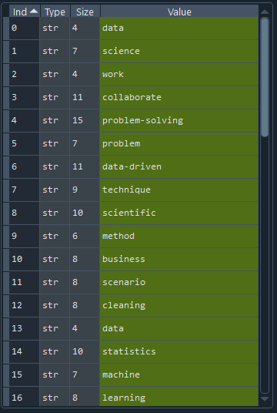
terms_for_nlp

Slide 8
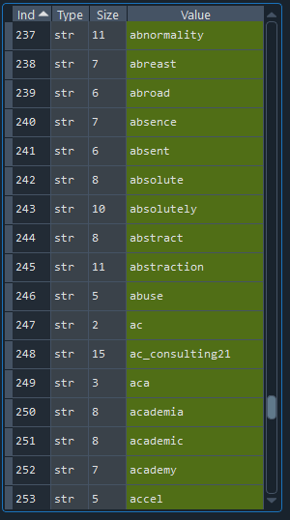
additional_stopwords

