Slide 1
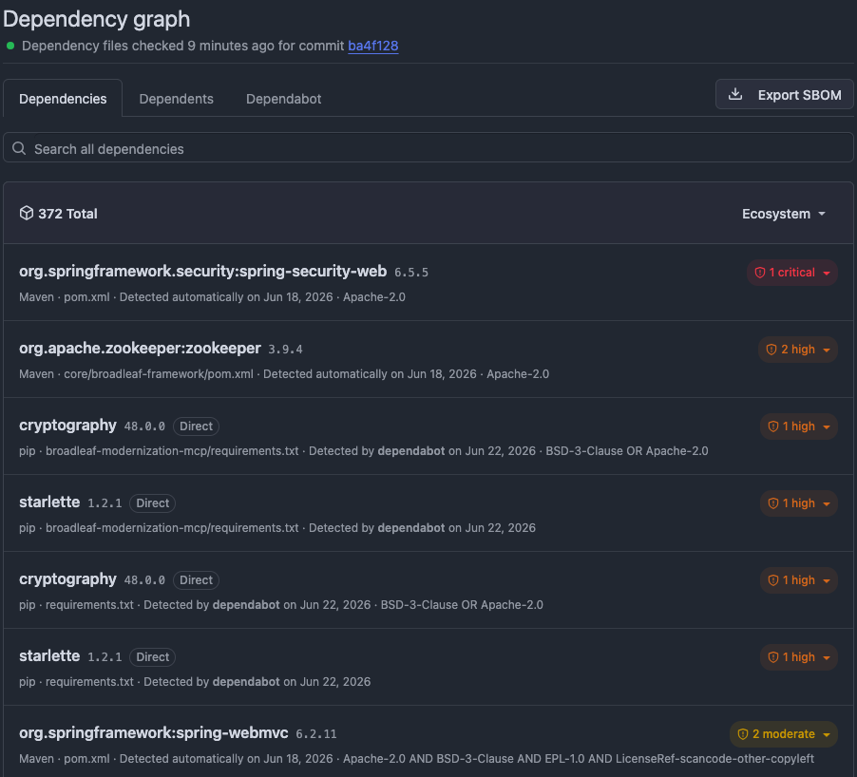
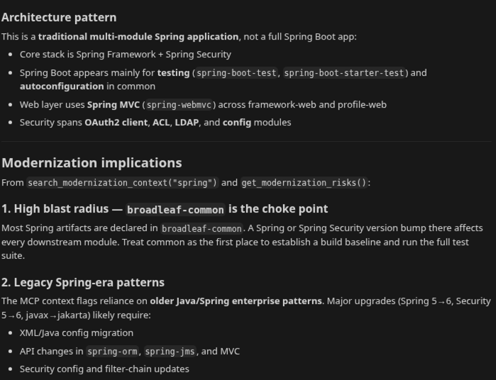
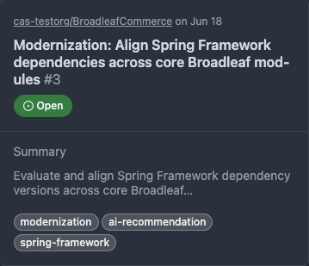
From Technical Debt to Action
An Agentic Workflow for Enterprise Application Modernization
Using application context, MCP, and AI to transform modernization analysis into actionable work.
Technical Debt →
Dependency & vulnerability data
Agentic Analysis →
Context-aware modernization recommendations
Actionable Outcome
Automated backlog creation
1
Broadleaf Commerce | MCP | AI Agent | GitHub Workflow Automation

Slide 2
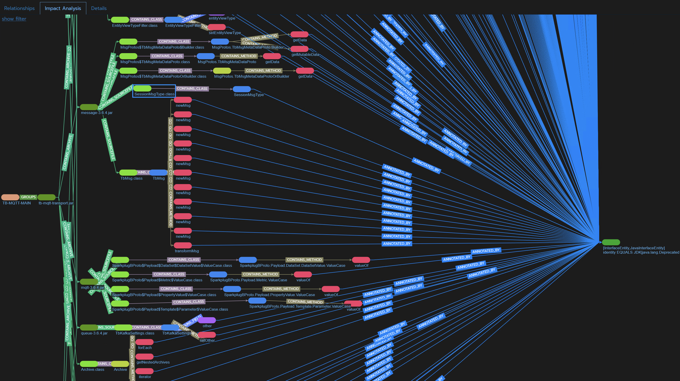
Enterprise Modernization Challenges
Enterprise teams face a common challenge:
Large, complex applications built and evolved over years of development
Outdated frameworks and dependencies
Limited visibility into modernization priorities
Pressure to adopt AI while maintaining confidence in the results
The challenge is not identifying technical debt. The challenge is determining where to start and how to take action.

Slide 3
Why Traditional AI Falls Short
AI can generate code and answer questions, but enterprise applications require more than source code alone.
Challenges
Limited Application Understanding
AI can read code but does not automatically understand architecture, dependencies, or business processes.
Lack of Organizational Context
Critical information often exists outside the repository, in documentation, tribal knowledge, and operational workflows.
Uncertain Modernization Priorities
AI can suggest changes, but determining where to start and what matters most remains difficult.
Risk of Generic Recommendations
Without context, recommendations are based on patterns rather than facts specific to the application.
Traditional AI
Source Code
Documentation
General Knowledge
↓
Recommendation
Context-Aware AI
Source Code
Application Context
Dependencies
Architecture
Business Knowledge
↓
Actionable Recommendation
AI is most effective when it has access to application specific context.
3

Slide 4
Agentic Modernization Workflow
Enterprise Application
↓
Application Context -Architecture, dependencies, modernization findings
↓
MCP - Secure access to application-specific context
↓
AI Agent - Analyze findings and prioritize work
↓
Modernization Recommendation
↓
Actionable Work Item - Create actionable modernization backlog entries
Demo Environment:
Enterprise Application: Broadleaf Commerce Application Context: Architecture Dependencies Modernization Findings Agent: Cursor + Claude Action: GitHub Issues
Context enables AI to produce evidence-based modernization recommendations and actionable outcomes.
4

Slide 5
Demo
5

Slide 6
Business Outcomes:
Turning application context into actionable modernization decisions
Faster Modernization Planning
Identify priorities faster
Create actionable modernization plans
Reduced Modernization Risk
Understand impact before change
Modernize with greater confidence
More Informed AI Recommendations
Ground recommendations in application facts
Reduce reliance on generalized patterns
Actionable Outcomes
Convert analysis into backlog items
Accelerate execution
Context-aware AI helps organizations move from understanding technical debt to taking action.
6

