Slide 1

Adaptation for Situational-Aware Cyber-Physical Systems Driven by Energy Consumption and Human Safety
Mai Abusair
Mohammad Sharaf
Henry Muccini
Paola Inverardi
University of L’Aquila

Slide 2
Outline
Research general idea and contribution
Background
Human safety and Energy consumption
Adaptation model
Evaluation
Conclusion

Slide 3
Research General Idea
Situational Aware cyber-physical systems must be aware of its surroundings and use this information to decide and act accordingly.
Using SiA-CPS to provide “ventilation on demand” is a challenge that drives this paper. We mean by ventilation on demand here; the ability to have ventilation air in a room (indoor) that requires it and as needed at a time.
Architectural decisions will be appreciated if they can preserve architecture qualities along with human satisfaction under different situations.
Notes:
In indoor spaces, monitoring air quality and the presence of gases is a big concern for human safety reasons. Moreover, achieving energy cost savings is a big concern for economic reasons. .

Slide 4
Research Contribution
Using CAPS environment for making early architecture assessments.
Bringing together software and human trade-off evaluation.
Creating energy consumption and human safety utility functions.
Using the adaptation model for architecture domain in CAPS.

Slide 5
Research Background

Slide 6
The CAPS Environment
It is an environment where SiA-CPS can be described through hardware, software and physical space models, and interpreted into Senscript files, composing a CupCarbon simulator project.
This environment is composed of two frameworks: The CAPS modeling framework and The CAPS code generation framework

Slide 7
The CAPS Modeling Framework
It is a modeling framework that supports the engineers of SiACPS.
The CAPS is designed and implemented taking into account three architectural views: the software architecture for structural and behavioral view (SAML), the hardware view (HWML), and the physical space view (SPML). Two auxiliary views, denoted as Mapping Modeling Language (MAPML) and Deployment Modeling Language (DEPML), are used to link together the three views [*].
[*] H. Muccini and M. Sharaf. 2017. CAPS: Architecture Description of situationa Aware Cyber Physical Systems. In 14th IEEE Int. Conference on Software Architecture (ICSA 2017).

Slide 8
The CAPS Code Generation Framework
It is a code generation framework in which CAPS models pass through different interpretations in order to build a code project that is able to be run in CupCarbon simulator.
The CupCarbon simulator will receive the input files generated by the CAPS code generator. Those files, encoding information coming from CAPS in the SenScript language, will be used to simulate energy consumption of model nodes associated to the CAPS architectural model.

Slide 9
Context Aware Adaptation
A system is considered context-aware if it uses the context to give a service that is relevant to its users state. The adaptation, is when the system changes its behavior accordingly.
A context aware adaptation approach for mobile applications, described in [*], targets both software quality and user satisfaction. In terms of Software quality the approach focus on service availability and leverage on a novel reward formula that contains the notion of software availability and users feedback.
[*]Mai Abusair, Antinisca Di Marco, Paola Inverardi. 2017. Context-Aware Adaptation of Mobile Applications Driven By Software quality and User Satisfaction. In Proceedings of the 2017 IEEE International Conference on Software quality, Reliability and Security Companion, Information Assurance Workshop, Prague, Czech Republic, July 2017.

Slide 10
Adaptation Model For CAPS Architecture
Tactics
Strategies
Utility functions

Slide 11
Tactic
It is an action that is primitive and relates to a single adaptation step.
The tactic can be tuning configuration parameters or allowing the selection among different algorithms for performing a single functionality.
An architecture tactic can be a mode/modes run inside a component with given configuration parameters for performing a single functionality.

Slide 12
Strategy
It defines the adaptation process in terms of tactics conditional execution.
A strategy can be represented as condition action decision tree.
A strategy will be able to select tactic/tactics that preserve energy consumption and human safety under certain contextual situations.

Slide 13
Utility Functions
They contribute to the selection of tactics inside strategies.
Utility functions U represent two dimensions of concerns. The first one is the architecture quality represented by the Energy Consumption EC. The second one is the Human safety HS represented by the breathing comfort for humans.

Slide 14
Utility Preferences
Each utility function will have a utility preference given as a weight.
The weight reflects the importance of the concern, and increases depending on its criticality. (e.g., weights WEC = 10% and WHS = 90% indicate that the main concern in the system architecture is the human safety).
The Energy Consumption and Human safety are put together with their preferences in a Reward Formula RF[*].
RF = WEC * UEC +WHS * UHS
[*]Mai Abusair, Antinisca Di Marco, Paola Inverardi. 2017. Context-Aware Adaptation of Mobile Applications Driven By Software availability and User Satisfaction. In Proceedings of the 2017 IEEE International Conference on Software availabilityy, Reliability and Security Companion, Information Assurance Workshop, Prague, Czech Republic, July 2017.

Slide 15
Human Safety Utility Function
Human Safety HS, is defined here as the degree of comfort in a human breathing under a given contextual situation and selected tactic.
The human safety utility function will be computed from three parameters: CO2 concentration in a room, CO2 sensor checking rate and number of persons in a room.

Slide 16

Human Safety Utility Function (Cont.)
Where
BC is the Breathing Convenient related to CO2
CF is the Checking Factor described by CO2 sensor checking rate
CR reflects the crowdness in a room.

Slide 17
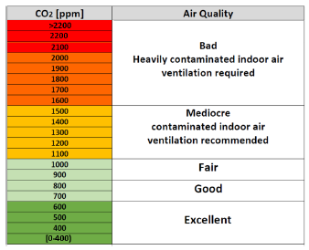
Breathing Convenient BC
It refers to the CO2 concentrations in a room.
It’s divided into 21 values from 0 to more than 2200 ppm for CO2 concentrations.
Thus, BC=1 for those values below 400, and at 400 we will have BC=1-0.05=0.95 and so on until we reach at 2200 where BC=0.05 and for any values above 2200 BC=0.

Slide 18

Checking Factor CF
The checking factor corresponds to the CO2 sensor checking rate per second
Where
MaxReadings represents the highest available number of readings per second for a sensor in an component among its different tactics
NumberOfSensorChecking represents the number of times a sensor checks its current value
TotalCheckingTime represents the time frame in seconds in which the sensor checks its current value
Notes:
(number of times per second the CO2 sensor sends its CO2 current value to other components).

Slide 19
Crowdness in a Room CR
The measure for the crowdness in the room computed from number of persons in a room related to the maximum capacity of persons in the same room. It can be computed as follows:
CR = NumberOfPersons/RoomCapacity
Where
NumberOrPersons is the current available persons exist in a room
RoomCapacity is the maximum number of persons allowed to be in a room as defined in the architecture description

Slide 20
Energy Consumption Utility Function
The energy consumption is meant by the total energy consumed from running the components that are composing CAPS architecture.
The values gained from this formula will range from [0,1]. The Zero value reflects the worst energy consumption and the one value reflects the best energy consumption (desirable).

Slide 21

Energy Consumption Utility Function (Cont.)
Where
CurrentEnergy represents the power consumption in Joules for the current applied architecture tactic/tactics and must be always larger than or equal to the minimum energy
MaxEnergy represents the maximum power consumption to be considered or noticed
MinEnergy represents the minimum power consumption to be considered or noticed

Slide 22
Adaptation Model
The energy consumption utility function, that represents the energy consumed by system nodes, will be used in conjunction with the human safety utility function, that represents the human breathing comfort, to compute the reward formula, that will allow to select tactics in CAPS architecture at different contextual situations.

Slide 23
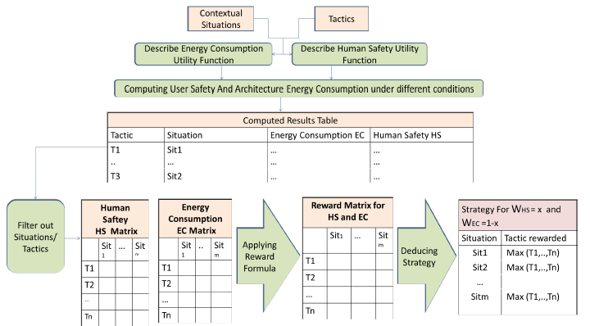
Adaptation Approach

Slide 24
Case Study
The UnivAq Street Science is the European Researchers’ Night (NdR) event organized by the University of L’Aquila. In this event, the research community and public are brought together from the afternoon until late at night to share a combination of entertainment and information.
We will describe CAPS architecture for NdR using CAPS modeling framework .
Using CAPS code generation framework, the models created will be automatically translated into Senscript files for running CupCarbon simulator.

Slide 25
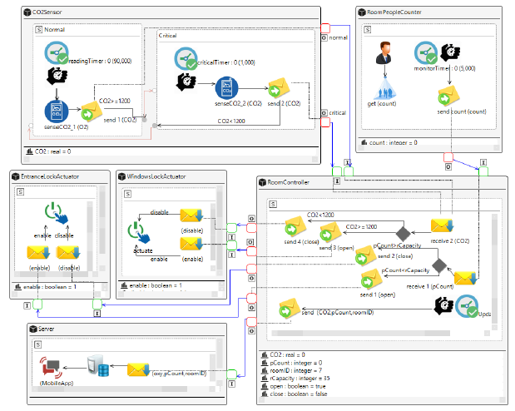

Slide 26
Experimentation
In NdR case study example, we applied three tactics: first, the CO2Sensor runs with normal mode only. Second, the CO2Sensor runs with critical mode only. Third, the CO2Sensor runs in normal and critical modes.
These three tactics are applied separately in CAPS modeling framework. Then, we used CAPS code generation framework tool to produce three CupCarbon projects.

Slide 27
Deciding Contextual Situation
The considered context variables and their values are written as:
PC ∈ { [0-25),[25-40] }
CD ∈{ [0-1000), [1000,1500), [1500,2200] }
Accordingly, the possible contextual situations (Sit) we need to study are:
Sit1={ PC([0-25)),CD([0-1000)) }
Sit2={ PC([25-40]), CD([0-1000)) }
Sit3={ PC([0-25)), CD([1000-1500)) }
Sit4={ PC([25-40]), CD([1000-1500)) }
Sit5={ PC([0-25)), CD([1500-2200]) }
Sit6={ PC([25-40]), CD([1500-2200]) }

Slide 28
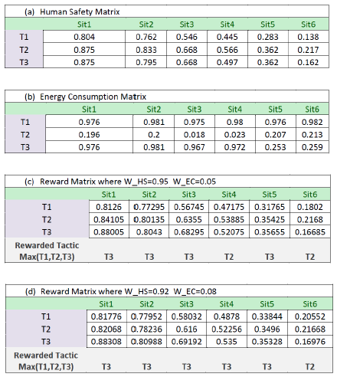
Computed Matrices

Slide 29
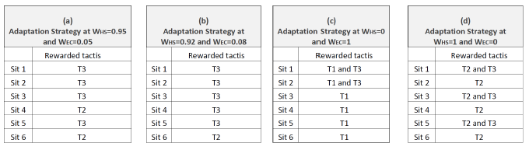
Adaptation Strategies

Slide 30
Conclusion
The adaptations in cyber-physical systems is an insistent need.
The adaptation model we applied has two concerns, energy consumption and human safety.
The paper describes part of the architecture of NdR case study using CAPS environment, and it runs the adaptation approach on it.
CAPS environment used along with the adaptation model will allow engineers to run a trade-off analysis between energy consumption and human safety. It can help them, at an early stages, to decide the best architecture tactic at different contextual situations. Thus, it can help them in improving the architecture itself.

Slide 31
THANKS FOR LISTENING

