Slide 1





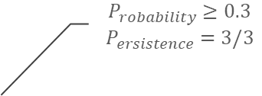


time step
day 1 |  | day 2 |  | day 3 |  | Day 4 |  | day 5 |  | day 6 |  | day 7 |  | day 8 |  | day 9 |  | day 10 |  | day 11 |  | day 12 |  | day 13 |  | day 14 |  | day 15 |  | day 16 |  | day 17 |  | day 18 |  | day 19 |  | day 20
$$min.$$
$$lead time$$
lead time (d) | 2
 | 3
 | 4
 | …
 | 9
 |  |  | 0.6 | 0.3 |  |  |  |  |  |  |  |  |  | 0.3 |  |  |  |  |  |  |  |  |  |  |  | 0.6 | 0.9 | 0.9
 |  |  | 0.3 | 0.4 |  |  |  |  |  |  |  |  |  | 0.3 |  |  |  |  |  |  |  |  |  |  |  | 0.6 | 0.6
 |  |  | 0.1 |  |  |  |  |  |  |  |  |  |  | 0.3 |  |  |  |  |  |  |  |  |  |  |  | 0.6 | 0.6
 |  |  |  |  |  |  |  |  |  |  |  |  |  |  |  |  |  |  |  |  |  |  |  |  |  | 0.3 | 0.6
 |  |  |  |  |  |  |  |  |  |  |  |  |  |  |  |  |  |  |  |  |  |  |  |  | 0.3 | 0.3
 |  |  |  |  |  |  |  |  |  |  |  |  |  |  |  |  |  |  |  |  |  |  |  | 0.3 | 0.3 | 0.3
 |  |  |  |  |  |  |  |  |  |  |  |  |  |  |  |  |  |  |  |  |  |  |  | 0.1 | 0.1 |  |  |  |  |  |  |  |  |  |  | 0.6
 |  |  |  |  |  |  |  |  |  |  |  |  |  |  |  |  |  |  |  |  |  |  |  |  |  |  |  |  |  |  |  |  |  |  |  | 0.3 | 0.6
 |  |  |  |  |  |  |  |  |  |  |  |  |  |  |  |  |  |  |  |  |  |  |  |  |  |  |  |  |  |  |  |  |  |  |  | 0.3 | 0.3
 |  |  |  |  |  |  |  |  |  |  |  |  |  |  |  |  |  |  |  |  |  |  |  |  |  |  |  |  |  |  |  |  |  |  |  | 0.1
$$P_{robability}≥0.3$$
$$P_{ersistence}=3/3$$
predicted
exceedance
probability
$$max.$$
$$lead time$$
predicted events
$$E_{pred}=3$$
observed events
$$E_{obs}=3$$
$$hits=1$$
$$misses=E_{obs}−hits=2$$
$$false alarms=E_{pred}−hits=2$$

Slide 2
discharge
exceedance probability
confusion matrix
skill
optimal criteria
reanalysis
reanalysis
Q₅
criteria
CV
forecast
forecast
Hits, misses, false alarms
f-score, recall, precision
probability, persistence
NWP
DWD
COSMO-LEPS
ECMWF-HRES
ECMWF-ENS
approach
1D+1P
MM
MW
BW
approach
probability
persistence
approach
probability
persistence
approach

Slide 3
time step
day 1 |  | day 2 |  | day 3 |  | Day 4 |  | day 5 |  | day 6 |  | day 7 |  | day 8 |  | day 9 |  | day 10 |  | day 11 |  | day 12 |  | day 13 |  | day 14 |  | day 15 |  | day 16 |  | day 17 |  | day 18 |  | day 19 |  | day 20
$$min.$$
$$lead time$$
lead time (d) | 2
 | 3
 | 4
 | …
 | 9
 |  |  | 0.6 | 0.3 |  |  |  |  |  |  |  |  |  | 0.3 |  |  |  |  |  |  |  |  |  |  |  | 0.6 | 0.9 | 0.9
 |  |  | 0.3 | 0.4 |  |  |  |  |  |  |  |  |  | 0.3 |  |  |  |  |  |  |  |  |  |  |  | 0.6 | 0.6
 |  |  | 0.1 |  |  |  |  |  |  |  |  |  |  | 0.3 |  |  |  |  |  |  |  |  |  |  |  | 0.6 | 0.6
 |  |  |  |  |  |  |  |  |  |  |  |  |  |  |  |  |  |  |  |  |  |  |  |  |  | 0.3 | 0.6
 |  |  |  |  |  |  |  |  |  |  |  |  |  |  |  |  |  |  |  |  |  |  |  |  | 0.3 | 0.3
 |  |  |  |  |  |  |  |  |  |  |  |  |  |  |  |  |  |  |  |  |  |  |  | 0.3 | 0.3 | 0.3
 |  |  |  |  |  |  |  |  |  |  |  |  |  |  |  |  |  |  |  |  |  |  |  | 0.1 | 0.1 |  |  |  |  |  |  |  |  |  |  | 0.6
 |  |  |  |  |  |  |  |  |  |  |  |  |  |  |  |  |  |  |  |  |  |  |  |  |  |  |  |  |  |  |  |  |  |  |  | 0.3 | 0.6
 |  |  |  |  |  |  |  |  |  |  |  |  |  |  |  |  |  |  |  |  |  |  |  |  |  |  |  |  |  |  |  |  |  |  |  | 0.3 | 0.3
 |  |  |  |  |  |  |  |  |  |  |  |  |  |  |  |  |  |  |  |  |  |  |  |  |  |  |  |  |  |  |  |  |  |  |  | 0.1
$$P_{robability}≥0.3$$
$$P_{ersistence}=3/3$$
predicted
exceedance
probability
$$max.$$
$$lead time$$
predicted events
$$E_{pred}=3$$
observed events
$$E_{obs}=3$$
$$hits=1$$
$$misses=E_{obs}−hits=2$$
$$false alarms=E_{pred}−hits=2$$

Slide 4
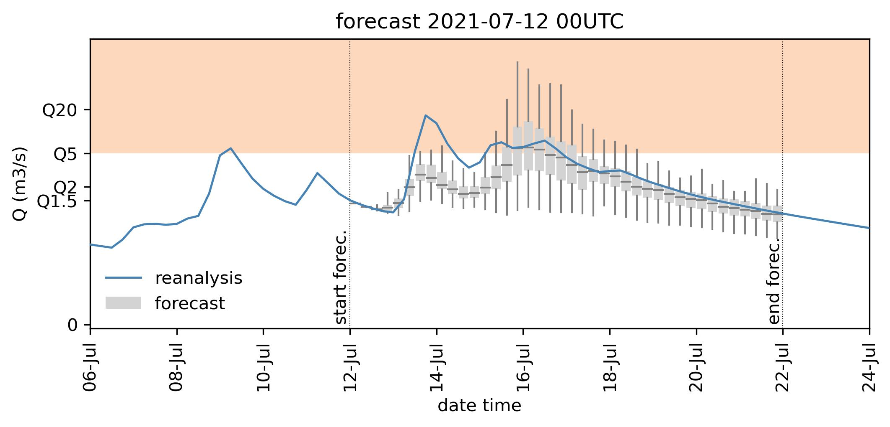
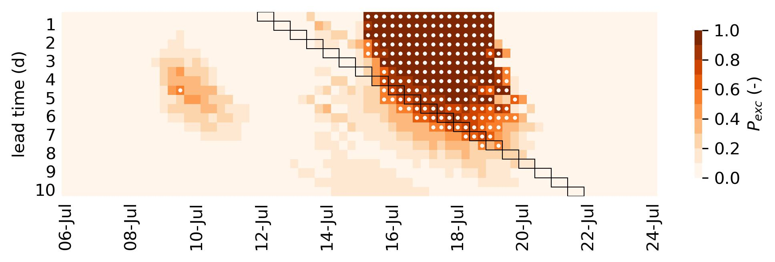
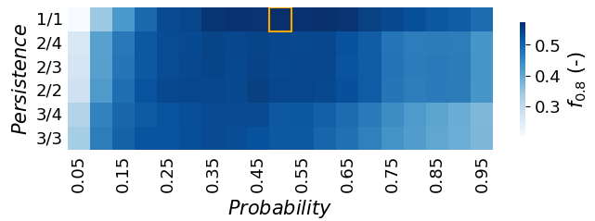
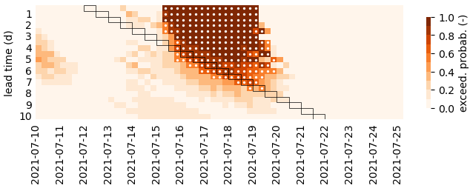
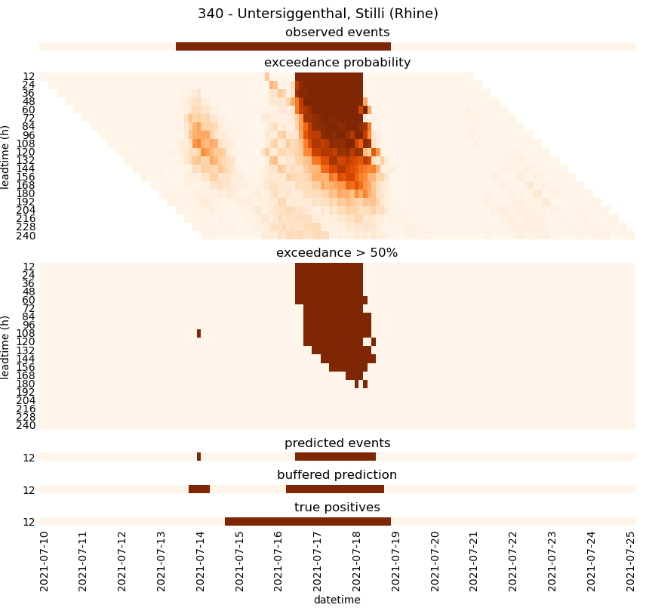
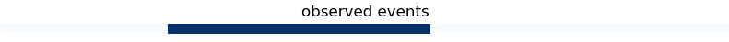


$$P_{robability}≥0.5$$
$$P_{ersistence}=1/1$$
 |  | Forecast
 |  | True | False
Observation | True | 1 | 2
 | False | 2 | -
$f_{.0.8}=0.$5

Slide 5

$$P_{robability}≥0.5$$
$$P_{ersistence}=1/1$$
 |  | Forecast
 |  | True | False
Observation | True | 1 | 2
 | False | 2 | -
$f_{.0.8}=0.$5

Slide 6
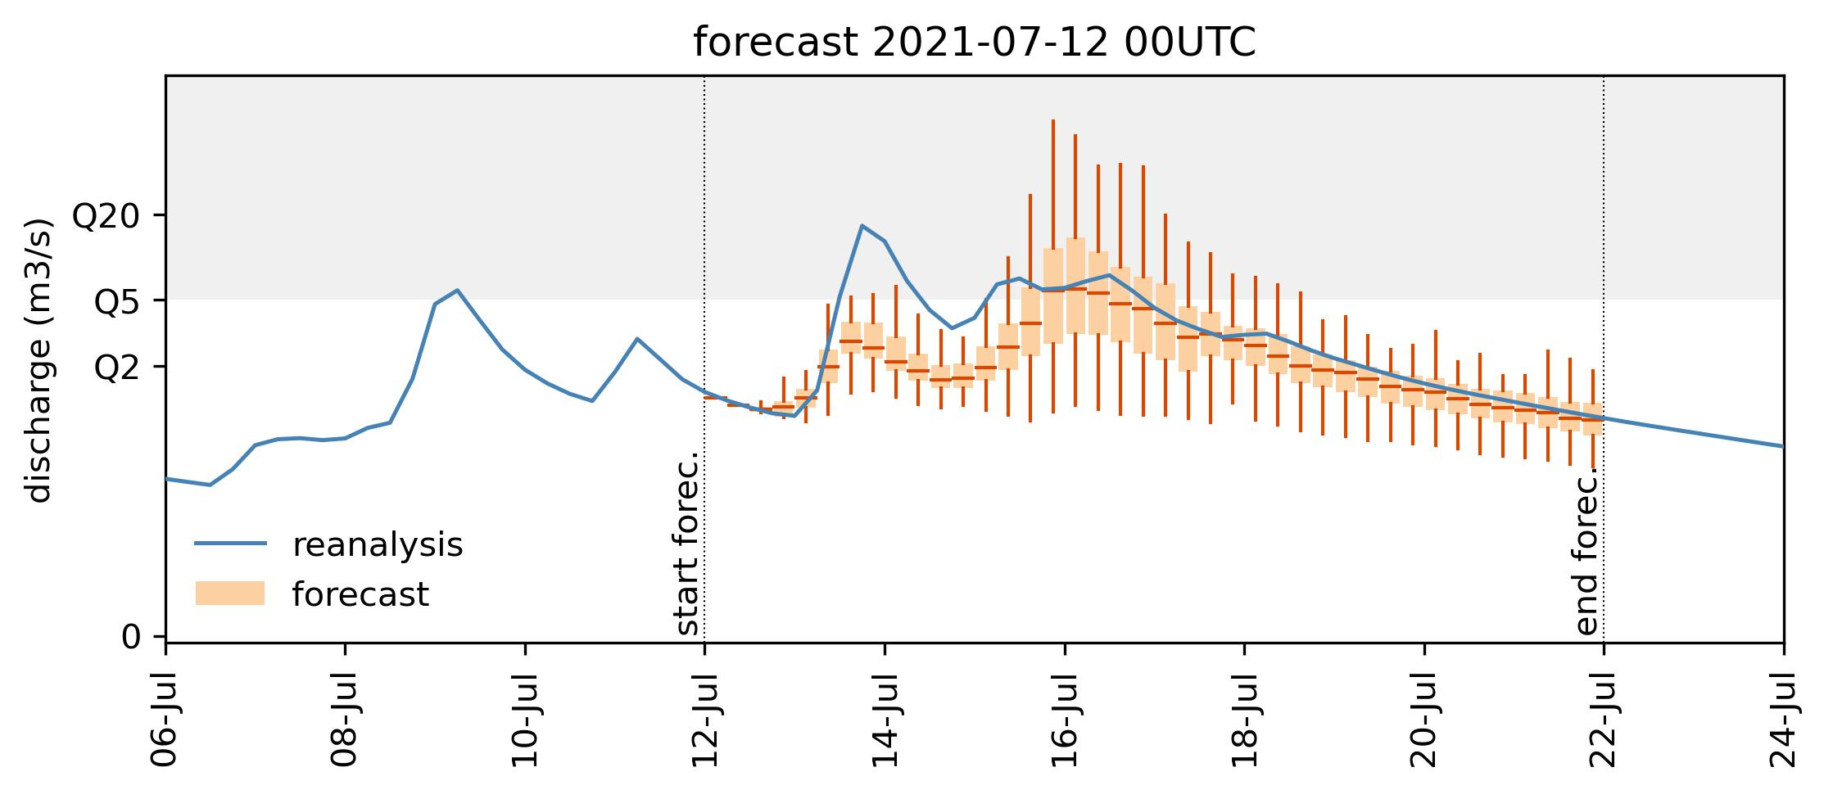
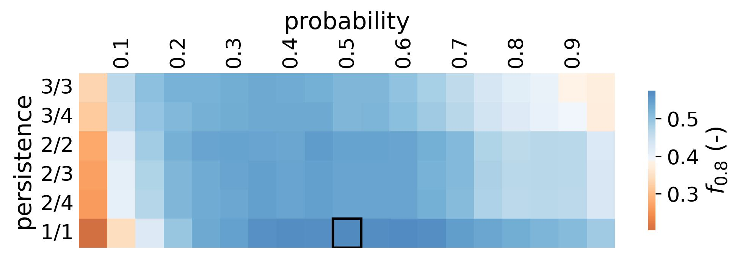
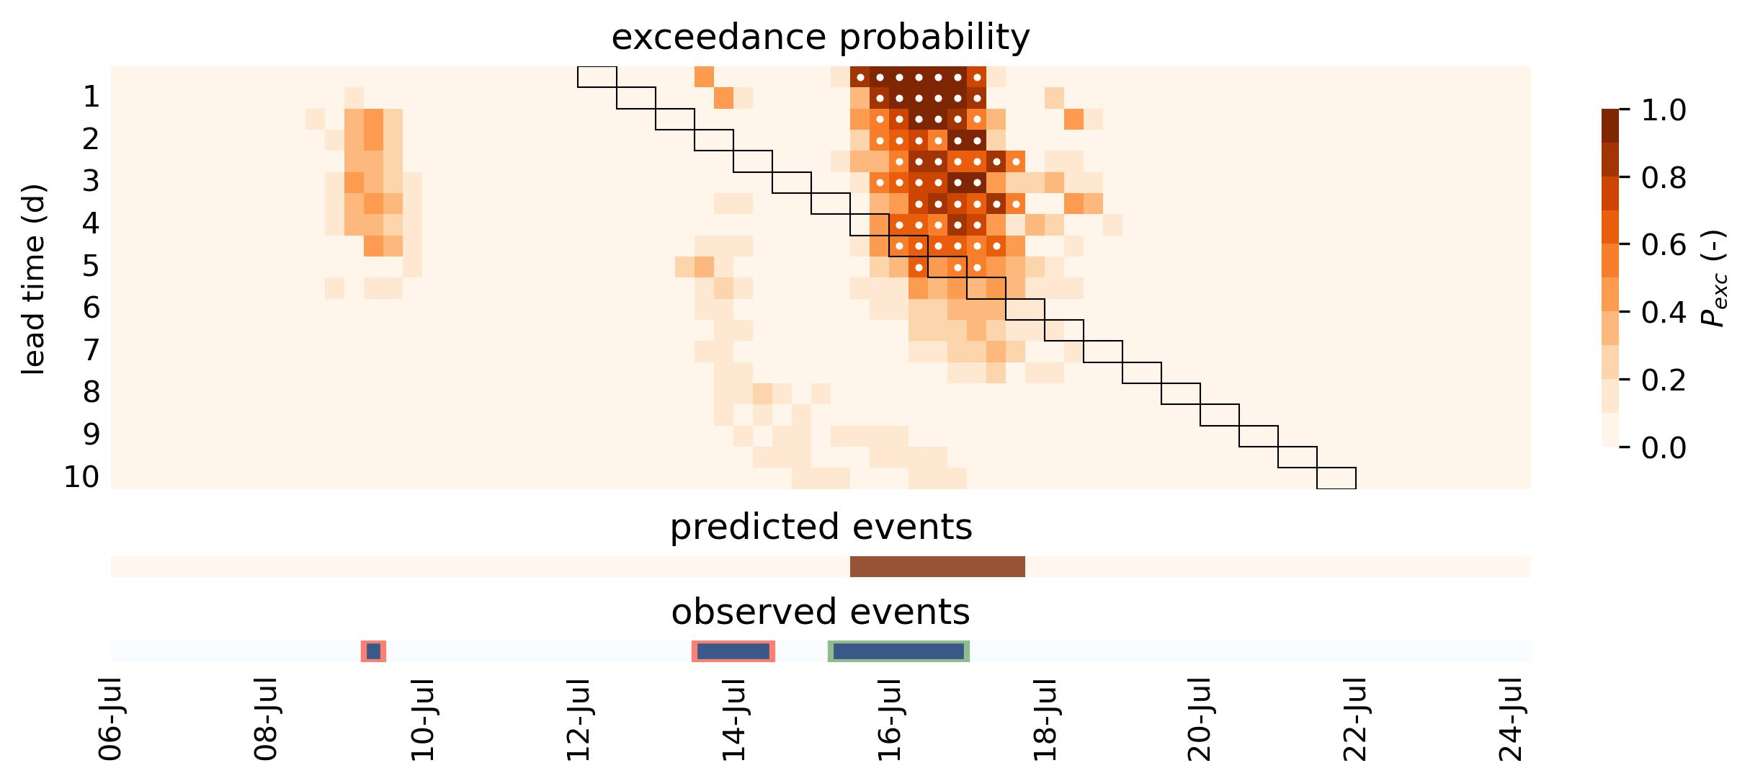


a)
d)
$$P_{robability}≥0.5$$
$$P_{ersistence}=1/1$$
b)
c)
$$f_{.0.8}=0.56$$
 |  | predicted
 |  | True | False | Total
observed | True | 1 | 2 | 3
 | False | 0 | -
 | Total | 1

