Slide 1
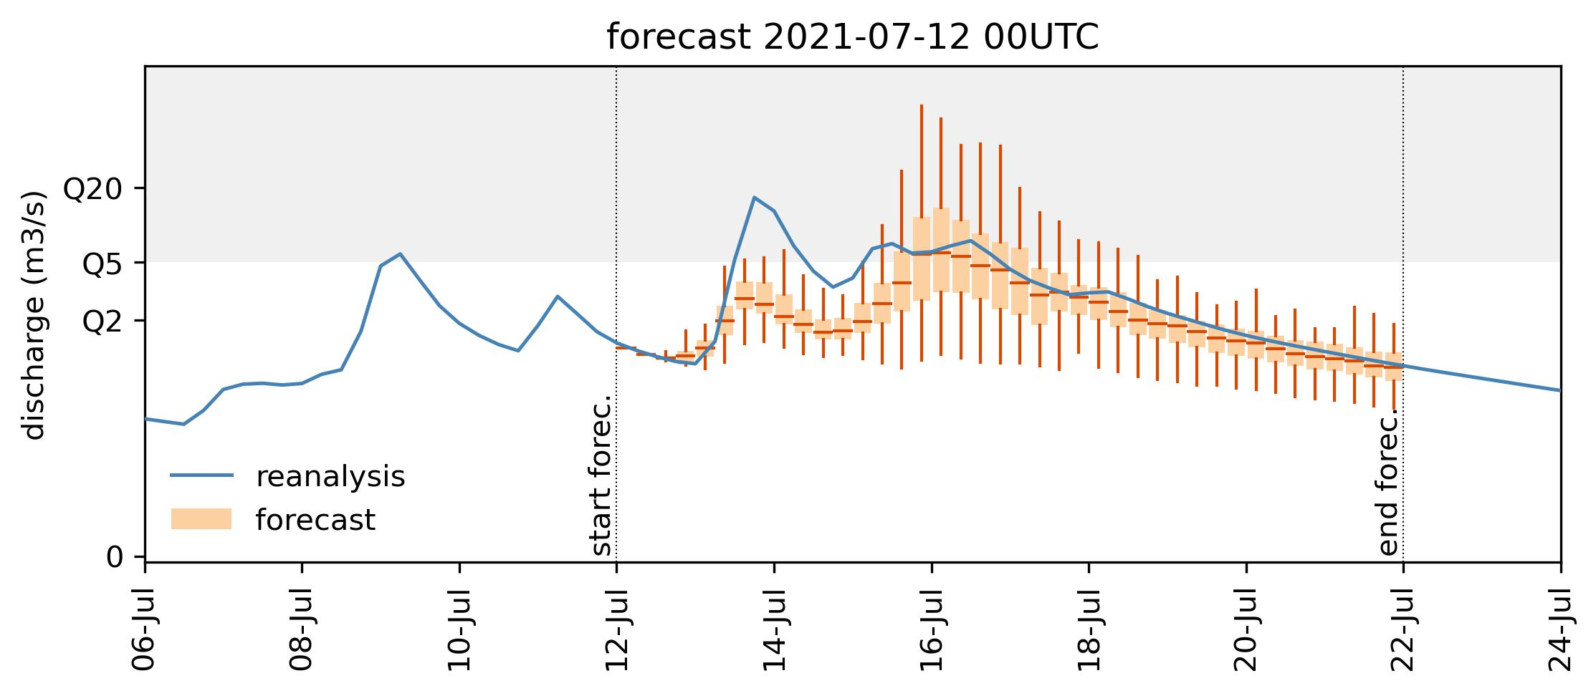
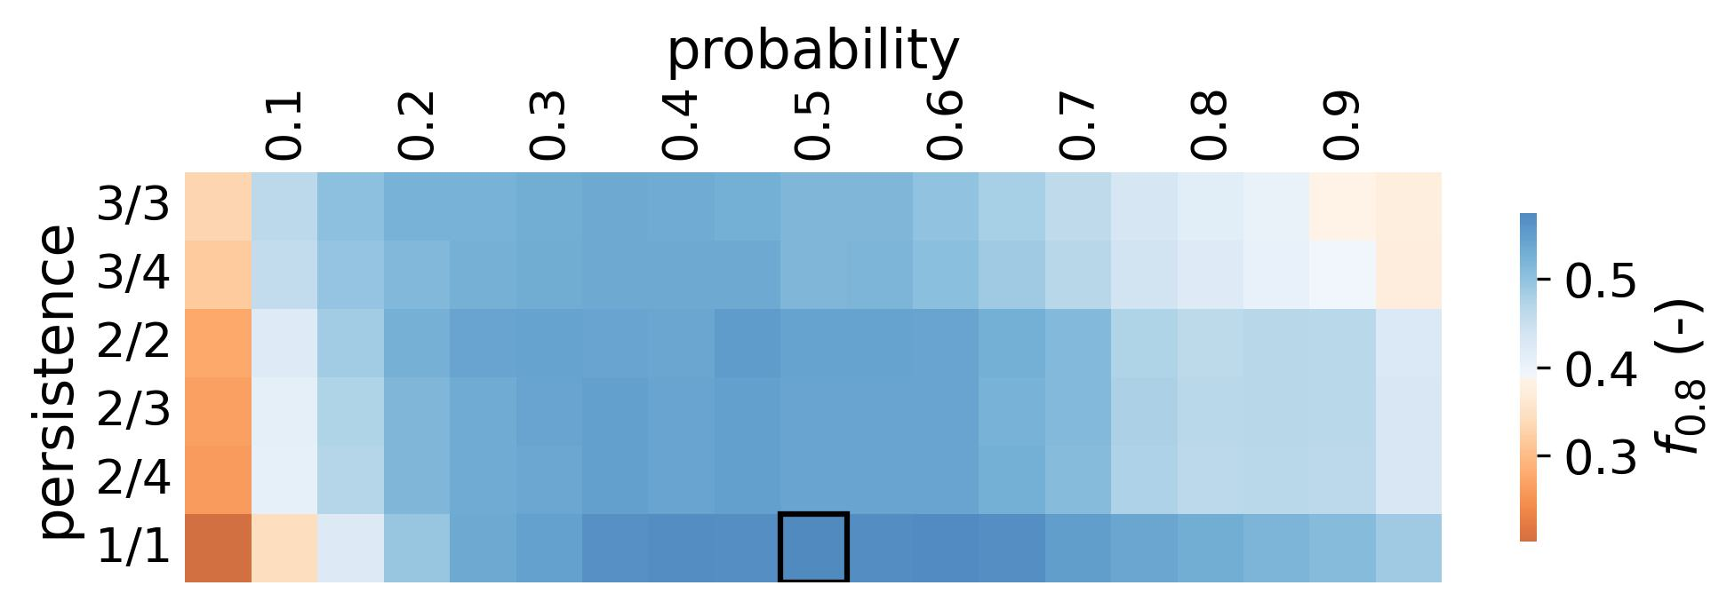
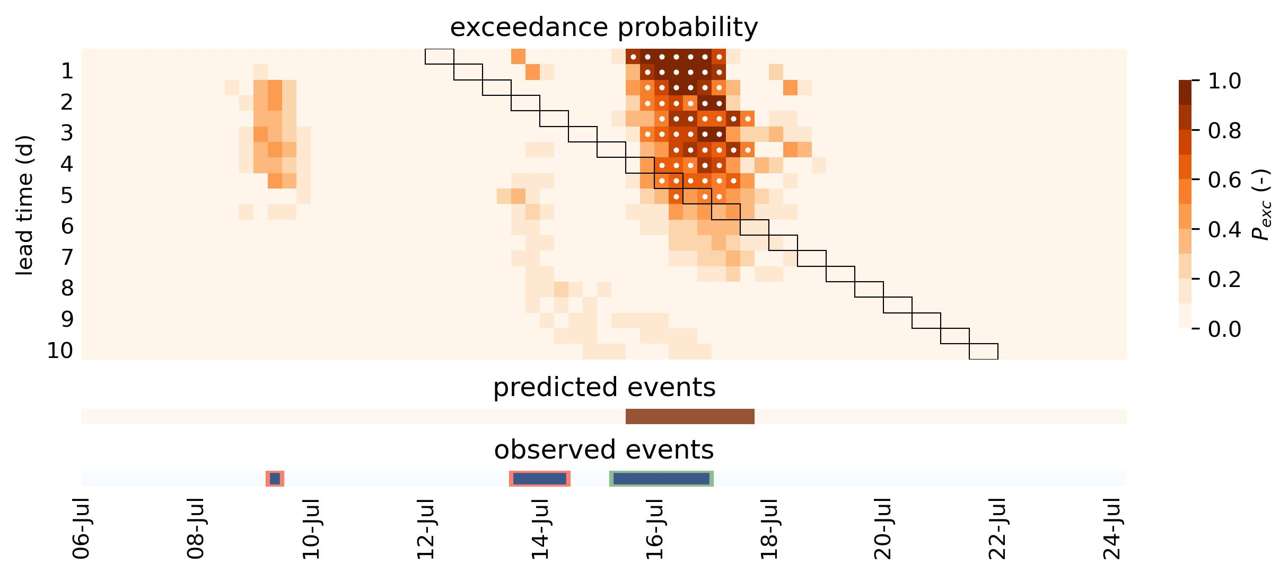


a)
d)
$$P_{robability}≥0.5$$
$$P_{ersistence}=1/1$$
b)
c)
$$f_{.0.8}=0.56$$
 |  | predicted
 |  | True | False | Total
observed | True | 1 | 2 | 3
 | False | 0 | -
 | Total | 1

