Slide 1
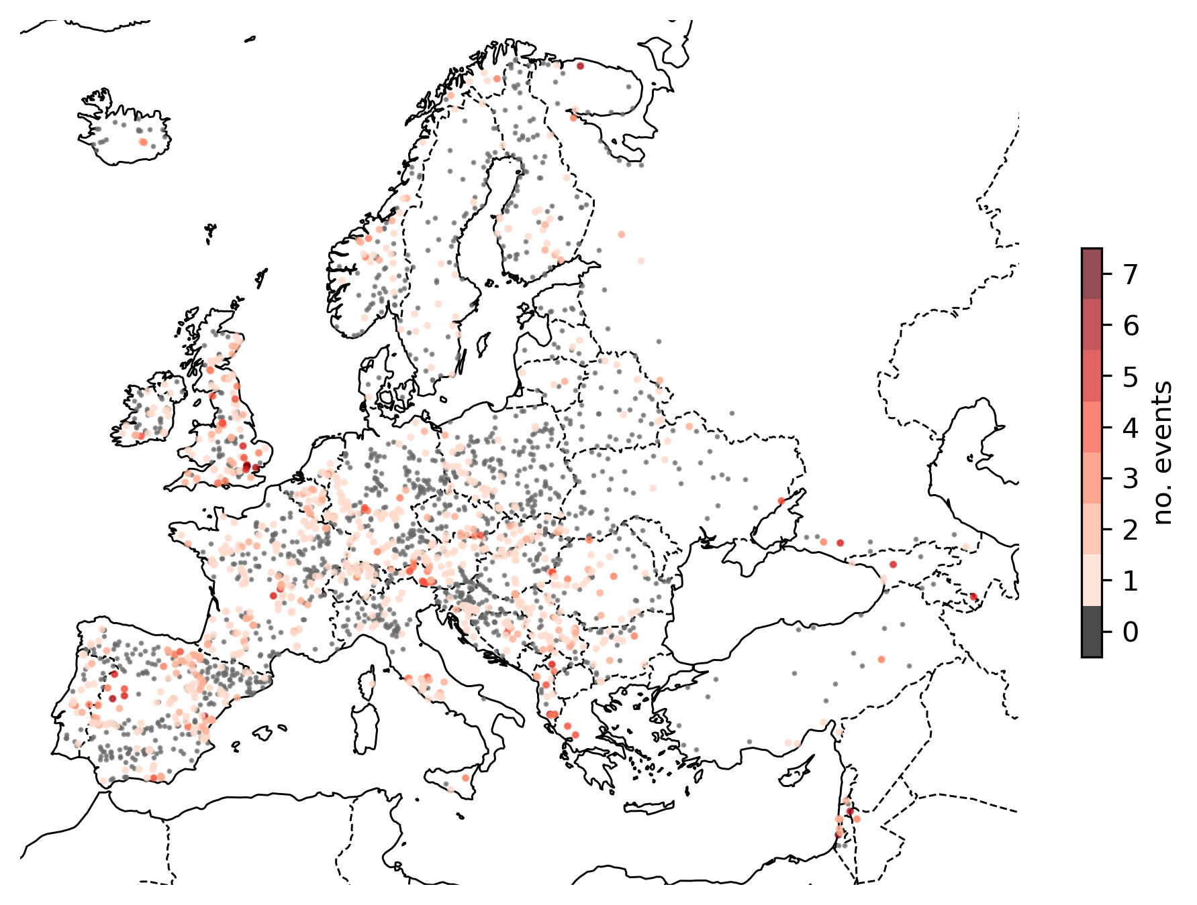
Introduction
Current EFAS formal notifications criteria
Catchment part of Condition of Access
Probabilistic forecasts: ECMWF-ENS or COSMO-LEPS
Probability of exceeding Q5 ≥ 30%
Persistence: 3 consecutive forecast
Deterministic forecasts: ECMWF or DWD
At least one of them exceeds Q5
Catchment area ≥ 2000 km²
Lead time ≥ 48 h
“observed” flood events (2021/2022)
Objective
To assess if EFAS skill in predicting flood events can be optimized by varying the notification criteria.
Data
Geographical extent: fixed reporting points with a contributing area larger than 500 km².
Temporal extent: years 2021 and 2022.
Discharge data:
Observed: EFAS v4.0 water balance.
Predicted: EFAS v4.0 reforecast for 4 meteorological forcings (ECMWF-ENS, COSMO-LEPS, ECMWF, DWD).
no. reporting points = 2370
total no. events = 1293

Slide 2
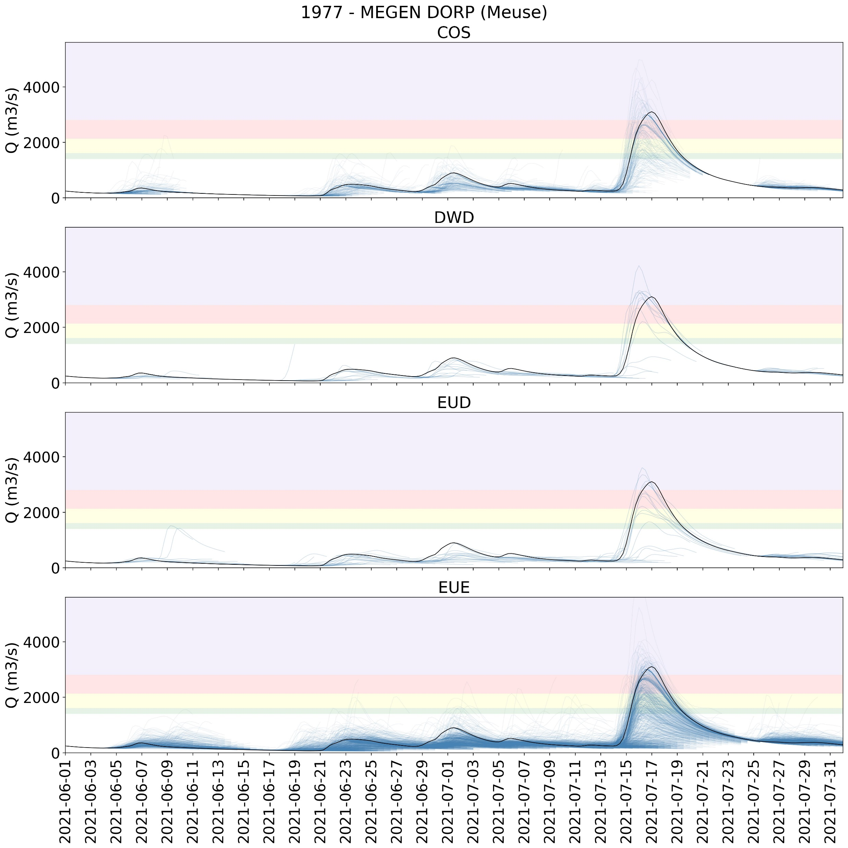
Example of forecast in the July 2021 flood

Slide 3
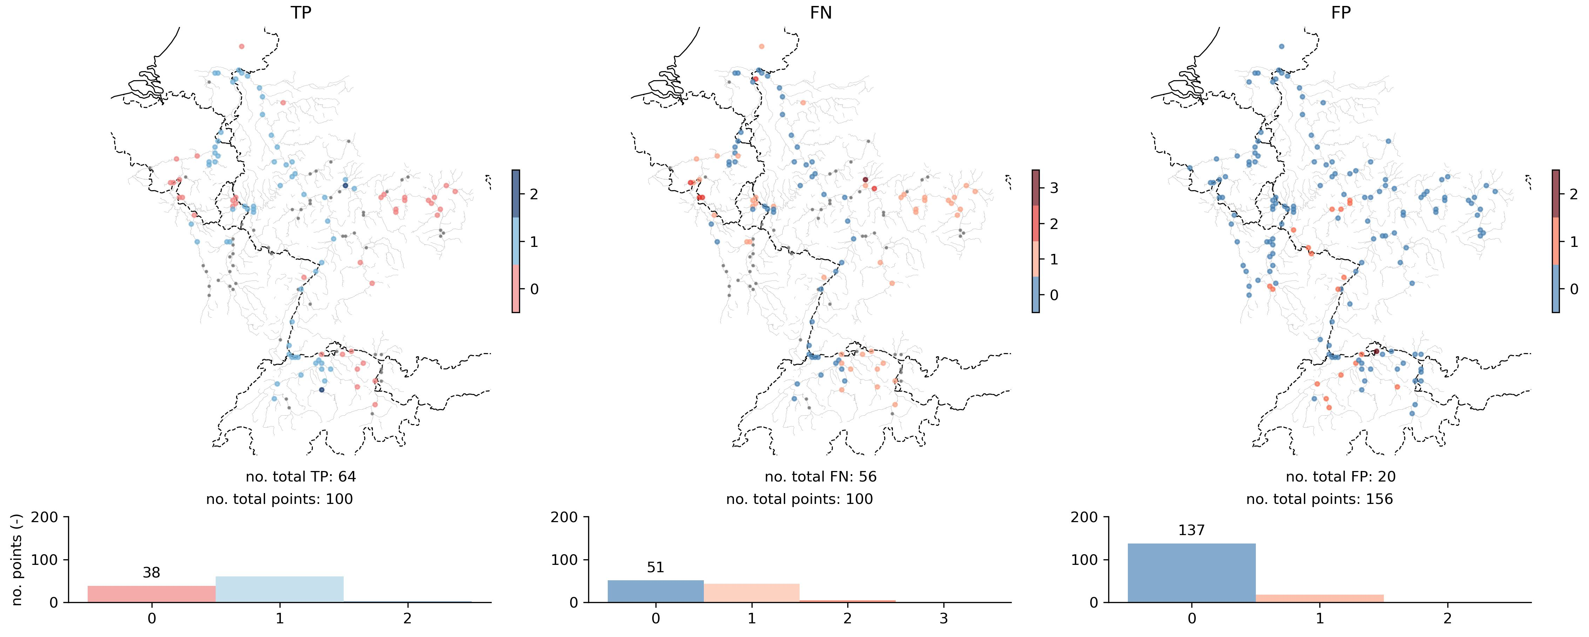
General outlook of hits (TP), misses (FN) and false alarms (FP)
Current criteria (leadtime ≥ 48 h):
Approach: 1 deterministic + 1 probabilistic
Probability: 30%
Persistence: 3 consecutive forecasts

Slide 4
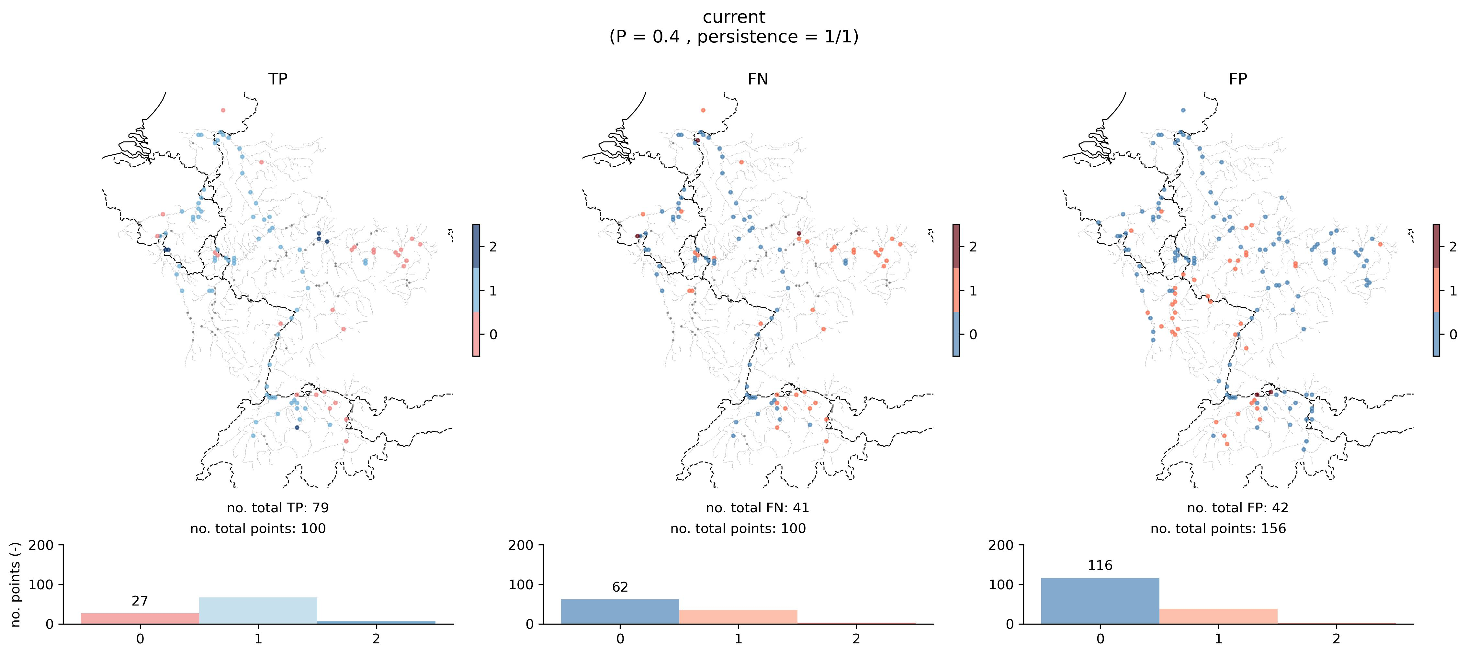
General outlook of hits (TP), misses (FN) and false alarms (FP)
Optimized criteria (leadtime ≥ 48 h):
Approach: 1 deterministic + 1 probabilistic
Probability: 40%
Persistence: 1 single forecast (no persistence)
The optimization has increased the number of hits and reduced the number of misses at the cost of increasing the false alarms.

Slide 5
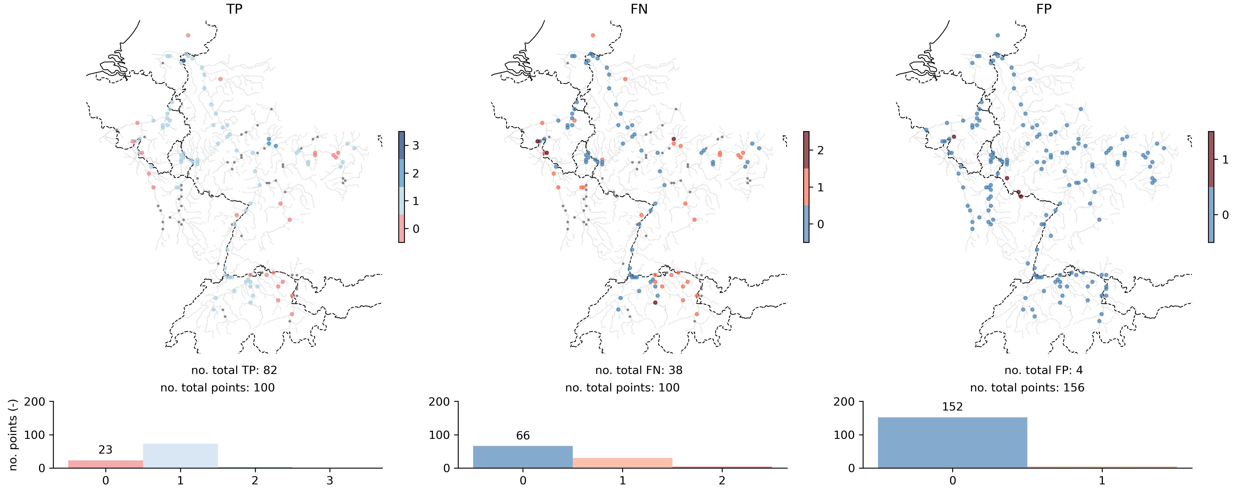
General outlook of hits (TP), misses (FN) and false alarms (FP)
Optimized criteria (all leadtimes):
Approach: performance-weighted
Probability: 90%
Persistence: 1 single forecast (no persistence)
Including shorter leadtimes would improve notably the skill:
70% of the events are captured
False alarms are practically inexistent

Slide 6
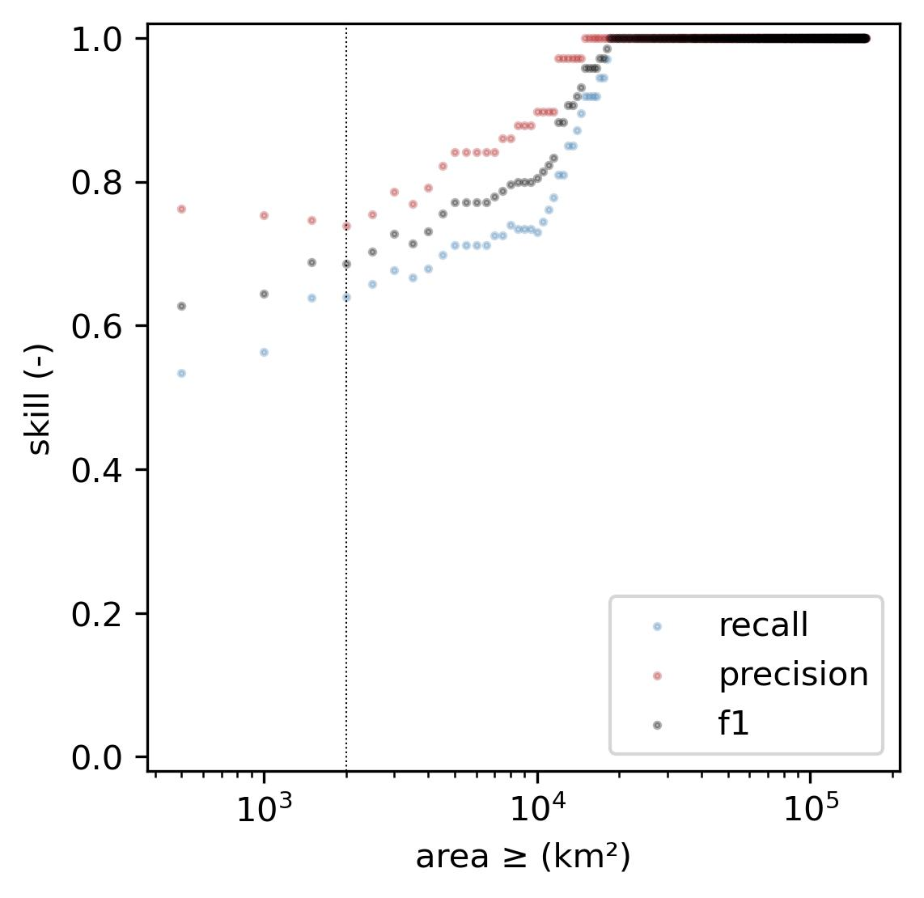
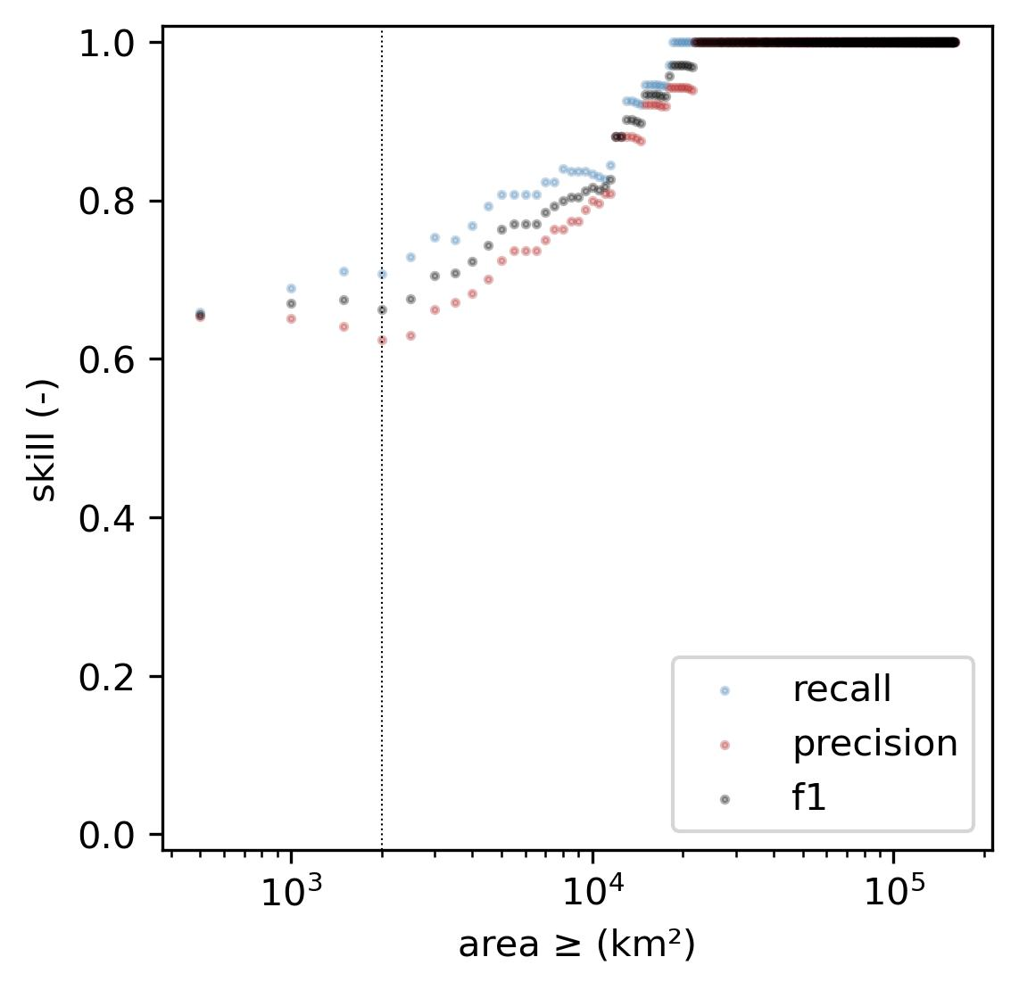



Performance regarding catchment area
Current criteria
Optimized criteria
The system performs perfectly for large catchments regardless of the criteria.
The optimization has slightly improved the performance for smaller catchments.
Even though f1 is fairly similar, optimizing the criteria has also reduced the difference between recall and precision (false negatives vs false alarms). In fact, these two metrics have shifted their position with respect to f1.
$$recall=\frac{TP}{TP+FN}$$
$$precision=\frac{TP}{TP+FP}$$
$$f_{1}=2\frac{precision·recall}{precision+recall}$$

Slide 7
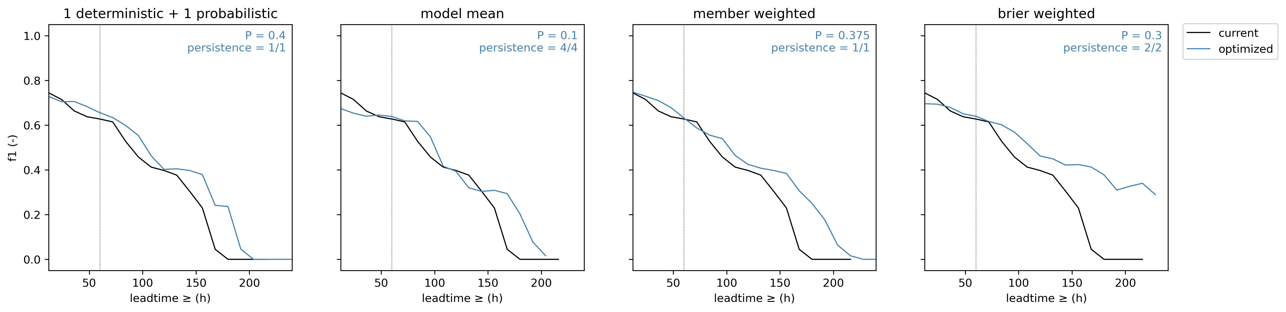

Performance regarding leadtime
The performance of the system at leadtimes larger than 48 h is similar for the current and the optimized criteria.
The optimization improves performance at longer leadtimes.
At leadtimes shorter than 48 h the performance increases.
$$f_{1}=2\frac{precision·recall}{precision+recall}=\frac{2·TP}{2·TP+FN+FP}$$

