Slide 1
A flood event started in station ID on November 25th 18:00
This matrix shows the onset of the observed event for different forecasts.
forecast
 | 16-Nov 00:00
 | 18-Nov 00:0
 | 20-Nov 00:00
 | 22-Nov 00:00
 | 24-Nov 00:00
 | 26-Nov 00:00
1 d | 2 d | 3 d | 4 d | 5 d | 6 d | 7 d | 8 d | 9 d | 10 d
leadtime

Slide 2
On top of that, I add the onset of the event according to EFAS forecasts
forecast
 | 16-Nov 00:00
 | 18-Nov 00:0
 | 20-Nov 00:00
 | 22-Nov 00:00
 | 24-Nov 00:00
 | 26-Nov 00:00
1 d | 2 d | 3 d | 4 d | 5 d | 6 d | 7 d | 8 d | 9 d | 10 d
leadtime

Slide 3
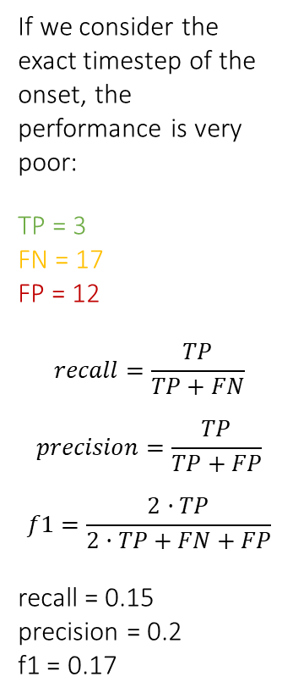
If we consider the exact timestep of the onset, the performance is very poor:
TP = 3
FN = 17
FP = 12
$$recall=\frac{TP}{TP+FN}$$
$$precision=\frac{TP}{TP+FP}$$
$$f1=\frac{2·TP}{2·TP+FN+FP}$$
recall = 0.15
precision = 0.2
f1 = 0.17
forecast
 | 16-Nov 00:00
 | 18-Nov 00:0
 | 20-Nov 00:00
 | 22-Nov 00:00
 | 24-Nov 00:00
 | 26-Nov 00:00
1 d | 2 d | 3 d | 4 d | 5 d | 6 d | 7 d | 8 d | 9 d | 10 d
leadtime

Slide 4
But we could accept as hits predictions close to the observation
(± 1 timestep, for instance)
forecast
 | 16-Nov 00:00
 | 18-Nov 00:0
 | 20-Nov 00:00
 | 22-Nov 00:00
 | 24-Nov 00:00
 | 26-Nov 00:00
1 d | 2 d | 3 d | 4 d | 5 d | 6 d | 7 d | 8 d | 9 d | 10 d
leadtime

Slide 5
But we could accept as hits predictions close to the observation
(± 1 timestep, for instance)
forecast
 | 16-Nov 00:00
 | 18-Nov 00:0
 | 20-Nov 00:00
 | 22-Nov 00:00
 | 24-Nov 00:00
 | 26-Nov 00:00
1 d | 2 d | 3 d | 4 d | 5 d | 6 d | 7 d | 8 d | 9 d | 10 d
leadtime

Slide 6
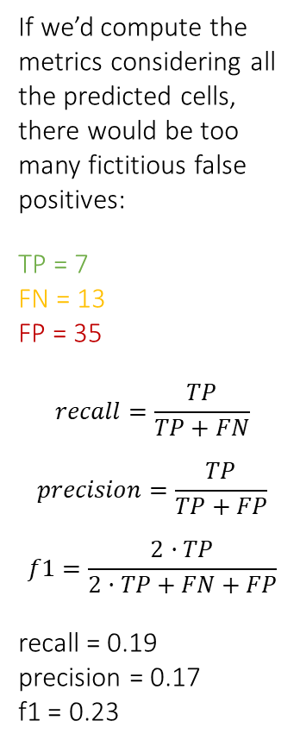
If we’d compute the metrics considering all the predicted cells, there would be too many fictitious false positives:
TP = 7
FN = 13
FP = 35
$$recall=\frac{TP}{TP+FN}$$
$$precision=\frac{TP}{TP+FP}$$
$$f1=\frac{2·TP}{2·TP+FN+FP}$$
recall = 0.19
precision = 0.17
f1 = 0.23
forecast
 | 16-Nov 00:00
 | 18-Nov 00:0
 | 20-Nov 00:00
 | 22-Nov 00:00
 | 24-Nov 00:00
 | 26-Nov 00:00
1 d | 2 d | 3 d | 4 d | 5 d | 6 d | 7 d | 8 d | 9 d | 10 d
leadtime

Slide 7
To avoid that, I apply a two-step procedure.
First, on the “expanded” predicted events…
forecast
 | 16-Nov 00:00
 | 18-Nov 00:0
 | 20-Nov 00:00
 | 22-Nov 00:00
 | 24-Nov 00:00
 | 26-Nov 00:00
1 d | 2 d | 3 d | 4 d | 5 d | 6 d | 7 d | 8 d | 9 d | 10 d
leadtime

Slide 8
To avoid that, I apply a two-step procedure
First, on the “expanded” predicted events, I apply a mask that selects only the cells where there’s an observed event.
This allows to count both true positives and false negatives.
TP = 7
FN = 13
forecast
 | 16-Nov 00:00
 | 18-Nov 00:0
 | 20-Nov 00:00
 | 22-Nov 00:00
 | 24-Nov 00:00
 | 26-Nov 00:00
1 d | 2 d | 3 d | 4 d | 5 d | 6 d | 7 d | 8 d | 9 d | 10 d
leadtime

Slide 9
Second, on the original predicted events…
forecast
 | 16-Nov 00:00
 | 18-Nov 00:0
 | 20-Nov 00:00
 | 22-Nov 00:00
 | 24-Nov 00:00
 | 26-Nov 00:00
1 d | 2 d | 3 d | 4 d | 5 d | 6 d | 7 d | 8 d | 9 d | 10 d
leadtime

Slide 10
Second, on the original predicted events, I search for predicted events out of the observed event ±1 timestep. Those are the false positives.
FP = 8
forecast
 | 16-Nov 00:00
 | 18-Nov 00:0
 | 20-Nov 00:00
 | 22-Nov 00:00
 | 24-Nov 00:00
 | 26-Nov 00:00
1 d | 2 d | 3 d | 4 d | 5 d | 6 d | 7 d | 8 d | 9 d | 10 d
leadtime

Slide 11

In the end, I get three matrixes with the true positives, false negatives and false positives. In this example the matrix has 2 dimensions (forecast and leadtime), but in reality it has 6 (station, forecast, leadtime, way to compute total probability, probability threshold, window).
Given this matrixes, we can compute the metrics aggregating the results in any of the dimensions. For instance, aggregating by forecast and leadtime:
TP = 7
FN = 13
FP = 8
$$recall=\frac{TP}{TP+FN}=0.35$$
$$precision=\frac{TP}{TP+FP}=0.47$$
$$f1=\frac{2·TP}{2·TP+FN+FP}=0.40$$
True positives
False negatives
False positives

