Slide 1
discharge
exceedance probability
confusion matrix
skill
optimal criteria
reanalysis
reanalysis
Q₅
criteria
f-score
forecast
forecast
Hits, misses, false alarms
f-score, recall, precision
NWP
DWD
COSMO-LEPS
ECMWF-HRES
ECMWF-ENS
approach
1D+1P
MM
MW
BW
approach
probability
persistence
approach
probability
persistence
approach
probability
persistence

Slide 2

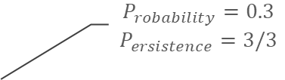




datetime
15-Nov 00:00 | 16-Nov 00:00 | 17-Nov 00:00 | 18-Nov 00:00 | 19-Nov 00:00 | 20-Nov 00:00 | 21-Nov 00:00 | 22-Nov 00:00 | 23-Nov 00:00 | 24-Nov 00:00
lead time (h) | 60
 | 72
 | 84
 | 96
 | 108
 | 120
 | 132
 | 144
 | 156
 | …
 |  |  |  |  |  |  |  |  |  |  |  |  |  | 0.3 |  |  |  |  |  |  |  |  |  |  |  | 0.6 | 0.9 | 0.9
 |  |  |  |  |  |  |  |  |  |  |  |  |  | 0.3 |  |  |  |  |  |  |  |  |  |  |  | 0.6 | 0.6
 |  |  |  |  |  |  |  |  |  |  |  |  |  | 0.3 |  |  |  |  |  |  |  |  |  |  |  | 0.6 | 0.6
 |  |  |  |  |  |  |  |  |  |  |  |  |  |  |  |  |  |  |  |  |  |  |  |  |  | 0.3 | 0.6
 |  |  |  |  |  |  |  |  |  |  |  |  |  |  |  |  |  |  |  |  |  |  |  |  | 0.3 | 0.3
 |  |  |  |  |  |  |  |  |  |  |  |  |  |  |  |  |  |  |  |  |  |  |  |  | 0.3 | 0.3
 |  |  |  |  |  |  |  |  |  |  |  |  |  |  |  |  |  |  |  |  |  |  |  |  | 0.1 |  |  |  |  |  |  |  |  |  |  | 0.6
 |  |  |  |  |  |  |  |  |  |  |  |  |  |  |  |  |  |  |  |  |  |  |  |  |  |  |  |  |  |  |  |  |  |  |  | 0.3 | 0.6
 |  |  |  |  |  |  |  |  |  |  |  |  |  |  |  |  |  |  |  |  |  |  |  |  |  |  |  |  |  |  |  |  |  |  |  | 0.3 | 0.3
 |  |  |  |  |  |  |  |  |  |  |  |  |  |  |  |  |  |  |  |  |  |  |  |  |  |  |  |  |  |  |  |  |  |  |  | 0..1
$$P_{robability}=0.3$$
$$P_{ersistence}=3/3$$
predicted
exceedance
probability
predicted events
$$E_{pred}=3$$
observed events
$$E_{obs}=3$$
$$hits=2$$
$$misses=E_{obs}−hits=1$$
$$false alarms=E_{pred}−hits=1$$

Slide 3



datetime
15-Nov 00:00 | 16-Nov 00:00 | 17-Nov 00:00 | 18-Nov 00:00 | 19-Nov 00:00 | 20-Nov 00:00 | 21-Nov 00:00 | 22-Nov 00:00 | 23-Nov 00:00 | 24-Nov 00:00
lead time (h) | 60
 | 72
 | 84
 | 96
 | 108
 | 120
 | 132
 | 144
 | 156
 | …
 |  |  |  |  |  |  |  |  |  |  |  |  |  | 0.3 |  |  |  |  |  |  |  |  |  |  |  | 0.6 | 0.9 | 0.9
 |  |  |  |  |  |  |  |  |  |  |  |  |  | 0.3 |  |  |  |  |  |  |  |  |  |  |  | 0.6 | 0.6
 |  |  |  |  |  |  |  |  |  |  |  |  |  | 0.3 |  |  |  |  |  |  |  |  |  |  |  | 0.6 | 0.6
 |  |  |  |  |  |  |  |  |  |  |  |  |  |  |  |  |  |  |  |  |  |  |  |  |  | 0.3 | 0.6
 |  |  |  |  |  |  |  |  |  |  |  |  |  |  |  |  |  |  |  |  |  |  |  |  | 0.3 | 0.3
 |  |  |  |  |  |  |  |  |  |  |  |  |  |  |  |  |  |  |  |  |  |  |  |  | 0.3 | 0.3
 |  |  |  |  |  |  |  |  |  |  |  |  |  |  |  |  |  |  |  |  |  |  |  |  | 0.1 |  |  |  |  |  |  |  |  |  |  | 0.6
 |  |  |  |  |  |  |  |  |  |  |  |  |  |  |  |  |  |  |  |  |  |  |  |  |  |  |  |  |  |  |  |  |  |  |  | 0.3 | 0.6
 |  |  |  |  |  |  |  |  |  |  |  |  |  |  |  |  |  |  |  |  |  |  |  |  |  |  |  |  |  |  |  |  |  |  |  | 0.3 | 0.3
 |  |  |  |  |  |  |  |  |  |  |  |  |  |  |  |  |  |  |  |  |  |  |  |  |  |  |  |  |  |  |  |  |  |  |  | 0..1
$$P_{robability}=0.3$$
$$P_{ersistence}=3/3$$
predicted
exceedance
probability
predicted events
$$E_{pred}=3$$
observed events
$$E_{obs}=3$$
$$hits=1$$
$$misses=E_{obs}−hits=2$$
$$false alarms=E_{pred}−hits=2$$

Slide 4
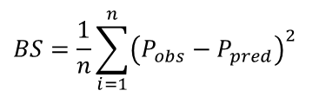
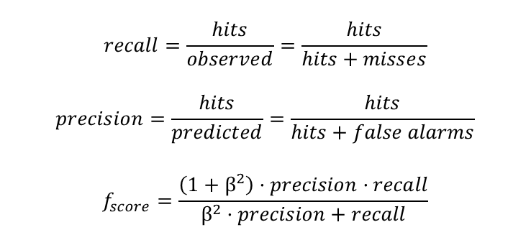
$$recall=\frac{hits}{observed}=\frac{hits}{hits+misses}$$
$$precision=\frac{hits}{predicted}=\frac{hits}{hits+false alarms}$$
$$f_{score}=\frac{\left(1+β^{2}\right)·precision·recall}{β^{2}·precision+recall}$$
$$BS=\frac{1}{n}\sum_{i=1}^{n}{{\left(P_{obs}−P_{pred}\right)}^{2}}$$

Slide 5
fold 1
fold 2
skill 1
skill 1
fold 3
fold 4
fold 5
fold 6
fold 7
fold 8
fold 9
fold 10
test set

