Slide 1
Introduction
In a first approach, I looked at the skill in predicting the onset of the flood events. Even when accepting a buffer of a few timesteps (up to ±12 h), the figures were rather low because the task of finding the time of the onset is very tough.
In this previous analysis the data was organized in a matrix with dimensions forecast and leadtime (left panel). Flood events were located in a diagonal (blue cells).
Drawbacks:
It generates for each flood event 20 possible hits/misses/false alarms (2 forecast a day by 10 days leadtime).
On top of that, there’s the issue that stations without observed events may mask the results, since their precision can only be 0 or NaN.
Instead, here I will try to answer to the question: were flood events predicted at any moment in time? To do so, I have to reshape all the data that I had pre-processed.
To simplify computation, I’ve reshaped the data into a matrix were date-time is one dimension and leadtime is another dimension (right panel).
Benefits:
Easier computing because now a flood event is aligned in a column.
Drawbacks:
Resolution reduces to 12 h, because that’s the frequency of the forecasts. Every datetime is forecasted 20 times (2 forecast per day for 10 days).
There are empty values in the lower-left and upper-right corner of the matrix.
leadtime
1 d | 2 d | 3 d | 4 d | 5 d | 6 d | 7 d | 8d | 9 d | 10 d
datetime
15-Nov | 16-Nov | 17-Nov | 18-Nov | 19-Nov | 20-Nov | 21-Nov | 22-Nov | 23-Nov | 24-Nov | 25-Nov | 26-Nov | 27-Nov | 28-Nov
forecast | 15-Nov 00:00
 | 17-Nov 00:00
 | 19-Nov 00:00
 | 21-Nov 00:00
 | 23-Nov 00:00
leadtime | 48 h
 | 96 h
 | 144 h
 | 192 h
 | 240 h

Slide 2
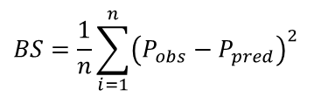
Probabilistic skill
The Brier score (BS) is a metric that measures the accuracy of probabilistic predictions.
It’s the mean squared error between observed and predicted probabilities:
Procedure for each station and meteorological forcing:
Vector with the observed events (timesteps that exceeded Q5). Probabilities are 0 or 1.
Matrix of predicted probabilities of exceeding the Q5.
Compute the Brier score for each leadtime.
$$BS=\frac{1}{n}\sum_{i=1}^{n}{{\left(P_{obs}−P_{pred}\right)}^{2}}$$
As an error metric, the optimal BS is 0.
datetime
15-Nov 00:00 |  |  |  | 16-Nov 00:00 |  |  |  | 17-Nov 00:00 |  |  |  | 18-Nov 00:00 |  |  |  | 19-Nov 00:00 |  |  |  | 20-Nov 00:00 |  |  |  | 21-Nov 00:00 |  |  |  | 22-Nov 00:00 |  |  |  | 23-Nov 00:00 |  |  |  | 24-Nov 00:00
Observed probabilities
(P_{obs})
0 | 0 | 0 | 0 | 0 | 0 | 0 | 0 | 0 | 0 | 0 | 1 | 1 | 0 | 0 | 0 | 0 | 0 | 0 | 0 | 0 | 0 | 0 | 0 | 0 | 0 | 1 | 1 | 1 | 0 | 0 | 0 | 0 | 0 | 0 | 0 | 0 | 0 | 0 | 0
Brier score
Leadime (h) | 12
 | 24
 | 36
 | 48
 | 60
 | 72
 | 84
 | 96
 | 108
 | 120
 |  |  |  |  |  |  |  |  |  |  |  |  | 0.3 |  |  |  |  |  |  |  |  |  |  |  |  | 0.6 | 0.9 | 0.9
 |  |  |  |  |  |  |  |  |  |  |  |  | 0.3 |  |  |  |  |  |  |  |  |  |  |  |  | 0.6 | 0.6
 |  |  |  |  |  |  |  |  |  |  |  |  | 0.3 |  |  |  |  |  |  |  |  |  |  |  |  | 0.6 | 0.6
 |  |  |  |  |  |  |  |  |  |  |  |  |  |  |  |  |  |  |  |  |  |  |  |  |  | 0.3 | 0.6
 |  |  |  |  |  |  |  |  |  |  |  |  |  |  |  |  |  |  |  |  |  |  |  |  | 0.3 | 0.3
 |  |  |  |  |  |  |  |  |  |  |  |  |  |  |  |  |  |  |  |  |  |  |  |  | 0.3 | 0.3
 |  |  |  |  |  |  |  |  |  |  |  |  |  |  |  |  |  |  |  |  |  |  |  |  | 0.1
0.07
0.11
0.11
0.12
0.15
0.15
0.16
0.16
0.16
0.16
Predicted probabilities
(P_{pred})

Slide 3
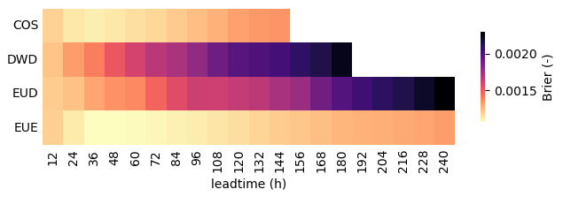
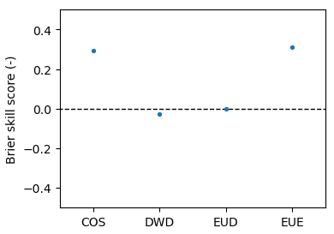
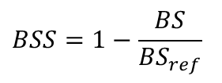
Applying the previous procedure to the predictions of each meteorological forcing and averaging over all the stations, we get a plot as that on the right. It shows the probabilistic skill of the predictions depending on the forcing and the leadtime.
The Brier skill score (BSS) is a metric based on the Brier score that compares the performance of a model against a benchmark model:
$$BSS=1−\frac{BS}{{BS}_{ref}}$$
Positive BSS represent models better than the reference, whereas negative values represent worse models.
When averaging over leadtime and taking the ECMWF deterministic as a reference, we get BSS values as those on the right.
COSMO-LEPS and ECMWF probabilistic rank clearly higher than the 2 deterministic models.

Slide 4










Criteria optimization
To optimize the notification criteria, the matrix of predicted probabilitiy must be converted into a boolean vector of event/non-event.
The procedure would be the following:
Define a probability threshold
Apply a buffer to allow for small lags in the prediction.
Create a vector of predicted events when any of the rows in the probability matrix exceeds the threshold
Compare against observed events.
Count true positives and compute false negatives and false positives.
datetime
15-Nov 00:00 |  |  |  | 16-Nov 00:00 |  |  |  | 17-Nov 00:00 |  |  |  | 18-Nov 00:00 |  |  |  | 19-Nov 00:00 |  |  |  | 20-Nov 00:00 |  |  |  | 21-Nov 00:00 |  |  |  | 22-Nov 00:00 |  |  |  | 23-Nov 00:00 |  |  |  | 24-Nov 00:00
 |  |  |  |  |  |  |  |  |  |  |  |  | 0.3 |  |  |  |  |  |  |  |  |  |  |  |  | 0.6 | 0.9 | 0.9
 |  |  |  |  |  |  |  |  |  |  |  |  | 0.3 |  |  |  |  |  |  |  |  |  |  |  |  | 0.6 | 0.6
 |  |  |  |  |  |  |  |  |  |  |  |  | 0.3 |  |  |  |  |  |  |  |  |  |  |  |  | 0.6 | 0.6
 |  |  |  |  |  |  |  |  |  |  |  |  |  |  |  |  |  |  |  |  |  |  |  |  |  | 0.3 | 0.6
 |  |  |  |  |  |  |  |  |  |  |  |  |  |  |  |  |  |  |  |  |  |  |  |  | 0.3 | 0.3
 |  |  |  |  |  |  |  |  |  |  |  |  |  |  |  |  |  |  |  |  |  |  |  |  | 0.3 | 0.3
 |  |  |  |  |  |  |  |  |  |  |  |  |  |  |  |  |  |  |  |  |  |  |  |  | 0.1
 |  |  |  |  |  |  |  |  |  |  |  |  | 0.3 |  |  |  |  |  |  |  |  |  |  |  |  | 0.6 | 0.9 | 0.9
 |  |  |  |  |  |  |  |  |  |  |  |  | 0.3 |  |  |  |  |  |  |  |  |  |  |  |  | 0.6 | 0.6
 |  |  |  |  |  |  |  |  |  |  |  |  | 0.3 |  |  |  |  |  |  |  |  |  |  |  |  | 0.6 | 0.6
 |  |  |  |  |  |  |  |  |  |  |  |  |  |  |  |  |  |  |  |  |  |  |  |  |  | 0.3 | 0.6
 |  |  |  |  |  |  |  |  |  |  |  |  |  |  |  |  |  |  |  |  |  |  |  |  | 0.3 | 0.3
 |  |  |  |  |  |  |  |  |  |  |  |  |  |  |  |  |  |  |  |  |  |  |  |  | 0.3 | 0.3
 |  |  |  |  |  |  |  |  |  |  |  |  |  |  |  |  |  |  |  |  |  |  |  |  | 0.1
Leadime (h) | 12
 | 24
 | 36
 | 48
 | 60
 | 72
 | 84
 | 96
 | 108
 | 120
$$P_{threshold}=0.3$$
 |  |  |  |  |  |  |  |  |  |  |  |  | 0.3 |  |  |  |  |  |  |  |  |  |  |  |  | 0.6 | 0.9 | 0.9
 |  |  |  |  |  |  |  |  |  |  |  |  | 0.3 |  |  |  |  |  |  |  |  |  |  |  |  | 0.6 | 0.6
 |  |  |  |  |  |  |  |  |  |  |  |  | 0.3 |  |  |  |  |  |  |  |  |  |  |  |  | 0.6 | 0.6
 |  |  |  |  |  |  |  |  |  |  |  |  |  |  |  |  |  |  |  |  |  |  |  |  |  | 0.3 | 0.6
 |  |  |  |  |  |  |  |  |  |  |  |  |  |  |  |  |  |  |  |  |  |  |  |  | 0.3 | 0.3
 |  |  |  |  |  |  |  |  |  |  |  |  |  |  |  |  |  |  |  |  |  |  |  |  | 0.3 | 0.3
 |  |  |  |  |  |  |  |  |  |  |  |  |  |  |  |  |  |  |  |  |  |  |  |  | 0.1
$$P_{threshold}=0.5$$
Predicted
probabilities
Predicted events
$$E_{pred}=1$$
$$E_{pred}=2$$
Buffered predicted events
Observed events
$$E_{obs}=2$$
$$FN=E_{obs}−TP=1$$
$$FP=E_{pred}−TP=0$$
$$TP=1$$
$$FN=E_{obs}−TP=0$$
$$TP=2$$

Slide 5
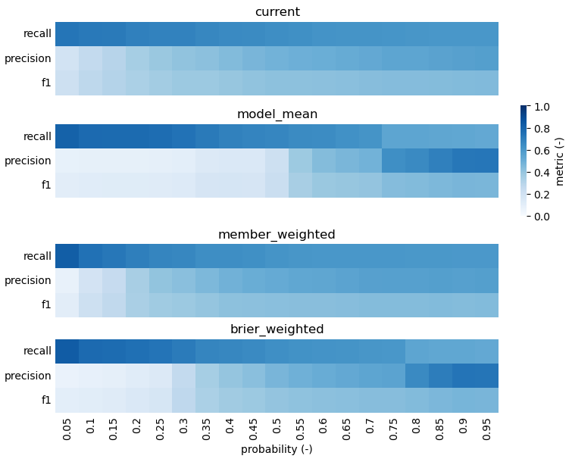
Applying the previous procedure to different methods of computing total probability and averaging over all the stations, we get a plot as that on the right:
Current stands for the current notification criteria.
Model_mean stands for a mean over forcings giving equal weight to each forcing.
Member_weighted is a mean in which every forcing gets a weight relative to the number of members it contains.
Brier_weighted is a mean in which every forcing gets a weight relative to the Brier score we saw in a previous slide.
The highest f1 score is very similar among the 4 methods (0.44-0.47) and it’s always relative to high probability thresholds (0.9 or 0.95).
The best f1 score is achieved by the brier_weighted method and the probability threshold 0.9 (f1 = 0.472).

Slide 6
Pending work
Apply the metric PR-AUC (area under the curve precision-recall).
Include the persistence criterium.
…

