Slide 1
EFAS notification skill assessment
16th February 2023

Slide 2
Objective of the working group
The objective is to assess if the formal notification criteria can be improved to optimize the skill of EFAS notifications.
EFAS formal notifications criteria
Catchment part of Condition of Access
Probabilistic forecasts: ECMWF-ENS or COSMO-LEPS
Probability of exceeding Q5 ≥ 30%
Persistence: 3 consecutive forecast
Deterministic forecasts: ECMWF or DWD
At least one of them exceeds Q5
Catchment area ≥ 2000 km²
Lead time ≥ 48 h
Research questions
Total probability
How should total probability be calculated?
What’s the total probability threshold that optimizes skill?
Is persistence a valuable criteria? Should it be revised?
Can the catchment area threshold be reduced?

Slide 3
Data
Geographical extent
The analysis will focus on those fixed reporting points that have a contributing area larger than 500 km².
Temporal extent
The period of analysis is from October 2020 till present, that for which EFAS v4.0 water balance and forecast is available.
Discharge data
Observed: we will use EFAS v4.0 water balance as a proxy of observed data.
Predicted: EFAS v4.0 reforecast for the 4 meteorological forcings (ECMWF-ENS, COSMO-LEPS, ECMWF, DWD).
Discharge asociated with the 5-year return period.

Slide 4
Methods
1 Preanalysis
1.1 Identify observed events
Apply the discharge threshold criteria to the observed discharge to estimate the number of flood events that took place during the last 2 year.
datetime
0 | 0 | 0 | 0 | 0 | 0 | 0 | 0 | 0 | 0 | 0 | 1 | 1 | 0 | 0 | 0 | 0 | 0 | 0 | 0 | 0 | 0 | 0 | 0 | 0 | 0 | 1 | 1 | 1 | 0 | 0 | 0 | 0 | 0 | 0 | 0 | 0 | 0 | 0 | 0
Station X
1.2 Identify predicted events
Apply the discharge threshold criteria to the forecasted discharge to estimate the exceedance probability for each meteorological forcing.
Criteria to define an event:
Total probability
Probability threshold
Persistence
Time windows
datetime
 |  |  |  |  |  |  |  |  |  |  |  |  | 0.3 |  |  |  |  |  |  |  |  |  |  |  |  | 0.6 | 0.9 | 0.9
 |  |  |  |  |  |  |  |  |  |  |  |  | 0.3 |  |  |  |  |  |  |  |  |  |  |  |  | 0.6 | 0.6
 |  |  |  |  |  |  |  |  |  |  |  |  | 0.3 |  |  |  |  |  |  |  |  |  |  |  |  | 0.6 | 0.6
 |  |  |  |  |  |  |  |  |  |  |  |  |  |  |  |  |  |  |  |  |  |  |  |  |  | 0.3 | 0.6
 |  |  |  |  |  |  |  |  |  |  |  |  |  |  |  |  |  |  |  |  |  |  |  |  | 0.3 | 0.3
 |  |  |  |  |  |  |  |  |  |  |  |  |  |  |  |  |  |  |  |  |  |  |  |  | 0.3 | 0.3
 |  |  |  |  |  |  |  |  |  |  |  |  |  |  |  |  |  |  |  |  |  |  |  |  | 0.1
Leadime
Station X & meteo forcing Y

Slide 5
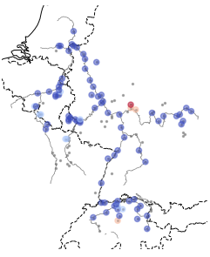

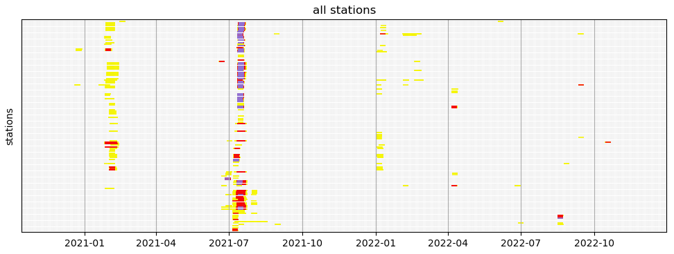
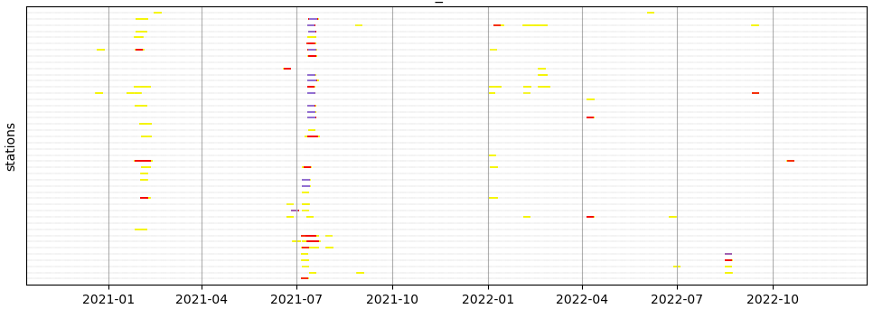
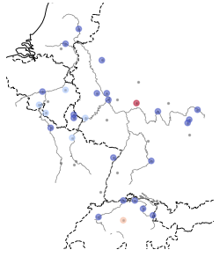
Methods
1 Preanalysis
1.3 Selection of stations
There is a high correlation in the flood events between fixed reporting points in a catchment.
If we do not remove this correlation, we would be analysing the same flood event multiple times.
Procedure for each catchment:
Sort stations from downstream-upstream, and by the number of observed events.
Remove stations with a Spearman correlation coefficient higher than 0.9. Priority is given to stations with observed events and downstream.

Slide 6
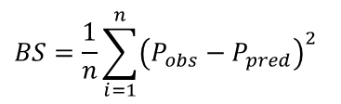
Methods
2 Analysis
2.1 Probabilistic point of view
The Brier score is a metric that would allow us to make use of the probabilistic nature of EFAS forecasts.
$$BS=\frac{1}{n}\sum_{i=1}^{n}{{\left(P_{obs}−P_{pred}\right)}^{2}}$$
datetime
15-Nov 00:00 |  |  |  | 16-Nov 00:00 |  |  |  | 17-Nov 00:00 |  |  |  | 18-Nov 00:00 |  |  |  | 19-Nov 00:00 |  |  |  | 20-Nov 00:00 |  |  |  | 21-Nov 00:00 |  |  |  | 22-Nov 00:00 |  |  |  | 23-Nov 00:00 |  |  |  | 24-Nov 00:00
Observed (P_{obs})
0 | 0 | 0 | 0 | 0 | 0 | 0 | 0 | 0 | 0 | 0 | 1 | 1 | 0 | 0 | 0 | 0 | 0 | 0 | 0 | 0 | 0 | 0 | 0 | 0 | 0 | 1 | 1 | 1 | 0 | 0 | 0 | 0 | 0 | 0 | 0 | 0 | 0 | 0 | 0
Brier score
Leadime (h) | 12
 | 24
 | 36
 | 48
 | 60
 | 72
 | 84
 | 96
 | 108
 | 120
 |  |  |  |  |  |  |  |  |  |  |  |  | 0.3 |  |  |  |  |  |  |  |  |  |  |  |  | 0.6 | 0.9 | 0.9
 |  |  |  |  |  |  |  |  |  |  |  |  | 0.3 |  |  |  |  |  |  |  |  |  |  |  |  | 0.6 | 0.6
 |  |  |  |  |  |  |  |  |  |  |  |  | 0.3 |  |  |  |  |  |  |  |  |  |  |  |  | 0.6 | 0.6
 |  |  |  |  |  |  |  |  |  |  |  |  |  |  |  |  |  |  |  |  |  |  |  |  |  | 0.3 | 0.6
 |  |  |  |  |  |  |  |  |  |  |  |  |  |  |  |  |  |  |  |  |  |  |  |  | 0.3 | 0.3
 |  |  |  |  |  |  |  |  |  |  |  |  |  |  |  |  |  |  |  |  |  |  |  |  | 0.3 | 0.3
 |  |  |  |  |  |  |  |  |  |  |  |  |  |  |  |  |  |  |  |  |  |  |  |  | 0.1
0.07
0.11
0.11
0.12
0.15
0.15
0.16
0.16
0.16
0.16
Predicted
(P_{pred})

Slide 7

Methods
2 Analysis
2.2 Deterministic point of view
By applying notification criteria (probability threshold, persistence...) we convert the probabilistic EFAS forecast into an imbalanced binary classification problem.
What do we consider a good forecast?
Is the first event a hit? Or a miss and a false alarm, instead?
Are we looking at the «exact» time of the onset, or we are looking at the whole exceeding period?
 | datetime
leadtime |  |  |  |  |  |  |  |  |  |  |  |  |  | 0.3 |  |  |  |  |  |  |  |  |  |  |  |  | 0.6 | 0.9 | 0.9
 |  |  |  |  |  |  |  |  |  |  |  |  |  | 0.3 |  |  |  |  |  |  |  |  |  |  |  |  | 0.6 | 0.6
 |  |  |  |  |  |  |  |  |  |  |  |  |  | 0.3 |  |  |  |  |  |  |  |  |  |  |  |  | 0.6 | 0.6
 |  |  |  |  |  |  |  |  |  |  |  |  |  |  |  |  |  |  |  |  |  |  |  |  |  |  | 0.3 | 0.6
 |  |  |  |  |  |  |  |  |  |  |  |  |  |  |  |  |  |  |  |  |  |  |  |  |  | 0.3 | 0.3
 |  |  |  |  |  |  |  |  |  |  |  |  |  |  |  |  |  |  |  |  |  |  |  |  |  | 0.3 | 0.3
 |  |  |  |  |  |  |  |  |  |  |  |  |  |  |  |  |  |  |  |  |  |  |  |  |  | 0.1
 | datetime
leadtime |  |  |  |  |  |  |  |  |  |  |  |  |  | 0.3 |  |  |  |  |  |  |  |  |  |  |  |  | 0.6 | 0.9 | 0.9
 |  |  |  |  |  |  |  |  |  |  |  |  |  | 0.3 |  |  |  |  |  |  |  |  |  |  |  |  | 0.6 | 0.6
 |  |  |  |  |  |  |  |  |  |  |  |  |  | 0.3 |  |  |  |  |  |  |  |  |  |  |  |  | 0.6 | 0.6
 |  |  |  |  |  |  |  |  |  |  |  |  |  |  |  |  |  |  |  |  |  |  |  |  |  |  | 0.3 | 0.6
 |  |  |  |  |  |  |  |  |  |  |  |  |  |  |  |  |  |  |  |  |  |  |  |  |  | 0.3 | 0.3
 |  |  |  |  |  |  |  |  |  |  |  |  |  |  |  |  |  |  |  |  |  |  |  |  |  | 0.3 | 0.3
 |  |  |  |  |  |  |  |  |  |  |  |  |  |  |  |  |  |  |  |  |  |  |  |  |  | 0.1
$$P_{threshold}=0.3$$
$$Persistence=3$$
Predicted events
Observed events
Notes:
$$Hansen−Kuipers=\frac{TP}{\sum{N}}−\frac{TP}{FP+TN}$$

Slide 8
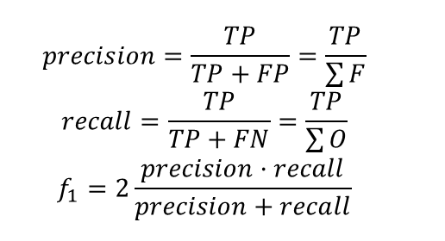
Methods
2 Analysis
2.2 Deterministic point of view
Metrics for imbalanced binary classification:
PR-AUC
 |  | Forecast
 |  | Notified | Non-notified
Observed | Flood | TP | FN | ∑O
 | Non-flood | FP | TN? | ?
 |  | ∑F | ?
$$precision=\frac{TP}{TP+FP}=\frac{TP}{\sum{F}}$$
$$recall=\frac{TP}{TP+FN}=\frac{TP}{\sum{O}}$$
$$f_{1}=2\frac{precision·recall}{precision+recall}$$
Predicted events
Observed events
Notes:
$$Hansen−Kuipers=\frac{TP}{\sum{N}}−\frac{TP}{FP+TN}$$

Slide 9
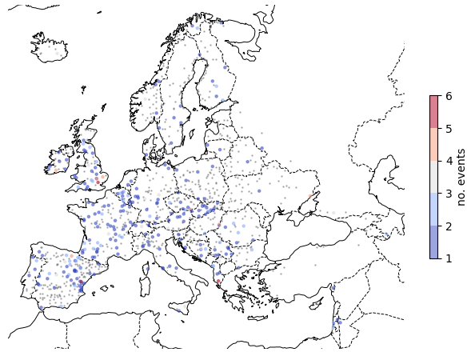
Preliminary results
Selection of reporting points and number of events
There remain 1039 fixed reporting points after removing highly correlated points (out of the original number 2219).
There were «observed» flood events in 275 of those points.
There were 392 «observed» flood events during the study period

Slide 10
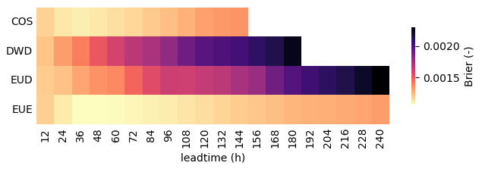
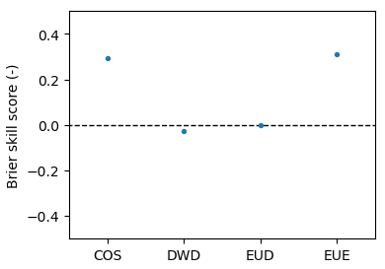
Preliminary results
Probabilistic approach
These preliminary results correspond to the forecast data for 2021
Probabilistic forcings have higher skill compared with deterministic.
As expected, skill decreases with increasing leadtime.
This skill matrix can be used as the weighing factor to compute total probability.

Slide 11
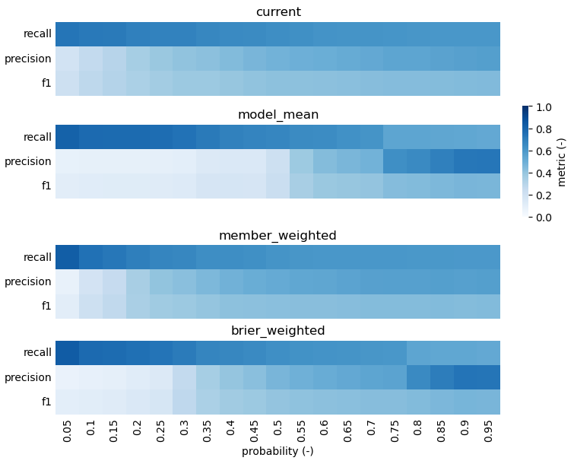
Preliminary results
Deterministic approach
Were flood events predicted at any point in time?
Example of the results we are looking for.
Best performing model (f1 = 0.451):
Brier weighted
Probability threshold: 90%

Slide 12
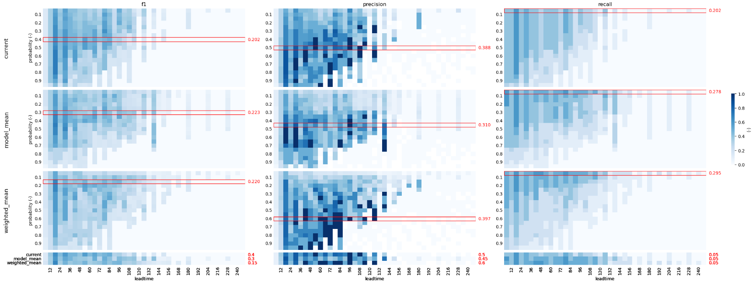
Preliminary results
Deterministic approach
Was the onset of flood events accurately predicted?
Plot represents only the Ebro!!

Slide 13
References
Bartholmes, J.C., Thielen, J., Ramos, M.H., Gentilini, S. The european flood alert system EFAS – Part 2: statistical skill assessment of probabilistic and deterministic operational forecasts. Hydrology and Earth System Sciences, 13, 141-153, 2009.
Cloke, H.L., Pappenberger, F., Smith, P.J., Wetterhall, F. How do I know if I’ve improved my continental scale flood early warning system? Environmental Research Letters, 12 (2017)
EFAS v4.0 ERIC flash flood forecast
EFAS v4.0 medium range forecast
EFAS v4.1 ERIC flass flood forecast
Hall, L. Integrating measures of model performance and forecast skill into European Flood Awareness System (EFAS) notifications. Master thesis, University Utrecht (2021)
Pappenberger, F., Ramos, M.H., Cloke, H.L., Wetterhall, F., Alfieri, L., Bogner, K., Mueller, A., Salamon. P. How do I know if my forecasts are better? Using benchmarks in hydrological ensemble prediction. Journal of Hydrology, 522, 687-713 (2015)
Ramos, M.H., Bartholmes, J., Thielen-del Pozo, J. Development of decision support products based on ensemble forecasts in the European flood alert system. Atmosferic Science Letters 8: 113-119 (2007)
Simon, L., Webster, R., Rabin, J. Revisiting precision and recall definition for generative model evaluation. 36° International Conference on Machine Learning (2019)
Skoien, J.O., Bogner, K., Salamon, R., Wetterhall, F. On the implementation of postprocessing of runoff forecast ensembles. Journal of Hydrometeorology, 22 (2021)
Thielen, J., Bogner, K., Pappenberger, F., Kalas, M., del Medico, M., de Roo, A. Monthly-, medium-, and short-range flood warning: testing the limits of predictability. Meteorological Applications: 77-90 (2009)

