Slide 1


Deep learning in LISFLOOD
LISFLOOD
Google Flood Hub
Calibration of hydrological models
Parameter learning
Jesús Casado Rodríguez
JRC-E1
28.02.2024

Slide 2
Parameter learning
LISFLOOD-OS
Reservoirs
General idea
To utilize the power of deep learning in the calibration of process-based hydrological models.
It merges model calibration and parameter regionalization into a single modelling chain that leverages the computation power and learning capacity of deep learning.
meteo
attributes
hydrological model
Q_{sim}
Q_{obs}
LF
parameters
input
model
output
back propagation
The hydrological model must backpropagate gradients:
Differentiable model
Surrogate
Notes:
To main ideas:
What we train is the transfer function from catchment attributes to model parameters.
Several basins are trained simultaneously, instead of one basin at a time.
Advantages:
Computation time
Generalization

Slide 3
Parameter learning
LISFLOOD-OS
Reservoirs
The plan
Create a surrogate of LISFLOOD-OS that replicates its discharge simulations
Implement a parameter learning framework on top of that surrogate model
Data
We have started working on the 739 headwater catchments used in GloFASV4 regionalization:
Static maps
Meteorological forcings
Observed discharge at the outlet
Pairs of model parameter sets and simulated discharge
Optimal parameter set + discharge of the GloFAS long run
Parameter sets in the calibration + modified KGE

Slide 4
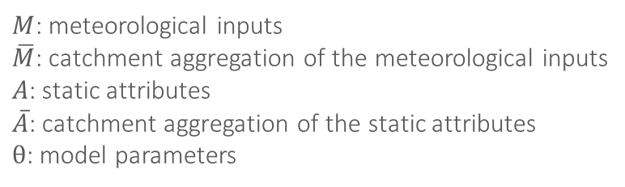






Parameter learning
LISFLOOD-OS
Reservoirs
Surrogate model
LISFLOOD-OS
$$M$$
$$A$$
$$Q_{sim,PB}$$
θ
$M$: meteorological inputs
$\overline{M}$: catchment aggregation of the meteorological inputs
$A$: static attributes
$\overline{A}$: catchment aggregation of the static attributes
$θ$: model parameters
training
surrogate
$$\overline{M}$$
$$\overline{A}$$
$$Q_{sim,DL}$$
θ
input
model
output

Slide 5
Parameter learning
LISFLOOD-OS
Reservoirs
Challenges
Apply parameter learning in a spatially distributed model
Extract from the static and dynamic maps the relevant information
Patching
Vision transformers
Include human intervention on natural catchments: reservoirs, water abstraction, irrigation...
How to include inflows?

Slide 6
Parameter learning
LISFLOOD-OS
Reservoirs
General idea
To investigate the potential use of deep learning to improve reservoir simulations in LISFLOOD-OS.
A data-driven model (LSTM, transformer…) able to reproduce operations of multiple reservoirs.
A process-based routine in a differentiable platform (PyTorch) and apply parameter learning.
Current LISFLOOD routine (Burek, 2013)
Hanazaki (2022)
Shin (2019), Sadki (2023), Shrestha (2024)

Slide 7
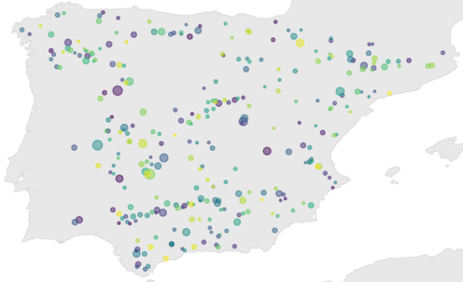
Parameter learning
LISFLOOD-OS
Reservoirs
Dataset
A new dataset of reservoirs operations in Spain including 292 reservoirs.
Daily time series:
Observed reservoir storage, level (and outflow) from CEDEX, ACA and Hidrosur
Simulated inflow from EFAS5 long-run
Meteorology from EMO1 (evaporation, temperature, precipitation)
The study period is at most from Jan-1990 to Sep-2020
Normalized by reservoir capacity
Attributes:
Reservoir and dam characteristics from Spanish Ministry of the Environment, ICOLD, GRanD
Catchment characteristics from EFAS5 static maps
Catchment meteorology from EMO1
Available in BDAP: /eos/jeodpp/projects/FLOODS-RIVER/LisfloodPL/reservoirs/ResOpsES/

Slide 8
Parameter learning
LISFLOOD-OS
Reservoirs
Long-Short Term Memory
Train a LSTM capable of reproducing reservoir operations for the complete dataset:
Target:
Storage
Outflow
Storage and outflow
T
P
E
Dynamic inputs:
Reservoir inflow
Precipitation/evaporation to/from the reservoir
Catchment average temperature
Year, month, day of the week
Q_{in}
S
Q_{out}
Static inputs:
Reservoir characteristics: maximum area and storage, dam height, elevation, coordinates
Catchment characteristics: area
Regulation indices

Slide 9
Parameter learning
LISFLOOD-OS
Reservoirs
Long-Short Term Memory
inp_{dyn}
emb_{dyn}
LSTM
sim
obs
inp_{stat}
emb_{stat}
input
model
output

Slide 10
Parameter learning
LISFLOOD-OS
Reservoirs
Differentiable routine + parameter learning
Write a process-based reservoir routine in a differentiable platform (PyTorch) and apply parameter learning.
inp_{dyn}
inp_{stat}
different. reservoir routine
sim
obs
parameters
input
model
output

