Slide 1
Reservoirs, lakes and wetlands
Add lakes and reservoirs
Improve the reservoir simulation
Add wetlands in the model simulation

Slide 2
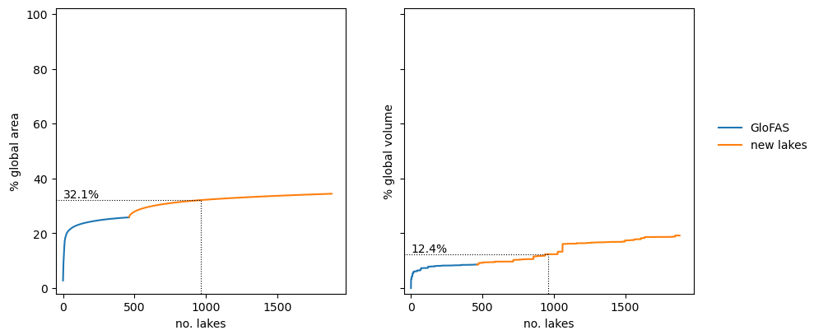
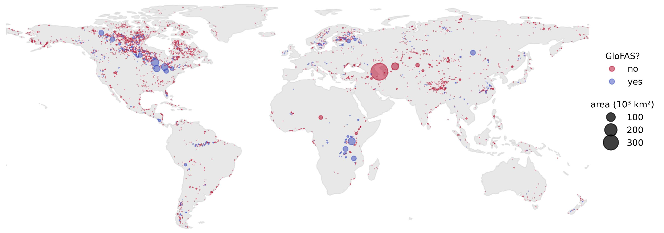
1. Add lakes and reservoirs
Lakes
GLWD
Source | Number of lakes | Total area (10⁶ km²) | Condition
HydroLakes | 1.4 ∙ 10⁶ | 2.927
GLWD | 3067 | 1.685 (58%)
GloFAS4 | 463 | 0.755 (26%) | A > 50 km²
GloFAS5 | 963 | 0.939 (32%) | A > 50 km² catchment > 1,000 km²

Slide 3
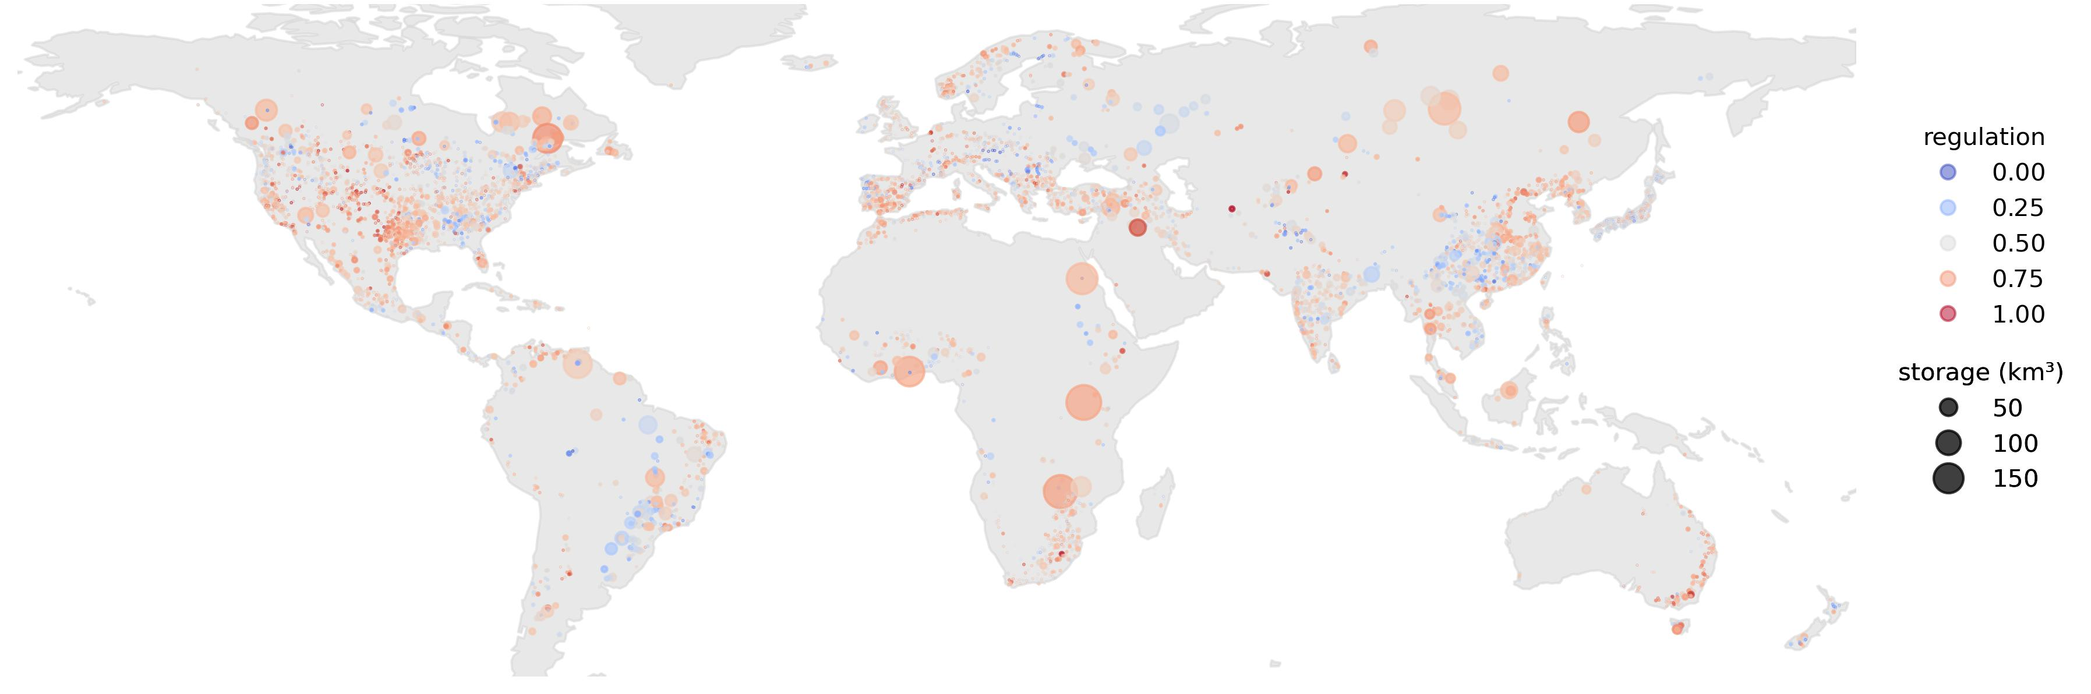
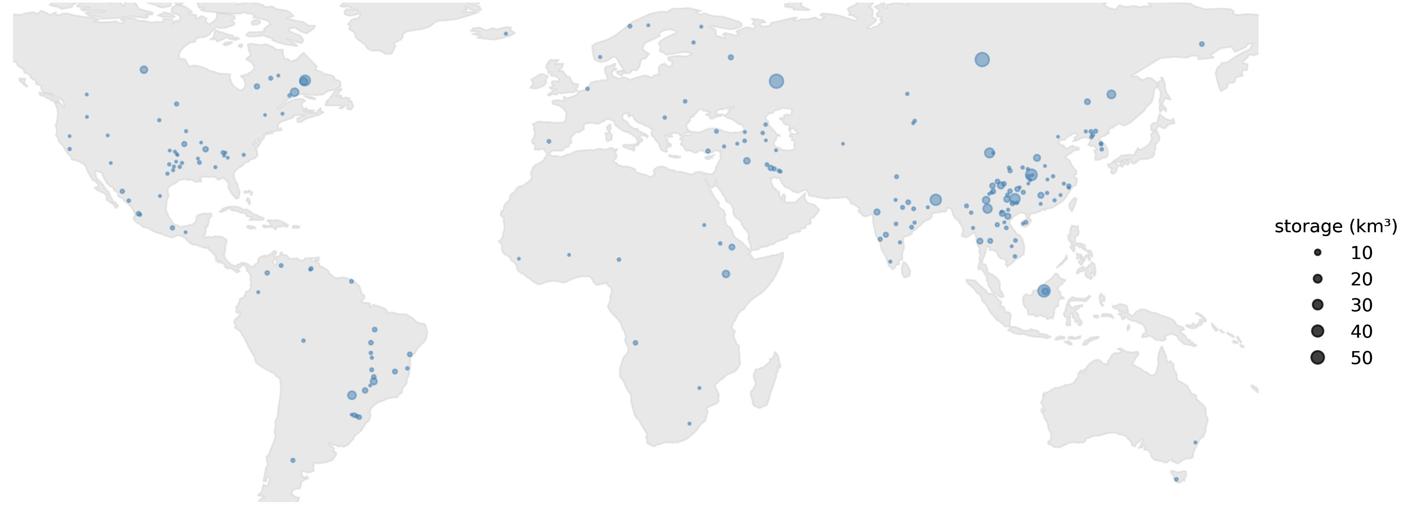
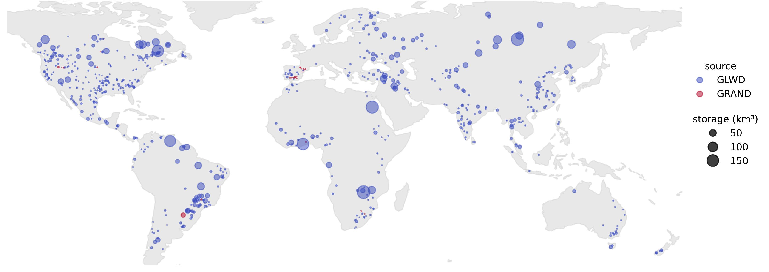
1. Add lakes and reservoirs
Reservoirs
GRanD
GRanD – to be added in GloFAS5
GloFAS
Source | Number | Total volume (km³) | Condition
GOODD | 38,000 | 7,000-8,300
GLWD | 654 | 4,615 (60%)
GRanD | 7,320 | 6,881 (90%)
GloFAS4 | 685 | 4,588 (60%) | V > 0.1 km³
GloFAS5 | 890 | 5,726 (80%) | V > 0.1 km³
Different reservoir capacity in GLWD and GRanD
650
35
205

Slide 4
2. Reservoir simulation
Current routine
Q_{f}
Different from Burek 2013
3 default parameters
Limited flood regulation
No seasonality
No reservoir use
k=1.2
outflow
Q_{n}
b
Q_{min}
V_{c}
V_{n}
V_{n}’
V_{f}
storage
inflow
a

Slide 5
2. Reservoir simulation
Current routine
Q_{f}
Κ=1.2
Different from Burek 2013
3 default parameters
Limited flood regulation
No seasonality
No reservoir use
1
outflow
Q_{n}’
b
Q_{n}
Q_{c}
V_{c}
V_{n}
V_{n}’
V_{f}
storage
inflow
a

Slide 6
2. Reservoir simulation
Current routine
Q_{f}
κ
Different from Burek 2013
3 default parameters
Limited flood regulation
No seasonality
No reservoir use
1
outflow
Q_{n}
γ
Q_{c}
V_{c}
V_{n}
V_{n}’
V_{f}
storage
inflow
α
β

Slide 7
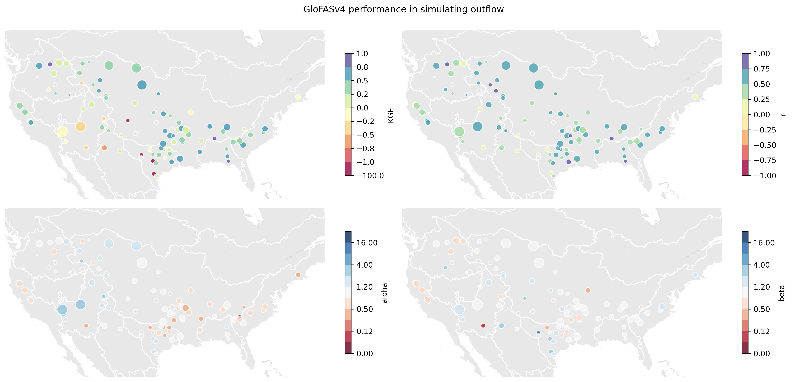
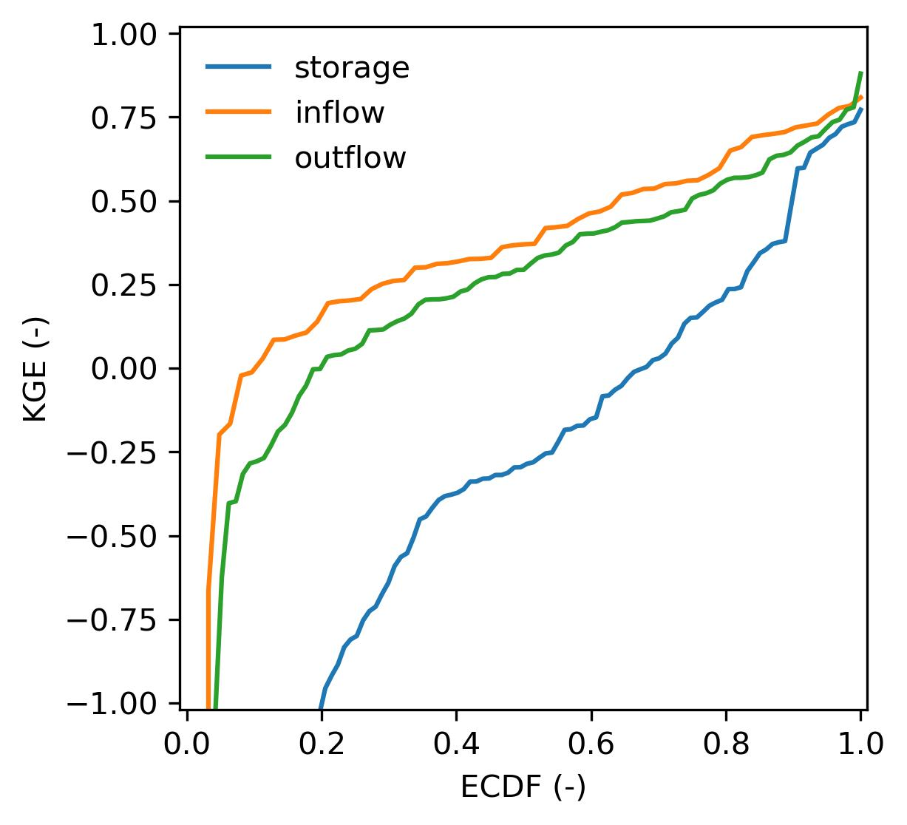
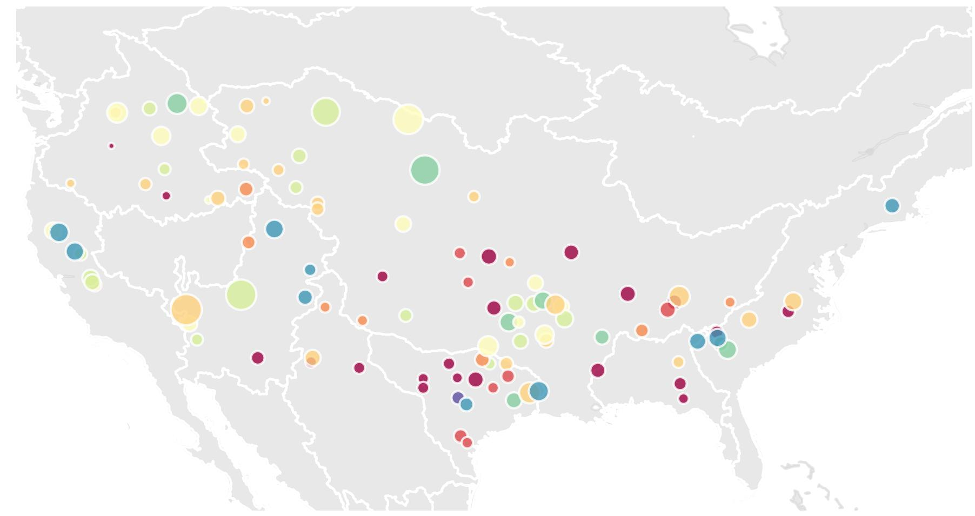
2. Reservoir simulation
Other data sources?
Spain
Norway
Japan
Performance GloFAS4
Observed records: ResOpsUS
outflow
storage

Slide 8
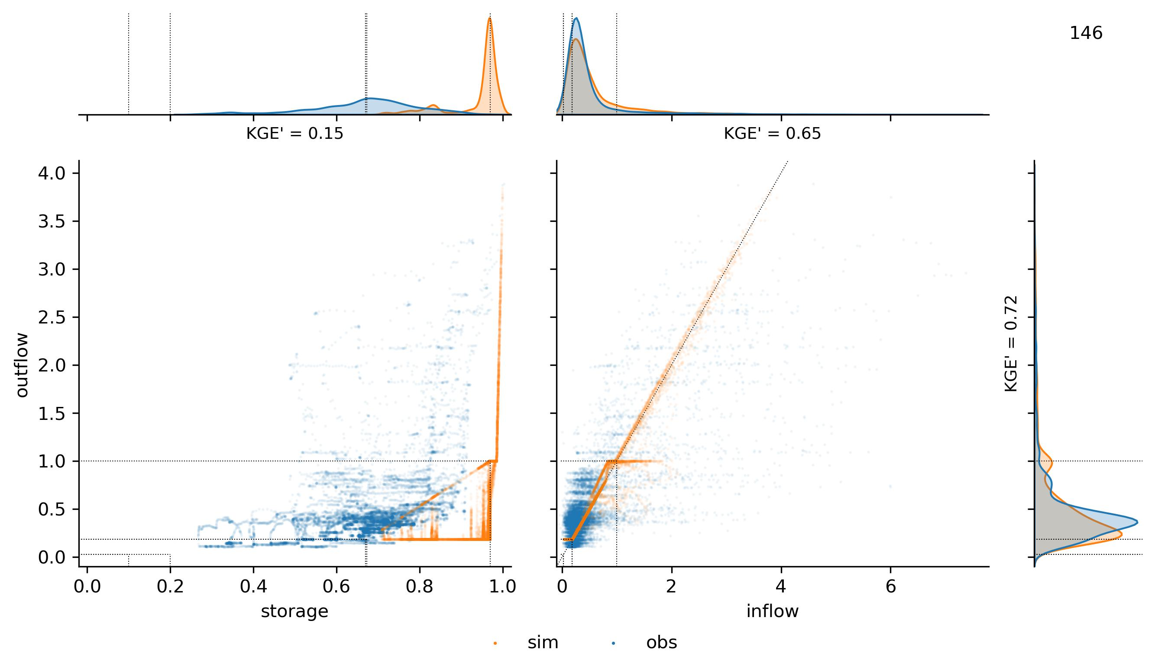
2. Reservoir simulation
An example: the Boysen Reservoir (Mississippi)
tendency to fill up
Q
inflow
outflow
non-calibrated
t
no flood
regulation
k = 1.2?

Slide 9
2. Reservoir simulation
Following steps:
Estimate parameters based on observed data.
Bivariable calibration: storage & outflow.
Regionalization of parameters based on reservoir use
Test the evolution of Burek 2013 by Hanazaki et al. (2022)
Test the approach to seasonality by Turner et al. (2021)
Deep learning? Ramos-Oliveira et al. (2023), Liu et al. (2019)

