Slide 1
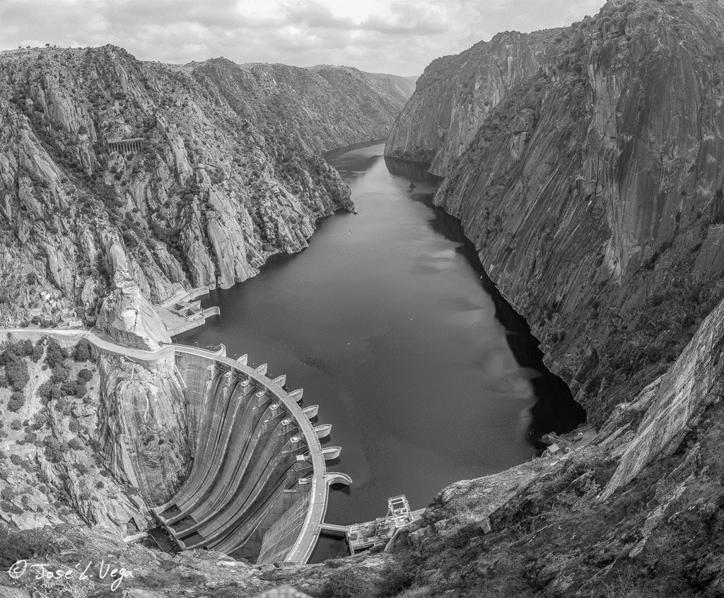


Reservoirs in LISFLOOD
Data
Reservoir simulation
2.1 Current routine
2.2 Other approaches
Jesús Casado Rodríguez
JRC-E1

Slide 2
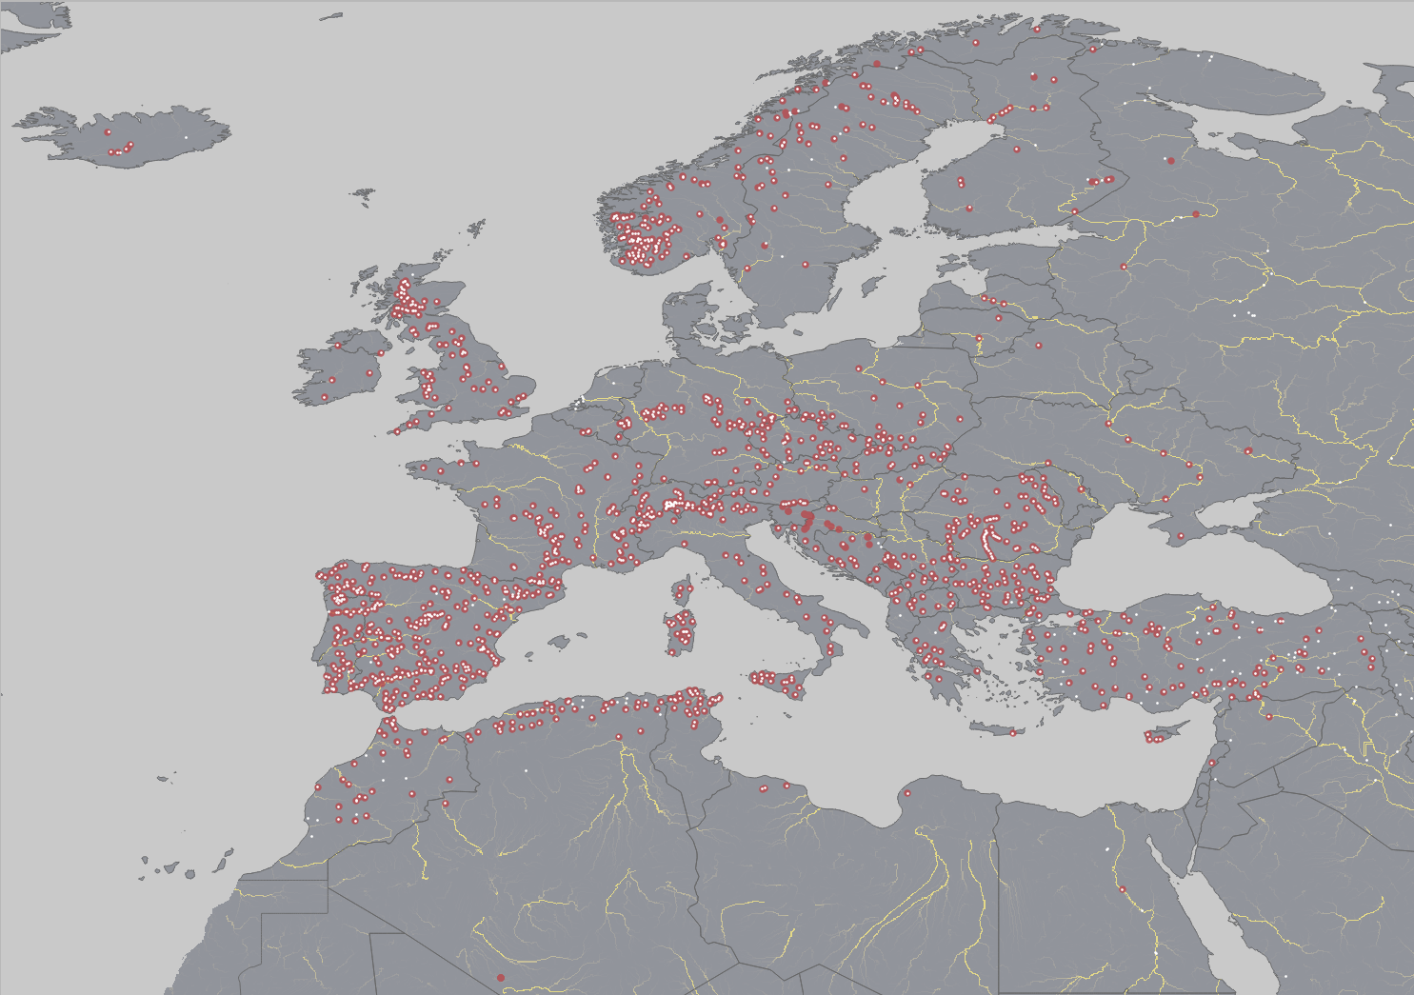
1. Data
Reservoir attributes
EFAS5 includes 1423 reservoirs (121 in Norway)
Very few reservoirs from GRanD are missing
D2 will get the ICOLD data set

Slide 3
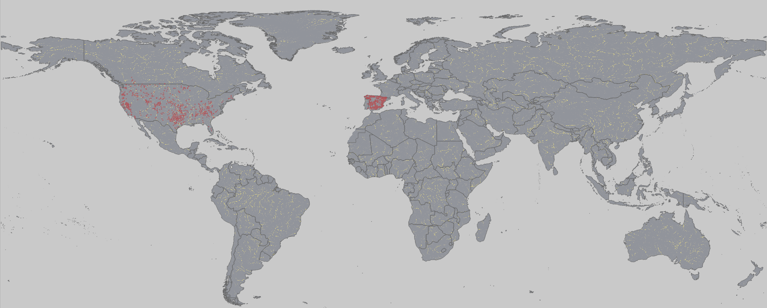
1. Data
Reservoir time series
Required to improve the reservoir routine
ResOpsUS:
679 major reservoirs in the US
Daily time series: inflow, storage, outflow, evaporation
Anuario de Aforos de España:
394 reservoirs in Spain
Daily time series: storage, outflow
EFAS Hydrological Data Collection Centre: Sava
D2 has contacted possible colaborators
Is the data in Norway available?

Slide 4
2. Reservoir simulation
Current routine
Different from Burek 2013
Parameters:
3 default (storage)
2 reservoir-specific (outflow)
2 calibrated
No seasonality
No reservoir use
Q_{f}
κ=1.2
1
outflow
Q_{n}’
Q_{c}
V_{c}
V_{n}
V_{n}’
V_{f}
storage
inflow

Slide 5
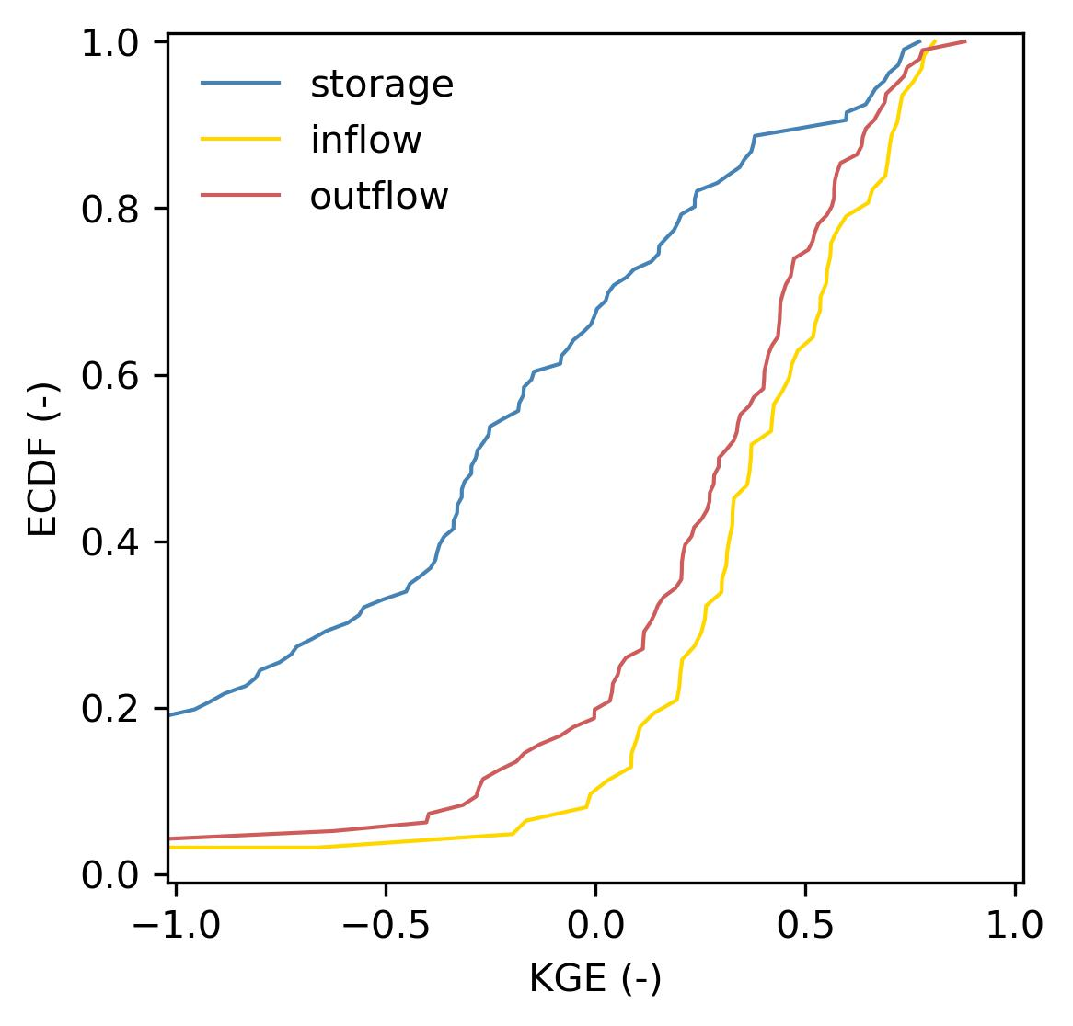

2. Reservoir simulation
: GloFAS4 performance
Current routine
Comparison of the simulated and observed time series for 121 reservoirs
The performance in terms of outflow is fairly good given the errors imposed by the inflow
The main issue is the performance in terms of storage
github.com/casadoj/LF_water_bodies/docs/performance_US.md

Slide 6
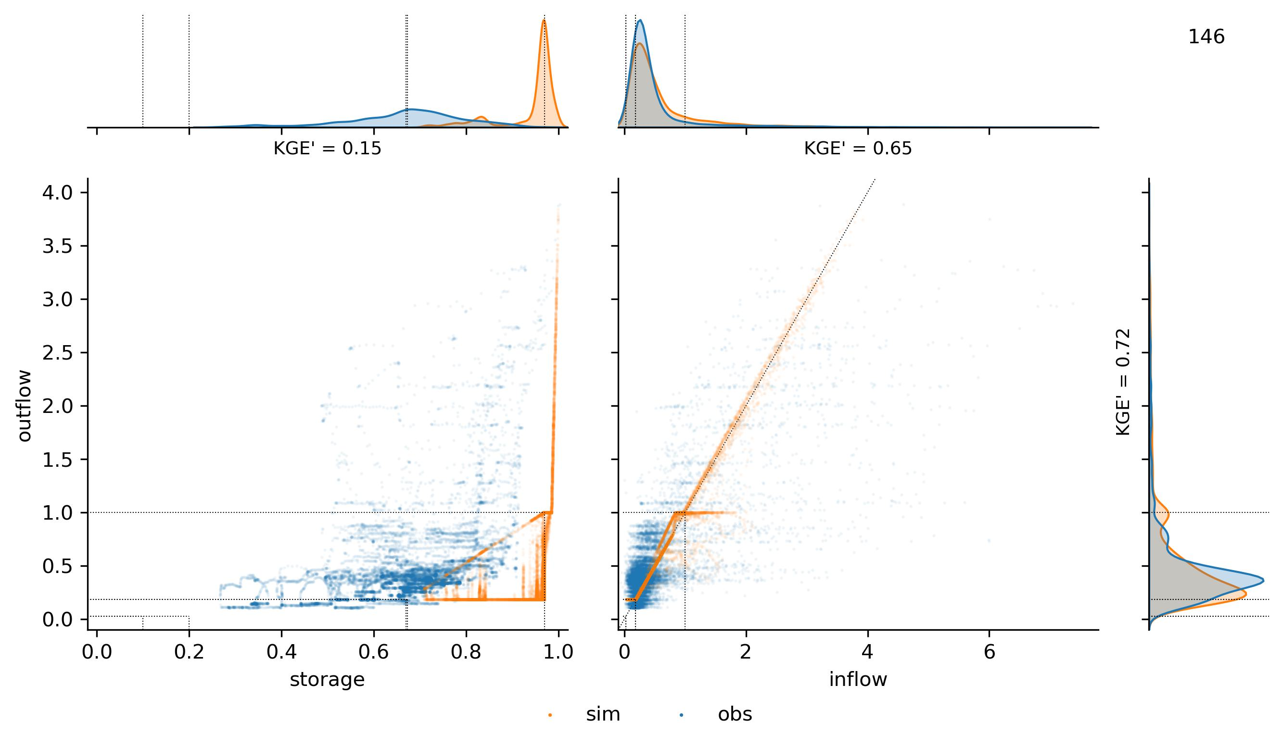
2. Reservoir simulation
Current routine
: the example of the Boysen Reservoir (Mississippi)
Q
tendency to fill up
S
I
Q
inflow
outflow
non-calibrated
t
no flood
regulation
k = 1.2?
github.com/casadoj/LF_water_bodies/docs/performance_US.md

Slide 7
2. Reservoir simulation
Current routine
: calibration
93 reservoirs from ResOpsUS
Optimization algorithm: SCE-UA
Objective function: KGE’
Target variable:
Outflow
Storage
Outflow & storage
Q_{f}
κ
1
outflow
Q_{n}
Q_{c}
V_{c}
V_{n}
V_{n}’
V_{f}
storage
inflow
github.com/casadoj/LF_water_bodies/docs/calibration_US.md

Slide 8
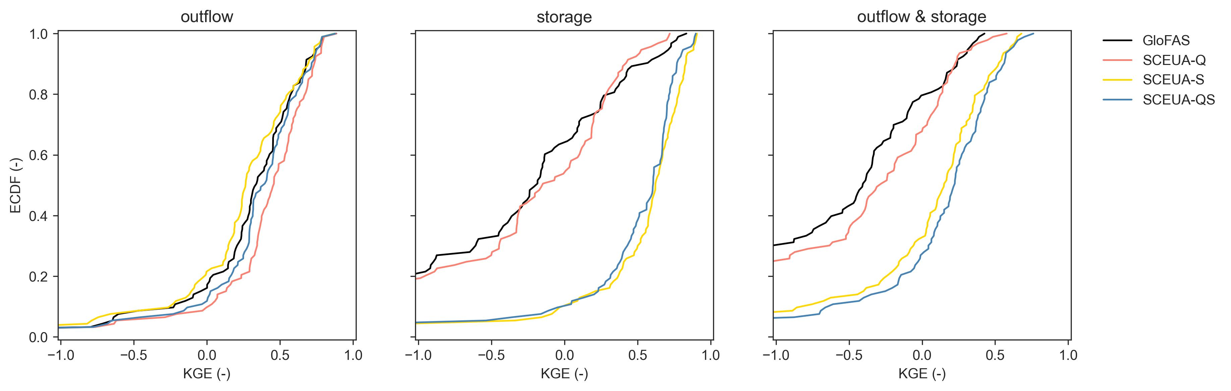
2. Reservoir simulation
Current routine
: calibration
Calibrating only storage gives surprisingly good results → global storage data sets from satellite data: GRSAD, ReaLSAT, ReGeom, DAHITI, Res-CN
github.com/casadoj/LF_water_bodies/docs/calibration_US.md

Slide 9
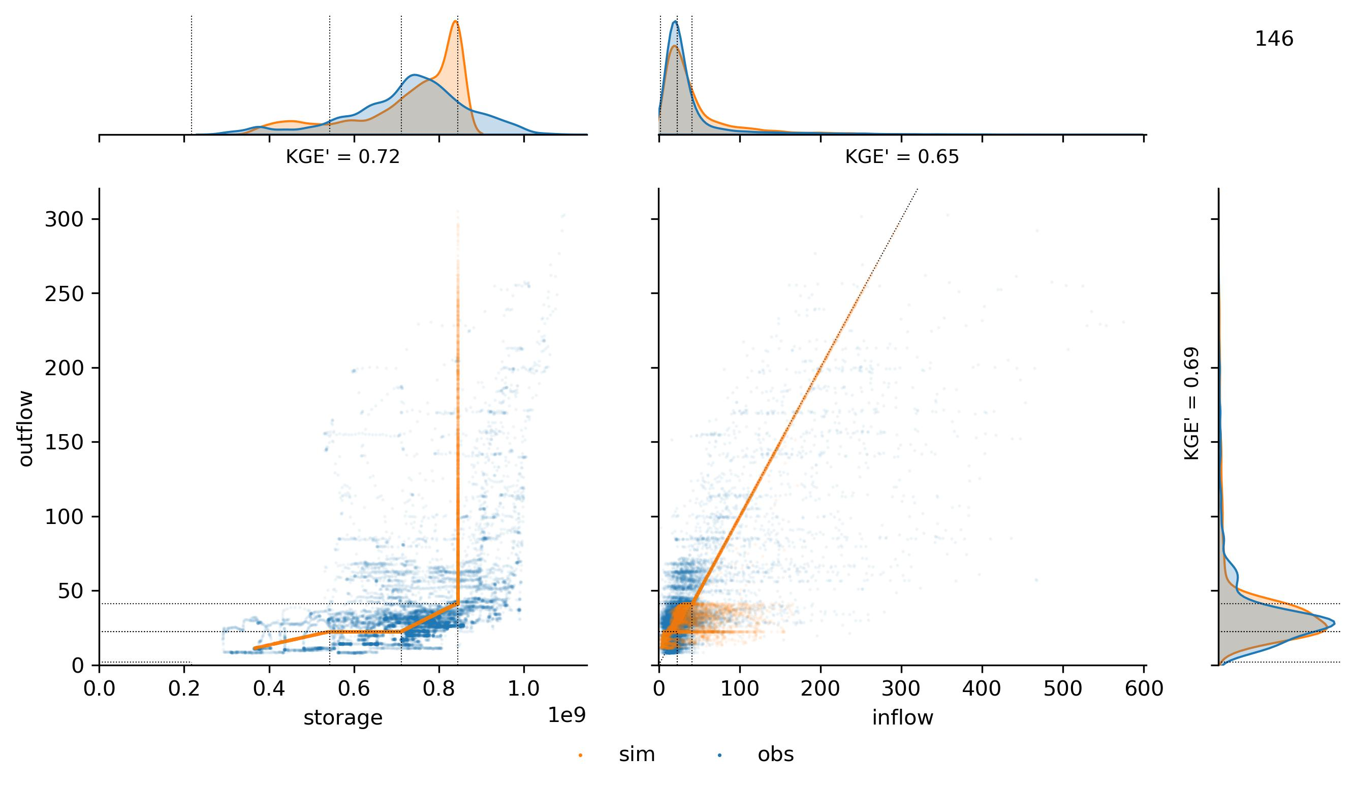
2. Reservoir simulation
Current routine
: calibration of the Boysen Reservoir (Mississippi)
Q
tendency to fill up
S
I
no flood
regulation
no κ
github.com/casadoj/LF_water_bodies/docs/calibration_US.md

Slide 10
2. Reservoir simulation
Other approaches:
Hanazaki et al. (2022)
κ
Q_{f}
1
Evolution from Burek 2013
All parameters are reservoir-specific
No seasonality
No reservoir use
outflow
Q_{n}
0.5·Q_{n}
0.5·V_{f}
V_{f}
V_{e}
storage
inflow
inflow < Q_{f}
inflow ≥ Q_{f}

Slide 11
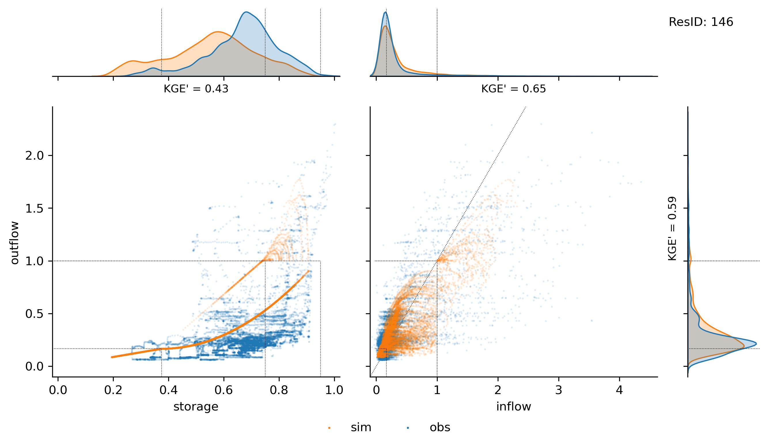
2. Reservoir simulation
Other approaches: Hanazaki et al. (2022)
Q
S
I

Slide 12
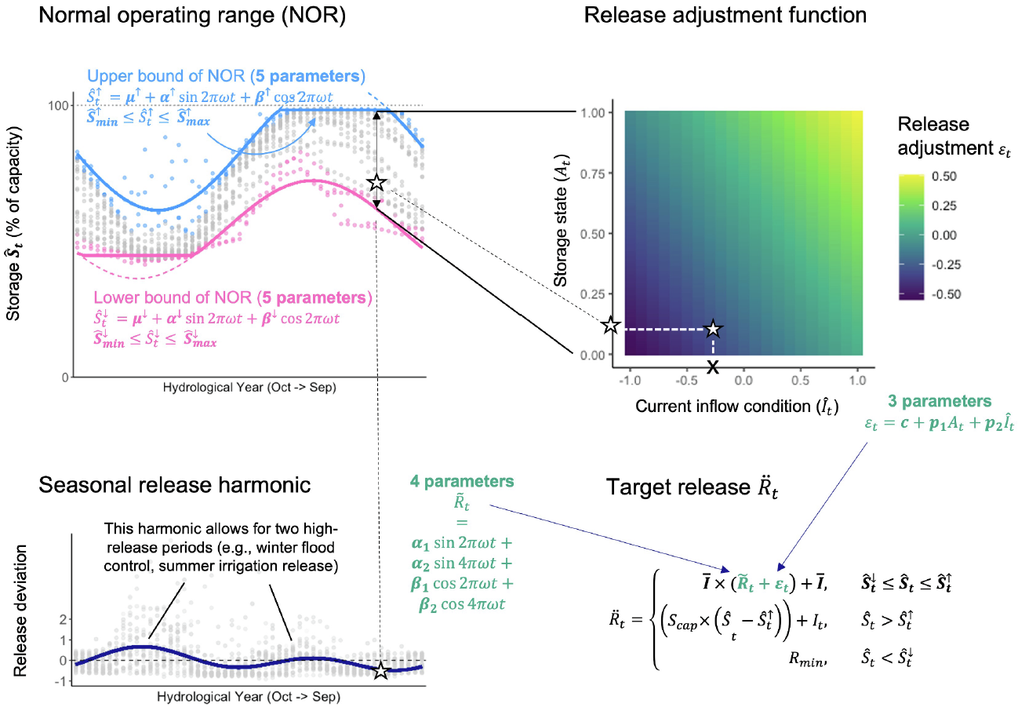
2. Reservoir simulation
Other approaches:
adding seasonality, Turner et al. (2021)

Slide 13
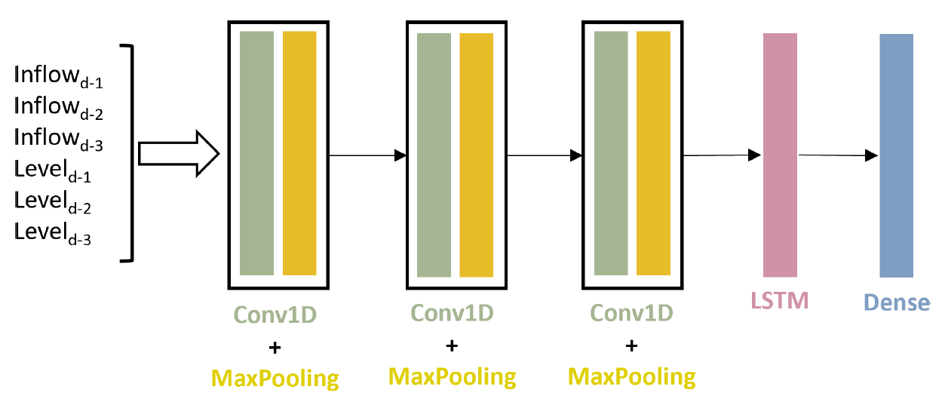
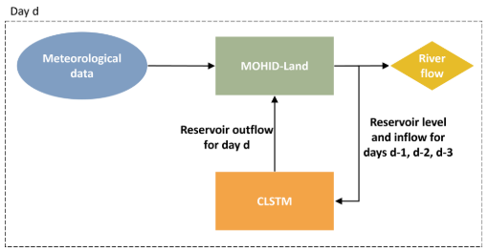
2. Reservoir simulation
Other approaches:
deep learning, Ramos-Oliveira et al. (2023)
Extend to multiple reservoirs to create a general model
Add static parameters: reservoir use, coordinates, climate, reservoir/dam properties, month, day of the week…

Slide 14

Thank you
github.com/casadoj/LF_water_bodies

