Slide 1
Reservoirs, lakes, and wetlands
Add lakes and reservoirs
Improve the reservoir simulation
Add wetlands in the model simulation

Slide 2
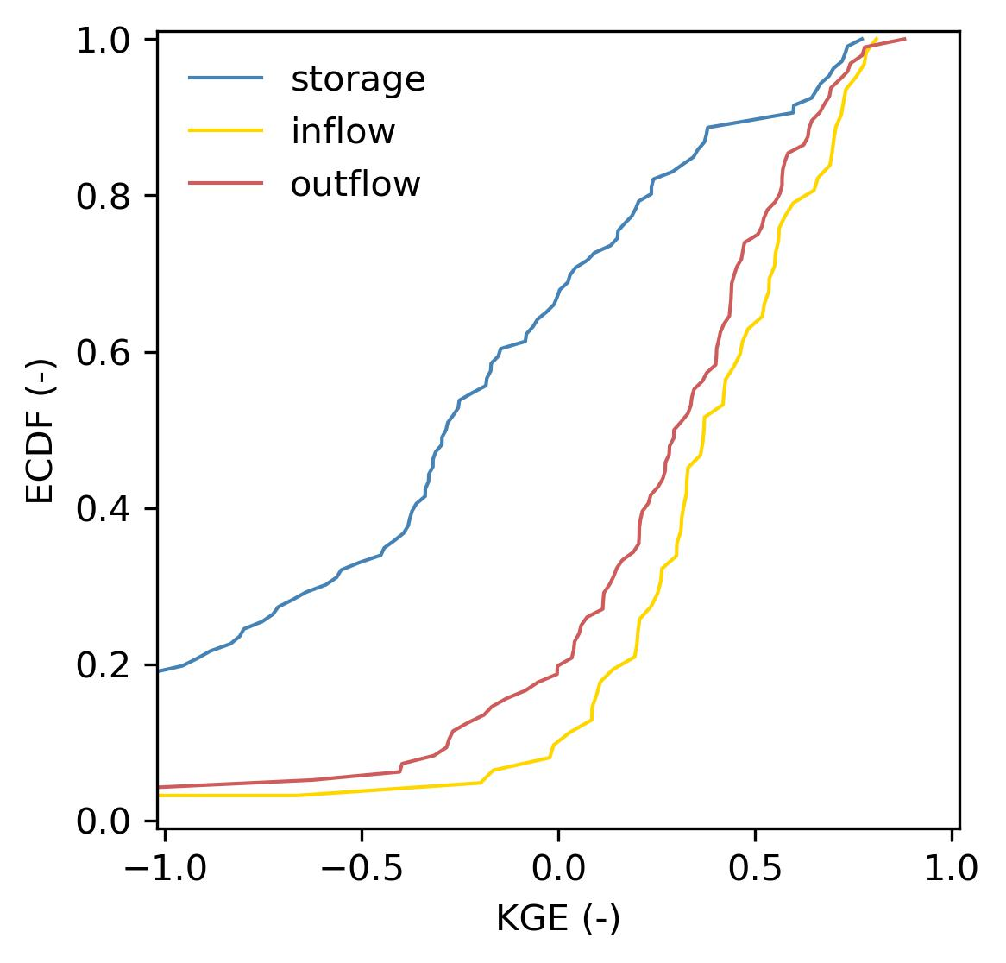

Reservoirs, lakes, and wetlands
Recap: GloFASv4 performance
Comparison of the simulated and observed time series for 121 reservoirs.
The performance in terms of outflow is fairly good given the errors imposed by the inflow
The main issue is the performance in terms of storage
github.com/casadoj/LF_water_bodies/docs/performance_US.md

Slide 3
Reservoirs, lakes, and wetlands
Calibration of the current routine
93 reservoirs from ResOpsUS
Optimization algorithm: SCE-UA
Objective function: KGE’
Target variable:
Outflow
Storage
Outflow & storage
Q_{f}
κ
1
outflow
Q_{n}
Q_{c}
V_{c}
V_{n}
V_{n}’
V_{f}
storage
inflow
github.com/casadoj/LF_water_bodies/docs/calibration_US.md

Slide 4
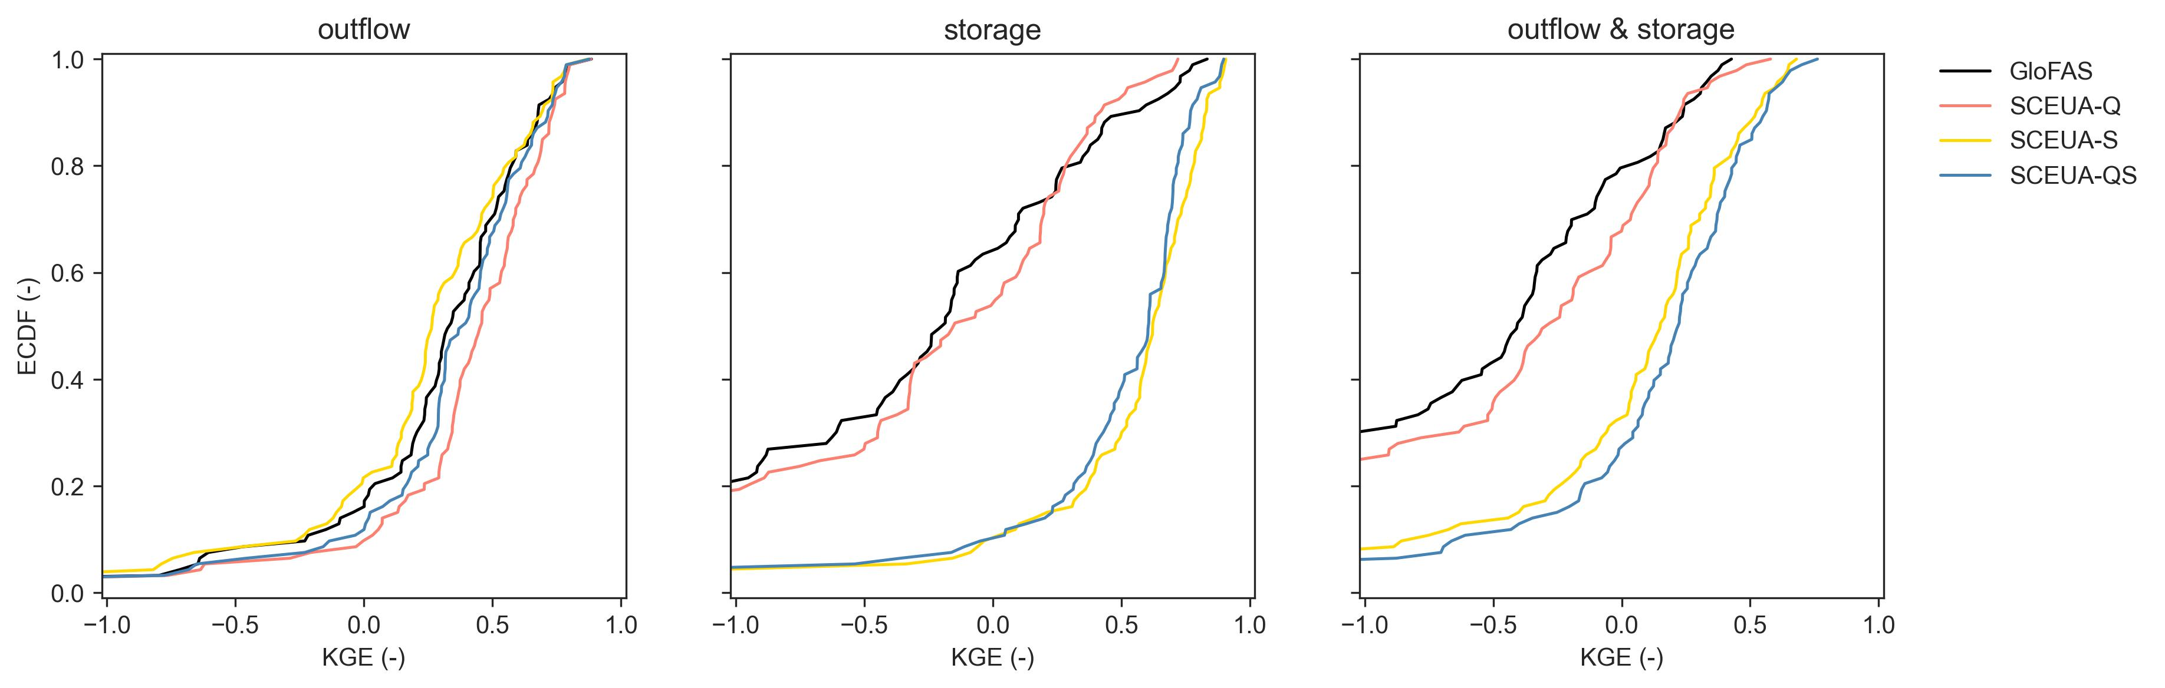
Reservoirs, lakes, and wetlands
Calibration of the current routine
Calibrating only storage gives surprisingly good results → global storage data sets from satellite data: GRSAD, ReaLSAT, ReGeom, DAHITI, Res-CN
github.com/casadoj/LF_water_bodies/docs/calibration_US.md

Slide 5
Reservoirs, lakes, and wetlands
Approach by Hanazaki et al. (2022)
κ
Q_{f}
1
Evolution from Burek et al. (2013)
All parameters are reservoir-specific
No seasonality
No reservoir use
outflow
Q_{n}
0.5·Q_{n}
0.5·V_{f}
V_{f}
V_{e}
storage
inflow
inflow < Q_{f}
inflow ≥ Q_{f}

Slide 6
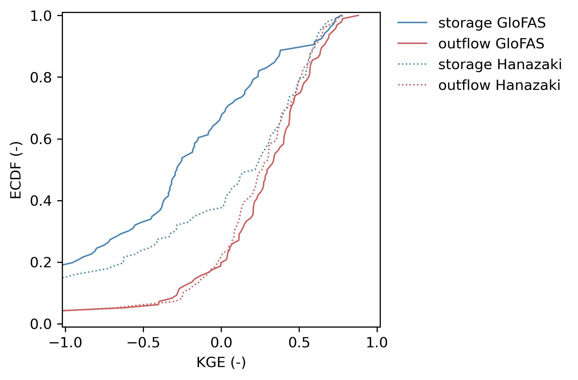
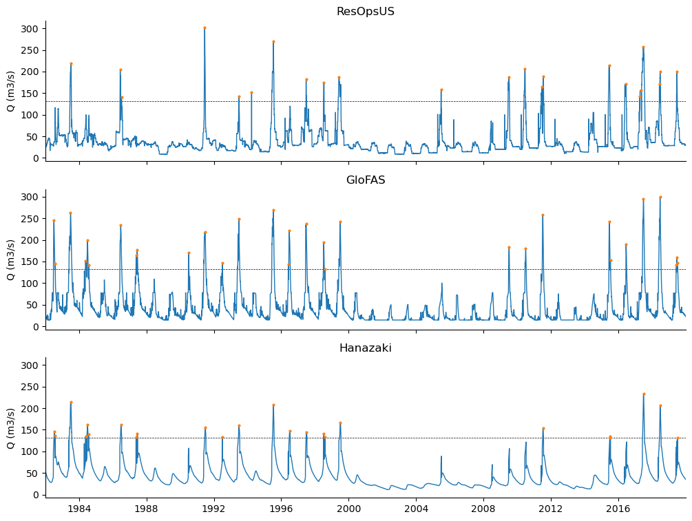
Reservoirs, lakes, and wetlands
Approach by Hanazaki et al. (2022)
Performance:
Similar in terms of outflow
Higher in terms of storage
Less realistic hydrographs → need for other metric?

Slide 7
Reservoirs, lakes, and wetlands
Following steps
Estimate parameters based on observed data
Bivariable calibration: storage & outflow
Regionalization of parameters based on reservoir use
Test the evolution of Burek 2013 by Hanazaki et al. (2022)
Test the approach to seasonality by Turner et al. (2021)
Deep learning? Ramos-Oliveira et al. (2023), Liu et al. (2019) → SEED-FD

