Slide 1
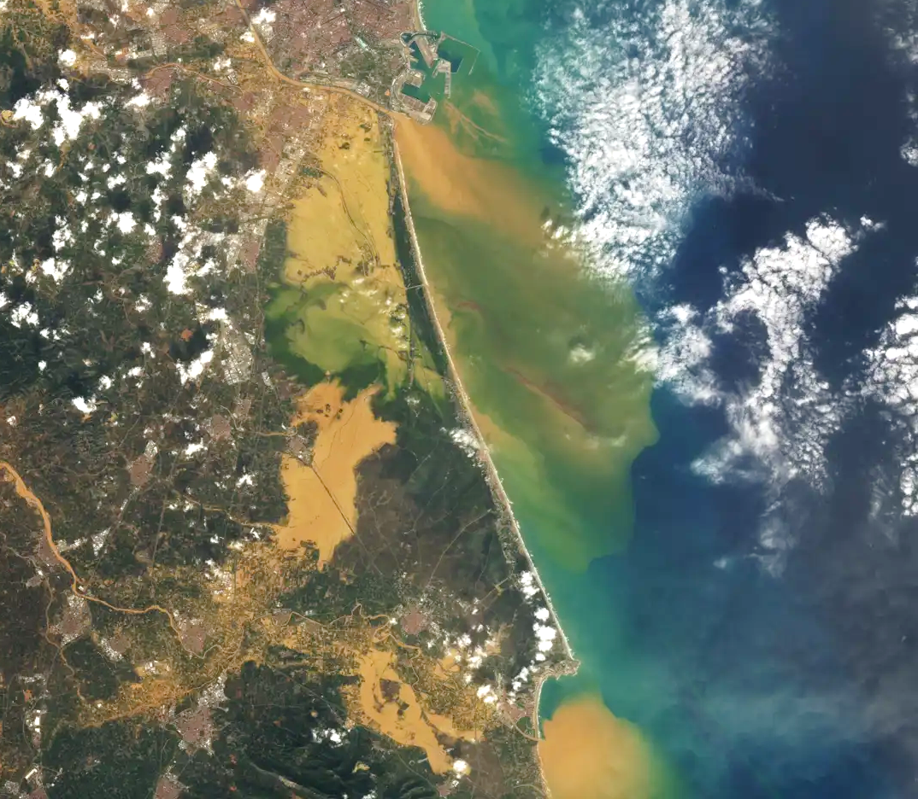


AP19 Flood Prediction
Introduction
Datasets
Models
Current state
Jesús Casado Rodríguez
j.casado@kajoservices.com
NASA: Landsat 8

Slide 2


Introduction
Datasets
Models
Current state
Proposal
Benchmark: GloFAS (Global Flood Awareness System) & GFM (Global Flood Monitoring)
Calibrate OS-LISFLOOD using a reanalysis produced by WG. Benchmark: ERA5 calibration.
Use WG medium-range forecast to drive OS-LISFLOOD. Benchmark: ECMWF-IFS forcing.
Develop and train a tail-network with the WG using flood extent estimates of GloFAS and GFM with data derived from citizen science observations.
New plan
The objective of this application is to create a deep-learning hydrological forecast system that predicts river discharge using the Weather Generator as meteorological forcing.
Benchmark: EFAS (European Flood Awareness System) and a LSTM forced with ECMWF-IFS.
www.kajoservices.com

Slide 3
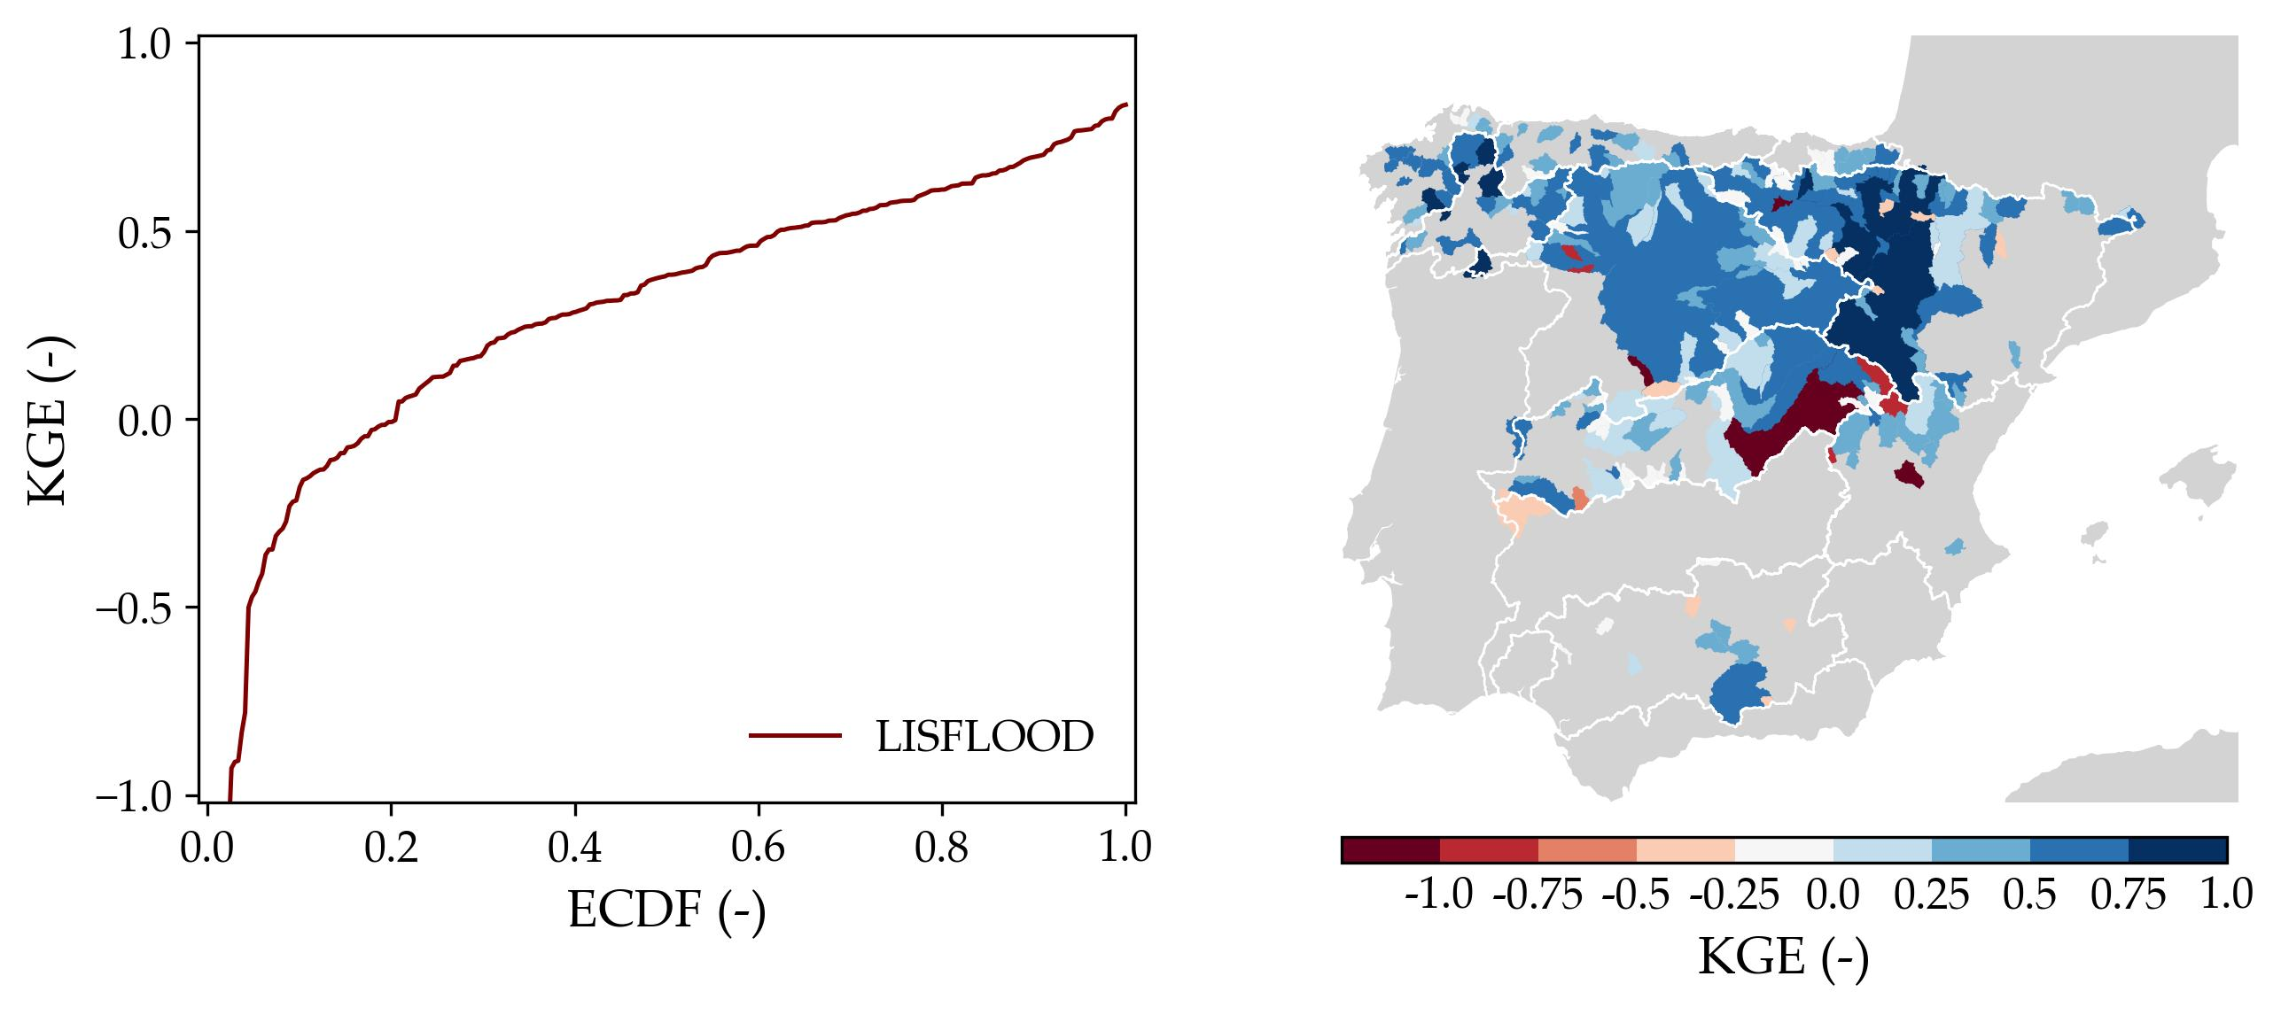
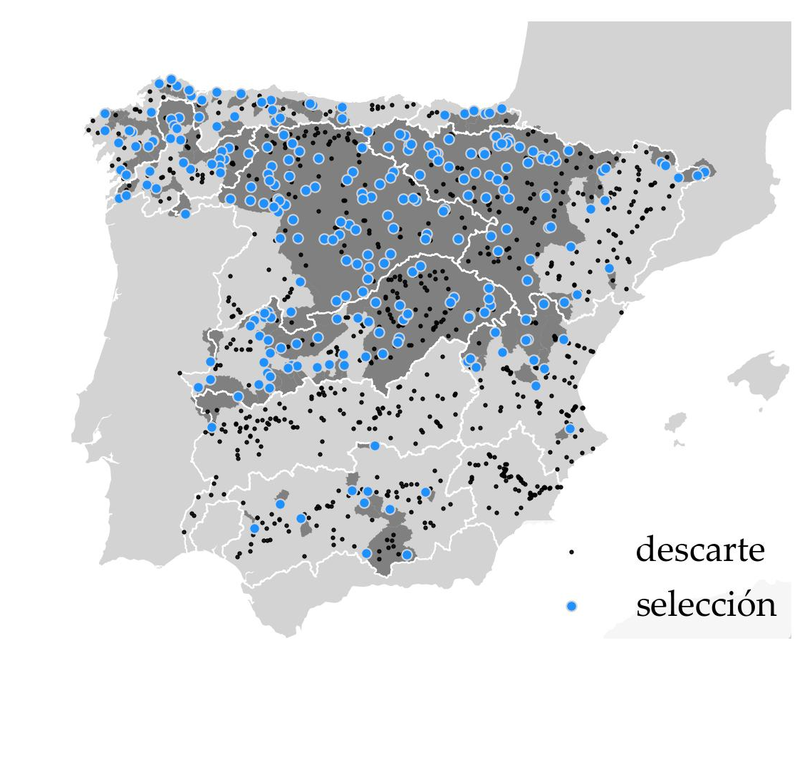
Introduction
Datasets
Models
Current state
Study case
CAMELS-ES v1
KGE_{median}: 0.383
We will test it in peninsular Spain.
Challenges:
Arid, Mediterranean climate in which hydrological models often struggle.
Very strong reservoir regulation.
www.kajoservices.com

Slide 4
Introduction
Datasets
Models
Current state
Plan
build
datasets
benchmark
model
WG tail-network
CAMELSES
lumped
natural
graph
BEAVERS
ES
reservoirs
www.kajoservices.com
Notes:
Benchmark dataset and LSTM model.
Update the CAMELS-ES dataset at daily resolution.
Retrain the LSTM benchmark model at national level.
Extension of CAMELS-ES at hourly resolution.
Fine tune the LSTM to the study case (daily-hourly timesteps).
Catchment embeddings:
(variational) autoencoder of the catchment characteristics.
Train the (V)AE+LSTM model.
Meteorological embeddings:
Use WG latent states or outputs as inputs to the hydrological model.

Slide 5
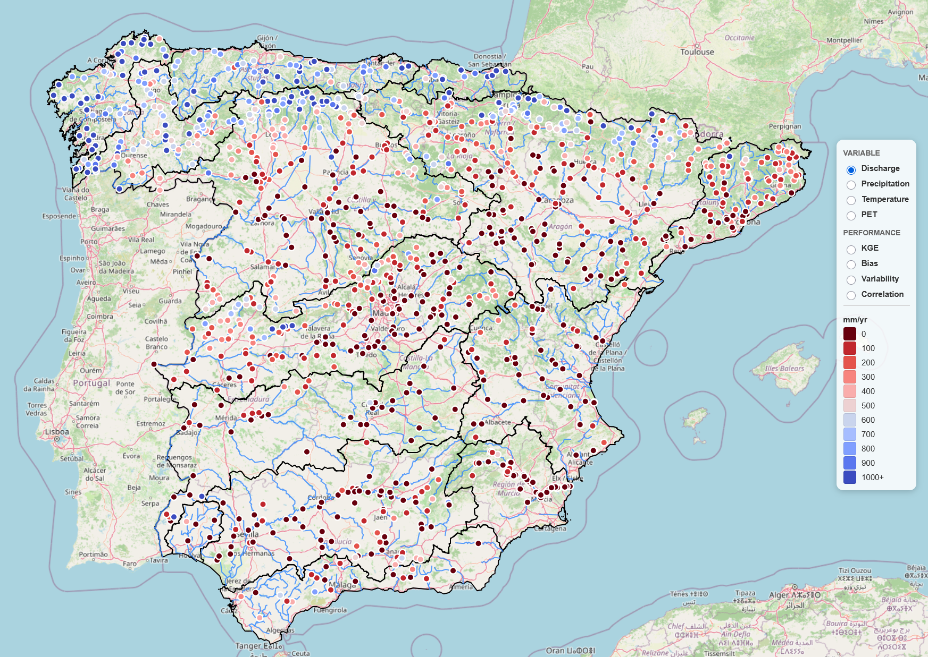
Introduction
Datasets
Models
Current state
CAMELS-ES v2
A dataset of river streamflow in (semi)natural.
BEAVERS-ES v1
A dataset of reservoir operations: storage, release.
Sources:
Hydrology: Ministry and River Basin Authorities
Meteorology:
Historical: ROCIO-IBEB, CERRA-Land, ERA5, EMO1
Forecast: ECMWF-IFS
Catchment characteristics: HydroATLAS, EFAS5
Characteristics:
Temporal resolution: daily (to be increased to hourly)
Period: 1980-2021 (from 2000s at hourly res.)
Selection of good-quality, (semi) natural stations.
https://casadoj.github.io/of_camels_and_beavers/
www.kajoservices.com

Slide 6
Introduction
Datasets
Models
Current state
Y_{t}
Static attributes (X_{s}): geomorphology, land use, soil characteristics, climate indices…
head
Dynamic inputs (X_{s}): meteorology, temporal encoders, water demand…
Limitations and challenges:
Lumped model:
Inputs are basic catchment statistics
It doesn’t reproduce regulation (reservoirs, diversions…)
The model requires as input the last year of meteorological forcings. How to plug in the WG?
tanh
LSTM
σ
σ
tanh
σ
embeddings
X_{s}
X_{d}
www.kajoservices.com

Slide 7
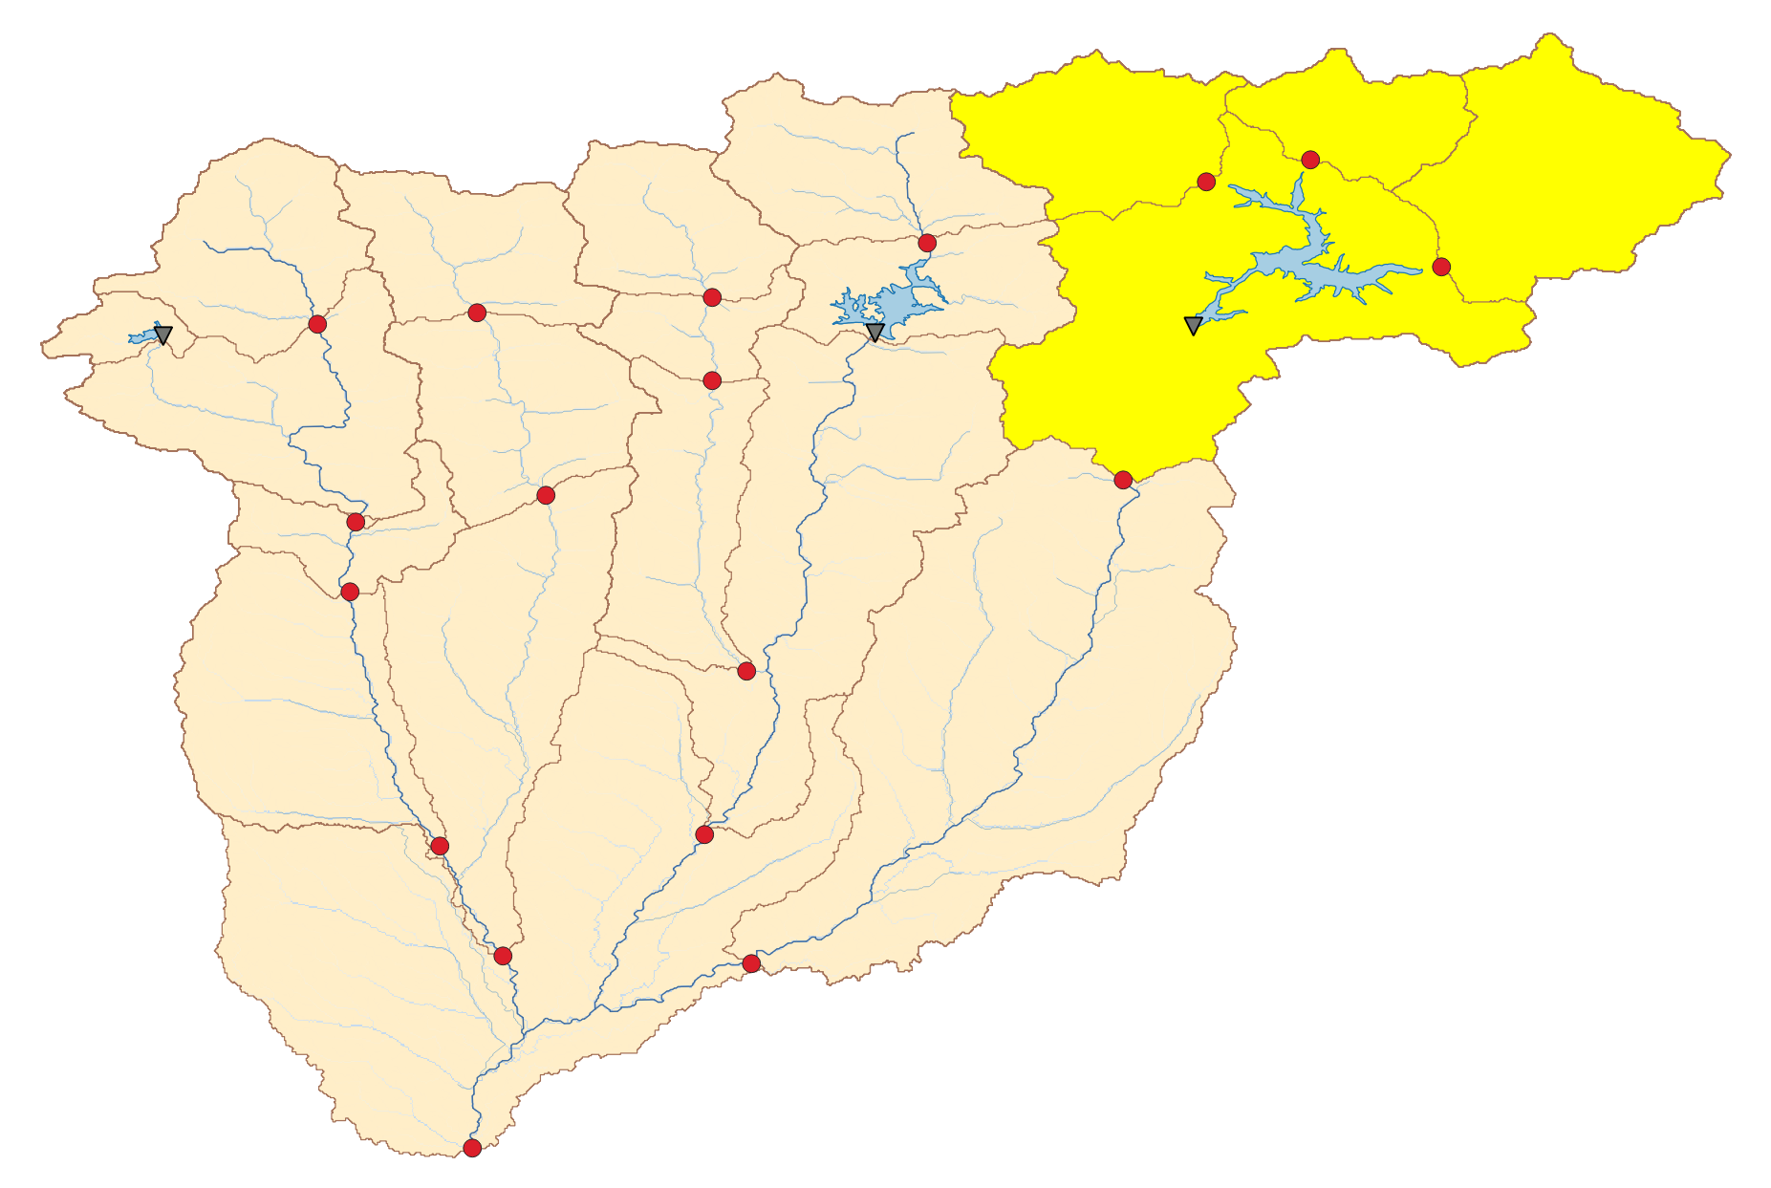
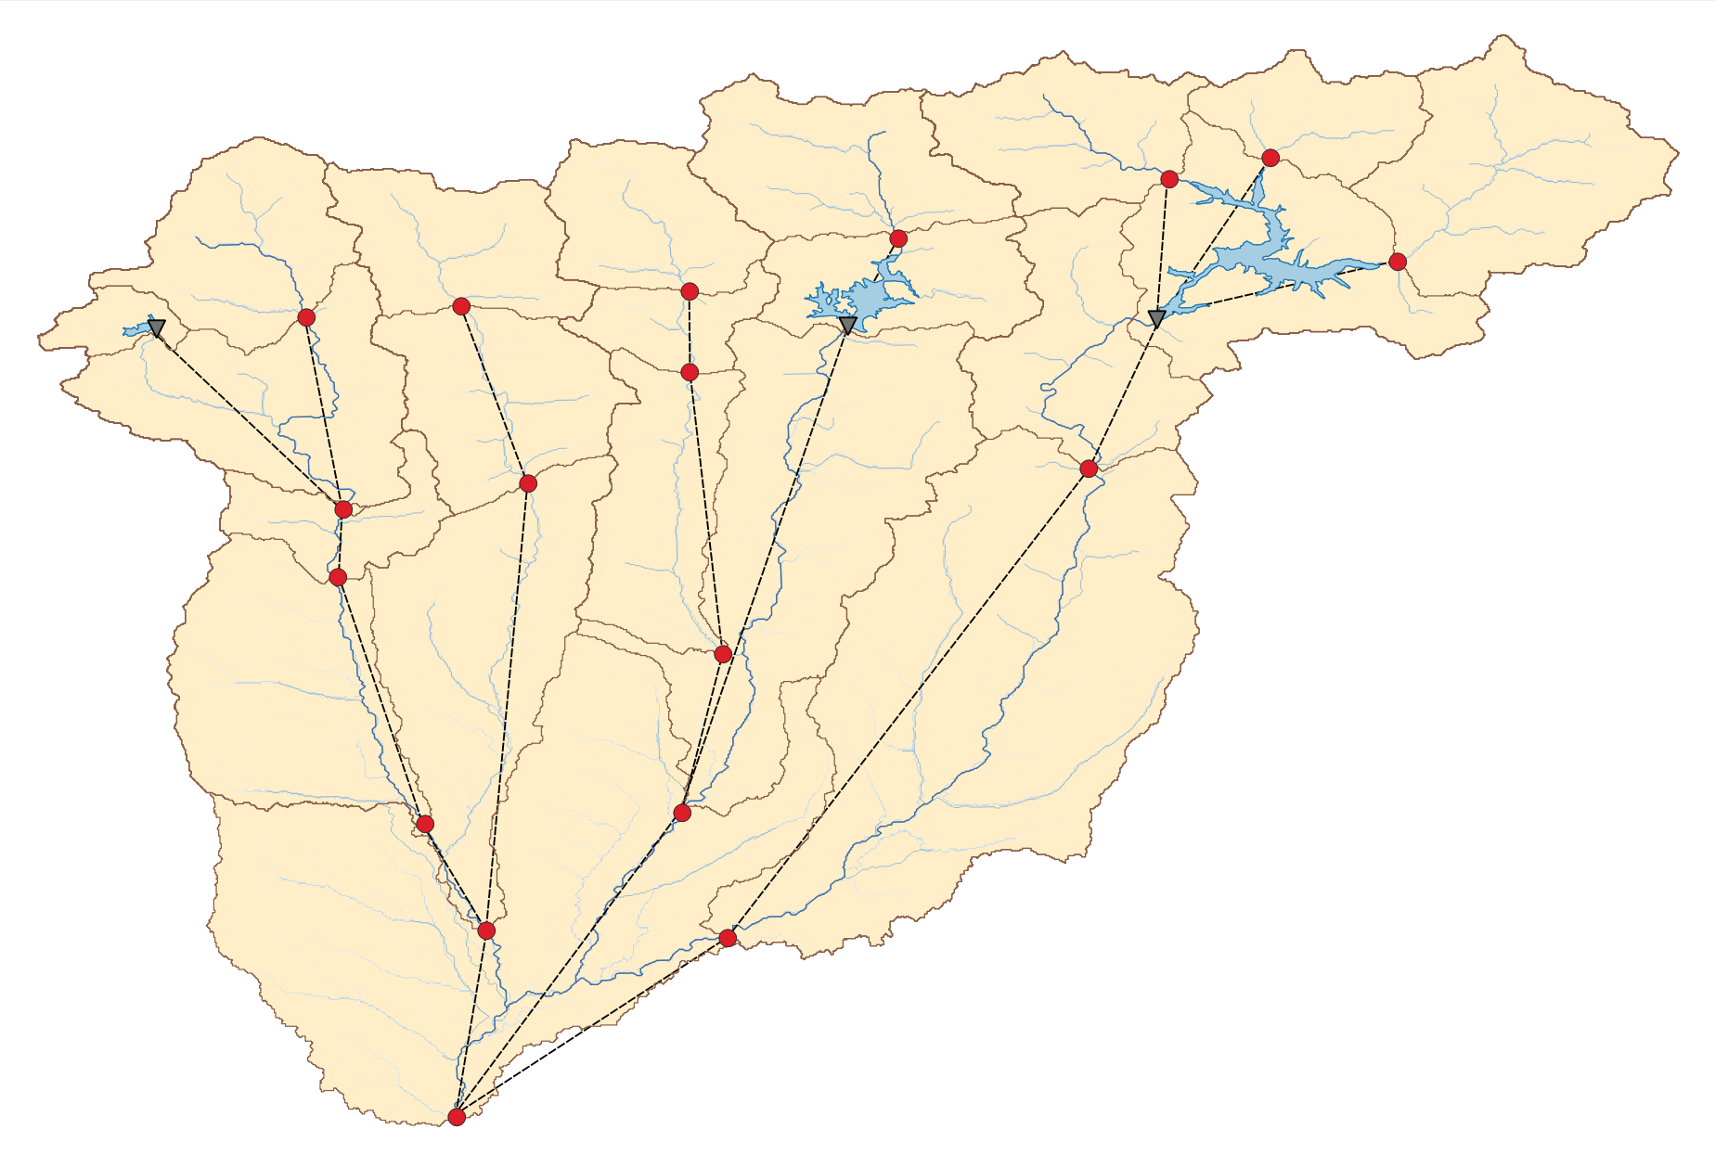
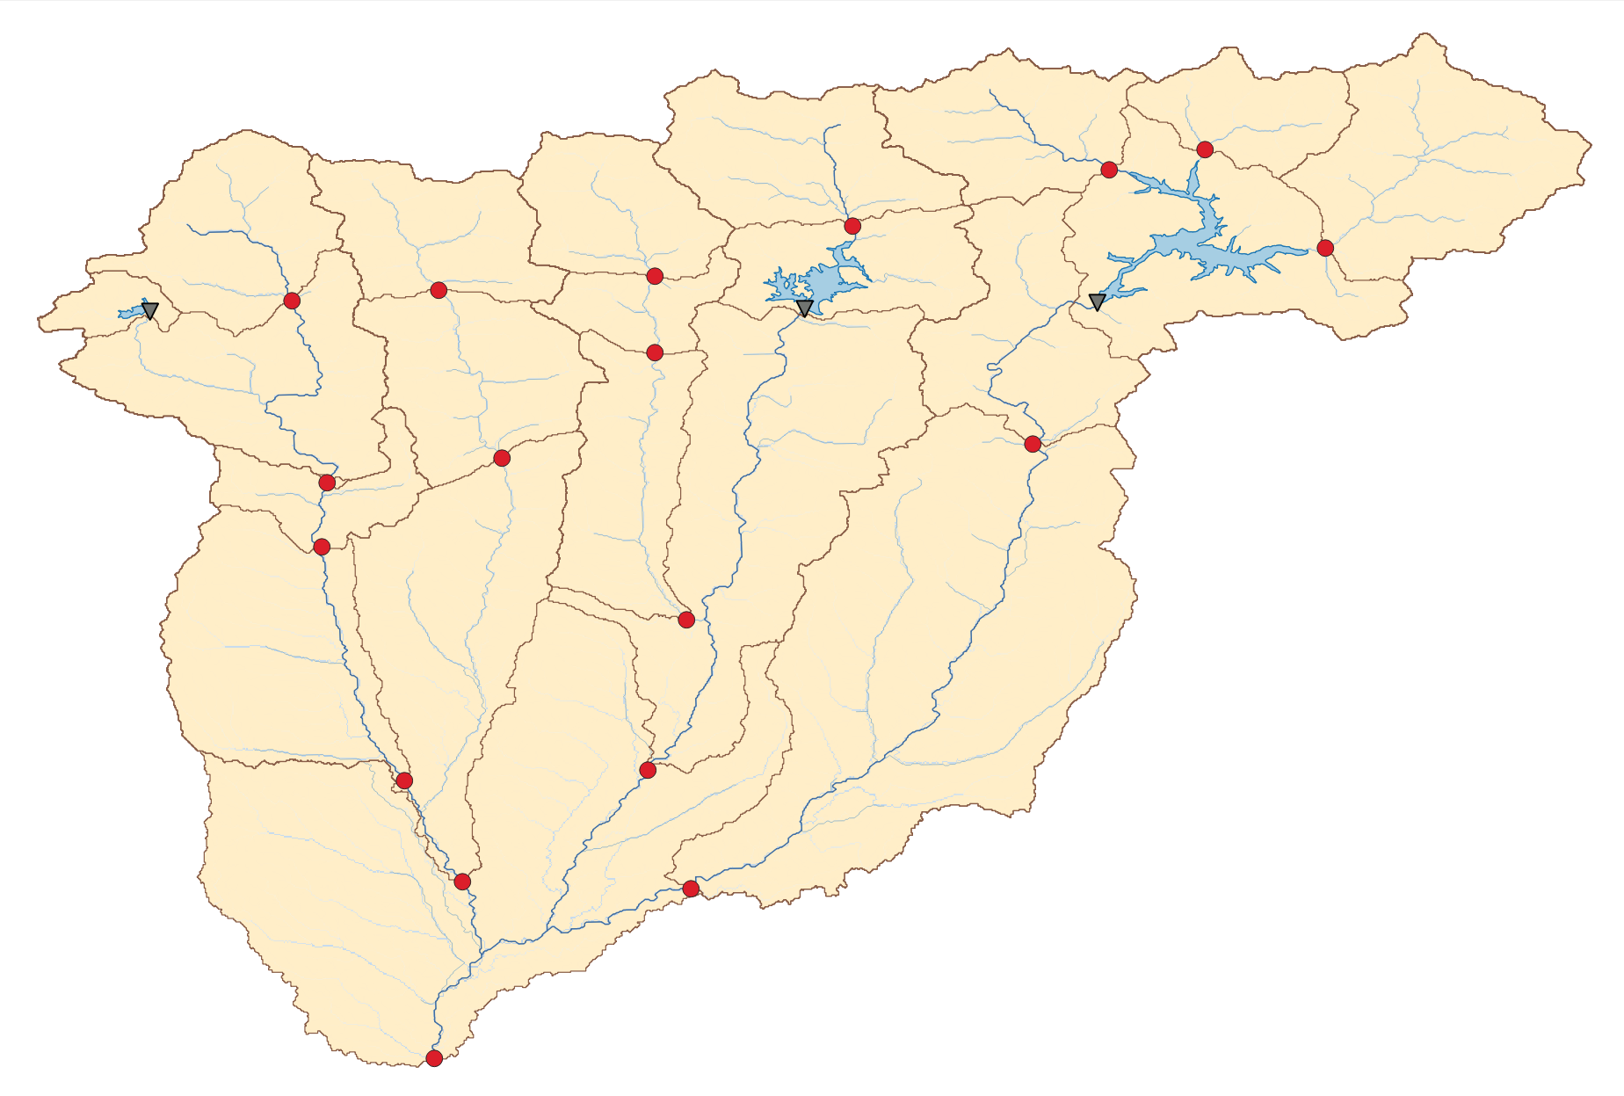
Introduction
Datasets
Models
Current state
From lumped to semi-distributed model
National scale:
A LSTM models (semi)natural subcatchment hydrology (CAMELS-ES).
A different LSTM models reservoir management (BEAVERS-ES).
Regional scale:
A GNN reproduces the catchment topology.
www.kajoservices.com

Slide 8
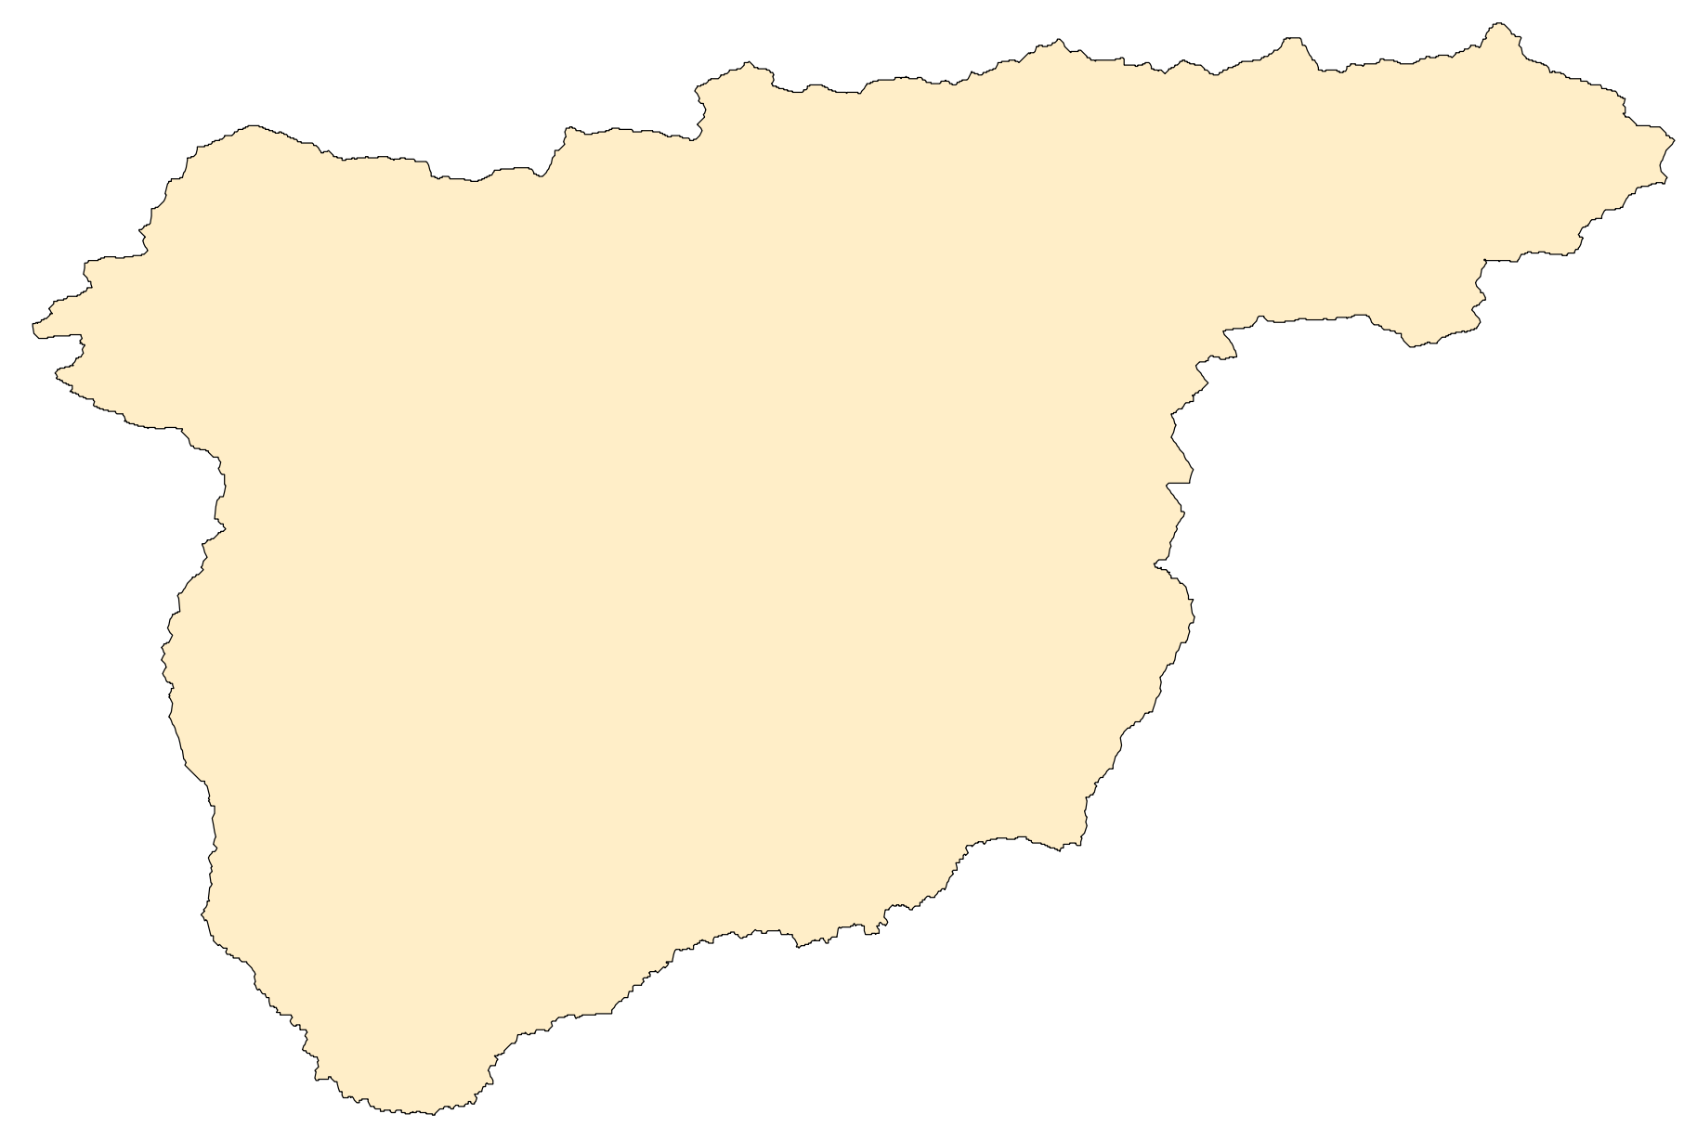
Introduction
Datasets
Models
Current state
From simple aggregates to encoders
Static attributes
Create a (variational) autoencoder that compresses the maps of catchment characteristics.
Dynamic inputs
Create a (variational) autoencoder that compresses the maps of catchment characteristics.
Use WG as forcing:
Latent states vs meteorological forecasts
Archive
Catchment discretization?
X_{s}
www.kajoservices.com

Slide 9
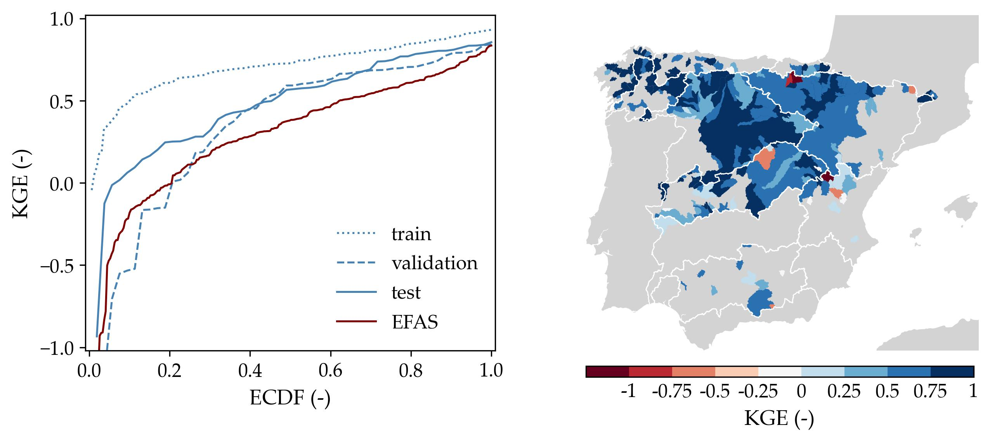
Introduction
Datasets
Models
Current state
Datasets
CAMELS-ESv2 at daily resolution: to be finished by mid July.
BEAVERS-ESv1 at daily resolution: to be finished by the end of August.
Models
LSTM trained on CAMELS-ESv1 outperforms EFAS.
Initial tests on CAMELS-ESv2 outperform v1.
KGE_{median}: 0.693
www.kajoservices.com

Slide 10
Thanks!
Jesús Casado Rodríguez
j.casado@kajoservices.com
NASA: Landsat 8

