Slide 1
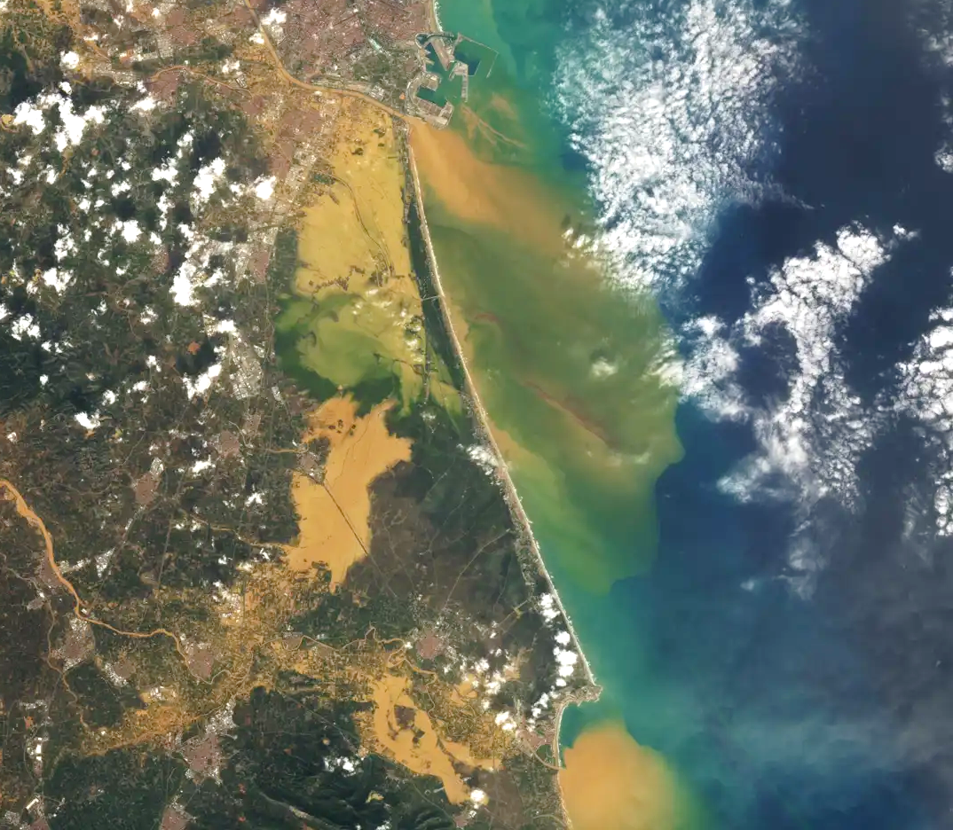


Takeover
---
Jesús Casado Rodríguez
j.casado@kajoservices.com
NASA: Landsat 8

Slide 2


Base model
Fine tuning
Transfer learning
Forecasting
CudaLSTM
Static attributes (X_{s}: 31):
Geomorphology: EFAS
Land use/land cover: HydroAtlas
Soil characteristics: HydroAtlas
Climate indices: ROCIO-IBEB
[64, 1]
Y_{t}
head MLP
Dynamic inputs (X_{s}: 9):
Meteorology: ROCIO-IBEB
Temporal encoders
tanh
LSTM
[365, 25, 64]
σ
σ
tanh
σ
[31, 64, 32, 16]
[9, 9]
Target variables (Y_{t}: 1):
Specific discharge: CEDEX
embedding MLP
Stations (651):
Training: 391
Validation: 130
Test: 130
X_{s}
X_{d}
www.kajoservices.com

Slide 3
Base model
Fine tuning
Transfer learning
Forecasting
CudaLSTM
Fine-tuning means that a model is pre-trained with a large amount of data (or a different purpose), but then that same model is re-trained on a smaller, more specific dataset. The model weights are not allowed to change dramatically, so it keeps the knowledge gained during pre-training.
The model is pre-trained on the complete CAMELS-ES dataset, learning general patterns in the Hydrology of the country. Later, the model is fine-tuned to a specific basin of interest, so it learns specific features in that area.
[64, 1]
Z_{t}
head MLP
tanh
LSTM
[365, 25, 64]
σ
σ
tanh
σ
[31, 64, 32, 16]
[9, 9]
Stations (80):
Training: 48
Validation: 16
Test: 16
embedding MLP
X_{s}
X_{d}
www.kajoservices.com

Slide 4
Base model
Fine tuning
Transfer learning
Forecasting
CudaLSTM
Transfer learning uses a model pre-trained on some task, and applies it on a new task, either exactly as it is, fine-tuning or replacing some blocks of the model.
Use the CAMELS-ES pre-trained model to generate reservoir inflow. It only requires changing the dataset, but the model is exactly the same.
Fine-tuning the head to reproduce reservoir filling. The embeddings and LSTM are frozen, so they keep their knowledge about catchment hydrology.2
Attach a second LSTM and a new head that reproduces reservoir operations.
[64, 1]
Z_{t}
head MLP
tanh
LSTM
[365, 25, 64]
σ
σ
tanh
σ
[31, 64, 32, 16]
[9, 9]
embedding MLP
X_{s}
X_{d}
www.kajoservices.com

Slide 5
Base model
Fine tuning
Transfer learning
Forecasting
SequentialForecastLSTM
This model uses a single LSTM to simulate both hindcast and forecast timesteps.
[64, 8]
Y_{t}
head MLP
tanh
LSTM
[365, 25, 64]
σ
σ
tanh
σ
[31, 64, 32, 16]
[9, 9]
Embedding MLP
X_{s}
X_{d,h} + X_{d,f}
www.kajoservices.com

Slide 6
Base model
Fine tuning
Transfer learning
Forecasting
HandoffForecastLSTM
[64, 8]
This model uses a single LSTM to simulate both hindcast and forecast timesteps.
Y_{t,h} + Y_{t,d}
Head MLP
[7, 23, 64]
Forecast LSTM
[128, 64, 128]
Handoff MLP
[365, 25, 64]
Hindcast LSTM
[41, 64, 32, 16]
[9, 9]
[41, 64, 32, 16]
[7, 7]
Embedding MLP
X_{s}
X_{d,h}
X_{s}
X_{d,f}
www.kajoservices.com

Slide 7
Base model
Fine tuning
Transfer learning
Forecasting
HandoffForecastLSTM
Hindcast
Forecast
This model uses two LSTMs, one fore the hindcast period and one for the forecast period.
The structure of both are similar: embeddings+LSTM+head.
The forecast LSTM hidden and cell state are initialized using an MLP from the hidden and cell state of the hindcast LSTM.
As it is independent, the forecast engine may have different width and depth, or it can use different dynamic inputs.
[64, 1]
[64, 1]
Y_{t,h}
Y_{t,f}
Head MLP
[365, 25, 64]
[128, 64, 128]
[365, 23, 64]
Handoff MLP
LSTM
[41, 64, 32, 16]
[9, 9]
[41, 64, 32, 16]
[7, 7]
Embedding
MLP
X_{s}
X_{d,h}
X_{s}
X_{d,f}
www.kajoservices.com

Slide 8
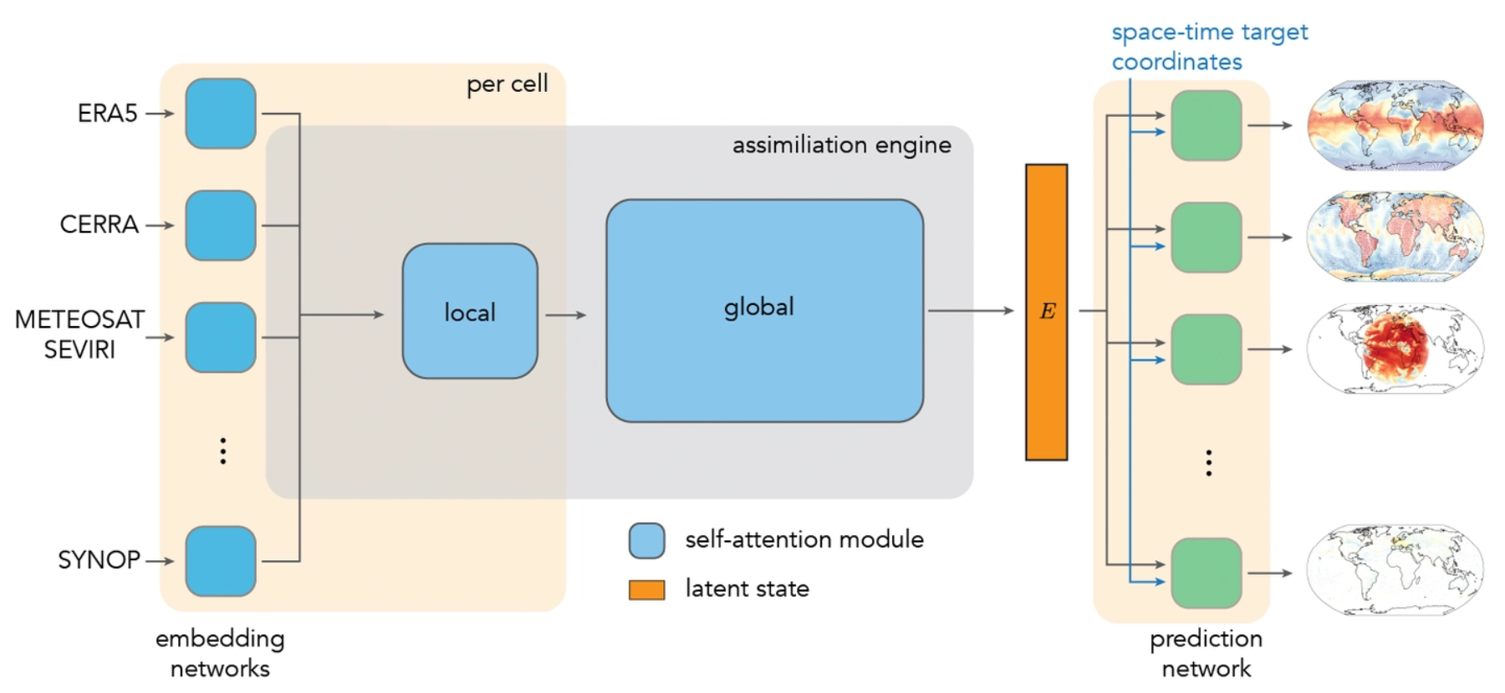
Base model
Fine tuning
Transfer learning
Forecasting
WeatherGenerator
WG is mostly a project about meteorology. That’s a initial-state problem, knowing the initial state (from observations), the model reproduces its evolution
Hydrology is a memory process, it requires knowledge about the past, since it is not possible to have a comprehensive knowledge of the initial state.
Most of the other applications in WG are spatial distributed. The processes in the atmosphere (in theory) can occur in any direction (lat, lon, z).
In Hydrology, processes are driven by the topography. It is a results of spatially aggregated processes.
www.kajoservices.com

Slide 9
Thanks!
Jesús Casado Rodríguez
j.casado@kajoservices.com
NASA: Landsat 8

