Slide 1


Deep learning in LISFLOOD
LISFLOOD
Google Flood Hub
Calibration of hydrological models
Parameter learning
Jesús Casado Rodríguez
JRC-E1
28.02.2024

Slide 2
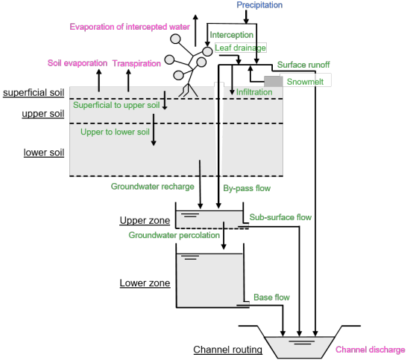
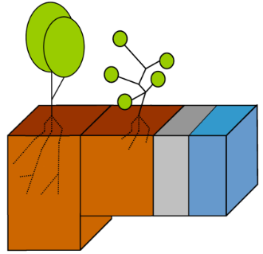
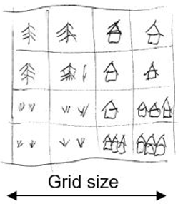
LISFLOOD-OS
Google Flood Hub
Calibration
Parameter learning
LISFLOOD is a spatially distributed, physically based rainfall-runoff model, developed by the Joint Research Centre (JRC) of the European Commission since 1997 - Ad De Roo, Van Der Knijff , Younis.
Hydrological processes
Main components:
3 soil layers
2 ground water storages
Surface runoff routing
Channel routing
Sub-grid land use
Other modules:
Snow processes
Lakes & reservoirs
Water use
Soil frost
...

Slide 3
LISFLOOD-OS
Google Flood Hub
Calibration
Parameter learning
LISFLOOD is a spatially distributed, physically based rainfall-runoff model, developed by the Joint Research Centre (JRC) of the European Commission since 1997 - Ad De Roo, Van Der Knijff , Younis.
A LISFLOOD run
physical properties
Spatially distributed!
meteorology
LISFLOOD
fluxes & storages
initial conditions
Discharge
Soil moisture
Reservoir storage
Snow water equivalent
…
model parameters

Slide 4
LISFLOOD-OS
Google Flood Hub
Calibration
Parameter learning
NeuralHydrology is a lumped, data-driven streamflow model developed initially by Frederik Kratzert (2018) and now used in Google Flood Hub.
physical properties
Advantages
Computation time
Generalization: it learns from multiple catchments simultaneously
Performance
Lumped!
(FC)
+
LSTM
+
FC
discharge/ stage
meteorology
Limitations
Black box
Only produces discharge/stage -> fluxes (hidden state may have correlation with hydrological storages)
Only produces outputs at specific, predefined points.
discharge/ stage

Slide 5
LISFLOOD-OS
Google Flood Hub
Calibration
Parameter learning
Process-based models
inputs
model
sim
OF
obs
Optimization algorithm
Catchment specific
parameters
Deep learning models
inputs
model
sim
obs
Back-propagation of gradients
Multiple catchments simultaneously
LF
weights bias
back propagation

Slide 6






LISFLOOD-OS
Google Flood Hub
Calibration
Parameter learning
LISFLOOD calibration
Estimate model parameters in catchments with observations.
Limitations
Lumped parameter maps
Computation time
What’s learnt from one catchment is not transferred to other catchments
$$C_{1}$$
$$C_{2}$$
$$C_{3}$$
$$θ_{1}$$
$$θ_{2}$$
$$θ_{3}$$

Slide 7

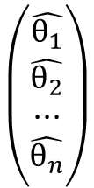


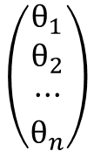


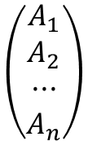




LISFLOOD-OS
Google Flood Hub
Calibration
Parameter learning
Parameter regionalization
Estimate model parameters in catchments without observations by transferring parameters from similar calibrated catchments.
GloFAS: Parameters are transferred based on climate and geographical proximity.
Attribute space
$$C_{1}\left\{A_{1} | θ_{1}\right\}$$
$$C_{1}$$
$$C_{2}\left\{A_{2} | θ_{2}\right\}$$
$$C_{i}$$
$$C_{i}\left\{A_{i} | θ_{3}\right\}$$
$$C_{3}\left\{A_{3} | θ_{3}\right\}$$
$$C_{3}$$
$$C_{i}\left\{A_{i} | ?\right\}$$
$$C_{2}$$
Other approaches: use linear functions, neural networks (SOM)…
$$\left({A_{1} \atop \begin{aligned}A_{2} \\ ··· \\ A_{n}\end{aligned}}\right)$$
$$\left({\hat{θ_{1}} \atop \begin{aligned}\hat{θ_{2}} \\ ··· \\ \hat{θ_{n}}\end{aligned}}\right)$$
$$\left({θ_{1} \atop \begin{aligned}θ_{2} \\ ··· \\ θ_{n}\end{aligned}}\right)$$
Problem of parameter identifiability

Slide 8
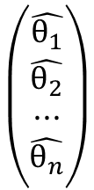
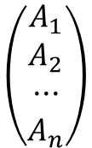
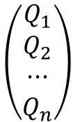
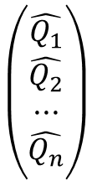
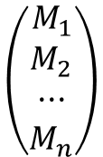
LISFLOOD-OS
Google Flood Hub
Calibration
Parameter learning
General idea
To utilize the power of deep learning in the calibration of process-based hydrological models.
It merges the model calibration and parameter regionalization into a single modelling chain that leverages the computation power and learning capacity of deep learning.
$$\left({M_{1} \atop \begin{aligned}M_{2} \\ ··· \\ M_{n}\end{aligned}}\right)$$
hydrological model
$$\left({\hat{Q_{1}} \atop \begin{aligned}\hat{Q_{2}} \\ ··· \\ \hat{Q_{n}}\end{aligned}}\right)$$
$$\left({Q_{1} \atop \begin{aligned}Q_{2} \\ ··· \\ Q_{n}\end{aligned}}\right)$$
$$\left({\hat{θ_{1}} \atop \begin{aligned}\hat{θ_{2}} \\ ··· \\ \hat{θ_{n}}\end{aligned}}\right)$$
LF
$$\left({A_{1} \atop \begin{aligned}A_{2} \\ ··· \\ A_{n}\end{aligned}}\right)$$
back propagation
The hydrological model must backpropagate gradients:
Differentiable model
Surrogate

Slide 9
LISFLOOD-OS
Google Flood Hub
Calibration
Parameter learning
Our plan
Create a surrogate of LISFLOOD-OS that replicates its discharge simulations
Implement a parameter learning framework on top of that surrogate model
Data
We will start working on the 739 headwater catchments used in GloFASV4 regionalization:
Static maps
Meteorological forcings
Observed discharge at the outlet
Pairs of model parameter sets and simulated discharge
Optimal parameter set + discharge of the GloFAS long run
Parameter sets in the calibration + modified KGE

Slide 10






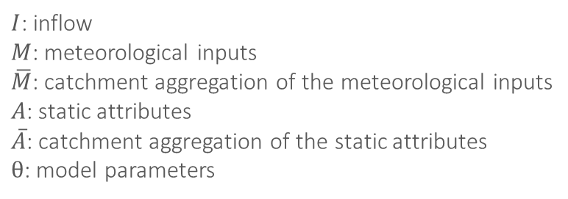


LISFLOOD-OS
Google Flood Hub
Calibration
Parameter learning
Surrogate model
$$I$$
LISFLOOD-OS
$$M$$
$$Q_{sim,PB}$$
$$A$$
θ
patching
training
$$I$$
surrogate
$$\overline{M}$$
$$Q_{sim,DL}$$
$$\overline{A}$$
$I$: inflow
$M$: meteorological inputs
$\overline{M}$: catchment aggregation of the meteorological inputs
$A$: static attributes
$\overline{A}$: catchment aggregation of the static attributes
$θ$: model parameters
θ
input
model
output

Slide 11












LISFLOOD-OS
Google Flood Hub
Calibration
Parameter learning
From static attributes
$$I$$
surrogate
$$\overline{M}$$
$$Q_{sim,DL}$$
training
$$Q_{obs}$$
$$\overline{A}$$
TF
$$θ$$
From static and dynamic attributes
$$I$$
surrogate
$$\overline{M}$$
$$Q_{sim,DL}$$
$$\overline{A}$$
TF
input
$$θ$$
model
$$Q_{obs}$$
training
output

Slide 12
LISFLOOD-OS
Google Flood Hub
Calibration
Parameter learning
Challenges
Apply parameter learning in a spatially distributed model
Extract from the static and dynamic maps the relevant information
Patching
Vision transformers
Include human intervention on natural catchments: reservoirs, water abstraction, irrigation...
How to include inflows?

Slide 13
Thank you

