Slide 1

Night on Earth
Group project Digital Visualisation
Anthony, Pei, Shu, Melanie

Slide 2
. Structure
Video Overview
Why is it relevant?
The Data
Implementation
Project Review
Further Extension

Slide 3
Video Promotion
https://www.youtube.com/watch?v=WaZoMPQ5kwU
Notes:
Quick taste of interactive web experience

Slide 4
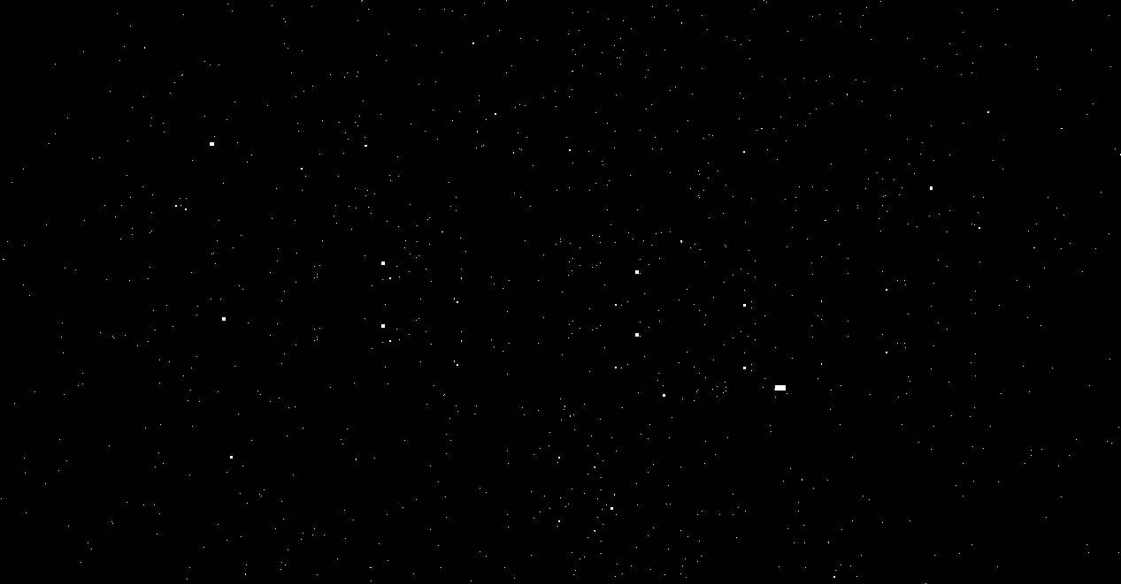
What is it about?
Imagining Pulse as the rhythmical interaction of light, darkness and social network activity by exploring the effect of natural and anthropogenic light sources on sleep quality and well-being..._

Slide 5
The
Why is it relevant?

Slide 6
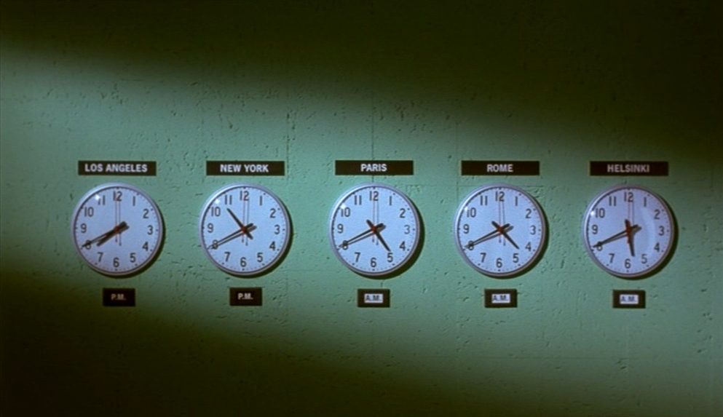
Night on Earth
(1991, Jim Jarmusch)
01 Why is this relevant?
Notes:
Inspiration1- night on earth
Jim Jarmusch in 1991, 5 cities, 5 taxis and one night on earth
Every city has their own pulse, which will be amplified through the lens of night

Slide 7
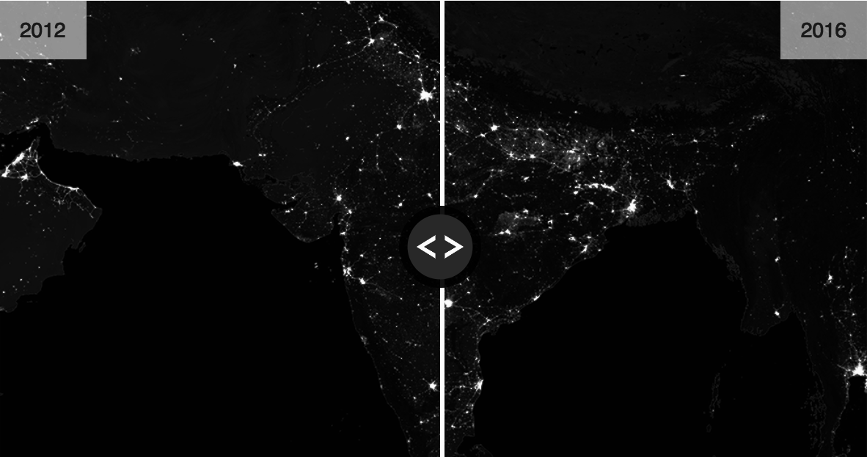
How we are losing the night
(2017，BBC Science & environment)
01 Why is this relevant?
“Satellite images reveal that earth's artificially lit area is growing by more than 2% every year.”
“Night-time light can negatively affect human sleep and health, nocturnal animal, planet seasonal pattern..”
“Researchers expected the wealthiest brightest nations to fade as they mainly switch to LED, however from 2012-2016 most developed countries just remain as bright, and urban bright spots in UK grows even brighter...”
Notes:
Which discuss current issue of light polltution. Satellite images have reveal that earth's artificially lit area is growing by more than 2% every year.Researchers expected the wealthiest brightest nations to fade as they mainly switch to LED, which do not appear as bright on the satellite's view, however from 2012-2016 most developed countries just as bright, and urban bright spots in UK even grow brighter, as the same time in india also grows dramatically
Night-time light can affect our sleep and health, nocturnal animal, planet seasonal pattern
So is it the time the turn down the light?

Slide 8
The
The Data

Slide 9
The six Cities
02 The Data
Tokyo 35°41′N 139°42′E
London 51°30′N 0°08′W
New York City 40°40′N 73°56′W
Stockholm 59°20′N 18°04′E
Delhi 28°37′N 77°13′E
Sydney 33°52′S 151°13′E

Slide 10
The Data sources
02 The Data
Globe at Night:
Citizen-science campaign from 2015-2017, 15,382 observations (2017)
Sunrise and sunset times:
For six cities
NASA Suomi Mission:
Satellite imagery 750 x 750 km from 2012

Slide 11
The Data sources
02 The Data
Tweets on word ‘sleep’ + sentiment analysis:
13,838 Tweets over 6 days in May 2018
Circadian Clock Boise State University:
Readings 47-year old male, 7 consecutive days

Slide 12
How they relate
02 The Data
LIGHT
HUMAN ACTIVITY
‘Sleep tweets’
When in the day people tweet
How they feel when they tweet
Circadian Clock
Biochemical body states over the length of a day
Globe at Night/NASA images
Anthropogenic sources
Sunrise and sunset times
Natural sources
patterns?

Slide 13
The
Implementation

Slide 14
Website Architecture
03 Implementation
Pre-loader
Universe
Globe
Earth
Tweets frequency and 3D light model
City
Circadian Clock
Human-being
Notes:
-Flat hira: Content is more discoverable when it's not buried under multiple intervening layers
-mixed type of presentation/ aggregated Vs individual city views
-cross platform, more user friendly/

Slide 15
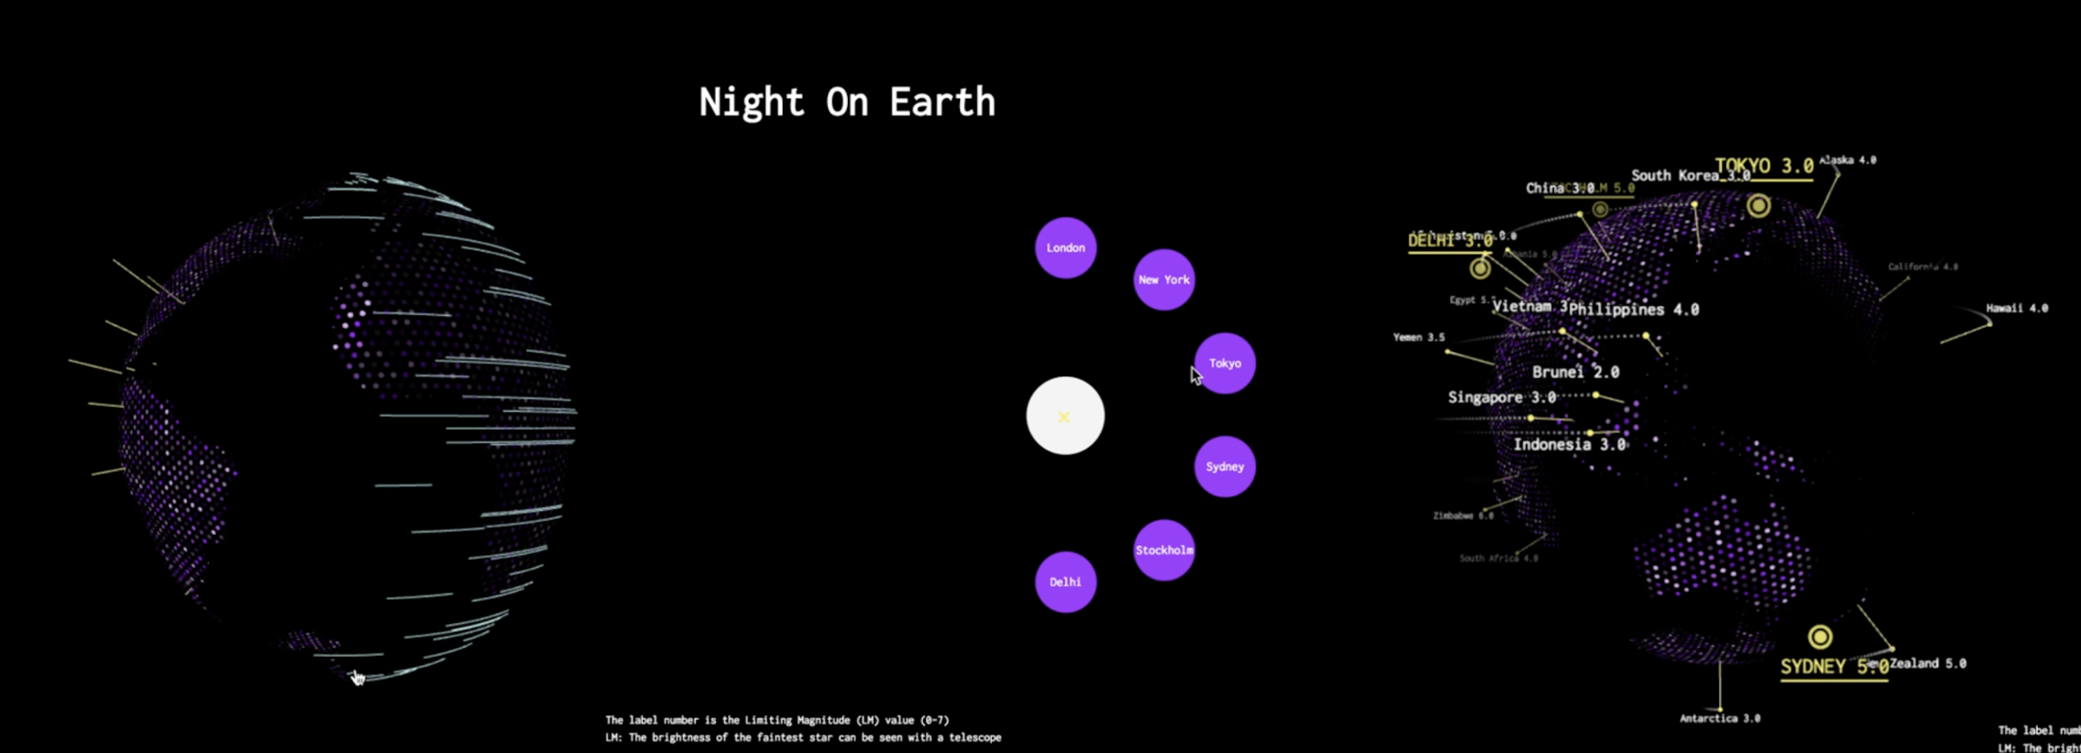
Three.Js （cross-platform/animation)
Library collaboration and User experience optimization
Reduce the bias of the crowdsourcing Data & Data Projection
Notes:
-pro load page
- browser friendly
- threeJs +mouse event
- setTimeOut+ frameCount for animation effect
- WebGL globe
Based google webGL globe experiment
-3D globe based on three geo / exclude
-project the data in a 3D globe (median value to avoid bias)
-

Slide 16
Threejs
03 Implementation
A cross-browser JavaScript library used to create and display animated 3D computer graphics in a web browser by using WebGL.
Elements: Scenes, Cameras, Controllers, Lights, Materials, Data loaders
Notes:
Scenes: add and remove objects
Cameras: perspective and orthographic;
Controllers: trackball, FPS and more
Lights: ambient, direction, point and spot lights;
Materials: Lambert, Phong,textures and more
Data loaders: binary, image, JSON and scene
WebGL (Web Graphics Library)

Slide 17
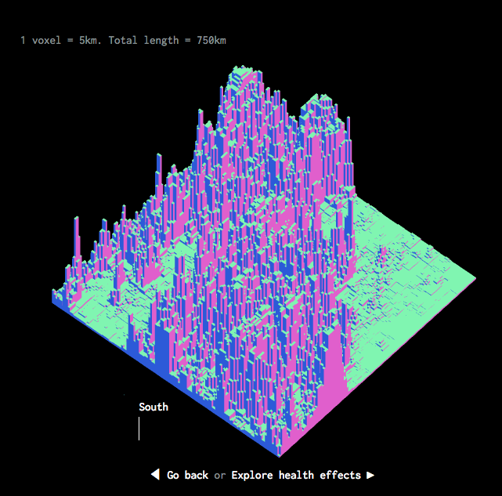
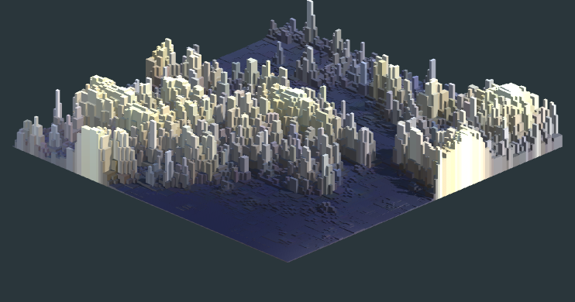
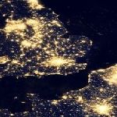
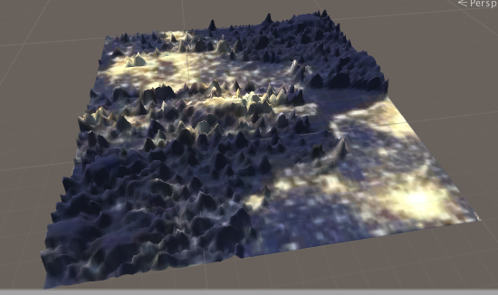
Light Landscapes
03 Implementation
750km x 750km

Slide 18
Twitter Graph
The numbers of tweets that contain the word “sleep”.
The day time and night time differences in cities
03 Implementation
Tools:
1.Python (for data cleaning)
2.Processing (for visualisation)
3.Processing.js (html)

Slide 19
Difficulties
03 Implementation
1.Scale of different cities’ graphs
2.Unexpected errors
3.Not all Processing functionalities work in Processing.js

Slide 20
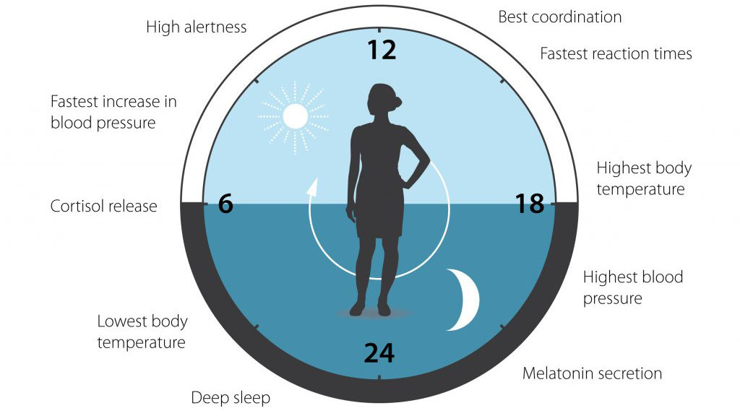
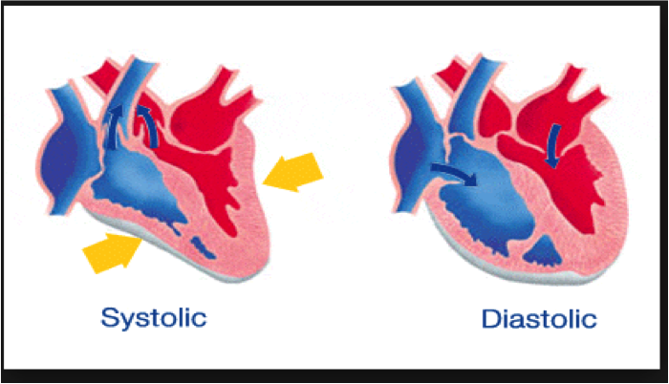
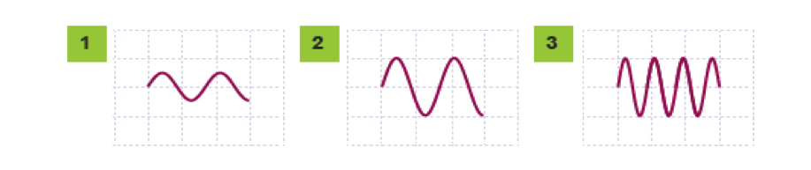
Circadian Clock
03 Implementation
How the environment represents or might represent the past, present and the future can be brought into better order if we look at how our bodies and our minds experience time - how time is built into us and yet also how we ourselves have created it.
What Time is This Place? - Kevin Lynch
Body and Mind(Sleep Well Being)
Time: Phases and Synchronous, Multi Dimensional
Waves and Pendulums
P5.JS
Clock Parts:
Circadian: Vital Life Signs Monitor
Circadian: Brightness Clock
Star Constellation
Night and Day
Twitter Mood: 2 Ways (Sight and Sound)
Clock/Dashboard.
Exploring:
Inner >>>>
Outer >>>>
Amongst Others >>>>

Slide 21
The
Project Review

Slide 22
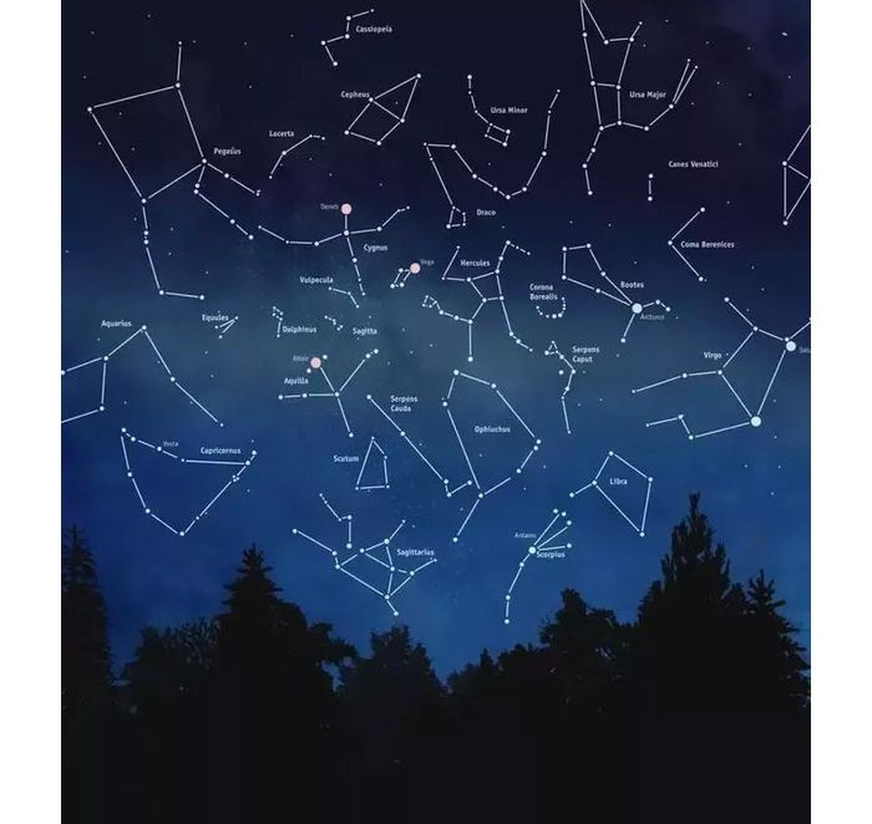
Project Review
04 Review
The City might be nothing more than flows and envelopes. The flows might involve the movement of people, plants, animals, air, water, and information
Amphibious Envelopes (Sentient City) - Benjamin and Yang
Motivation Recap: Pulse, Light and Darkness, Social Network Activity.
Key Points:
Immersive
Raising Awareness
Art Design and Mood
Theme Exploration & Theme Juxtaposition
Platform Mix & Collaborative Working Tools
Sum of it Parts

Slide 23
The
Further Extension

Slide 24
Further Extension
05 Further extension
1.Improve the responsiveness for cross-platform experience (mobile/tablet/different browsers)
2. Improve the cinematic vibes by adding more interactive audio effect...
3. Extend the sources of social activity data (eg. Foursquare check-in / Facebook / Instagram)
4. Improve the aggregate view

Slide 25
The
Questions
http://www.bbc.co.uk/news/science-environment-42059551
https://www.globeatnight.org
https://www.timeanddate.com
https://worldview.earthdata.nasa.gov
http://www.circadian.org/data

