Slide 1
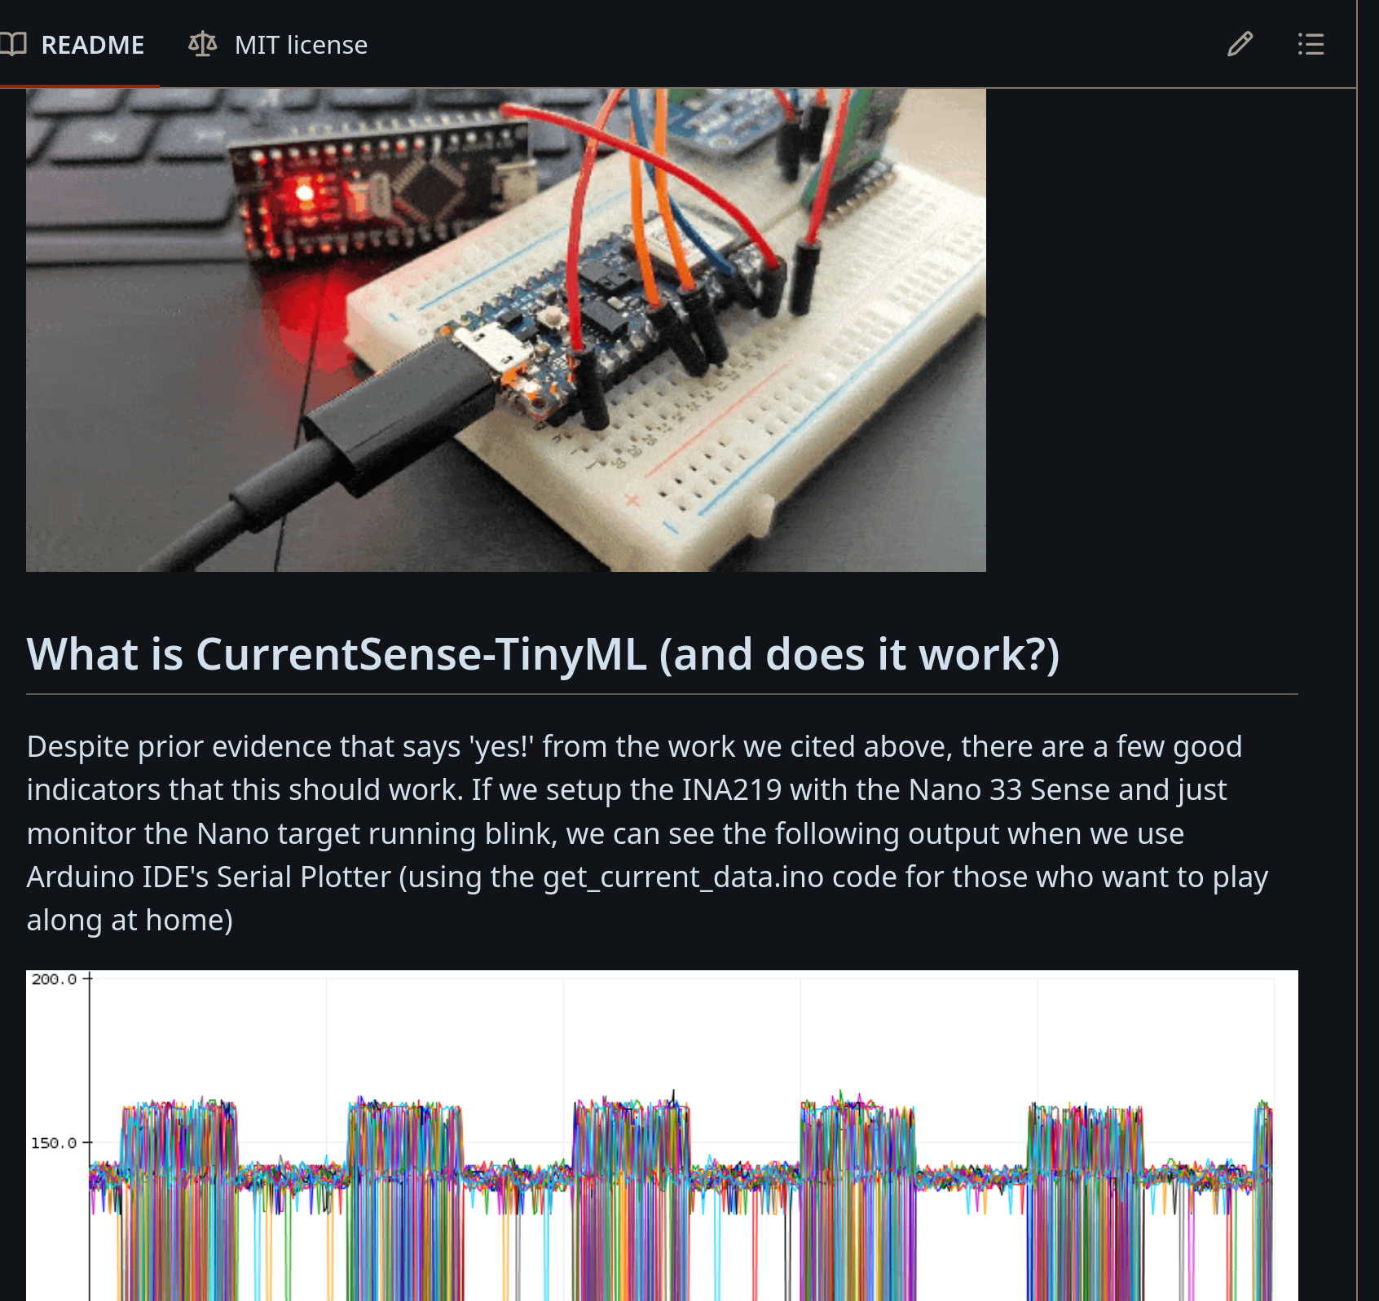
2021 https://github.com/Santandersecurityresearch/CurrentSense-TinyML
- Santander Group Cyber Security Research Team
- read current from target and predict LED on / off state

Slide 2
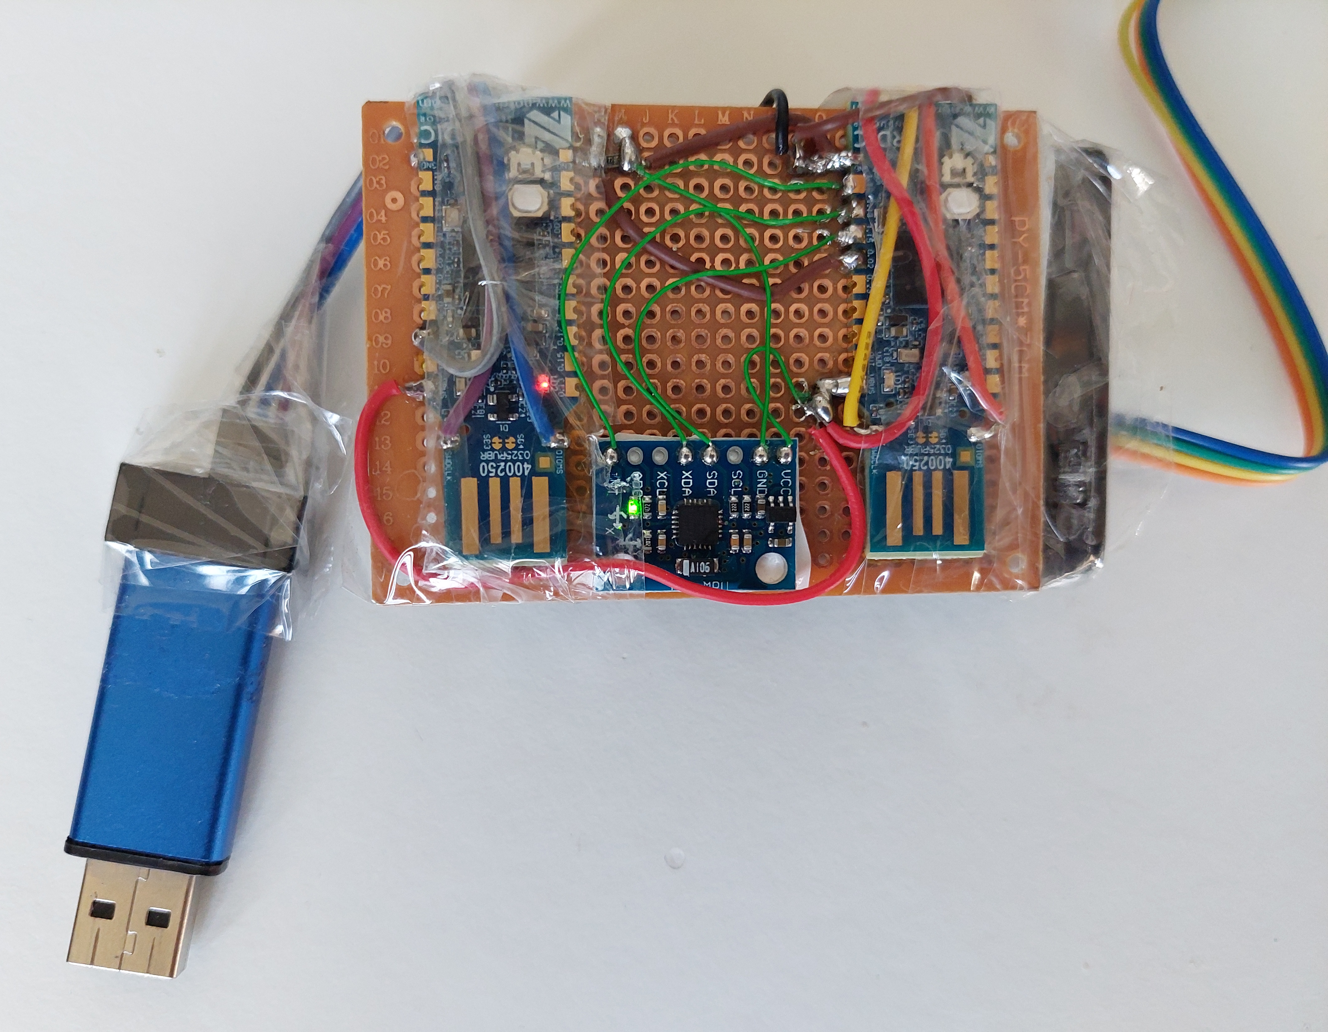
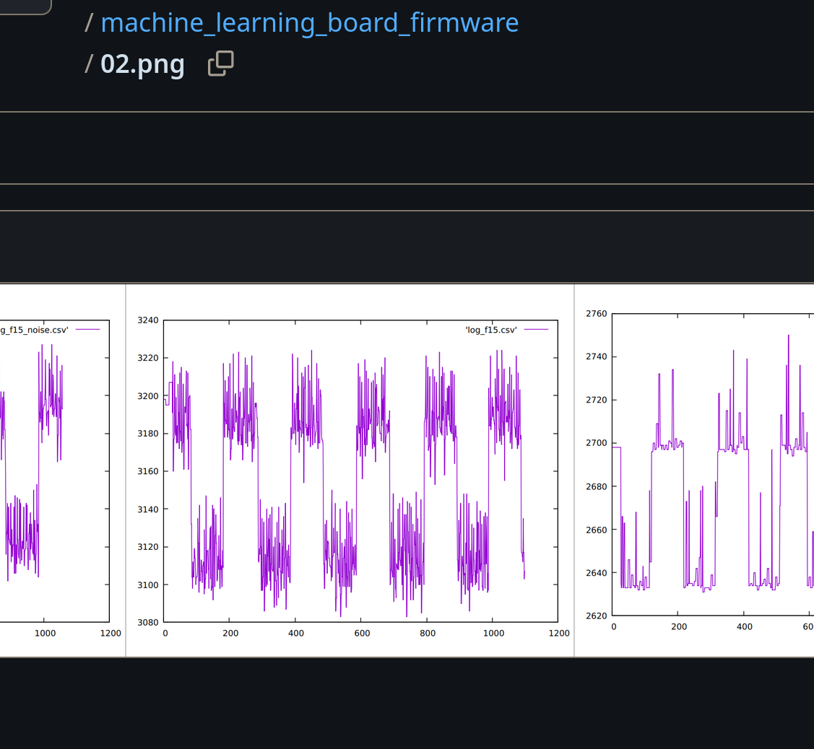
2021
- didn’t finish the project due to my lack of knowledge
- no AI to help as of today in 2024

Slide 3
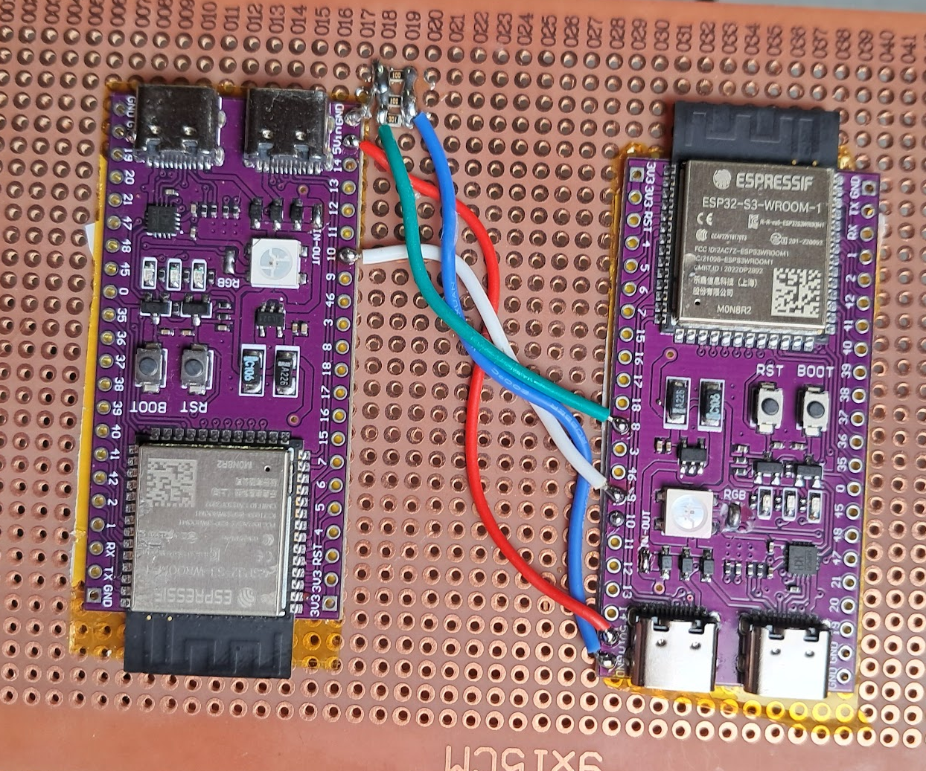
2024
left: target board | right: observer board
RGB LED: R, G and B values [0 - 255]

Slide 4
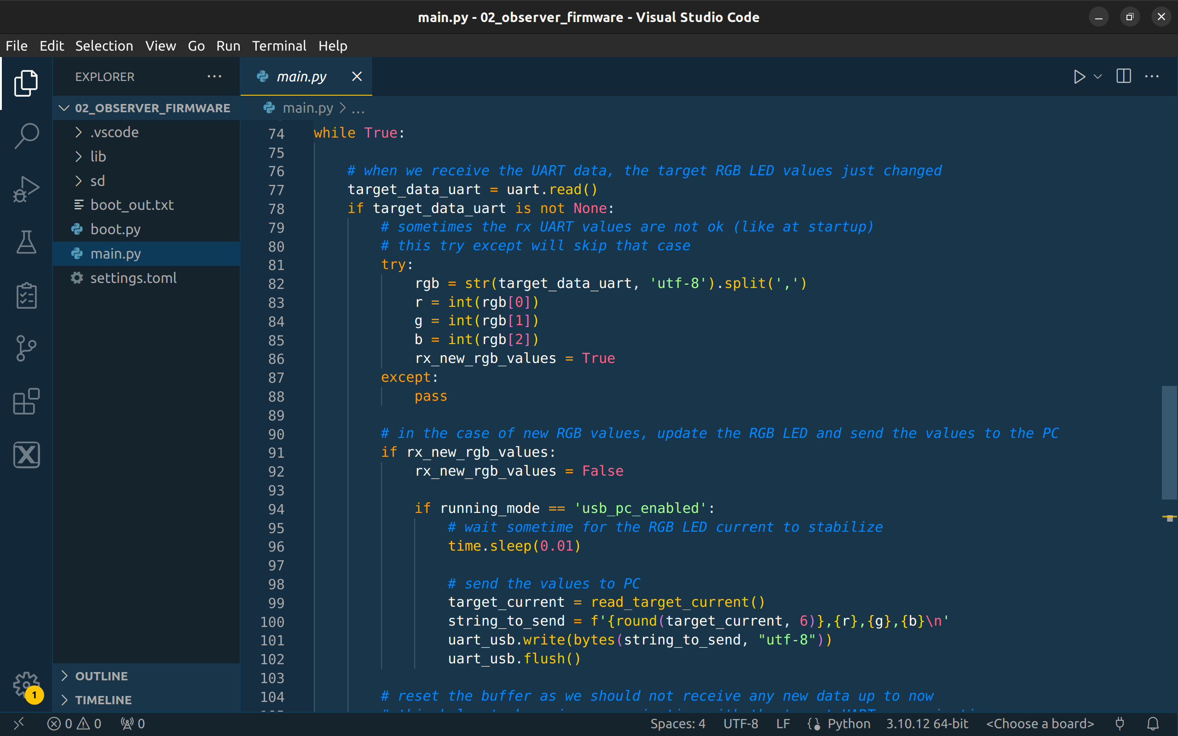
- Python firmware on both boards + PC software
- ADC oversampling to reduce the noise
- PC software is ready to receive current and send the RGB value

Slide 5
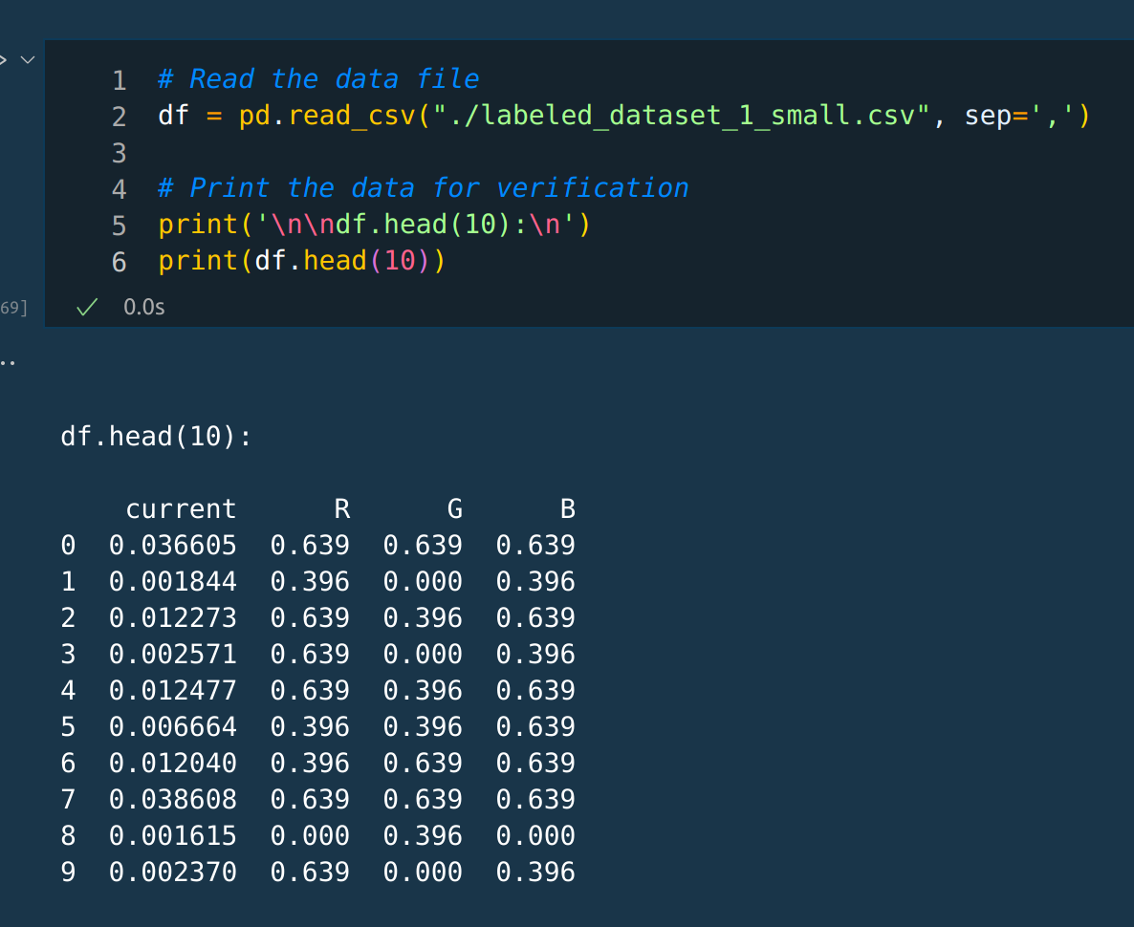
27 possible combinations

Slide 6
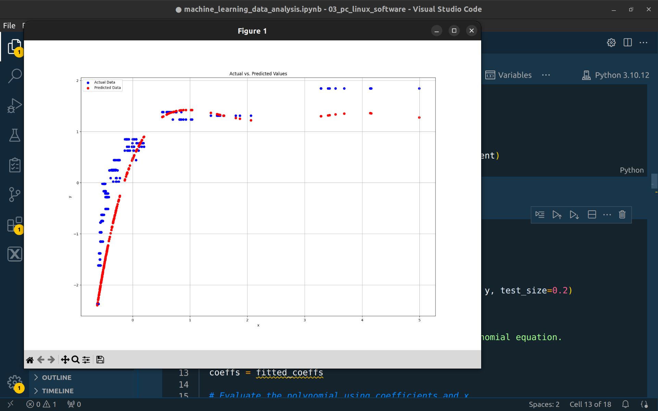
- feature engineering
- testing polynomial fit

Slide 7
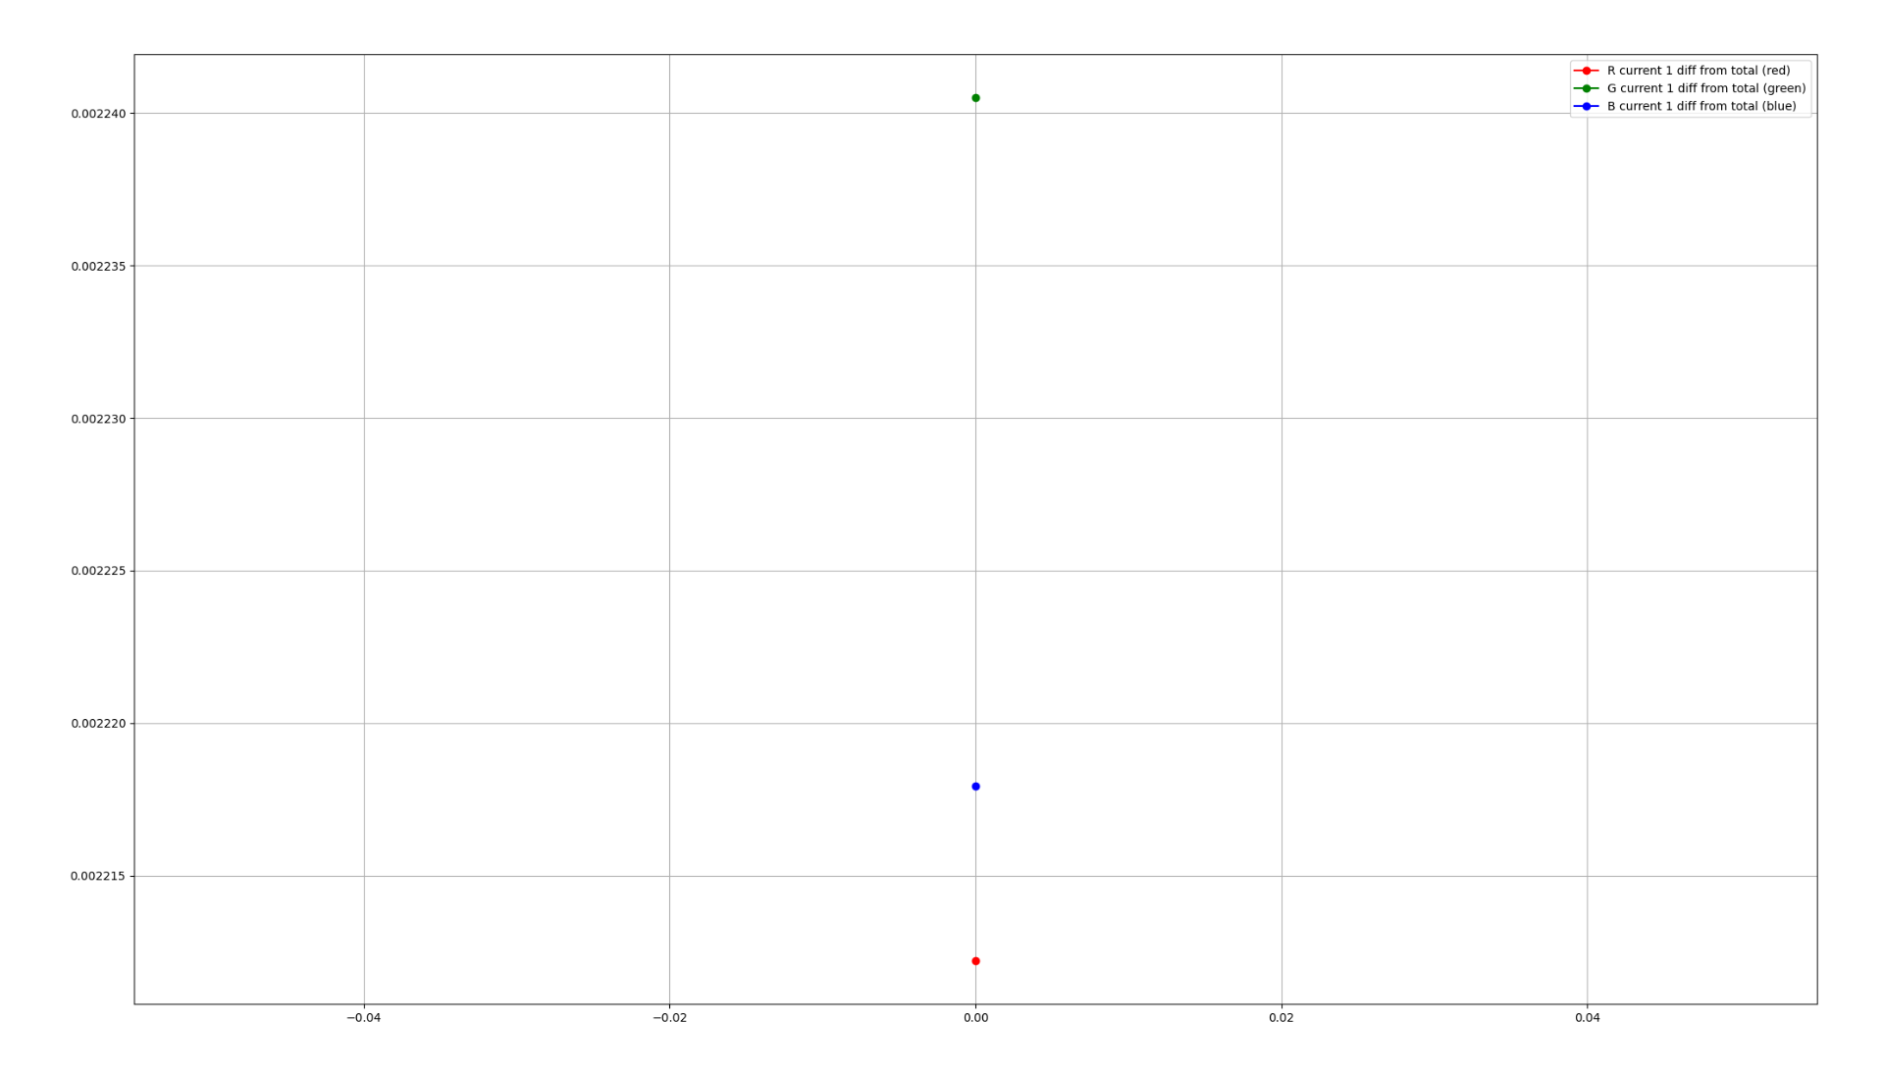
- very small differences of each current from the total currents
- need to (quickly) improve the hardware to read higher values

Slide 8


