Slide 1

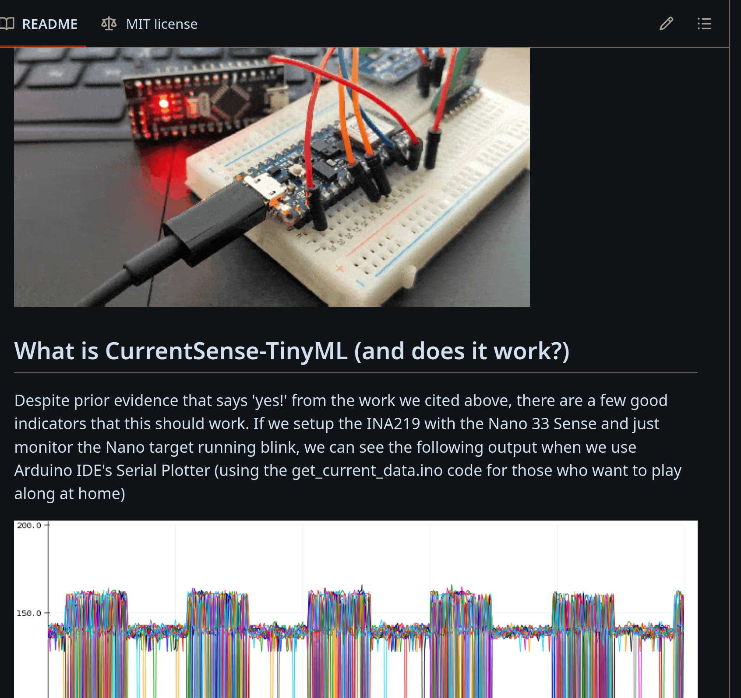
Inspiration
Inspiration
  Santander Group Cyber Security Research Team
  Read current from target and predict LED on/off state
  https://github.com/Santandersecurityresearch/CurrentSense-TinyML
01 June 2024, ESTGA, Águeda

Slide 2
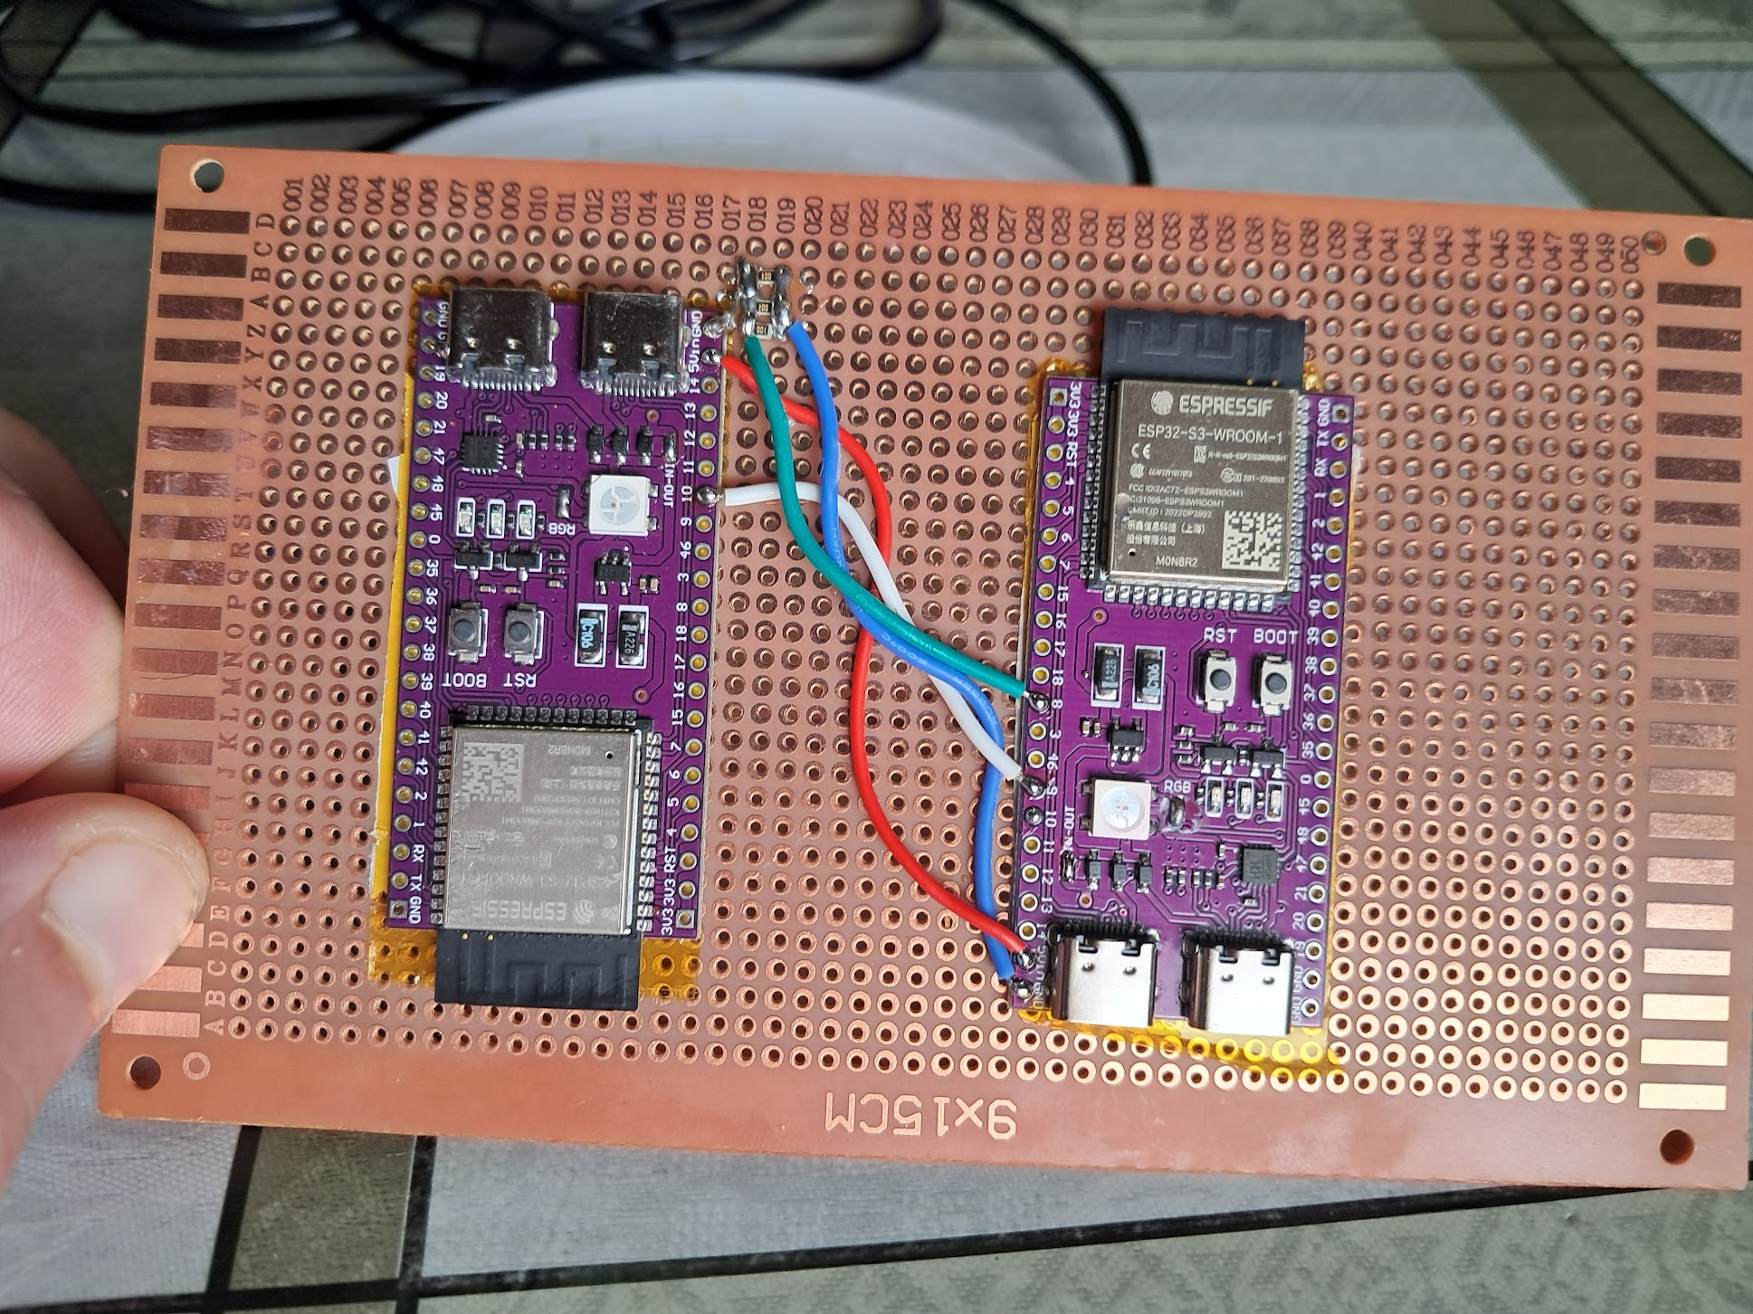
Hardware
Target board
  3 different energy values for each R, G, B channels??
Observer board
Poor man current reading: ADC + resistor
Python firmware

Slide 3
Training
Target board
  Random blink RGB LED
Observer board
  Read target board energy usage
Target board → RGB state → Observer board
Observer board → RGB state and energy → PC

Slide 4
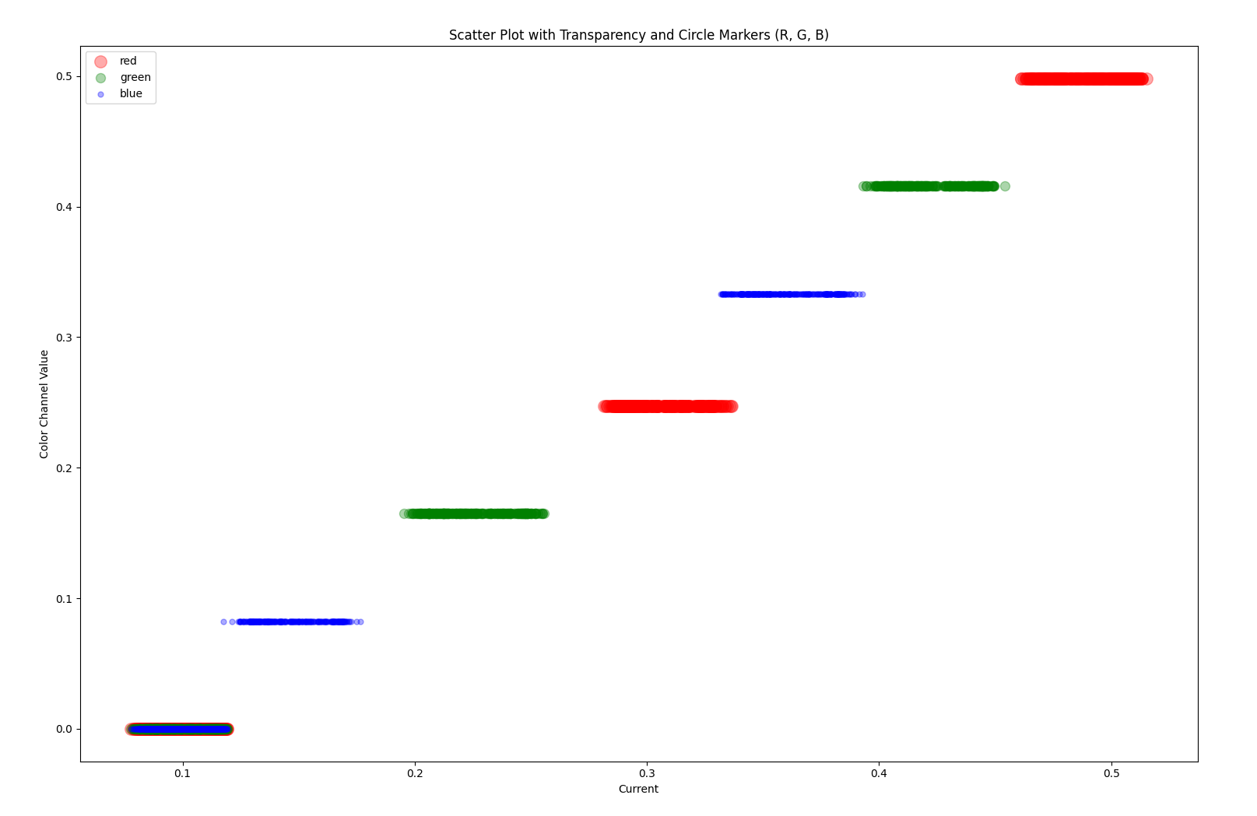
To much noise
Values overlap due to to much noise
Possible actions
  Check the electric signal
  Use a dedicated IC for measurements
  Testing software filters

Slide 5
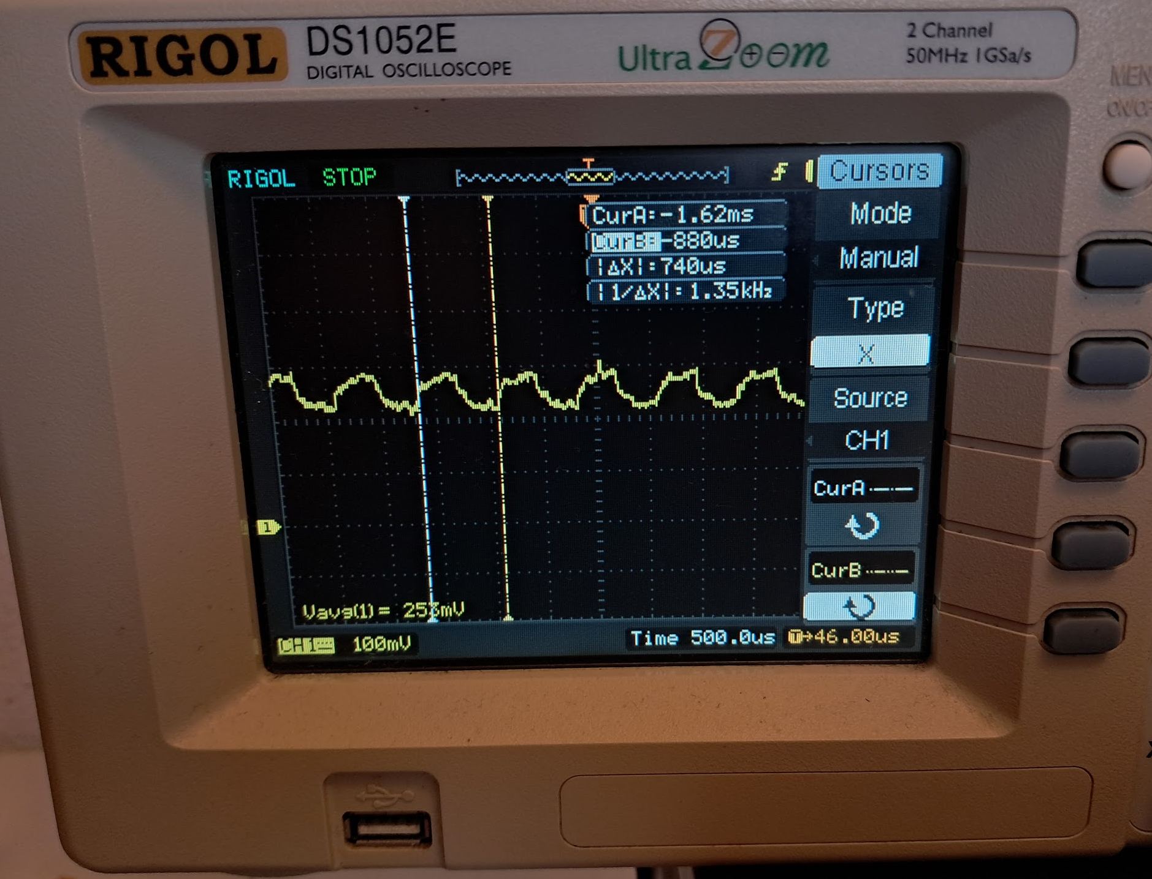
PWM energy
IC controlling each R G B channels
  Energy is equal for each channel
  Pulsating energy, not constant

Slide 6

Filters
PWM filtering: reading signal 5 or 10x slower
Noise filtering: median of 15 readings
  1/5 of a second
  STD measure to evaluate Median VS AVG
https://www.youtube.com/watch?v=lcfSk9RP8xA

Slide 7
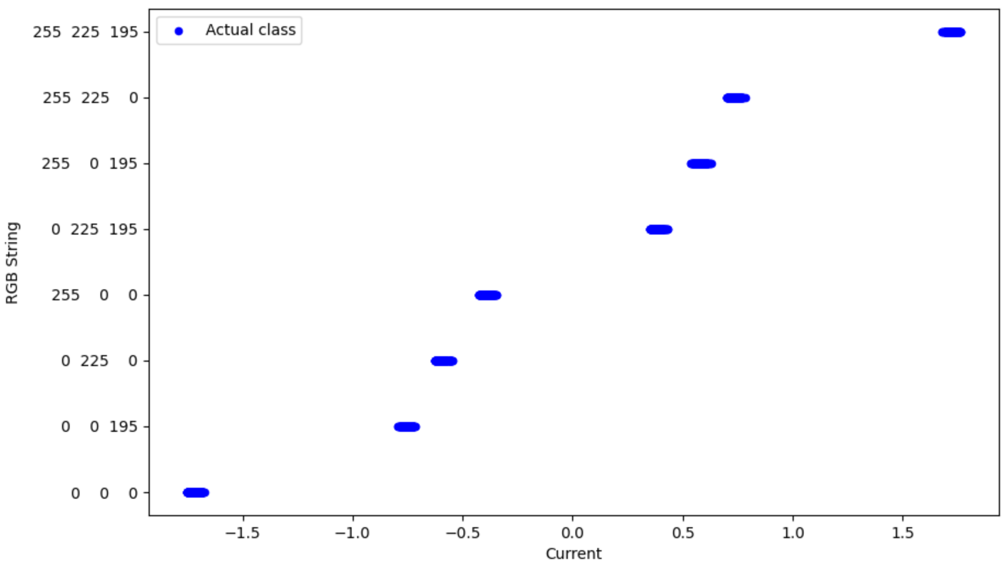
Filters (cont.)
After
  Dedicated IC for measurements
  Software filters

Slide 8
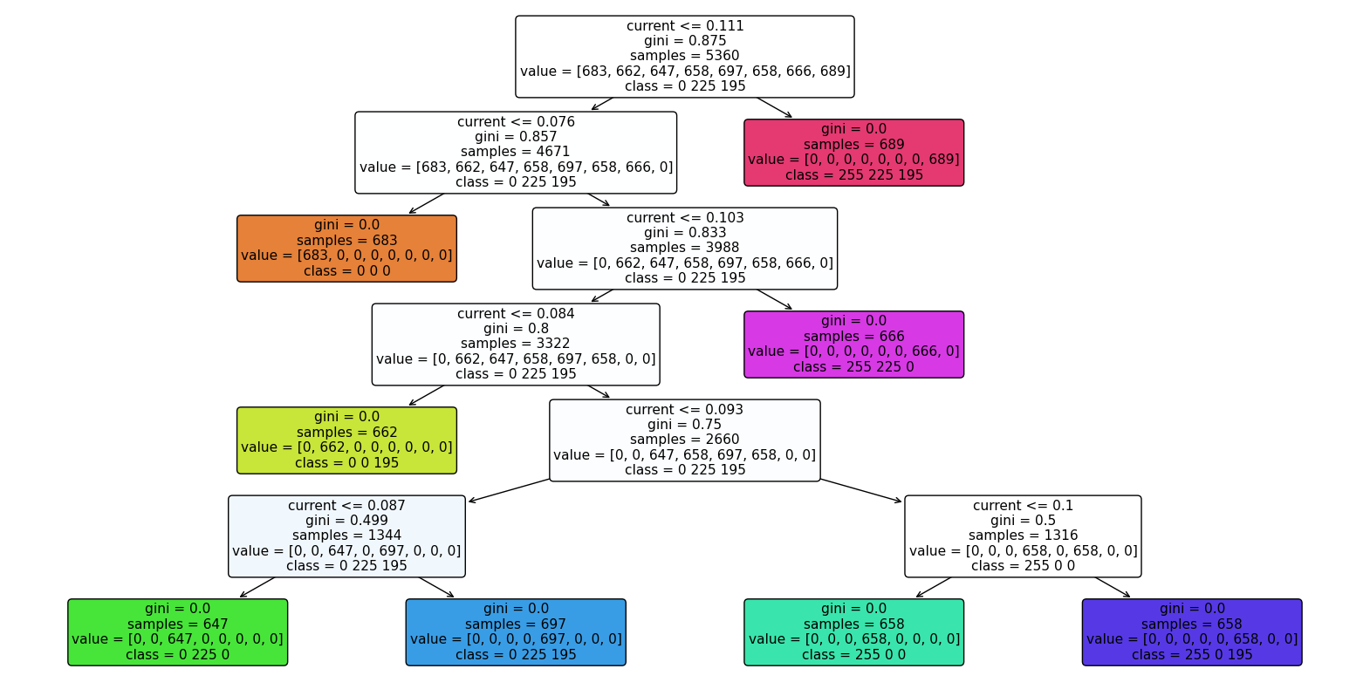
Decision Tree
Precision 100%, “perfect” confusion matrix
sklearn.tree plot_tree
Very simple to implement
Implemented on the microcontroller
Processing time: ~1us

Slide 9
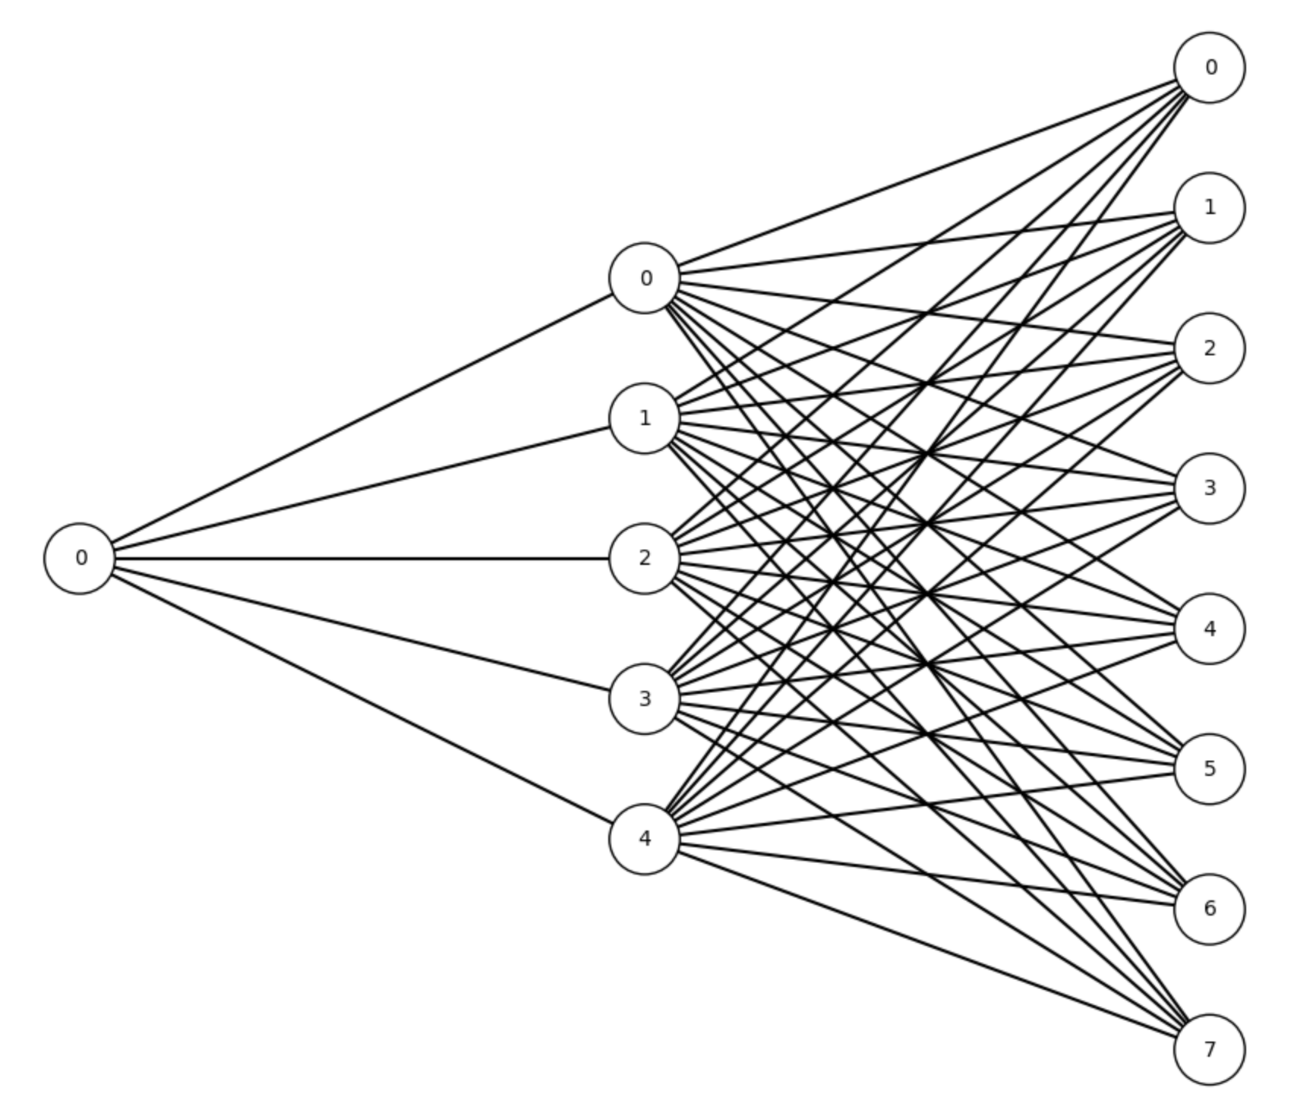
Simple NN
Precision 100%, “perfect” confusion matrix
1 hidden layer
5 nodes only

Slide 10
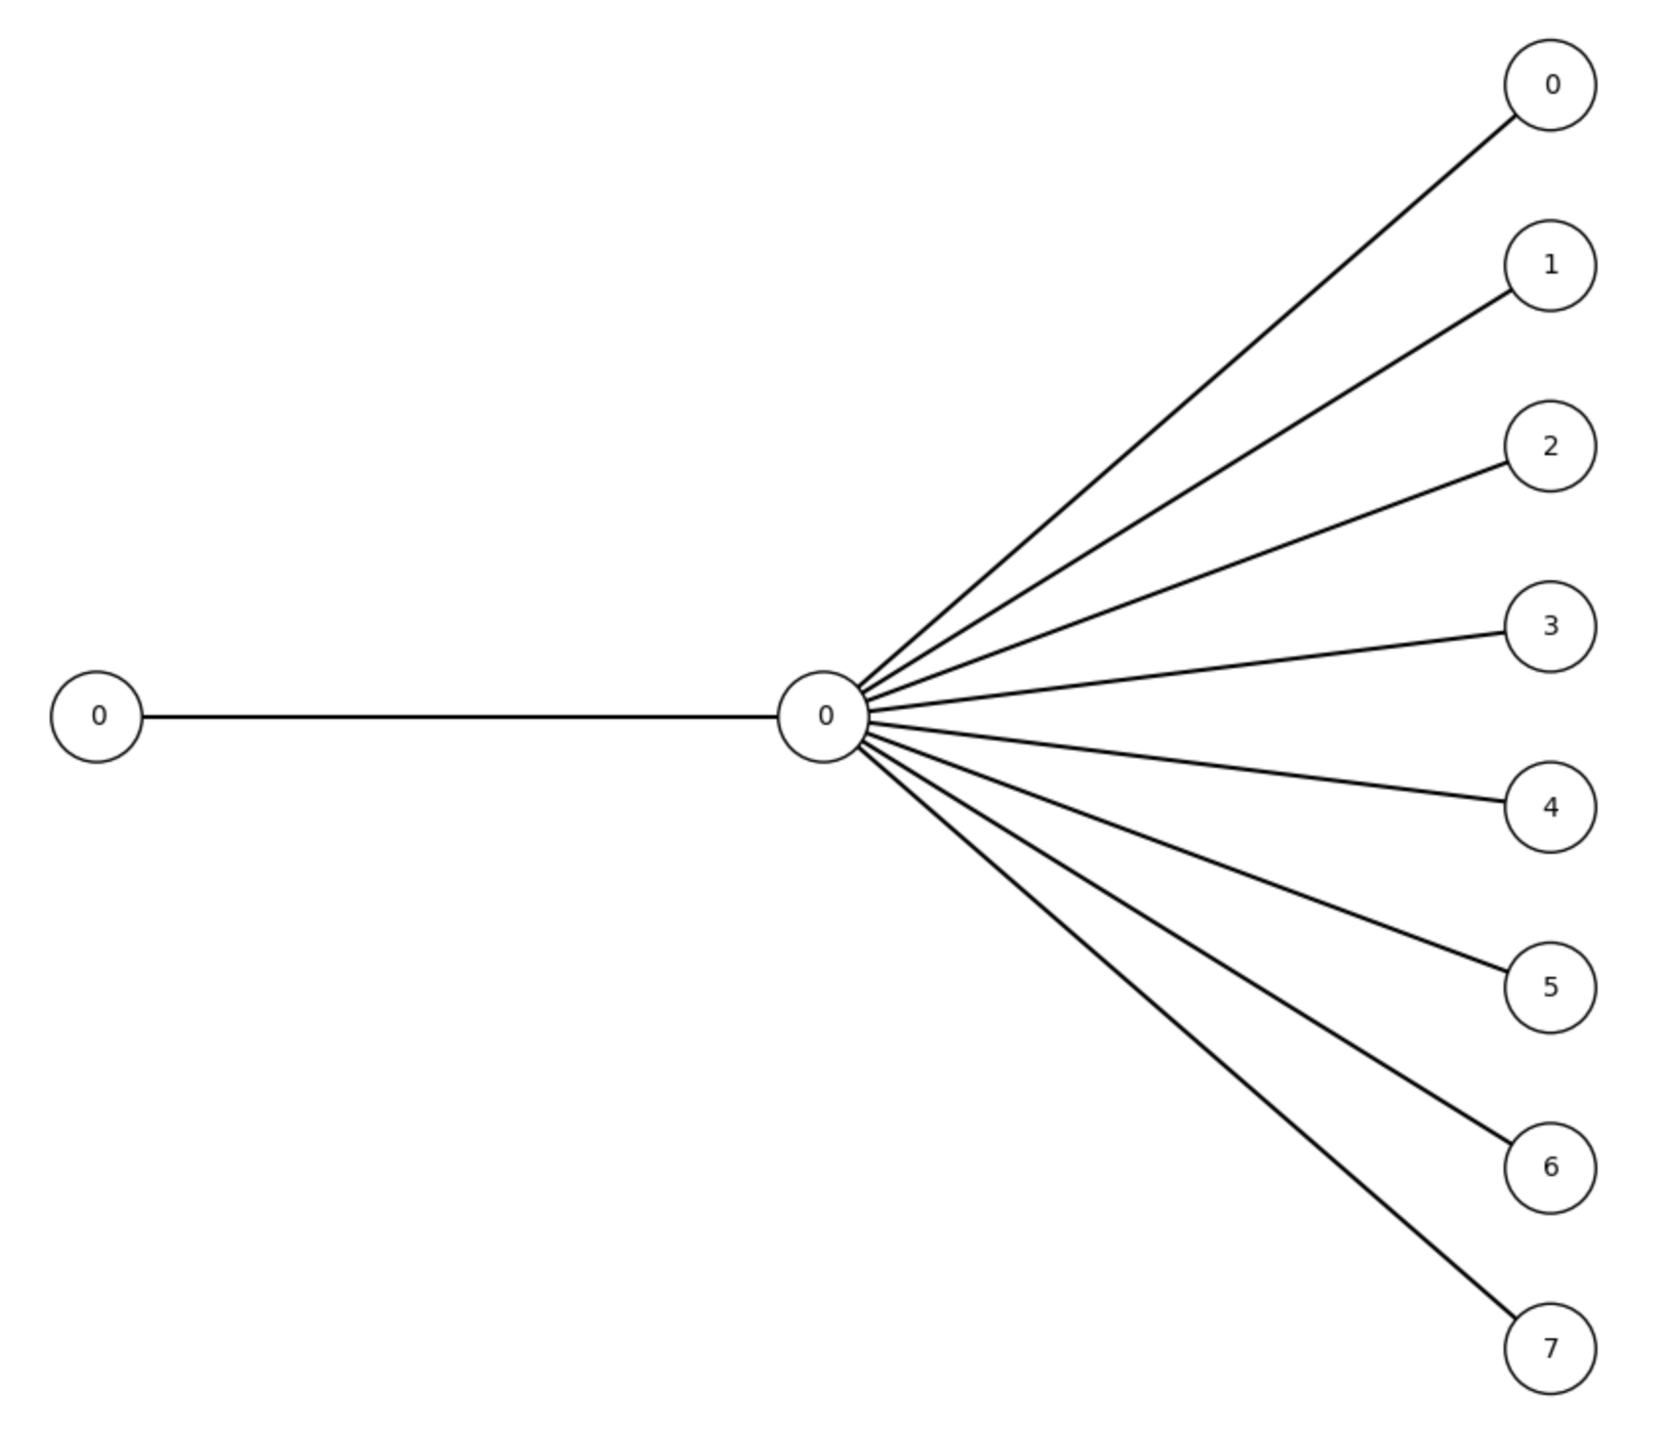
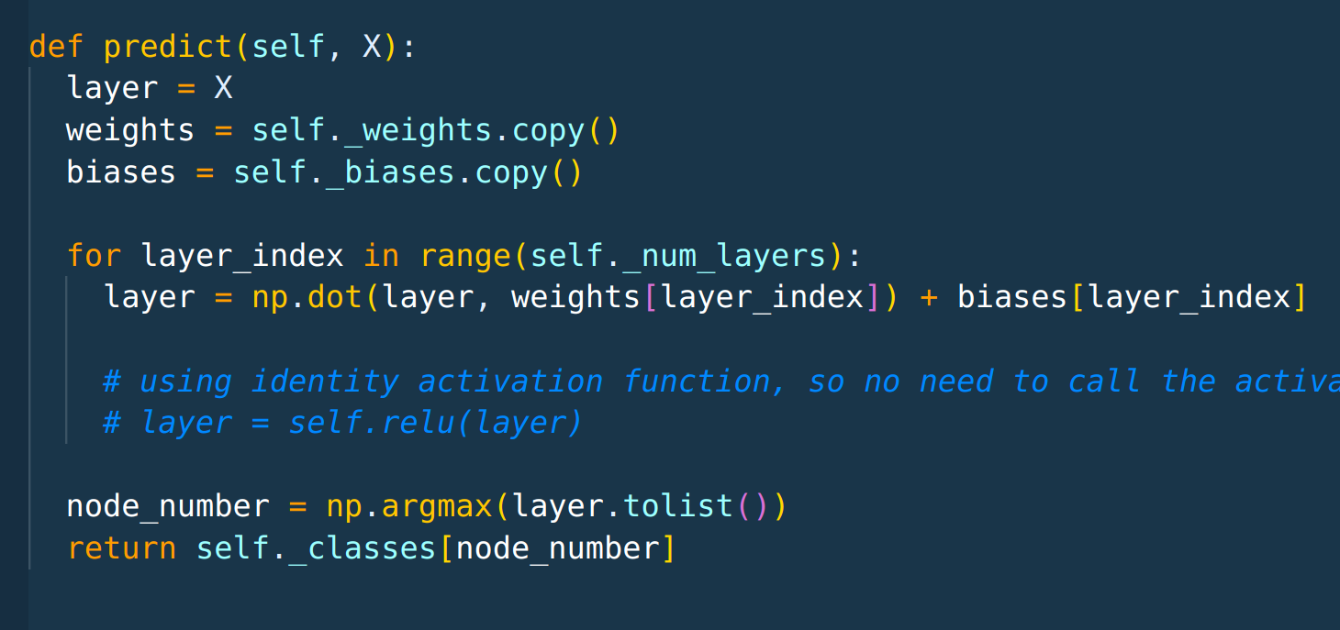
Simple NN (cont.)
Precision 100%, “perfect” confusion matrix
1 hidden layer, 1 node only
Weights, Biases exported from sklearn
Processing time: 500us
ESP32-S3 has matrix multiplication DSP

Slide 11
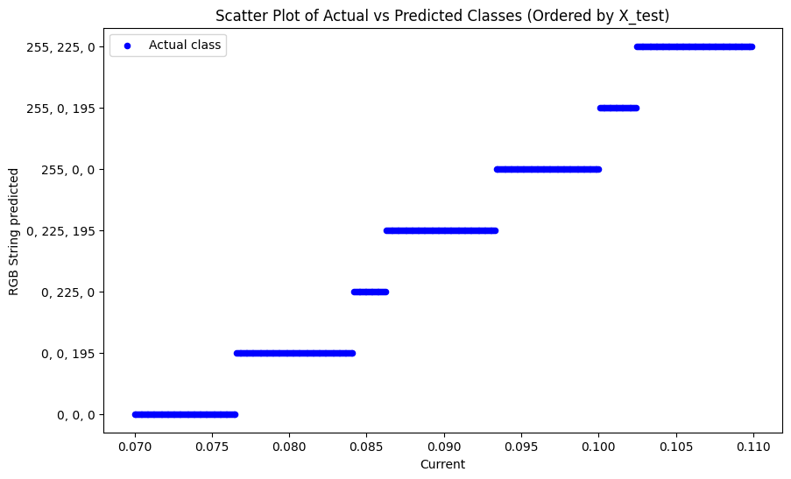
Simple NN (cont.)
Input all possible valus and check the transitions between classes

Slide 12
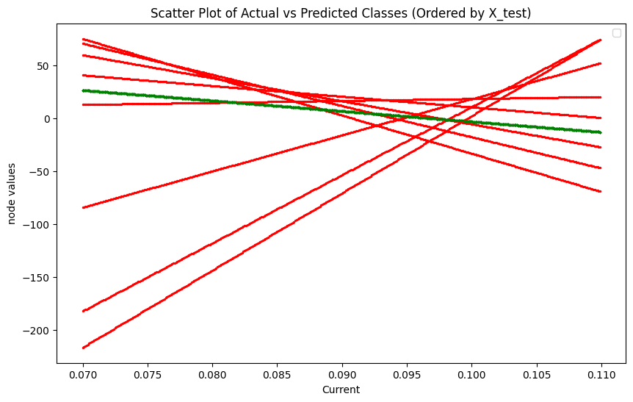
Simple NN (cont.)
Checked the internal states
Each node has identify activation function
  Y = ( weight * X ) + bias
  Straight line equation
Each line represents the value on the output node
Node with MAX value → class

Slide 13
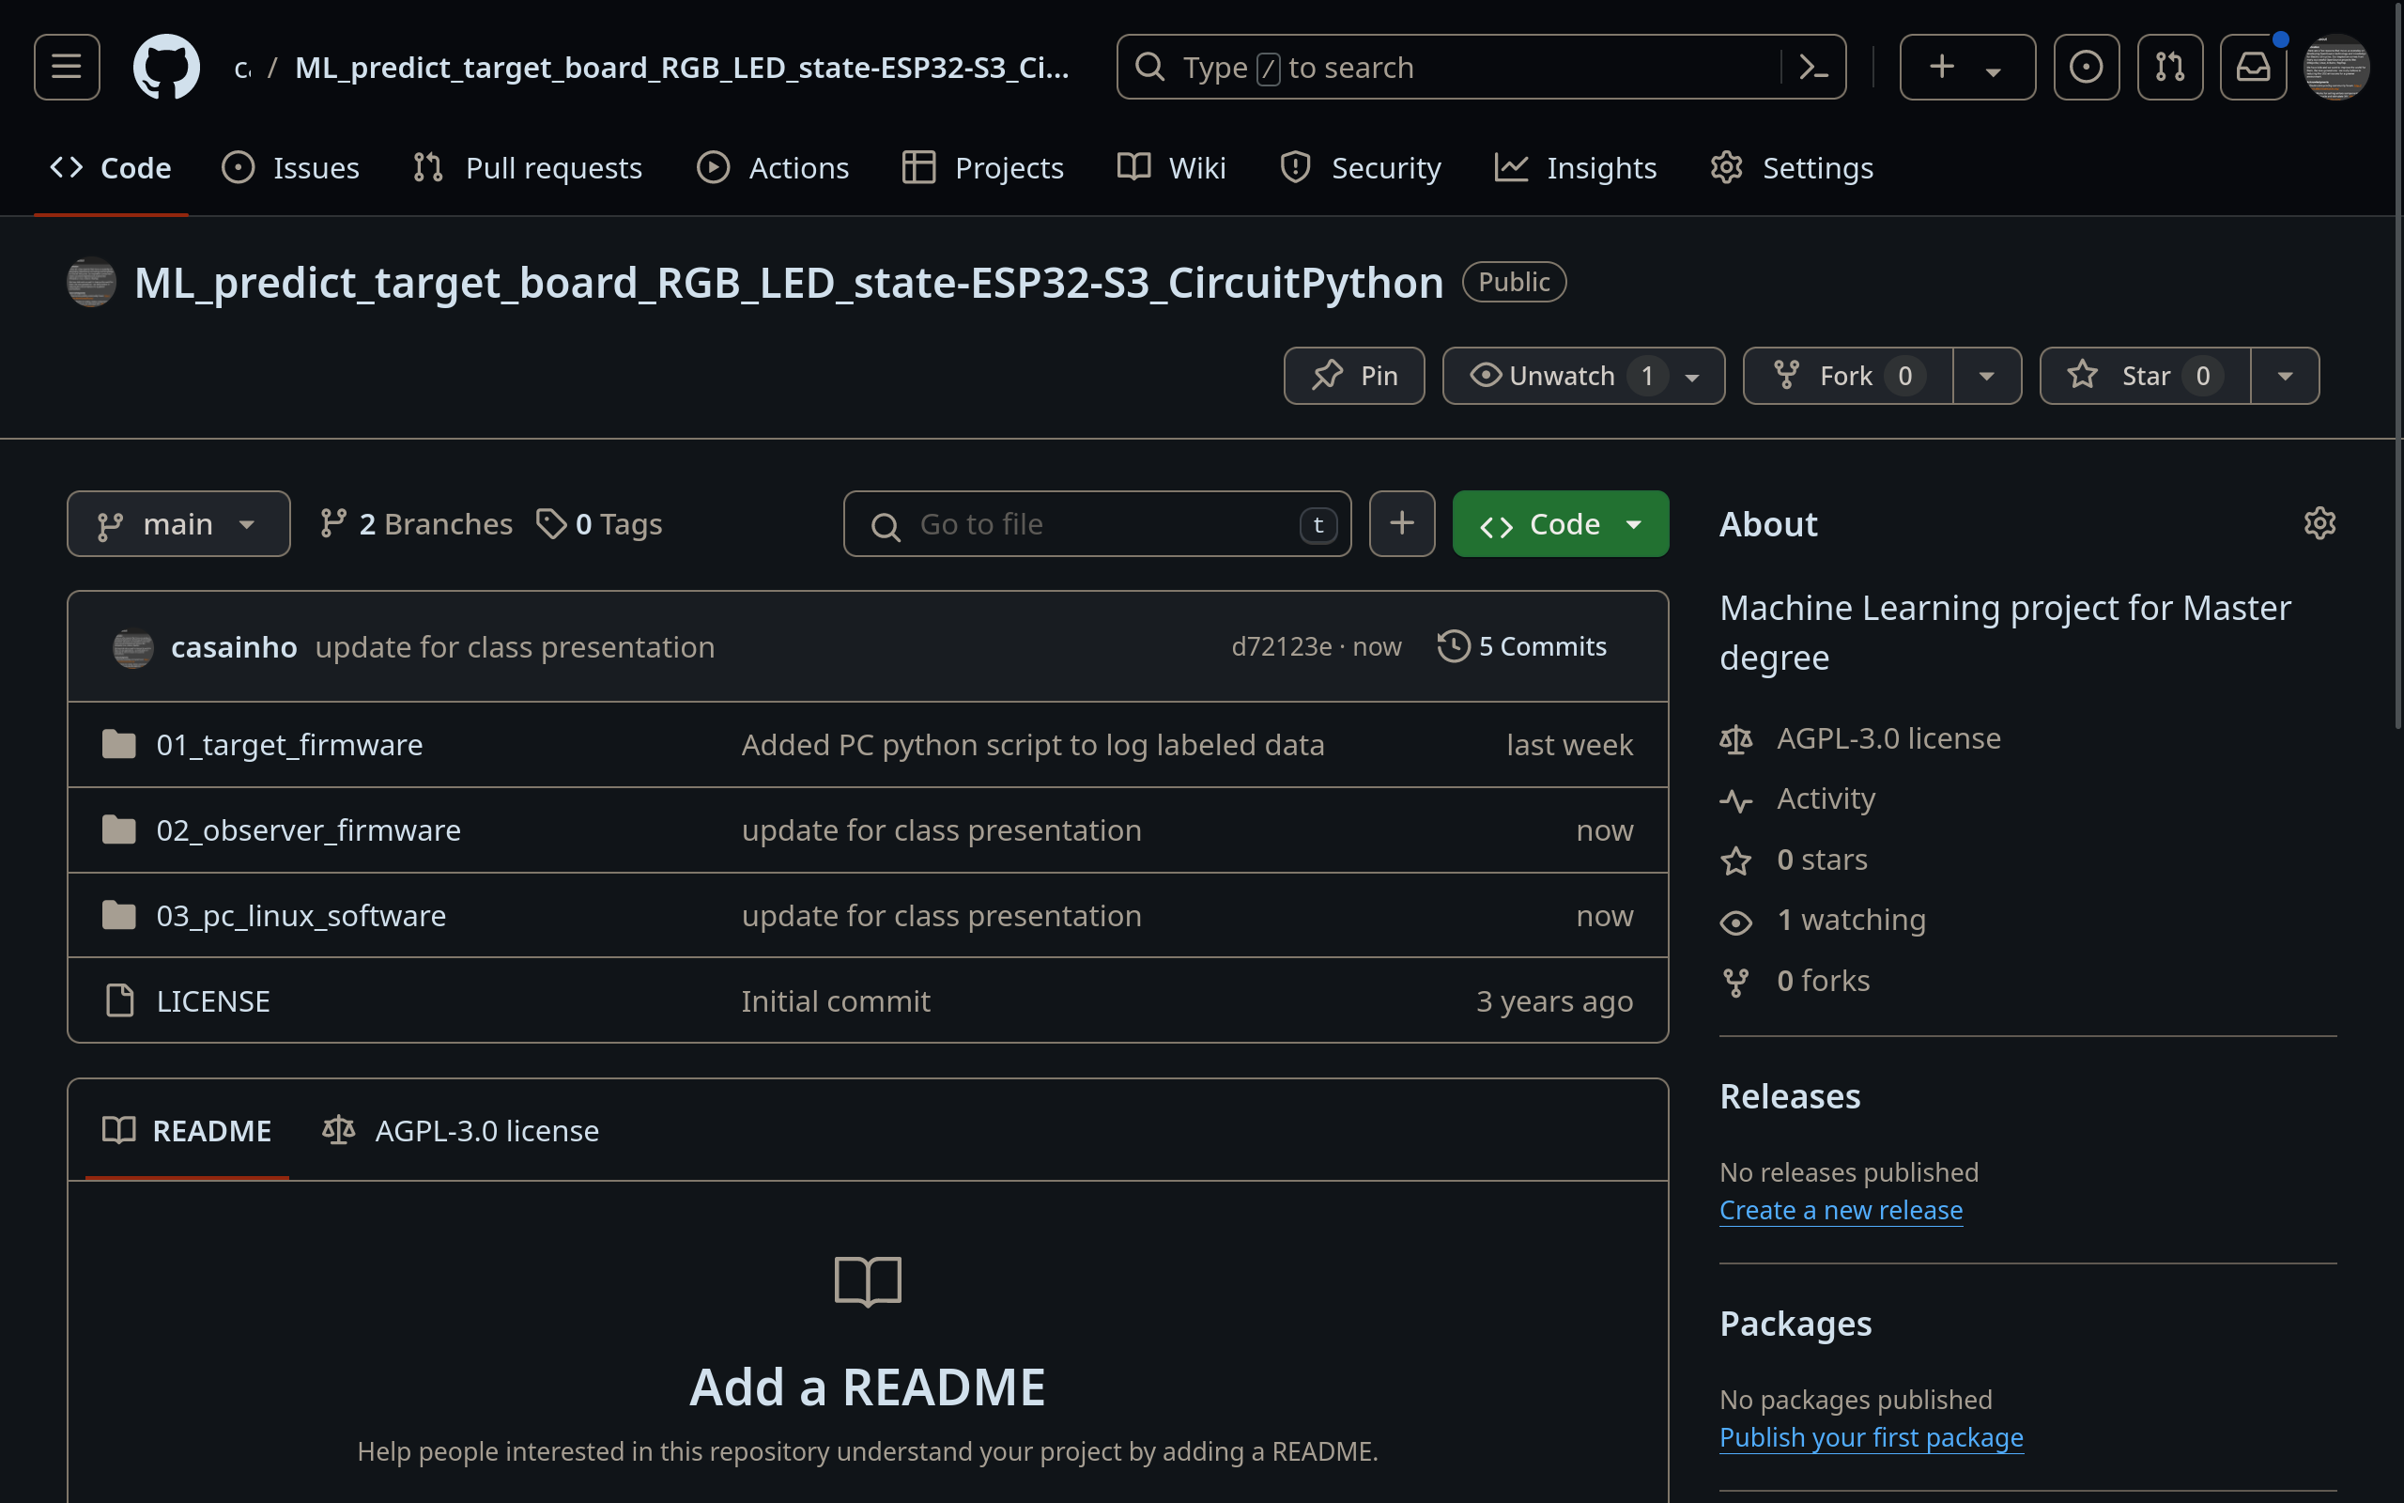
Future work
Is possible to predict the next RGB value by predicting the next RANDOM value generated inside the microcontroller?

