Slide 1
.NET
Free. Cross-platform. Open source.
A developer platform for building all your apps.
www.dot.net

Slide 2
¿Que es .NET?
Juan David Pareja Soto
CreApps
Notes:
So what is .NET?

Slide 3










Una plataforma para construir
¡cualquier aplicación!
DESKTOP
WEB
CLOUD
MOBILE
GAMING
IoT
AI
.NET
Notes:
You can build anything with .NET. From desktop apps to cloud-native services, iPhone and Android mobile apps to artificial intelligence, you can build almost anything with the .NET platform.

Slide 4

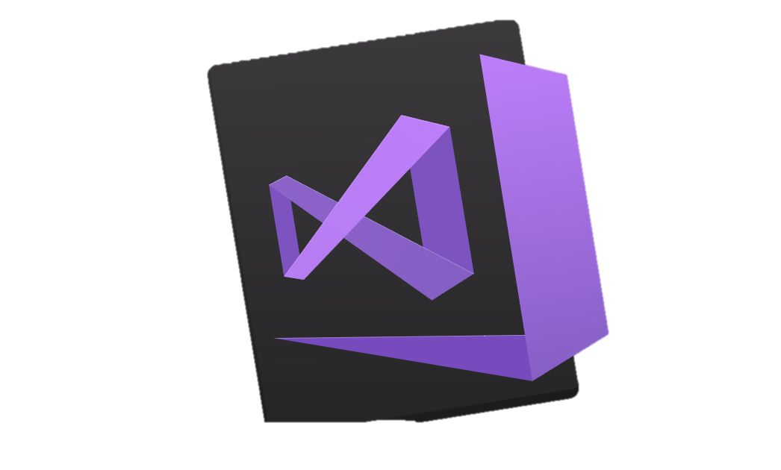


.NET es una plataforma para Desarrollo
TOOLS
DESKTOP
WEB
CLOUD
MOBILE
GAMING
IoT
AI
VISUAL STUDIO
.NET STANDARD
VISUAL STUDIO FOR MAC
LIBRARIES
VISUAL STUDIO CODE
INFRASTRUCTURE
RUNTIME COMPONENTS
COMPILERS
LANGUAGES
COMMAND LINE INTERFACE
Notes:
.NET is an entire software development platform that takes care of a lot of the heavy lifting for you when you want to build an application. Applications frameworks help you build the specific types of apps or workloads and enable you to literally build any app for any platform with any operating system. Each .NET workload shares a common infrastructure and .NET Standard library. This means not only are your .NET skills portable, but your actual code is portable no matter what you’re building. This makes it easy to share reusable components (called libraries) across the breadth of applications people build.
Additionally, there are a broad set of development tools that makes it really productive to write, debug, build and manage code bases.
See: www.dot.net

Slide 5
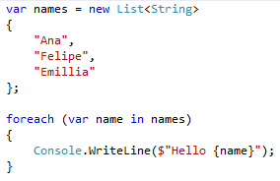
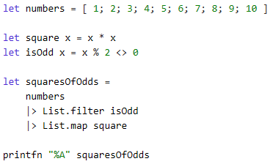
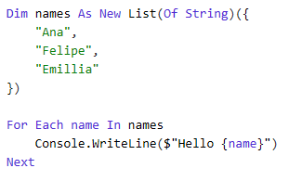
You can write code with many .NET languages
C# (c-sharp)
C# es un lenguaje “tipado”, sencillo, moderno y orientado a objetos
Al nacer de la familia del lenguaje C, C#es muy familiar para programadores C, C++, Java, y JavaScript.
F# (f-sharp)
F# es un language multi-plataforma y opensource enfocado a la programación functional en .NET
Tambien soporta paradigma orientado a objetos y programación imperativa
Visual Basic
Visual Basic es un lenguaje de gran recorrido, sintaxis sencilla que permitir construir aplicaciones orientadas a objetos
Notes:
(Speak to slide bullet points.)

Slide 6
.NET es rápido. Realmente rápido!
2.22M
0.73M
requests / sec
0.53M
requests / sec
requests / sec
Java Servlet
.NET Core
Node.js
Data sourced from official tests available at TechEmpower Round 15.
“Using the same-size server, we were able to go from 1,000 requests per second per node with Node.js to 20,000 requests per second with .NET Core.“ — Raygun
https://www.microsoft.com/net/customers
Notes:
.NET is fast. Really fast! That means applications provide better response times and require less compute power. StackOverflow serves 5.3M page views a day on just 9 servers!
The popular TechEmpower benchmark compares web application frameworks with tasks like JSON serialization, database access, and server side template rendering - .NET performs faster than any other popular framework.
https://www.techempower.com/benchmarks/#section=data-r14&hw=ph&test=plaintext
The community has played a crucial role in performance work for the .NET stack.
https://blogs.msdn.microsoft.com/dotnet/tag/performance/

Slide 7

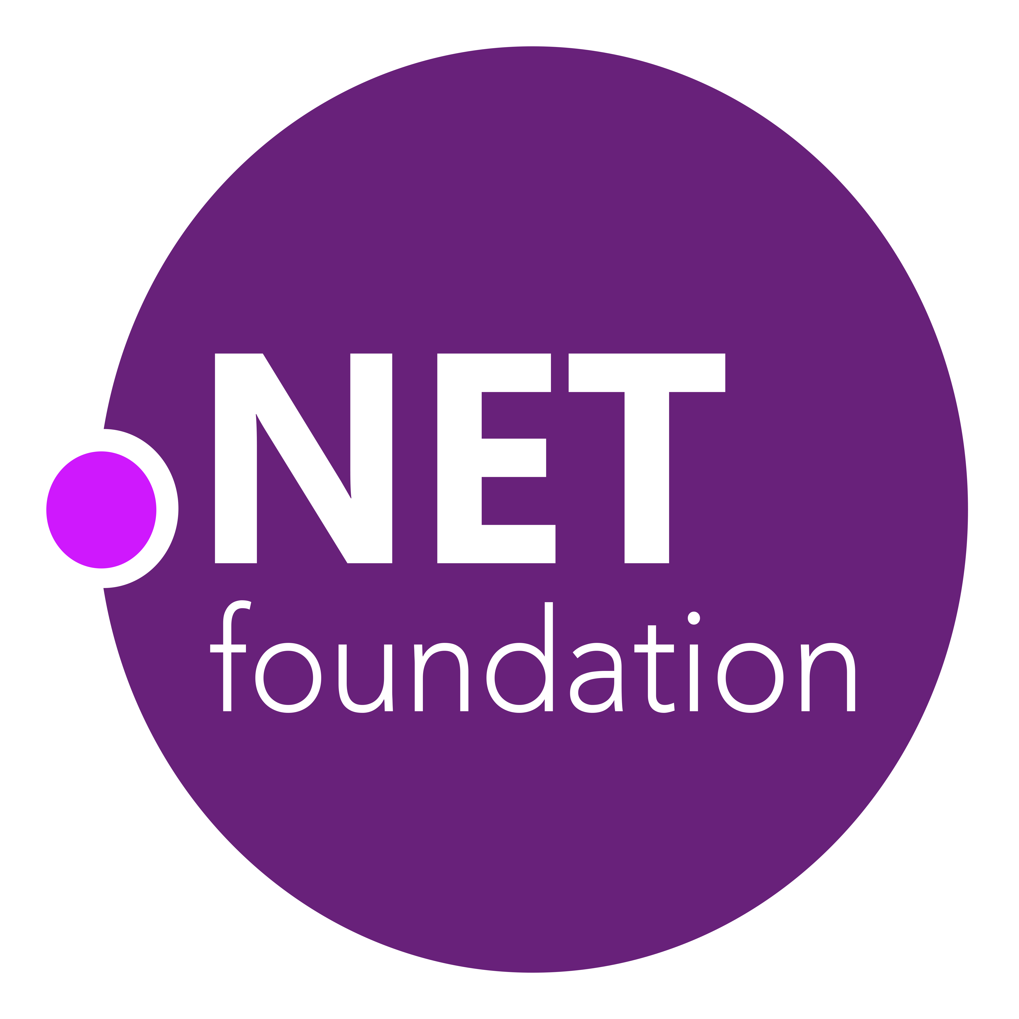
.NET Open Source Journey
2001- ECMA-335
2002- .NET 1.0 for Windows released, Mono project begins
April 2014- .NET Compiler Platform (“Roslyn”) Open Source .NET Foundation founded
Nov 2014- .NET Core Cross-plat, Open Source
2008- ASP.NET MVC (web platform) Open Source
.NET
Aug 2017- .NET Core 2
2016- Mono project joins .NET Foundation
Notes:
This didn’t happen overnight. Here’s a little history of .NET open source…..
Dec 2001-Feb 2002.
A new platform is born. Along with HP, Intel and others, the ECMA-335 standard was created that defined a common language infrastructure to support multiple programming languages. C# and Visual Basic.NET were released and F# came later in 2007, but there are over 20 other .NET languages today. Visual Studio .NET was released and included C#, VB, C++ development all in one box. This was the first IDE that was truly integrated across multiple languages.
Mono project begins. The CLI spec gave others the ability to create their own .NET implementations. Even though Microsoft built the first .NET Framework for Windows-only, the spec was intentionally portable across OSes and chipsets. The Mono project began, spearheaded by Miguel de Icaza, with the goal to implement Microsoft's new .NET development platform on Linux and Unix-like platforms. Later, Miguel started Xamarin which focused on cross-platform, native, mobile development with C#, built upon Mono. This allows developers to use C# and .NET to build apps for iOS and Android. Unity games development also emerged from Mono.
2008.
ASP.NET MVC web development stack is released to CodePlex as open source. This was the first application development framework from Microsoft to be released as open source. The underlying runtime and compilers were still closed however.
2014.
Hell freezes over & pigs fly. Early 2014 at Microsoft’s BUILD conference, Anders Hejlsberg, the father of C#, releases the .NET Compiler Platform “Roslyn” as open source on stage. Later in November, .NET Core project begins in the open. The technology world is shocked, and the .NET community is excited. .NET Core is a new cloud-native implementation of .NET that is geared for cross-platform, hyper-scale services as well as small IoT devices. It’s meant to bring .NET into the next 15 years of computing. And the community has been extremely supportive.
2016.
Mono comes home. In early 2016, Microsoft finally acquires Xamarin and brings Miguel de Icaza into Developer Division. Mono joins the .NET foundation and is officially supported and contributed to by Microsoft. The Microsoft community officially meets the Mono community.
2017.
.NET Core 2.0 Released. Our cross platform and open source implementation of .NET finally releases to the world with unified tooling support across multiple operating systems and editors.

Slide 8

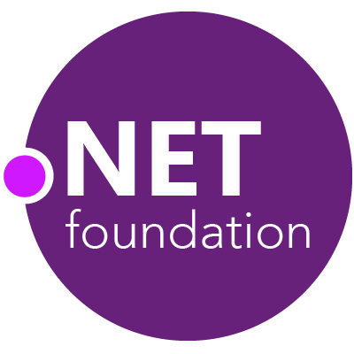
Steeltoe
.NET Core
Microsoft Web Protection Library
MSBuild
DotNetNuke
ASP.NET AJAX Control Toolkit
ASP.NET Core
SourceLink
Microsoft Azure WebJobs SDK
Salesforce Toolkits for .NET
nUnit
MVVM Light Toolkit
IronPython
Mailkit
WorldWide Telescope
Nancy
Open XML SDK
.NET SDK for Hadoop
MvvmCross
MEF
Mimekit
xUnit
ASP.NET Web Pages
NuGet
IdentityManager
Couchbase Lite for .NET
iOS
macOS
Entity Framework
.NET ECOSYSTEM
WCF
ILMerge
Xamarin.Mobile
ASP.NET SignalR
.NET Micro Framework
Open Live Writer
Mono
Xamarin.Auth
Xamarin SDK
Orchard CMS
OWIN Authentication Middleware
ProtoBuild
IdentityServer
Microsoft Azure SDK for .NET
.NET Compiler Platform ("Roslyn")
Prism
ASP.NET Web API
Cake
Orleans
Kudu
Cecil
LLILC
Umbraco
System.Drawing
ASP.NET MVC
Notes:
The .NET Foundation is our center of gravity for open development and collaboration around the .NET ecosystem. The .NET Foundation has over 60 projects and hundreds of repos under its stewardship. Open Source Software foundations provide protection, support, services and best practices for helping each project be successful and to grow the ecosystem of people and software.

Slide 9
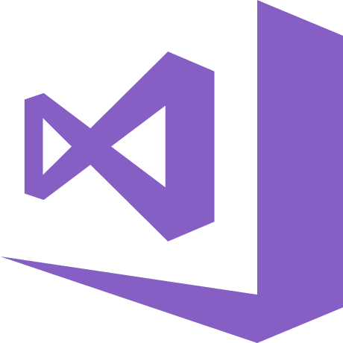
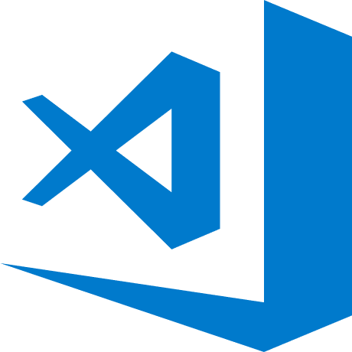
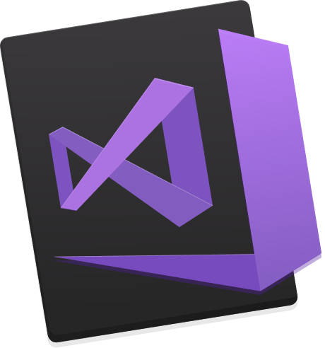
Make it easier with some free tools www.VisualStudio.com
Visual Studio
A fully-featured, integrated development environment (IDE) for developing .NET apps on a Windows PC development machine.
Visual Studio Code
Open source, cross-platform editor with .NET support.
Visual Studio for Mac
A fully-featured IDE for developing .NET apps on a Mac OS development machine.
Download from www.VisualStudio.com
Notes:
We also have free tools that can help you build your apps.

Slide 10

.NET
THANK YOU
Free. Cross-platform. Open source.
A developer platform for building all your apps.
www.dot.net

