Slide 1



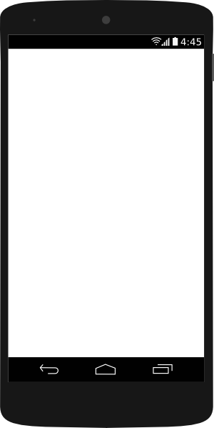


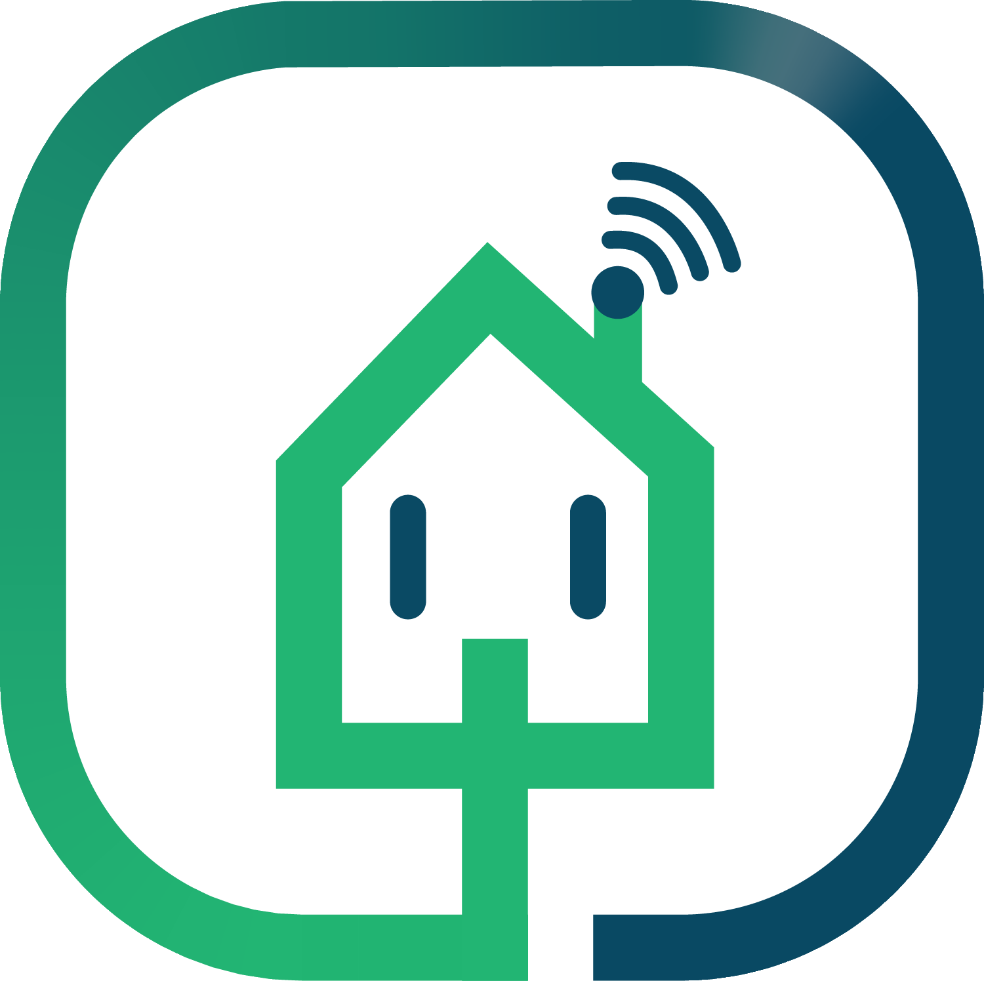
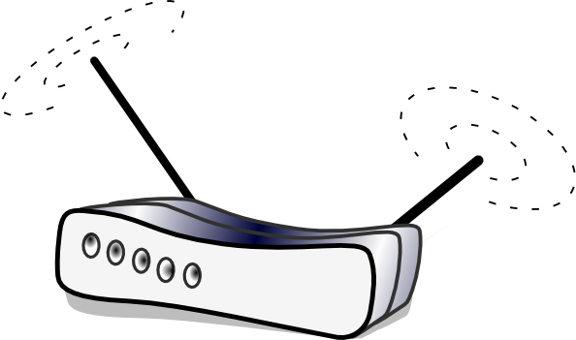
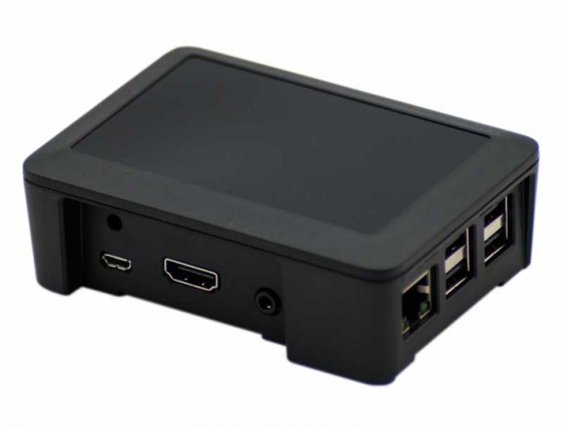
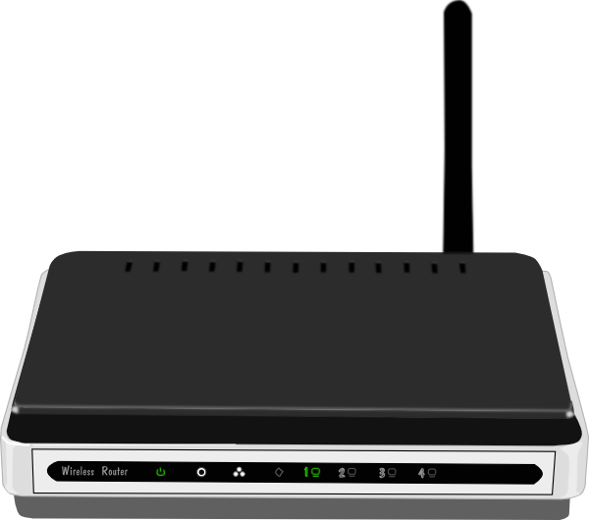
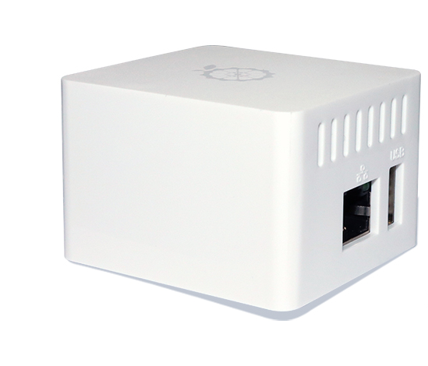
Public cloud service (AWS, Heroku, Azure etc)
casanet remote server
Web sockets channel
HTTP requests
HTTP requests
Web sockets channel
IoT devices
IoT devices
Casanet local server
Home network router
Clients endpoint device
Casanet local server
Office network router
Local casanet system
Local casanet system

