Slide 1
Internship work
Tentative estimate of the probability of occurrence of temporary supply disruption events and their intensity in terms of reduced supply and increased costs, by assuming probabilities and normalized cost increments like the past energy crises.
Pietro Casarin

Slide 2



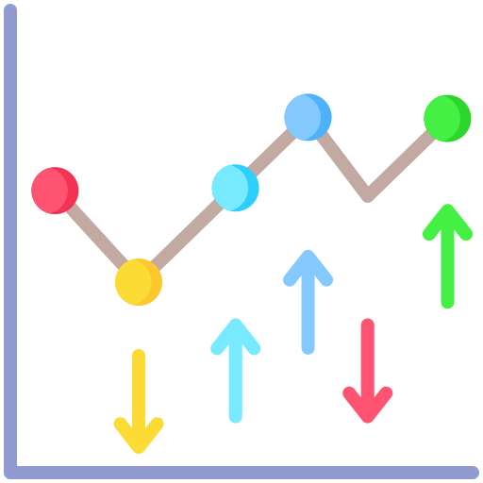









Supply disruption scenarios building
SR-based multiplier
CLUSTERING
Price disruption scenarios in EU framework
Market volatility in long/short term:
Log returns (DERA)
Rolling Δ-windows
EVT-GARCH
Hierarchical and k-means clustering
Normalization procedure
Quality check
Stability check
On annual real prices
On rolling Δ-windows
Impact Scores
Disruption
Mild increase (cycles)
EVT-GARH clustering
Clustering of tail behaviors of CRMs prices
Possible robustness check
CRMs global real prices
EU_CRM framework
SUPPLY DISRUPTION SCENARIOS
Methodology
Projects (RMIS, SCRREEN)
Source: USGS
EU-framework price elasticities
Supply Risk
Economic Importance
HHI, SI, IR, EOLRIR
All CRMs PED and PES
Database (Eurostat, SCRREEN, RMIS, …)
HS codes + Production
Sectoral value added
EU GDP and usd_eur exchange rate
Export restrictions, strikes
Mine-level, industrial-level variables
Price elasticity of the supply/demand of CRMs:
How CRMs markets and supply chains behave
Key methodologies
Supply or demand elasticity?
Short-run or long-run elasticity?
Literature review
ELASTICITY
Elasticity database
New solution
PED and PES for main CRMs
Elasticity ranges
Short and long run elasticities
High/mid/low levels
Short/long run
Data
Possible improvements
Source: www.flaticon.com

Slide 3
Index
Starting hypothesis: link between price disruptions and supply disruptions
EU_CRM framework
CRMs market analysis: → Price disruption scenarios
Pre-processing
Clustering
Post-processing
Price elasticity of demand and supply:
Literature estimates
Suggested future workflow for EU_CRMs estimation
Elasticity database
Supply disruption scenarios:
Aggregation of clustering and elasticity analysis

Slide 4
Starting hypothesis and CRMs markets
CRMs global real prices
Market volatility in long/short term:
Log returns (DERA)
Rolling Δ-windows
EVT-GARCH
Source: USGS

Slide 5
Starting hypothesis
We start our analysis from the hypothesis that the CRMs supply disruption events are linked to CRMs extreme price events:
Definition of supply disruption
Concept of risk, probability of risk, vulnerability, criticality in CRMs framework
CRMs markets and their correlation with crude oil market
Drivers of CRMs supply crises events in history
What can we define as an extreme event?
How the supply/demand function is related to price function, in global and non-perfect markets?
These are the main questions studied in the first part of the analysis, from a literature review on the criticality concept, geopolitical and macro-economical drivers, and statistical definition of “extreme”

Slide 6
Starting hypothesis – Price volatility in CRMs markets
Price as fingerprint of supply-chain health:
“Price volatility represents the greatest risk” in industry framework – DERA, 2021
monitoring and mitigation strategies (diversification, recycling) are essential parts of raw materials risk management
Analyzed through log-returns of market prices (in short and log terms), DERA ROSYS
“Price changes are determined by interactions between demand growth, mining productivity, and resource quality” - Bhuwalka et al (JIE), 2023
substitutes and large recycling rates reduce the prevalence of price risk

Slide 7
Starting hypothesis – Price volatility in CRMs markets
Price as fingerprint of supply-chain health:
“Significant heterogeneity in ETM volatility… neither GARCH nor a single SV specification systematically prevails” – Bastianin et al, 2025
No single model dominates
Study on short-term volatility
According to IEA, the price volatility is embedded with critical raw materials, as for crude oil prices. This is mainly related with the interdependency of markets not only within the same sector

Slide 8
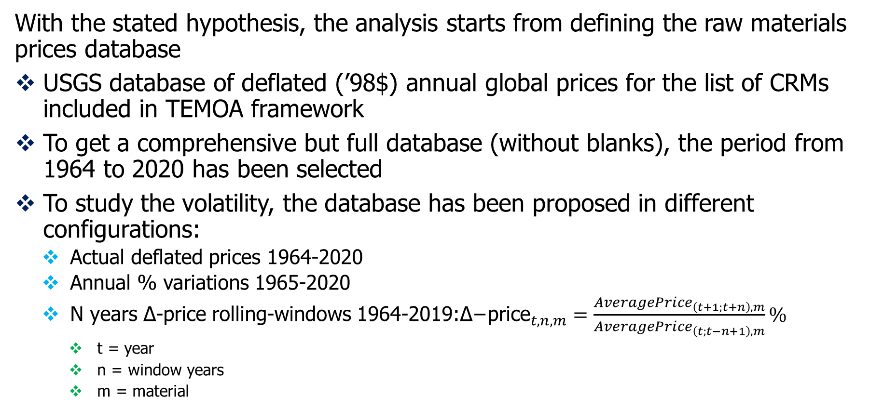
Starting hypothesis – Price volatility in CRMs markets - Database
With the stated hypothesis, the analysis starts from defining the raw materials prices database
USGS database of deflated (’98$) annual global prices for the list of CRMs included in TEMOA framework
To get a comprehensive but full database (without blanks), the period from 1964 to 2020 has been selected
To study the volatility, the database has been proposed in different configurations:
Actual deflated prices 1964-2020
Annual % variations 1965-2020
N years Δ-price rolling-windows 1964-2019:${\text{Δ}\text{−}\text{price}}_{t,n,m}=\frac{{AveragePrice}_{\left(t+1;t+n\right),m}}{{AveragePrice}_{\left(t;t−n+1\right),m}}\%$
t = year
n = window years
m = material

Slide 9



Starting hypothesis – Price volatility in CRMs markets – DERA Approach
Log returns: → stationary returns
Log return volatility:
Rolling volatility: → how volatility changes in time (N = time window)
Note:
Prices must be indexed
This characterizes the volatility, not extreme events occurrence

Slide 10
GEV analysis on material prices

Slide 11

GEV analysis on material prices
Extreme Value Theory is a branch of statistics that focuses on the behavior of the tails of a distribution, rather than the central tendency.
GEV – Generalized Extreme Value – distribution is a foundational model in EVT that combines the three possible types of extreme value distributions into a single, comprehensive family
Steps:
From historical yearly data, compute the yearly trend in %
Select a time window (2, 5, 10 years) and for each consecutive time span find the maximum absolute % variation among the years included in that window
The CDF of the GEV distribution is given by the following formula:
Where:
x is the value of the extreme event (e.g., the maximum price change).
μ (location) is the center of the distribution of extremes.
σ (scale) measures the dispersion or spread of the extremes.
ξ (shape) controls the shape of the tail
ξ>0 : Fréchet Distribution, heavy tailed
ξ=0 : Fréchet Distribution, light tailed
ξ<0 : Gumbel Distribution, heavy tailed

Slide 12
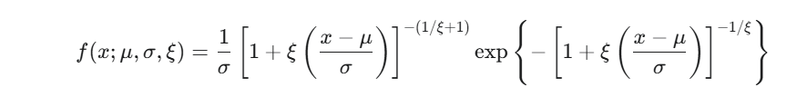
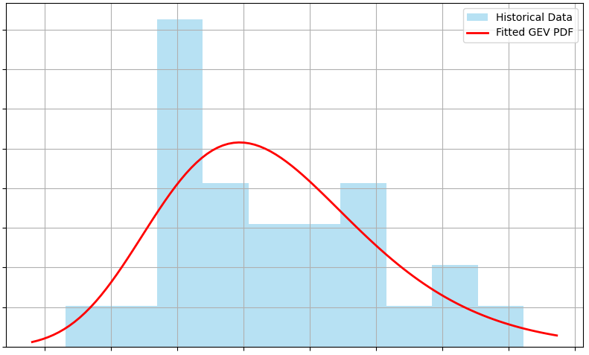
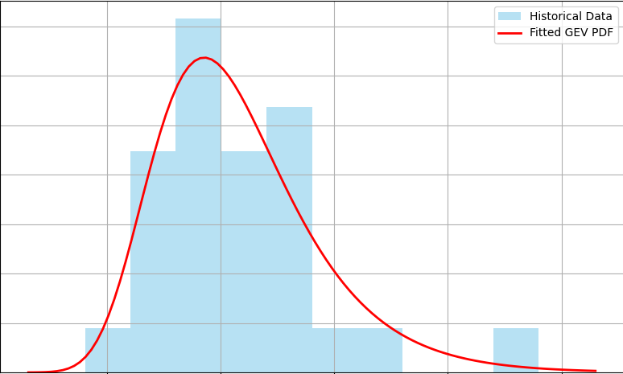
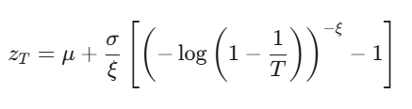
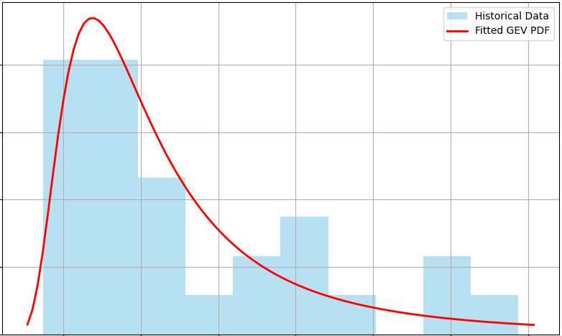
Starting hypothesis – Price volatility in CRMs markets – GARCH + EVT
The GEV PDF is found and plotted (histogram of historical data and fitting)
The GEV procedure allows to determine the return levels zT for specific time periods (5, 10, 25 years). The return level is calculated using the quantile function, starting from the non-exceedance probability: p=1 - 1/T
5-year return level: There is a 1/5=20% probability that a price change of this magnitude or greater will occur in any given year.
The return levels can be used to determine specific scenarios of extreme price values, with proper quantified risks (probabilities)
In alternative, the GEV results can be used as a robustness check to study the extreme price behaviour of the materials

Slide 13
Starting hypothesis – Price volatility in CRMs markets – GARCH + EVT
From the literature, GEV is applied to determine market volatility, but it requires almost about 30 data to get realistic and robust results
So, a 2-years window will be used to label the historical trends data, where the maximum absolute % is selected for each couple of years
A 5-years window could better emphasize the long-lasting volatility, but here we don’t have enough raw data to process
A shock in a 5-years window, if repeated or consecutive, would tell us that there could be the probability of a shock every 5 years, or lasting more than that time span
A shock in a 2-years window is easily linked to less-lasting phenomena

Slide 14
Starting hypothesis – Price volatility in CRMs markets – GARCH + EVT

Slide 15
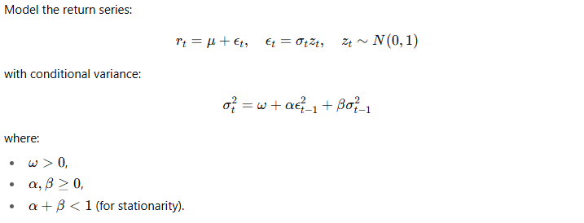

Starting hypothesis – Price volatility in CRMs markets – GARCH + EVT
Bastianin et al, 2025
GARCH: Generalized Autoregressive Conditional Heteroskedasticity
model for conditional volatility
α and β are estimated from the raw data by fitting the GARCH model via Maximum Likelihood Estimation (MLE)

Slide 16
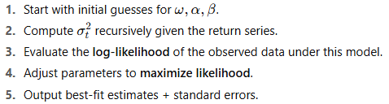
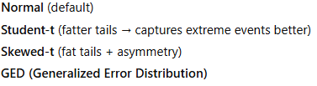
Starting hypothesis – Price volatility in CRMs markets – GARCH + EVT
Maximum Likelihood Estimation (MLE):
A possible issue is that the log-likelihood function assumes normally distributed return shocks εt
Actually the distribution of the log returns can be different (different tailing, or skewing), and it’s possible to select different likelihood functions (normal, student-t, skewed-t, GED)
In any case, the EVT (Extreme Value Theory) on standardized residuals is here applied on top of GARCH to quantify probabilities of extreme moves

Slide 17
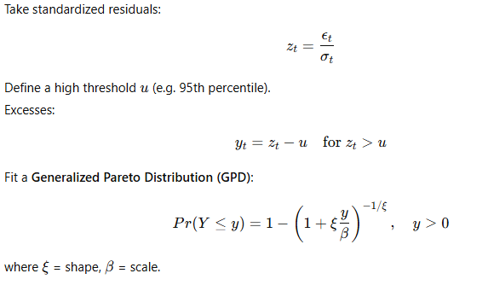
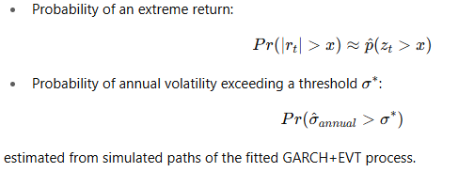
Starting hypothesis – Price volatility in CRMs markets – GARCH + EVT
Extreme Value Theory (EVT) for tail risk, from risk-theory literature
The threshold stdev is the key parameter, and it can be computed in several ways (quantile threshold, k*stdev, ….)
Shape and scale factor have the same formulation of the GEV procedure
Much deeper analysis is required to study CRMs markets with GARCH + EVT analysis, so, here it’s let as a possible future development as a combined model to be coupled with clustering analysis

Slide 18
Global and EU_CRM framework
EU_CRM framework
Methodology
Projects (RMIS, SCRREEN)
Supply Risk
Economic Importance
HHI, SI, IR, EOLRIR

Slide 19
Global and EU_CRM framework
IRENA, 2024: Geopolitics of the Energy Transition: Critical Materials
Mining, processing concentration
Corporate concentration → oligopolistic behavior and price sensitivity
CRM markets and trades:
Unlike oil, many CRMs are not broadly exchange‑traded; price discovery often relies on bilateral contracts, giving commodity traders outsize influence
CRMs trade values are orders of magnitude smaller than fossil fuels; market liquidity and hedging instruments are limited
External shocks (wars, pandemic, global energy crisis)
Reserves: they appear sufficient, while near‑term constraints are investment, permitting, and mid‑stream capacity
Study of the key drivers of CRM supply disruptions

Slide 20
Global and EU_CRM framework
IEEP-EU, 2024: Sourcing critical raw materials through trade and cooperation frameworks
Gaps in external supply approach:
Current EU approach lacks concrete mechanisms for value‑addition in partner countries and faces challenges in scaling secondary raw‑material markets.
New mining lead times:
New mining and processing projects have multi‑year lead times, making rapid rebalancing difficult
And discussion about hurdles in the application of counterbalance strategies:
Stockpiling trade‑offs:
Strategic stockpiles alone are not a robust long‑term solution and can exacerbate price spikes or inequities if poorly designed
CRMs Club uncertainty: (also Hendrix, 2023)
A proposed CRMs Club could strengthen allied supply but faces freerider risks, intra‑EU distributional tensions, and equity concerns for partners

Slide 21
Criticality framework
IEA ETP 2024:
Disruptions to critical materials slow the transition, not day‑to‑day operations:
Material shortages raise costs and delay uptake rather than immediately turning off the energy system;
In TEMOA this will be studied (how costs will adapt?, how capacities/activities prepare before the disruption?
transition risk ≠ operational risk
diversification mitigates transition delays.
Market structure: processing is the choke point:
Mining is concentrated, but processing is even more concentrated

Slide 22
Criticality framework – recent example of Supply disruption and responses
Rare earths 2010–11: a concrete template for shock‑and‑response:
A ~37% quota cut produced a price spike; substitution, recycling, new mines and smuggling attenuated prices; WTO later required lifting the restrictions. Use this as an empirical shape for duration, magnitude, and endogenous mitigation
China, 2023: Export restrictions on gallium and germanium due to their use in semiconductor technolgy as a reaction on the tensions with EU and US ("Chips War"), export restrictions on graphite products
China, 2024: Export restictions on antimony "to secure national security and interests"; December: export ban for the US on raw materials for dual-use technologies (antimony, gallium, germanium)
Indonesia, 2020: Export ban on nickel ores
GATT Article XI by WTO generally prohibits export quotas but allows exceptions.
WTO notification database (available online) shows how trades disputes are more and more frequent

Slide 23
Global and EU_CRM framework
Key sources of CRM supply disruptions
Market manipulation (i.e. Chinese market flooding, little liquidity)
Geographical concentration of the different stages of the CRMs supply chain
Circularity gaps (low EOLRIR)
Barriers to material supply diversification
Export restrictions (OECD, WTO)
Resource nationalism
Mineral cartels
Political instability and social unrest
External shocks
Mineral curses in low WGI and highly resource-based countries
Environmental diseases
Market volatility encompasses several drivers of disruption, and it’s difficult to relate it only with energy crises.
→ How to quantify and relate price volatility with CRMs supply risks?

Slide 24
Global and EU_CRM framework – Criticality
Definition of criticality:
NRC. 2008. Minerals, Critical Minerals, and the U.S. Economy, on criticality assessment:
The impact of a supply disruption of the raw material
The probability that the supply of the material is disrupted
→ Criticality is a risk construct: likelihood of supply restriction (supply risk) × consequence (impact on system).
Definition of critical raw material:
Schrijvers et al. (2020) review:
CRM lists are scope-dependent; results vary with goal, system boundary, time horizon, indicator choices, and aggregation method
The EU_CRM SR links both intensity and probability of a supply disruption

Slide 25
Global and EU_CRM framework – Criticality
Criticality assessment:
Schrijvers et al. (2020) review:
Criticality of a raw material then can be considered in the short term (e.g. a few years) or in the long term (i.e. decades)
The EIT (European Institute of Innovation & Technology) Raw Materials project IRTC (“International Round Table on Materials Criticality”) was established to address criticality methods missing
List of indicators of supply disruption
Vulnerability (in economies, technologies, companies) concept: referred to a supply disruption
The indicator that is included in most criticality studies is substitutability
U.S. Department of Energy, 2023 Critical Materials Assessment:
Enabling activities that promote better assessments
Taking a forward-looking approach in the criticality assessment: demand projections and trajectories for each material, that can inform energy demand, competing technology demand, and basic availability
Dynamic supply projections
Others (LCA, TEA)

Slide 26
Global and EU_CRM framework – Criticality
Criticality assessment: IRTC and EU framework
Critical Raw Materials Act:
EU CRM dependency and lack of industry
2030 benchmarks on domestic production: ≥10% extraction, ≥40% processing, ≥25% recycling of EU consumption domestically; ≤65% from any single third country at each stage
Methodologies:
Supply Risk indicators
Indicator aggregation choices (Duclos (2010); Graedel (2015); NSTC (2016))
IRTC encourages to adapt indicator selection/aggregation to the specific scope and run sensitivities
Data uncertainty (Nuss et al. (2014))

Slide 27
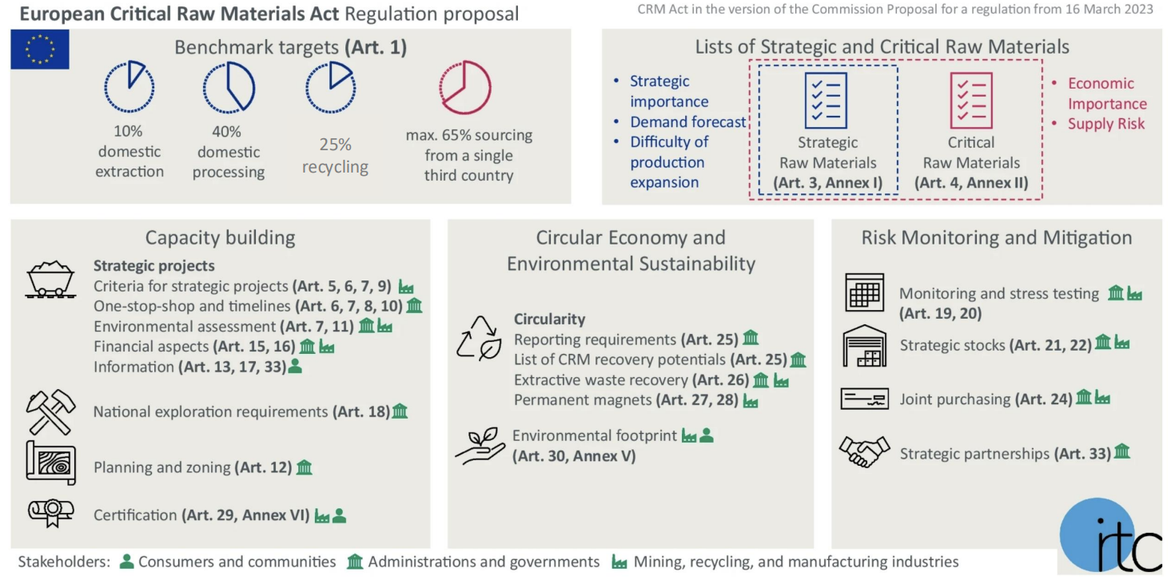
Global and EU_CRM framework – Criticality: CRMA (in force since 2024)

Slide 28

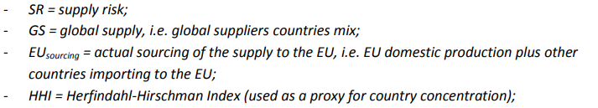
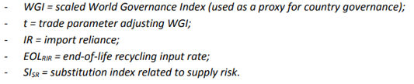
Global and EU_CRM framework – Criticality: EU_SR
Criticality assessment: IRTC and EU framework, EU CRM (2023)
Key drivers:
Geographical concentration
Import reliance
Countries governances
Recycling rates
Substitutability
Trade disputes (tariffs, export
restrictions, quotas, licensing controls
Stockpiling
Nationalization of refining facilities
Market flooding

Slide 29
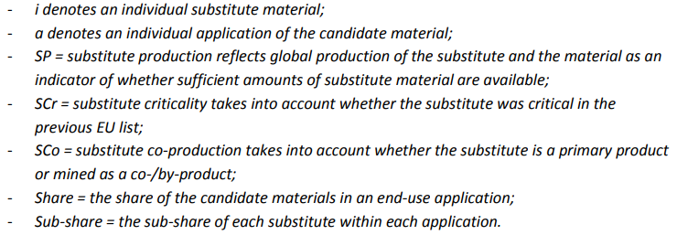



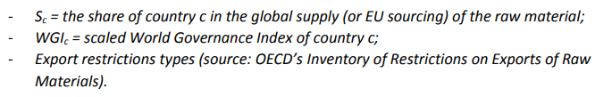
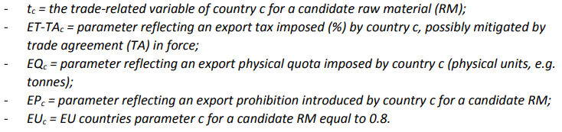
Global and EU_CRM framework – Criticality: EU_SR
Criticality assessment: IRTC and EU framework, EU CRM (2023)

Slide 30
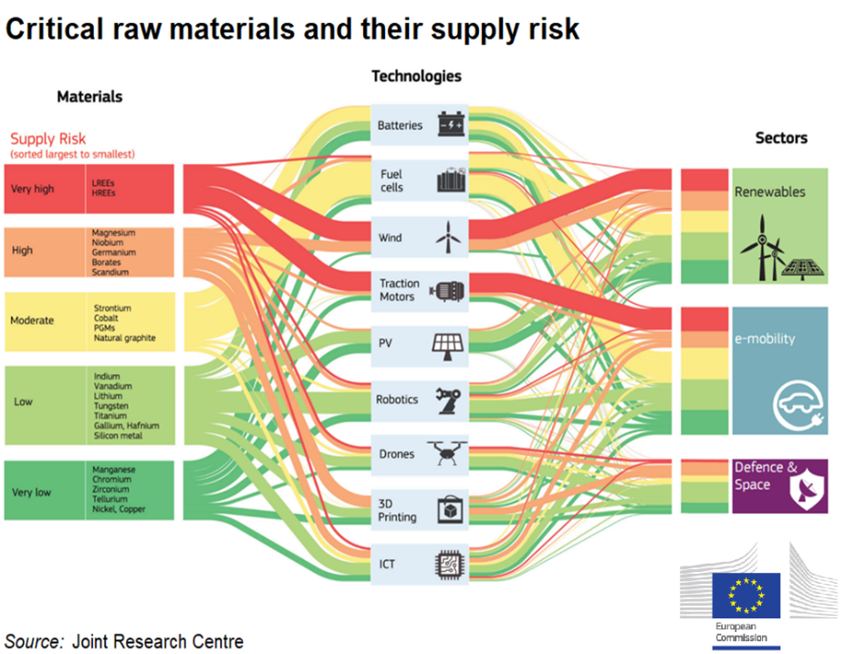
Global and EU_CRM framework – Criticality: EU_SR

Slide 31
Global and EU_CRM framework – Criticality: EU_SR
EU_SR and other key parameters (HHI, IR, WGI, SI, EOLRIR) are a constitutive database for this analysis, because they allow to bring the assessment into a EU risk framework, going deeper market volatility and extreme volatility phenomena
A note to remember is the one brought by IRTC: adapt indicator selection/aggregation to the specific scope and run sensitivities

Slide 32
CRMs market analysis → Price disruption scenarios
SR-based multiplier
CLUSTERING
Price disruption scenarios in EU framework
Hierarchical and k-means clustering
Normalization procedure
Quality check
Stability check
On annual real prices
On rolling Δ-windows
Impact Scores
Disruption
Mild increase (cycles)
EU_CRM framework
Methodology
Projects (RMIS, SCRREEN)
Supply Risk
Economic Importance
HHI, SI, IR, EOLRIR

Slide 33
Hierarchical Clustering procedure
Source: “Gestione Energetica ed Automazione negli Edifici (GEAE)», A.A. 2024/2025
Data.xlxs file contains all the sheets with the raw data (actual prices, rolling-window trends for the different time spans) listed for each CRM
Log-return (DERA approach) isn’t included here
Data scaling/normalization:
This is a point of interest for the analysis
Having different kind of raw data (actual prices, % trends) these data could be subjected to different types of normalization (or its absence)
Post-processing module

Slide 34



Hierarchical Clustering procedure – Data normalization
Different types of normalization studied:
Max normalization:
Pros:
Particularly useful when you want to preserve the zero-center of the data.
Simple to implement, effective for data with outliers, and keeps the original sign of the data.
Cons:
It doesn't scale all features to a uniform range like Min-Max scaling, which can be a drawback for some algorithms.
Min-Max-normalization:
Pros:
It ensures that all features contribute equally to the distance calculation by compressing all values into the same specified (uniform) range → common for preparing data for machine learning models
Cons:
It is highly susceptible to the presence of outliers. A single extreme outlier can compress the majority of the data into a very small range
Z-score normalization:
Pros:
It is not affected by outliers and is the preferred method for algorithms that assume a normal distribution
Cons:
It assumes a normal distribution of the data
No normalization
Pros:
Useful if the original scale of data is the most meaningful or is already a scaled range of data
Cons:
Features with a larger range will dominate the distance calculations

Slide 35
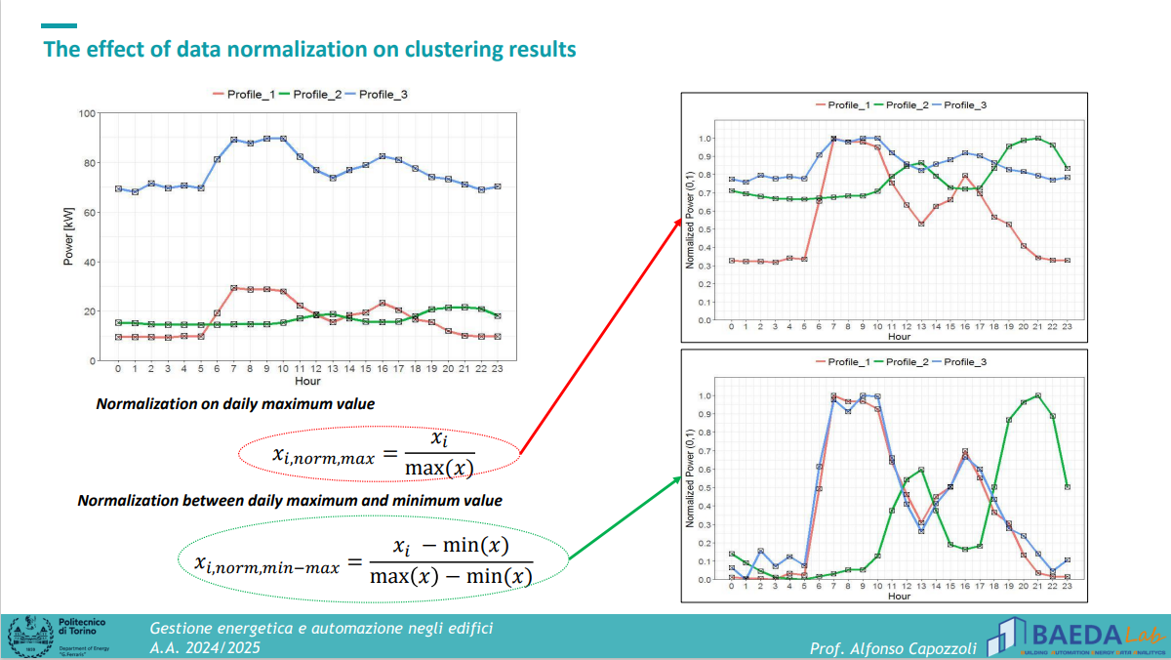
Hierarchical Clustering procedure – Data normalization

Slide 36
Hierarchical Clustering procedure – Data normalization
No normalization: Not significant
Ward and k-means minimize Euclidean distortion. Without scaling, features with large variance/units dominate the geometry.
A higher Silhouette under “none” often reflects scale dominance rather than a truer regime structure
Z-score: standardization
Centers and scales each material to mean 0, sd 1
Preserves relative anomalies in σ-units
Min-max [0,1]:
Preserves shape and rank of each series; keeps all materials on the same numeric range
More robust for bounded/% change panels and when you don’t want z-score to over-emphasize short, choppy series
Makes charts directly comparable in “percent of range” space

Slide 37
Hierarchical Clustering procedure – Data normalization
Z-score vs min-max:
Z-score:
When you will interpret regime strength in σ units
When outliers are not extreme
Min-max:
When distributions are skewed or bounded; when you want to keep monotone relationships intact
When you expect multi-material co-movement to reflect relative positions within each series’ range

Slide 38
Hierarchical Clustering procedure - steps
Hierarchical clustering and dendogram visualization:
Computing distance matrix as euclidean distances
Hierarchical(Agglomerative) clustering and dengrogram visualization
Hierarchical clustering of pairwise distances through the “ward” linkage method
Agglomerative algorithms start with the objects as singletons (clusters with one object) and at each step merge the closest pair of clusters according to a proximity measure
The Ward linkage method is based on the concept of minimizing variance. At each step, it identifies the pair of clusters that, when merged, will result in the smallest possible increase in the total within-cluster variance. In other words, it looks for the two clusters that are "most similar" in a way that preserves the tightness of the resulting new cluster.
Visual representation of the clustering

Slide 39
Hierarchical Clustering procedure – Quality indices
Determining optimal number of clusters through the Silhouette score:
A good cluster analysis should lead to the identification of sub dataset that are characterised by high intra-class and low inter-class similarity
Silhouette Score: This metric measures how similar a data point is to its own cluster compared to other clusters:
A score close to +1 means data points are well-clustered and far from neighboring clusters. This is ideal
A score near 0 indicates overlapping clusters
A score close to -1 suggests data points have been assigned to the wrong clusters
→ It’s preferable to find the number of clusters that maximizes the silhouette score
Here the Silhouette score is applied to determine the optimal number of clusters, between 2 and 10 clusters (can be modified)

Slide 40
Hierarchical Clustering procedure – Quality indices
Also the Davies-Bouldin Index is here computed (but not selected as the main criteria for number of clusters selection)
This metric measures the ratio of within-cluster scatter to between-cluster separation
The selected number of clusters should minimize the Davies-Boulding Index
Similarly, the Calinski-Harabasz index was included

Slide 41

Hierarchical Clustering procedure – Stability check
Stability check are included, through the bootstrap procedure
Cluster stability is the average probability that members of cluster c stay together under perturbations.
Build a co-assignment matrix P by re-fitting the clustering many times on perturbed data (bootstrap over features/years). Each entry Pij is the frequency with which years i and j land in the same cluster across bootstraps
Year consistency is each year’s average Pij​ with its cluster-mates—useful to spot borderline years.
ARI is the adjusted Rand index between the baseline labels and each bootstrap; It’s summarized as a distribution (mean/SD). It’s a global agreement score
Stabilityc ∈ [0,1] behaves like a belief that cluster c is not an artifact of noise or of one exact set of features.
Good stability if Sc>0,7

Slide 42
Hierarchical Clustering procedure
Calculating cluster centroids for each CRM:
Actually the centroid is the average between the raw data of that CRM for those years included in that cluster
For our purpose, the centroid value of the CRM in a cluster is compared with the historical mean value:
The results file contains a sheet named “charts”, where for each cluster there’s a chart that compares the centroids data with the mean historical data for all the materials
Another chart representation outputs the “shifts”, which are the z-scores of the centroids with respect to the historical means
The code is within the folder:
Literature\CRM probabilities\Volatility\Clustering\Hierarchical
hierarchical.py

Slide 43

K-means clustering as robustness check
The same as hierarchical for:
Normalization procedures
Quality indices
Stability checks
Different methodology from hierarchical:
Ward (hierarchical) favors compact, globular clusters from an agglomerative merge tree
k-means directly optimizes within-cluster variance via centroid updates
→ Comparison among results, quality and stability indices

Slide 44
CRMs market analysis → Price disruption scenarios
Data.xlxs file includes the following sheets:
Actual prices for each CRM from 1964 to 2020
Annual variations for each CRM from 1965 to 2019
[2,…,10] years rolling-window trends for each CRM from 1965 to 2020
Oil prices were included as a proxy reference
For each sheet is provided a respective folder, divided into min-max and z-score normalization

Slide 45
CRMs market analysis → Price disruption scenarios
Questions:
Which is the best normalization method?
It depends from the raw data featurings:
Actual prices might require normalization to better catch the similarities, min-max normalization seems to be the best one to catch the similarity, but can lead to misleading interpretations due to the presence of outliers (if the peaks are considerable as outliers)
Annual and [2, …,10] years trends are relative data, maybe not requiring any normalization. For these raw data, z-score normalization seems to be misleading due to the fact that the distribution of the data (as seen from GEV analysis) isn’t normal
It’s also true that Z-score actually applies a “semi-wrong” assumption on all the time-frames, so the whole effect is almost null

Slide 46
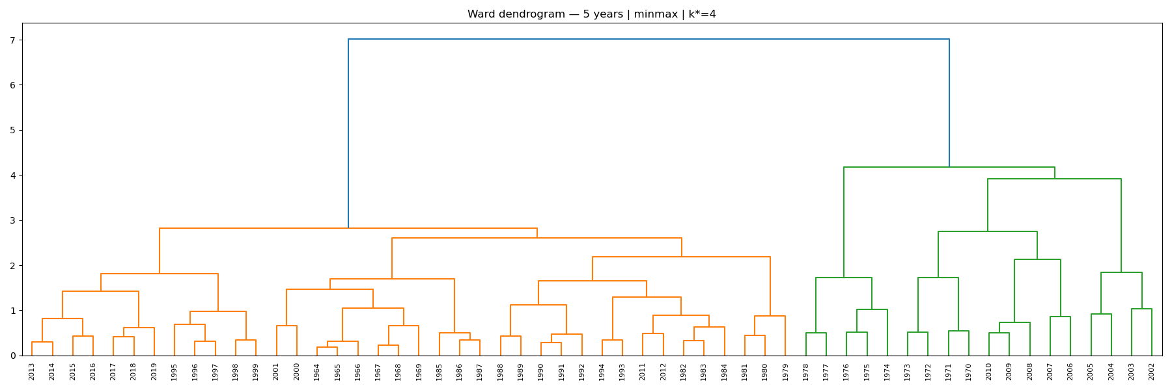
CRMs market analysis → Price disruption scenarios
i.e. 5 years rolling-window with min-max normalization

Slide 47
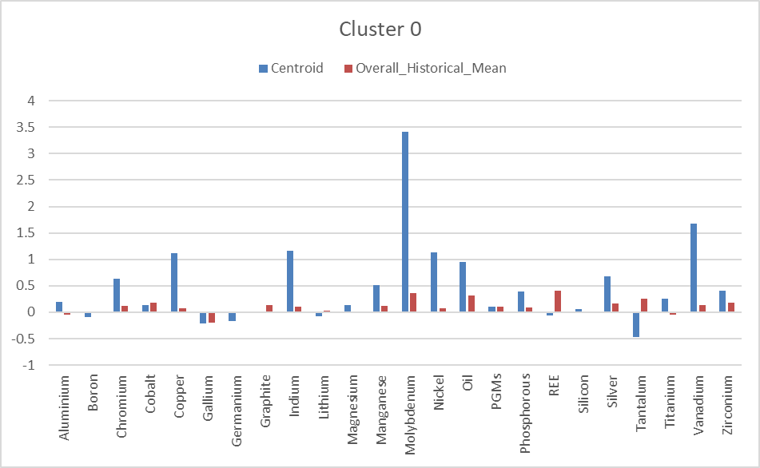
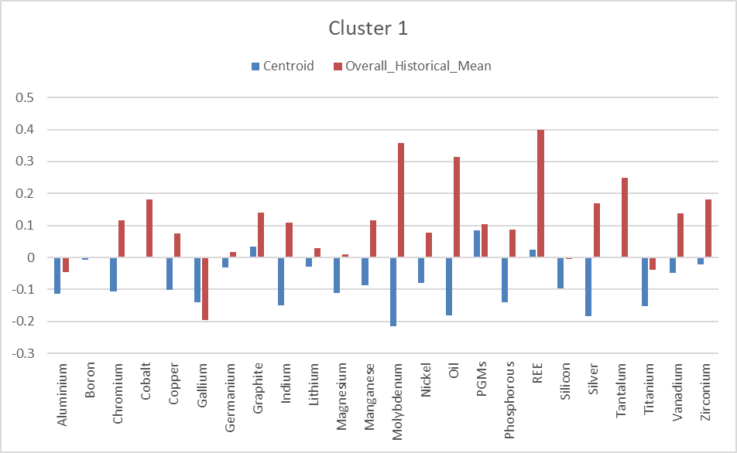
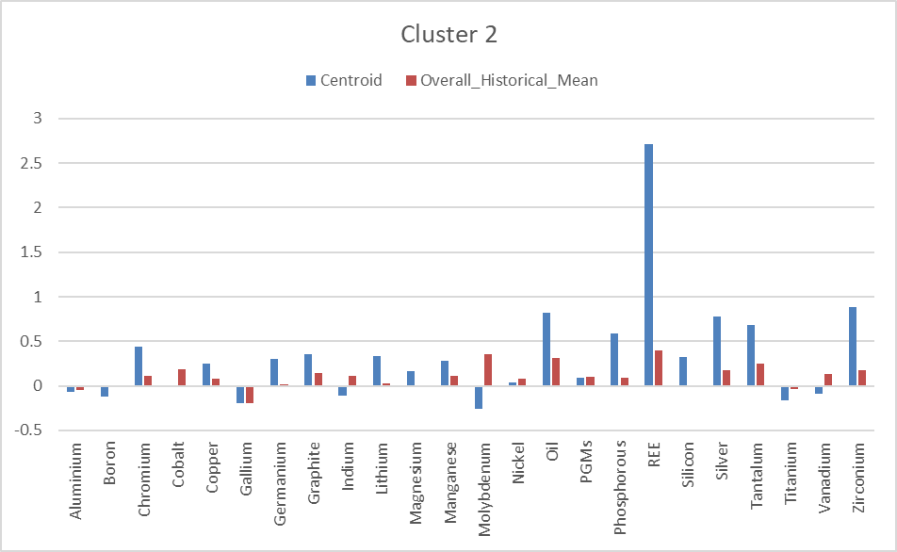
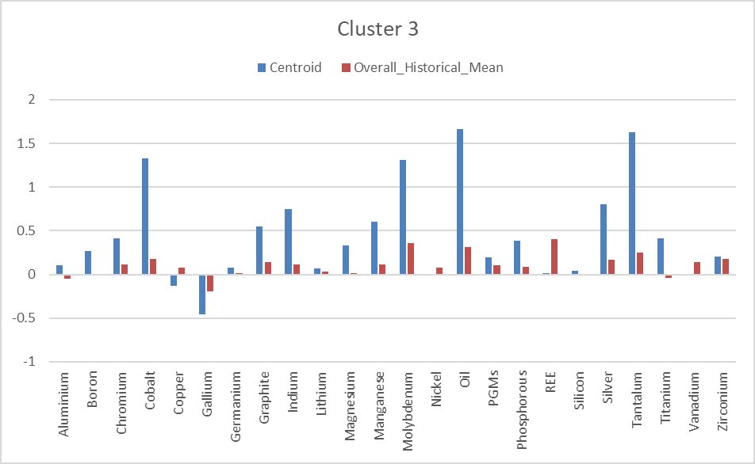
CRMs market analysis → Price disruption scenarios

Slide 48
CRMs market analysis → Price disruption scenarios
From the comparison between the centroid and whole timeframe mean:
Cluster 0:
From 2000 to 2005: for the 5-years window, these years intercept the 2008 crisis
Some materials are widely over their historical mean
Cluster 1:
Widest cluster, without particular market shocks
It can be considered as a less-volatile cluster
Cluster 2:
1969-1971 and 2006-2010, both anticipating price shocks (oil crisis and China export restrictions on REE)
Extreme price shock for REE, and attenuated shock for other materials
Cluster 3:
1972-1978, the years of the first oil crisis, with also other materials shocks

Slide 49
CRMs market analysis → Price disruption scenarios
How to apply clustering analysis in the definition of price disruption scenarios?
The clusters can be used to built some historical-based scenario-trees with some CRMs involved
The probabilities of these scenarios can be determined as the ratio between the number of years within the respective cluster and the total number of years in the timeframe → Probability = Occurrence

Slide 50
CRMs market analysis → Price disruption scenarios
To build the disruption scenarios, a focus is needed on:
Definition of disruptive → Impact Score evaluation → Severity labels, material and scenario based
Time horizon: Short (Actual → 3 years), Medium (4 → 6 years), Long (7 → 10 years)
From the literature review: CRMs move together
The inclusion of EU_SR framework is needed:
EU characterization of global prices clustering analysis
Inclusion of CRMs SR framework → Actual CRMs price/supply disruptions can be inflated by their criticality
Joint CRMs price disruption scenarios

Slide 51


Joint CRMs price disruption scenarios
The Shift is defined in terms of z-scores:
Cm,c,t = material centroid for cluster c in time-horizon t
µm,t = historical mean raw value of material m in time-horizon t
σm,t = standard deviation for material m series in time-horizon t
→ Shift allows to intercept and emphasize the single material out of normal behaviors
The Vulnerability here is parametrized through the SR:
Just the SR: May be too influencing
A SR-based parameter:
Linear normalization: keeps proportional differences between SR values.
Dimensionless: Not bonded to SR’s native 0–10 scale
Bounded effect: limits influence to ×1–×2 multiplier, preventing runaway impacts
“Materials with the highest SR have twice the vulnerability contribution of the least risky ones.”
→This makes the impact term slightly amplify high-SR materials but never by more than a factor of 2, so the price disruption scenarios remain dominated by cluster behavior, not SR extremes.
$${Shift}_{m,c,t}=\frac{C_{m,c,t}−μ_{m,t}}{σ_{m,t}}$$
$$V_{m}=1+\frac{SR−{SR}_{min,m}}{{SR}_{max,m}−{SR}_{min,m}}$$
Titanium metal instead of titanium
Average between HREE and LREE
Fluorspar and niobium not included because the lack of USGS price data

Slide 52
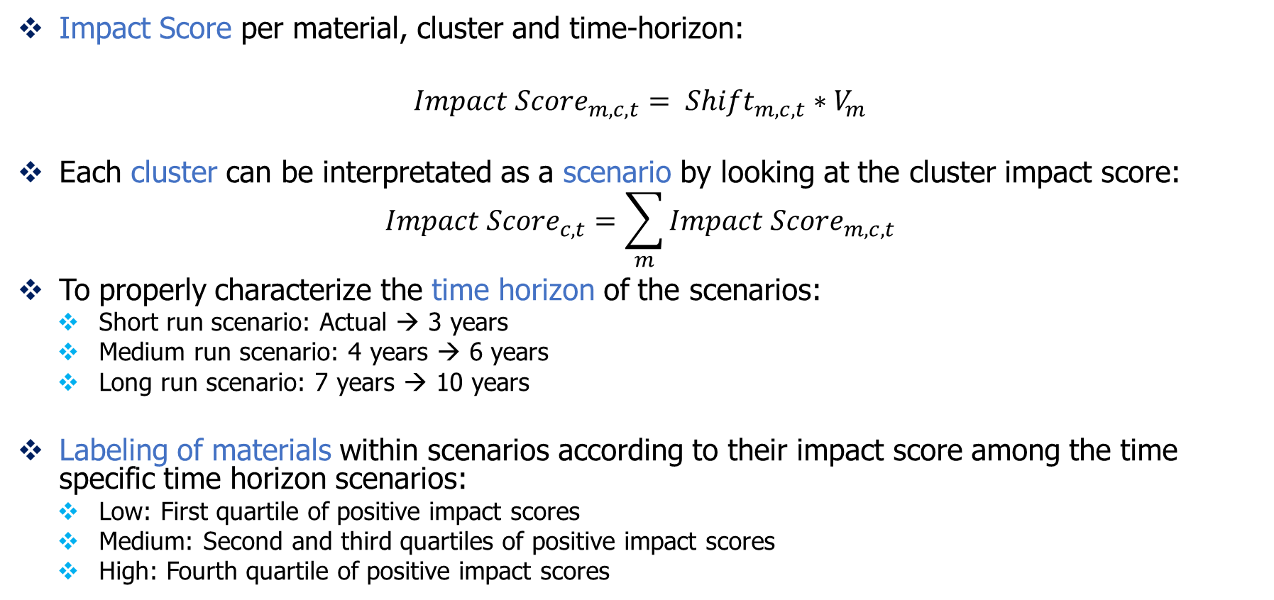
Joint CRMs price disruption scenarios
Impact Score per material, cluster and time-horizon:
$${Impact Score}_{m,c,t}= {Shift}_{m,c,t}∗V_{m}$$
Each cluster can be interpretated as a scenario by looking at the cluster impact score:
$${Impact Score}_{c,t}=\sum_{m}{{Impact Score}_{m,c,t}}$$
To properly characterize the time horizon of the scenarios:
Short run scenario: Actual → 3 years
Medium run scenario: 4 years → 6 years
Long run scenario: 7 years → 10 years
Labeling of materials within scenarios according to their impact score among the time specific time horizon scenarios:
Low: First quartile of positive impact scores
Medium: Second and third quartiles of positive impact scores
High: Fourth quartile of positive impact scores
3 bunches of scenarios characterized by their time-horizons

Slide 53
Joint CRMs price disruption scenarios
No labeling to the clusters, because they’re not a statistical-significant number, but they will be judged according to their own materials labeling and total impact scores:
i.e. A quite disruptive long-run scenario is the one where lithium has a high impact, with also manganese, while many other materials have a medium impact. Total impact score of X explains the severity
Cluster is a regime signature across materials (a vector of shifts), while materials have different behaviors across clusters (regimes)
The probabilities of disruption can be shaped starting from the base probabilities:
Possibly, relate them with the EU_SR framework → SR-based factor to express the “exposure level” of a scenario
In TEMOA-stochastic environment, since sum of probabilities must be 1, the

Slide 54
Joint CRMs price disruption scenarios
Actually, cluster material centroids will be the input values in TEMOA-stochastic environment.
It should be discussed whether to multiply the centroids or not times the vulnerability factor, or another SR-based multiplier.
Since TEMOA_Europe database doesn’t include a supply-risk factors responsive/dependent structure, and it’s just dependent to input flows, the SR-based multiplier can be a viable solution.
Price joint disruptive scenarios are thus defined:
Data-driven approach
No need to define a subjective threshold for the concept of disruptive
The SR granularity is included
Need to justify most impactful scenarios with historical findings:
Disruption events
Cycles
Despite not having clearly defined the disruptive threshold, it’s clear how much critical some scenarios are

Slide 55
CRMs market analysis → Price disruption scenarios: Results

Slide 56
CRMs market analysis → Price disruption scenarios: Results
Aggregate results for all the time horizons
IS0: Impact scores table with zeros
IS: Impact scores table w/o zeros

Slide 57
CRMs market analysis → Price disruption scenarios: Results
Aggregate results for short-term horizon

Slide 58
CRMs market analysis → Price disruption scenarios: Results
Aggregate results for medium-term horizon

Slide 59
CRMs market analysis → Price disruption scenarios: Results
Aggregate results for long-term horizon

Slide 60
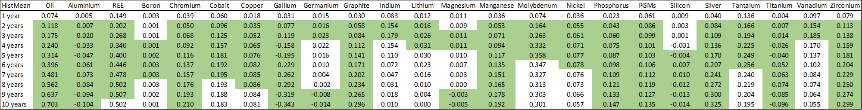
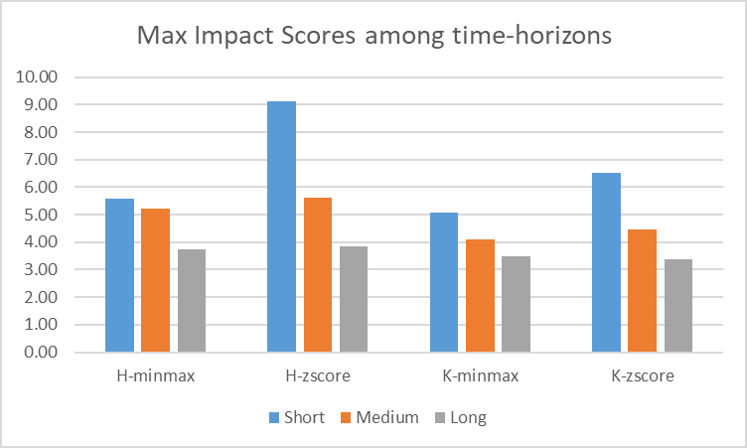
CRMs market analysis → Price disruption scenarios: Results
The stdev of a CRM historical price or Δ for a specific time-horizon is higher (in module) than the one of the previous time-horizon, for the 74% of the times
→ Increasing volatility with time horizon
What about extreme price events?
Max z-scores are increasing just 30% of the times with increasing time horizon, while max spikes are increasing 40% of the times
Joint price disruption scenarios results

Slide 61
CRMs market analysis → Price disruption scenarios: Results
Short, medium, long term results for one material (i.e. REE H-minmax)

Slide 62
CRMs market analysis → Price disruption scenarios: Results

Slide 63
CRMs market analysis → Price disruption scenarios: Results

Slide 64
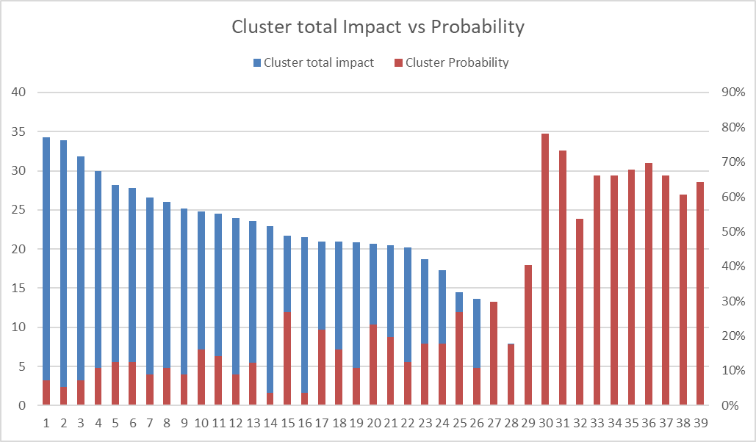
CRMs market analysis → Price disruption scenarios: Results

Slide 65
CRMs market analysis – Clustering rationale
The study on rolling-windows delta-price panels and clustering are aligned with persistent episodes rather than transitory spikes:
Disruptions: Supply disruptions: supply shortages modeled in TEMOA by means of maxActivity constraints
Business cycles:
They’re more linked to the change in technology costs; in TEMOA these dynamics are modeled through the capacity-cost relation
CRMs cost shares needed for each technology → EU CRMs framework database
Still, the costs constraints aren’t modeled in TEMOA

Slide 66
Price elasticity of demand and supply
EU_CRM framework
Methodology
Projects (RMIS, SCRREEN)
EU-framework price elasticities
All CRMs PED and PES
Database (Eurostat, SCRREEN, RMIS, …)
HS codes + Production
Sectoral value added
EU GDP and usd_eur exchange rate
Export restrictions, strikes
Mine-level, industrial-level variables
Supply Risk
Economic Importance
HHI, SI, IR, EOLRIR
Price elasticity of the supply/demand of CRMs:
How CRMs markets and supply chains behave
Key methodologies
Supply or demand elasticity?
Short-run or long-run elasticity?
ELASTICITY
Elasticity database
PED and PES for main CRMs
Elasticity ranges
Short and long run elasticities
High/mid/low levels
Short/long run

Slide 67
Price elasticity of demand and supply - Index
Context
Conceptual foundations of elasticity analysis (PED/PES, horizons, substitution)
Recent literature review (2017–2025) and data collection
Key methodological outputs and elasticity results
Post-processing of elasticity database
Application of elasticity results on TEMOA-stochastic framework
Open issues & next steps

Slide 68
Price elasticity of demand and supply - Roadmap
Goal: translate price shocks into quantity shocks compliant with TEMOA‑stochastic (TEMOA_Europe database).
Medium: robust, recent estimates of demand (PED) and supply (PES) elasticities for key CRMs.
Approach: combine comprehensive but dated database results (Dahl MEDS) with modern econometrics (Divisia, ECM, SVECM, GIV, mine‑level local projections).
Results: Short run vs Long run elasticity ranges + severity classes to parameterize scenario trees linked with different disruption scenarios coming from clustering analysis

Slide 69
Price elasticity of demand and supply - Sources
Sullivan, L. R., Moore, E. A., Ho, P., Wang, A. A., Tangog, G. M., Bhuwalka, K., Olivetti, E., & Roth, R. (2025). Analysis of the impact of automaker strategies on lithium price elasticity using a novel bottom-up demand model (Working paper). Materials Systems Laboratory, MIT. https://phuongmho.github.io/LiDemand.pdf
Tilton, J. E. (1984). Economics of metal markets (IIASA Working Paper WP-84-034). International Institute for Applied Systems Analysis. http://pure.iiasa.ac.at/id/eprint/2484/
Atakhanova, Z., Howie, P., Madani, N., & Azhibay, S. (2025, May 28). Productive capacities and exports of critical minerals: The case of copper. Mineral Economics. https://doi.org/10.1007/s13563-025-00521-x
Shojaeddini, E., Alonso, E., & Nassar, N. T. (2024). Estimating price elasticity of demand for mineral commodities used in lithium-ion batteries in the face of surging demand. Resources, Conservation and Recycling, 107664. https://doi.org/10.1016/j.resconrec.2024.107664
Severson, M. H., Nguyen, R. T., Ormerod, J., & Williams, S. (2023). An integrated supply chain analysis for cobalt and rare earth elements under global electrification and constrained resources. Resources, Conservation and Recycling, 189, 106761. https://doi.org/10.1016/j.resconrec.2022.106761

Slide 70
Price elasticity of demand and supply - Sources
Bogmans, C., Pescatori, A., Petrella, I., Prifti, E., & Stuermer, M. (2024). The power of prices: How fast do commodity markets adjust to shocks? IMF Working Paper 2024/077. https://doi.org/10.5089/9798400271953.001
Stuermer, M. (2017). Industrialization and the demand for mineral commodities. Journal of International Money and Finance, 76, 16–27. https://doi.org/10.1016/j.jimonfin.2017.04.006
Evans, M., & Lewis, A. C. (2003). Is there a common metals demand curve? Resources Policy, 28(3–4), 95–104.
Shojaeinia, S. (2023). Metal market analysis: An empirical model for copper supply and demand in US market. Mineral Economics, 36(3), 509–517. https://doi.org/10.1007/s13563-023-00371-5
Ryter, J., Bhuwalka, K., Roth, R., Olivetti, E., Buarque-Andrade, L., Frenzel, M., Shojaeddini, E., Alonso, E., & Nassar, N. (2025). Modeling interconnected minerals markets with multicommodity supply curves: Examining the copper–cobalt–nickel system. Nature Communications, 16, 7302. https://doi.org/10.1038/s41467-025-62570-8
Fernández, V. (2018). Price and income elasticity of demand for mineral commodities. Resources Policy, 59, 160–183. https://doi.org/10.1016/j.resourpol.2018.06.013
Cuddington, J. T., & Jerrett, D. (2008). Super cycles in real metals prices? IMF Economic Review. https://doi.org/10.1057/imfsp.2008.19

Slide 71
Price elasticity of demand and supply - Sources
Vertier, P., Jacolin, L., Mien, E., & Léon, F. (2025). Critical minerals: Estimating price elasticity of supply using mine-level data (Working Paper No. 1002). Banque de France. https://www.banque-france.fr/en/publications-and-statistics/publications/critical-minerals-estimating-price-elasticity-supply-using-mine-level-data
Dahl, C. A. (2020). Dahl Mineral Elasticity of Demand and Supply Database (MEDS) (Working Paper 2020-02). Colorado School of Mines. http://econbus-papers.mines.edu/working-papers/wp202002_v2.pdf
Baffes, J., Kabundi, A., & Nagle, P. (2022). The role of income and substitution in commodity demand. Oxford Economic Papers, 74(2), 498–522. https://doi.org/10.1093/oep/gpab029
Fally, T., & Sayre, J. (2018). Commodity trade matters (NBER Working Paper No. 24965). National Bureau of Economic Research. https://doi.org/10.3386/w24965
Ryter, J., Bhuwalka, K., O'Rourke, M., Montanelli, L., Cohen-Tanugi, D., Roth, R., & Olivetti, E. (2024). Understanding key mineral supply chain dynamics using economics-informed material flow analysis and Bayesian optimization. Journal of Industrial Ecology, 28, 709–726. https://doi.org/10.1111/jiec.13517
IRTC Training Course Raw Materials Risk Management (Basic) Luis Tercero, Dieuwertje Schrijvers, Alessa Hool Ljubljana, February 17th and 18th, 2025

Slide 72
Price elasticity of demand and supply - Conceptual Foundations (Metals)
Metals and minerals markets and supply chains have been studied in the literature, since the oil crises in 70s, and then in the early 2000s
Many statements have been provided by the different analyses, depicting the complex framework characterizing the market structures, driven by many macroeconomical factors
These macroeconomical drivers are related mainly to:
Production concentration
Refining concentration
Product/Co-products/By-products dependances in the markets
Substitutability shares of materials
Strikes, export restrictions
Business cycles
Inflation and exchange rates
Etc…

Slide 73
Price elasticity of demand and supply - Conceptual Foundations (Metals)
Complex market and supply chain frameworks affect the response of the supply and of the demand in very different ways
Here, we focus on the price elasticity
In Tilton, 1984 paper on metal markets, supply and demand curves are characterized, and the concept of elasticity was studied
PED and PES are respectively price elasticty of demand and supply
Since their different nature within CRMs markets and supply chains, the main numeric feature is ususally that:
PED<0
PES>0

Slide 74
Price elasticity of demand and supply – Implementation in TEMOA
Exogenous demand‑shock approximation:
For a % price shock coming from clustering analysis:
For material m
For a specific time horizon (long, medium, short)
For a severity level (low, medium, high)
A % supply shortage is determined by means of the corresponding elasticity:
Determined for the specific material, time-horizon, and severity level
The supply shortage is applied in TEMOA-stochastic by leveraging the MaxActivity constraint
We can rely on precise estimates only for a bunch of CRMs, and for the other materials, we consider family-level pooling

Slide 75
Price elasticity of demand and supply – Which elasticity?
PED and PES extracted from the literature review are often refering to different stages of the supply chain, or products aggregates.
TEMOA models the energy system, which is projected towards the demand, so it can be a choice to select demand elasticity
The material demand in TEMOA_Europe is at the technology level, at the industrial stage, so from the manufacturer’s perspective
The supply curve of CRMs here is the one from the mining stage, but it’s not modeled in TEMOA_Europe
TEMOA_Europe considers material supply technologies to provide materials from ‘ethos’ → A supply shortage can be modeled, because it’s what actually drives the disruption within the model

Slide 76


Price elasticity of demand and supply – Implementation in TEMOA, exogenous
Supply shortage modeling through market partial equilibrium and comparative statistics:
Actually, the focus of the analysis is the supply shortage after a price surge, and so it’s better to focus on what a supply shortage means in the market partial equilibrium model:
Demand curve:
Supply curve:
Marshallian comparative-statics:
The Marshallian demand curve gives for each quantity the price at which buyers are willing to buy that quantity
The identification of how the static equilibrium changes in response to changes in outside factors is called comparative statics

Slide 77
Price elasticity of demand and supply – Implementation in TEMOA, exogenous
ln Q
Demand curve
εd
Supply curve
Right/down shifted supply curve after price disruption
ΔQ
ΔP
εs
εs
ln P

Slide 78
Price elasticity of demand and supply – “Disruption” vs. “business‑cycle”
Furthermore, TEMOA framework already includes technologic development, in terms of efficiencies and substitutes:
These features can intercept some dynamics concerning the response of the system (TEMOA_Europe) to supply shortages or economic cycles
Price increase following a disruption scenario is different from a normal price increase linked to a production surge. If the aim of this analysis is to model supply disruption, maybe it’s better to consider just demand elasticity, more linked to the response of price increase due to a supply disruption

Slide 79
Price elasticity of demand and supply – “Disruption” vs. “business‑cycle”
NRC. 2008. Minerals, Critical Minerals, and the U.S. Economy
The impact of a supply disruption of the raw material
The probability that the supply of the material is disrupted
IRTC Training Course Raw Materials Risk Management, about risk for Company’s perspective:
Sudden and/or substantial changes in price
Supply disruption (geopolitical, export restriction, strikes, by‑product constraints) is different from a cyclical upswing driven by demand booms.
Cuddington, J. T., & Jerrett, D. (2008). Super cycles in real metals prices?
For mild price increases, it is reasonable to treat them as cyclical tightness rather than true disruptions—this aligns with the “super‑cycle” literature that attributes long multi‑year upswings largely to demand (industrialization) rather than acute supply loss.
Kind of low-impact, long-run clusters
This is exactly what done in clustering analysis!

Slide 80
Price elasticity of demand and supply – “Disruption” vs. “business‑cycle”
In TEMOA:
Disruption-type shocks imply supply shortages, and they will be applied in the scenario tree
Cyclical-type shocks are long lasting price increases with lower amplitudes, that can have an impact more on the prices than to the quantities. Rather, these cycles can be modeled just as mild price increases, and TEMOA will adapt the framework (price-based substitution, …)

Slide 81
Price elasticity of demand and supply – Time horizons: short and long run
In terms of elasticity, different time horizons refer to diversified responses from the supply chain:
immediate (output fixed);
short run (capacity fixed);
long run (new capacity; tech fixed);
very long run (tech & deposits adjust)
Minerals:
typically inelastic in SR;
more elastic in LR;
identification matters (price endogeneity), in the different stages, regions, dependencies, as studied in many elasticity studies
Heterogeneity: conflicts, ownership, multi‑mineral, concentration (HHI), byproduct/coproduct supply.
Tilton, 1984

Slide 82
Price elasticity of demand and supply – CRMs lacking in literature
Some sources report the aggregate values, but just for a small bunch of metals
There’s a lack of non-metals and precious metals elasticity assessment
The most reported CRMs are aluminium, copper, lithium (only in recent years), nickel
Some references about cobalt, graphite, and manganese (Li-ion batteries), from Shojaeddini et al. (2024)
Lack of comprehensive CRMs elasticity assessments

Slide 83
Price elasticity of demand and supply – CRMs lacking
Possible trade-offs:
Dahl MEDS (2020): Historical literature review of elasticities (1960s–2010s).
Typical PES medians: SR ≈ 0.15–0.30; LR ≈ 0.6–0.7 (across metals).
It can be used as an anchor for modern assessment and for lacking CRMs elasticities
Group elasticities:
By technologies belonging (according to TEMOA_Europe database)
literature actually investigates materials in EV batteries and finds different values
Other types of grouping: market concentration, economic value, … → much more details are needed, and future assessments can fill this gap:
Full datasets are needed for all CRMs
Higher granularity in the CRMs supply chain is needed
CRMs dependencies are a branch of interest in supply risk frameworks

Slide 84
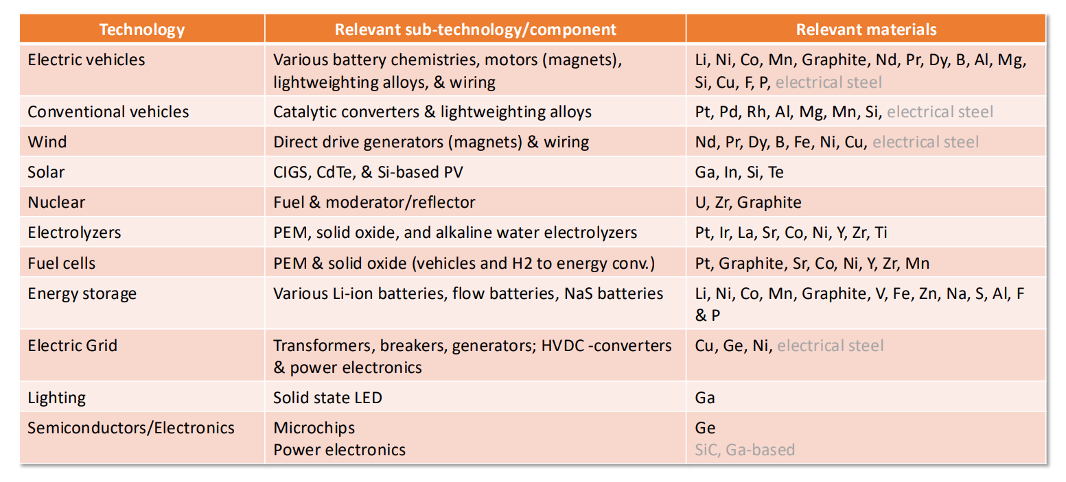
Price elasticity of demand and supply – CRMs lacking
Technologic grouping:

Slide 85
Price elasticity of demand and supply – Some studies:
Bogmans et al. , IMF (2024): Granular IV across commodities
Consistent dataset (1960–2021) with granular IV (country shocks) to identify slope of demand/supply.
Minerals: demand and supply are price‑inelastic; both become more elastic with longer horizons.
Result used here: horizon‑dependent elasticities for minerals.
Shojaeddini et al. , USGS (2024): PEDs for Battery Minerals (2SLS)
Lithium −0.11 (post‑2020 SR); Nickel −0.09; Cobalt −0.45; Manganese −0.04.
Graphite: flake ≈ −0.58; amorphous ≈ −0.36.
Method: 2SLS with commodity‑specific IVs; structural breaks tested.

Slide 86
Price elasticity of demand and supply – Some studies:
Sullivan et al. (2025): Lithium PED under Automaker Strategies
Short‑run lithium demand remains highly inelastic (|ε| < 0.13) through 2050.
Long‑run elasticity becomes more elastic (−0.35 to −0.20) with strategic flexibility (chemistry mix, range, densities).
Bottom‑up, automaker‑level scenario model.
Vertier et al, Banque de France (2025): Mine‑level PES (Local Projections)
Mine‑level response to demand‑induced price shocks (through Vector autoregressive (VAR) model) across 8 minerals (2000–2019).
Average PES ≈ +0.5 within 1–5 years; lower near conflicts & in concentrated markets.
Heterogeneity: reserves, multi‑owner, multi‑mineral mines respond less.

Slide 87
Price elasticity of demand and supply – Some studies:
Fernandez (2018): Divisia‑Moment / Price Flexibility
World/regional income & price elasticities for 7 base metals (1960–2015).
Low price–quantity correlation at world level; heterogeneity across regions.
Adds IV corrections; Working’s expenditure curves for metal baskets.
Stuermer (2017): Dynamic model applied to long historical series
Pool Mean Group (PMG) estimation procedure applied to an Autoregressive distributed lag model (ARDL) to catch dynamic effects
Post WWII estimations used here
Country-based lags reveal significant country-by-country differences

Slide 88
Price elasticity of demand and supply – Some studies:
Baffes et al. (2020): Income and price demand elasticities
Aggregate demand equations
ARDL model applied to a large cross panel (instead of VAR, not suitable here)
Broad control variables (urbanization, investment share, population density, …) have specific effects on the materials
Interesting robustness checks (also cross-price effects) to reinforce the results

Slide 89
Price elasticity of demand and supply – Elasticity database
Elasticity_database.xlxs:
Results are reported in the Database sheet
Glossary is reported in the Definitions sheet
Useful comments are in Statements sheet
Dahl’s database summary is in Dahl sheet

Slide 90
Price elasticity of demand and supply – Elasticity database - Medians

Slide 91
Price elasticity of demand and supply – Elasticity database post-procesing
Scope and taxonomy
For each CRM, record: short‑run vs. long‑run estimate, geography, time period, method (IV/ARDL/panel FE), market level (global/national), and commodity form/grade.
Harmonized estimates
All reported estimates are grouped to range or point elasticities on lnQ vs lnP and to time-horizons, for each material or aggregate

Slide 92
Price elasticity of demand and supply – Alternative implementation in TEMOA
A possible alternative:
Endogenous system response:
Map the specific price CRMs shock into technology specific cost adders, through the knowledge of the specific CRMs economic value
After running the model, it’s possible to see how CRMs use has changed after price response
The proposed endogenous alternative can be implemented as a comparative check between NetZero scenario and disruption-scenarios, comparing the costs elasticities of the technology deployments (activities or capacities) in different regimes.
IEA ETP 2024: material/tech supply shocks raise costs and slow deployment, but do not immediately halt energy system operations.
Actually, in TEMOA-stochastic it’s possible to intercept the slow deployment effect thanks to the scenario-tree structure, because at different nodes can correspond a new response of the system.

Slide 93
Tie specific scenario families to disruption types
Issue:
Elasticities tie price disruption with supply shortage
Actually, lower elasticities mean higher total cost of the system:
A low elasticity means that the system isn’t able to adapt to price shock, and find alternatives
This aspect isn’t intercepted by TEMOA if actually the disruption enters only as activity restriction and not as cost increases

