Slide 1
Machine Learning in ClimateWins
August 5th, 2025
Bacary Casimiro Djassi

Slide 2
1. Project Objective & Hypotheses
Objective:
Use machine learning to help predict the consequences of climate change while working as a data analyst at a European nonprofit organization
Hypotheses:
Machine learning algorithms can predict favorable weather conditions with at least 70% accuracy using historical climate data
Regional weather patterns in Europe show distinct trends that can be identified and predicted using supervised learning techniques
Specific weather stations provide more reliable prediction data than others due to geographical and meteorological factors

Slide 3
2. Data & Bias
Data Source:
European Climate Assessment & Dataset project (ECAD)
Dataset URL: https://s3.amazonaws.com/coach-courses-us/public/courses/da-spec-ml/Scripts/A1/Dataset-weather-prediction-dataset-processed.csv
Potential Biases:
Regional representation: Some climate events are more common in certain regions
Geographic distribution: Weather stations may not be evenly distributed
Economic impact: Predictions could affect regional economies, tourism, and investment
Human verification: Machine learning outputs require human review and context
Ethical Considerations:
No personal data concerns in current dataset
Transparency in data collection and algorithm methods is essential
Results require proper contextualization when communicated to the public (Machine learning)

Slide 4
3. Testing Optimization Methods for Weather Data
We tested the gradient descent optimization technique on 1991 average temperature data from European cities. This helps ClimateWins decide which algorithms and computing resources to use.
What We Discovered:
The 1991 temperature data shows clear linear relationships between variables
Simple differentiable functions work well with this historical temperature data
Algorithm Selection Insights:
The smooth convergence pattern suggests linear relationships in temperature data
Linear regression would be most appropriate for this pattern
KNN could work if needed, but would use unnecessary resources

Slide 5
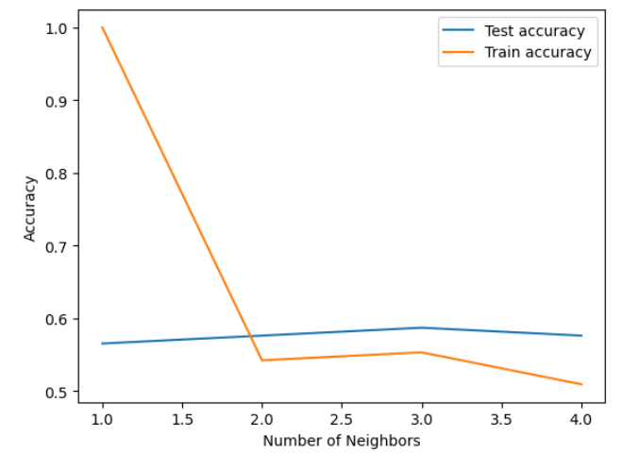
3. Machine Learning Algorithms & Results
K-Nearest Neighbors (KNN):
Peak test accuracy: 60% with 3 neighbors
Training accuracy fluctuated with neighbor count
Decision Trees:
Complex structure with many leaves
Poor accuracy in both training and testing
Requires pruning to reduce complexity
Captured noise rather than meaningful patterns
Artificial Neural Networks (ANN):
Accuracy was also close to 60%, similar to KNN
More powerful but less intuitive than KNN
Multiple scenarios tested with varying results
Accuracy for testing and training of KNN model.

Slide 6
3. Summary & Next Steps
Key Findings:
KNN model recommended for ClimateWins due to its accuracy and how easy it is to use
60% prediction accuracy achieved with optimal parameters
Regional patterns identified in data contribute to overall accuracy

