Slide 1
MeltingPop
버전 | 0.2
작성일 | 2020.04.21
소속 | 홍익대학교
작성자 | 최현지

Slide 2
✓ Index
Revision History
Menu Structure
List of Screen
Flowchart
Policy
Permission
Wireframe
Validation
INDEX
Revision History
Menu Structure
List of Screen
Flowchart
Polilcy
Permission
Wireframe
Validation

Slide 3
Index
✓ Revision History
Menu Structure
List of Screen
Flowchart
Policy
Permission
Wireframe
Validation
REVISION HISTORY
Version | Author | Description | Date
0.1 | 최현지 | 로그인/회원가입, 아이디/비밀번호 찾기, 비밀번호 변경, 1:1 문의 Flowchart 작성 Menu Structure 1차 작성 Wireframe 1차 작성 화면설계서 1차 작성 | 2022-03-23
0.2 | 최현지 | home.html signin.html signup.html Wireframe 2차 작성 화면설계서 2차 작성 | 2022-04-21

Slide 4
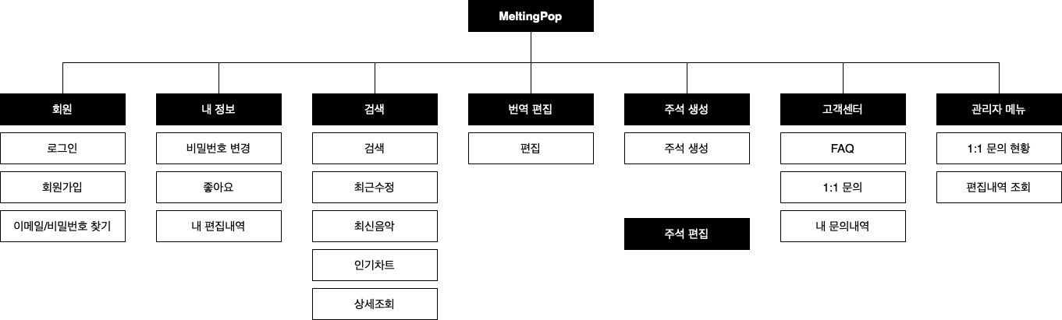
Index
Revision History
✓ Menu Structure
List of Screen
Flowchart
Policy
Permission
Wireframe
Validation
MENU STRUCTURE

Slide 5
Index
Revision History
Menu Structure
✓ List of Screen
Flowchart
Policy
Permission
Wireframe
Validation
LIST OF SCREEN
대메뉴 | 중메뉴 | 소메뉴 | Screen ID | Description | 비고

Slide 6
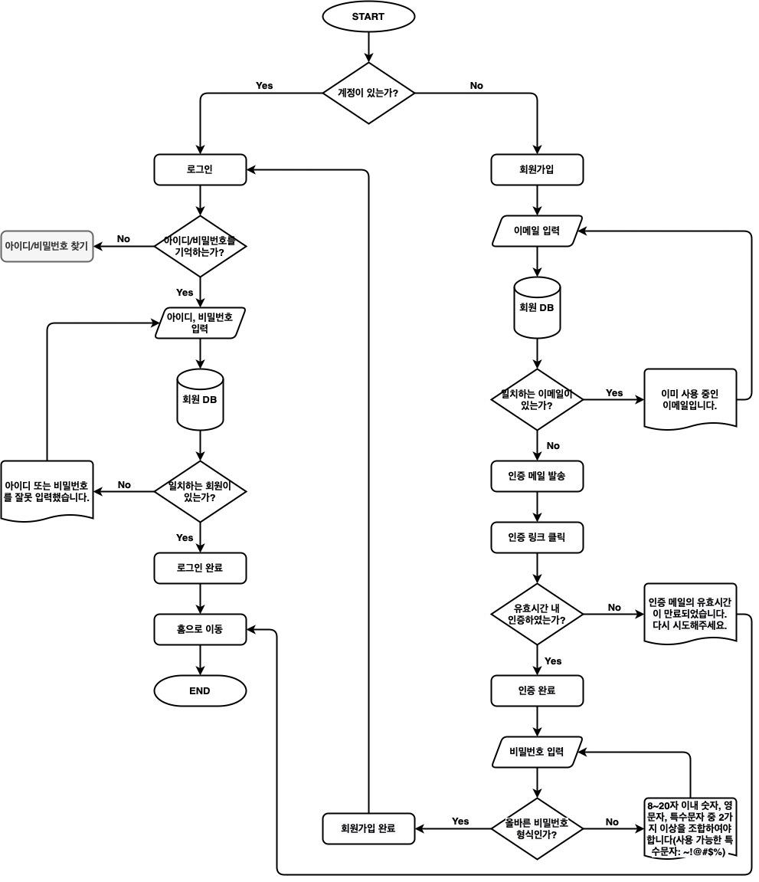
Index
Revision History
Menu Structure
List of Screen
✓ Flowchart
Policy
Permission
Wireframe
Validation
FLOWCHART
로그인/회원가입

Slide 7
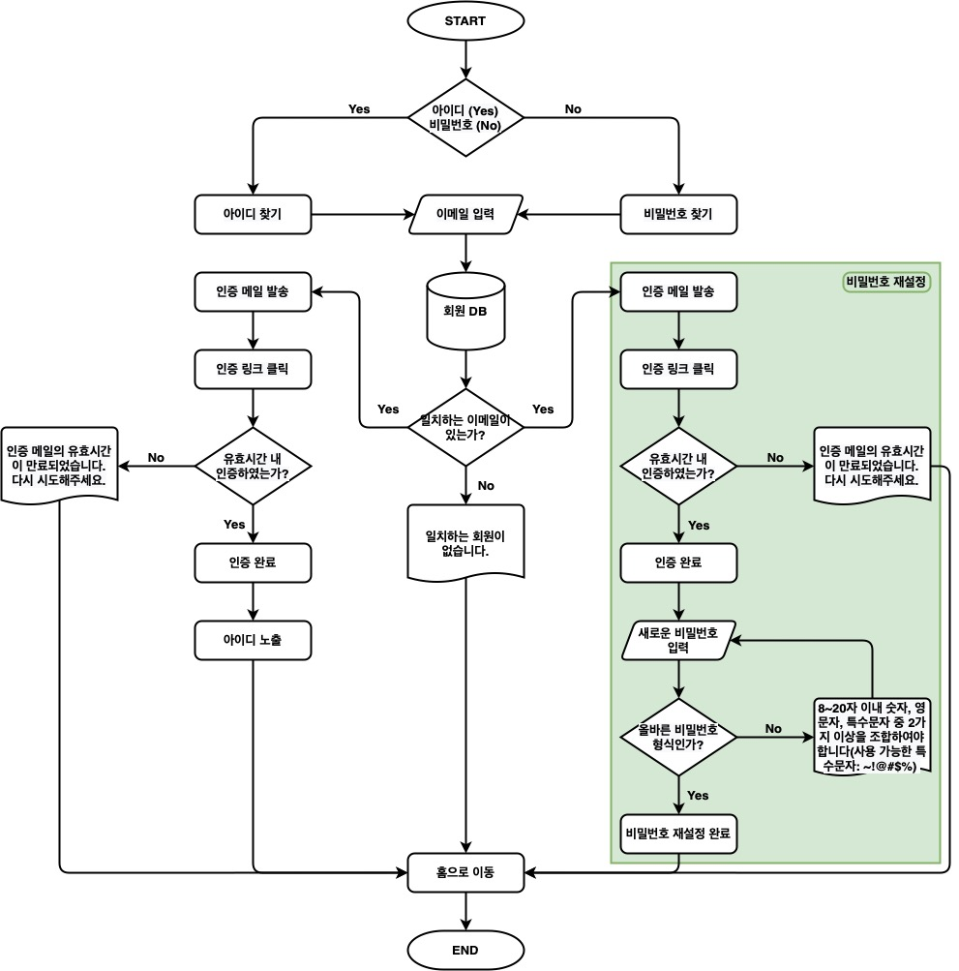
Index
Revision History
Menu Structure
List of Screen
✓ Flowchart
Policy
Permission
Wireframe
Validation
FLOWCHART
아이디/비밀번호 찾기

Slide 8
Index
Revision History
Menu Structure
List of Screen
✓ Flowchart
Policy
Permission
Wireframe
Validation
FLOWCHART
검색

Slide 9
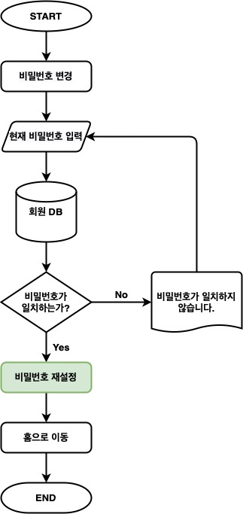
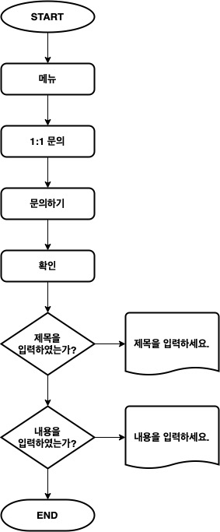
Index
Revision History
Menu Structure
List of Screen
✓ Flowchart
Policy
Permission
Wireframe
Validation
FLOWCHART
비밀번호 변경
1:1 문의

Slide 10
Index
Revision History
Menu Structure
List of Screen
Flowchart
✓ Policy
Permission
Wireframe
Validation
POLICY
빈 칸

Slide 11
Index
Revision History
Menu Structure
List of Screen
Flowchart
Policy
✓ Permission
Wireframe
Validation
PERMISSION
빈 칸

Slide 12
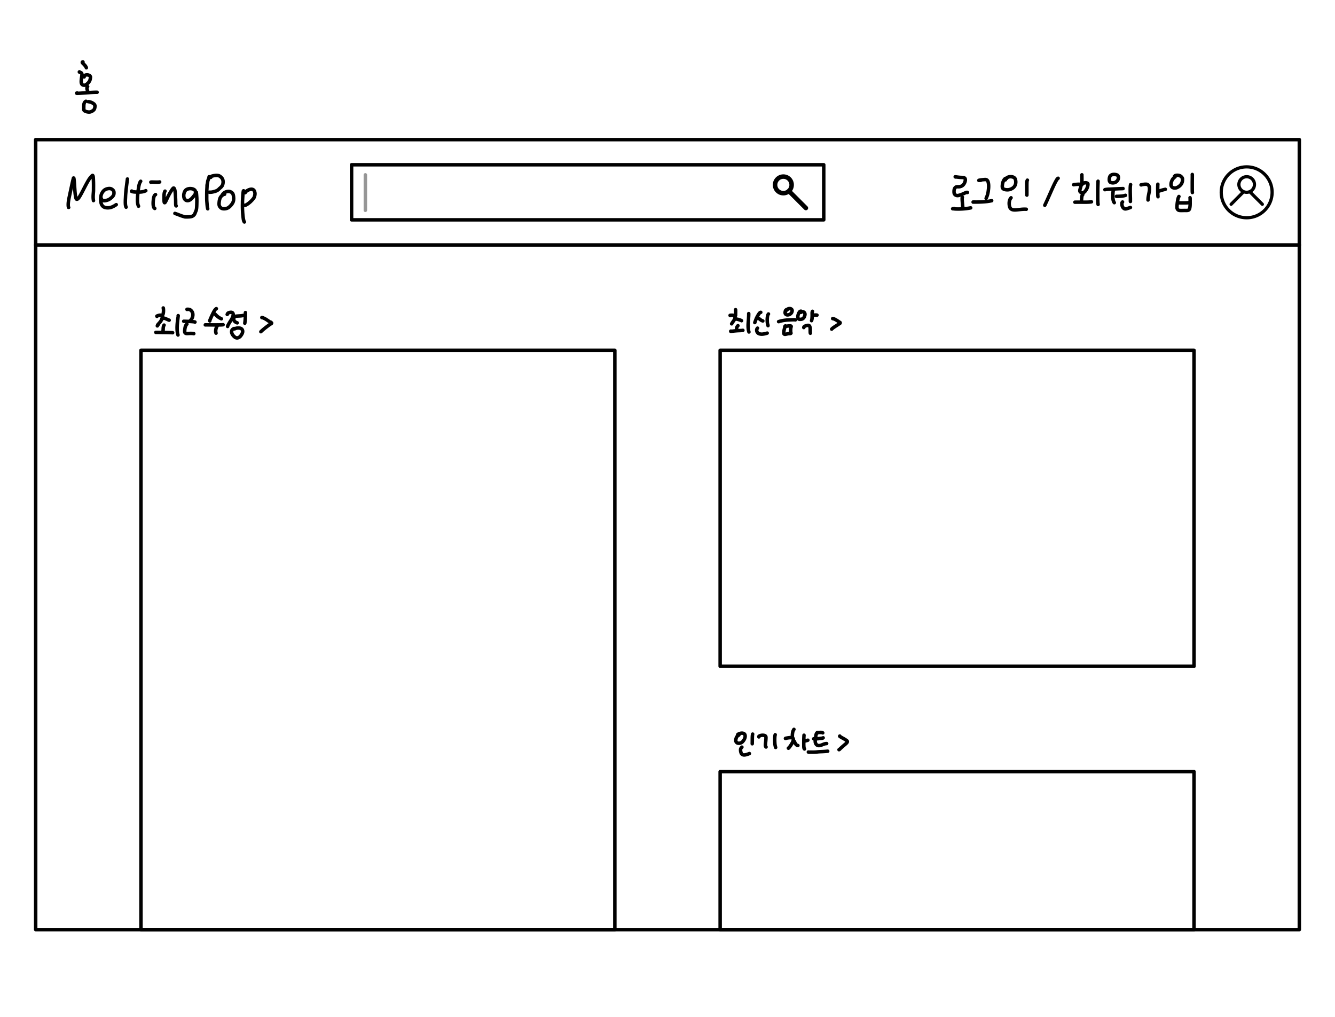
Index
Revision History
Menu Structure
List of Screen
Flowchart
Policy
Permission
✓ Wireframe
Validation
WIREFRAME – index.html

Slide 13
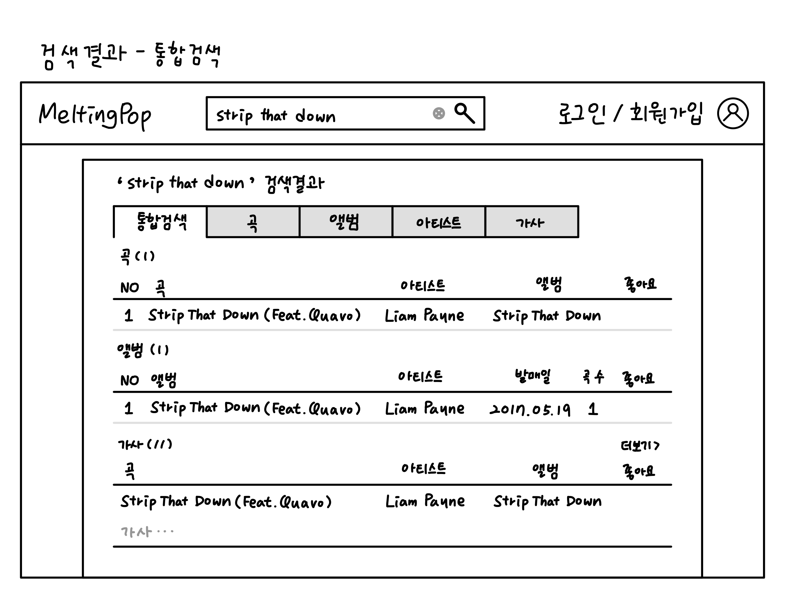
Index
Revision History
Menu Structure
List of Screen
Flowchart
Policy
Permission
✓ Wireframe
Validation
WIREFRAME – search-all.html

Slide 14
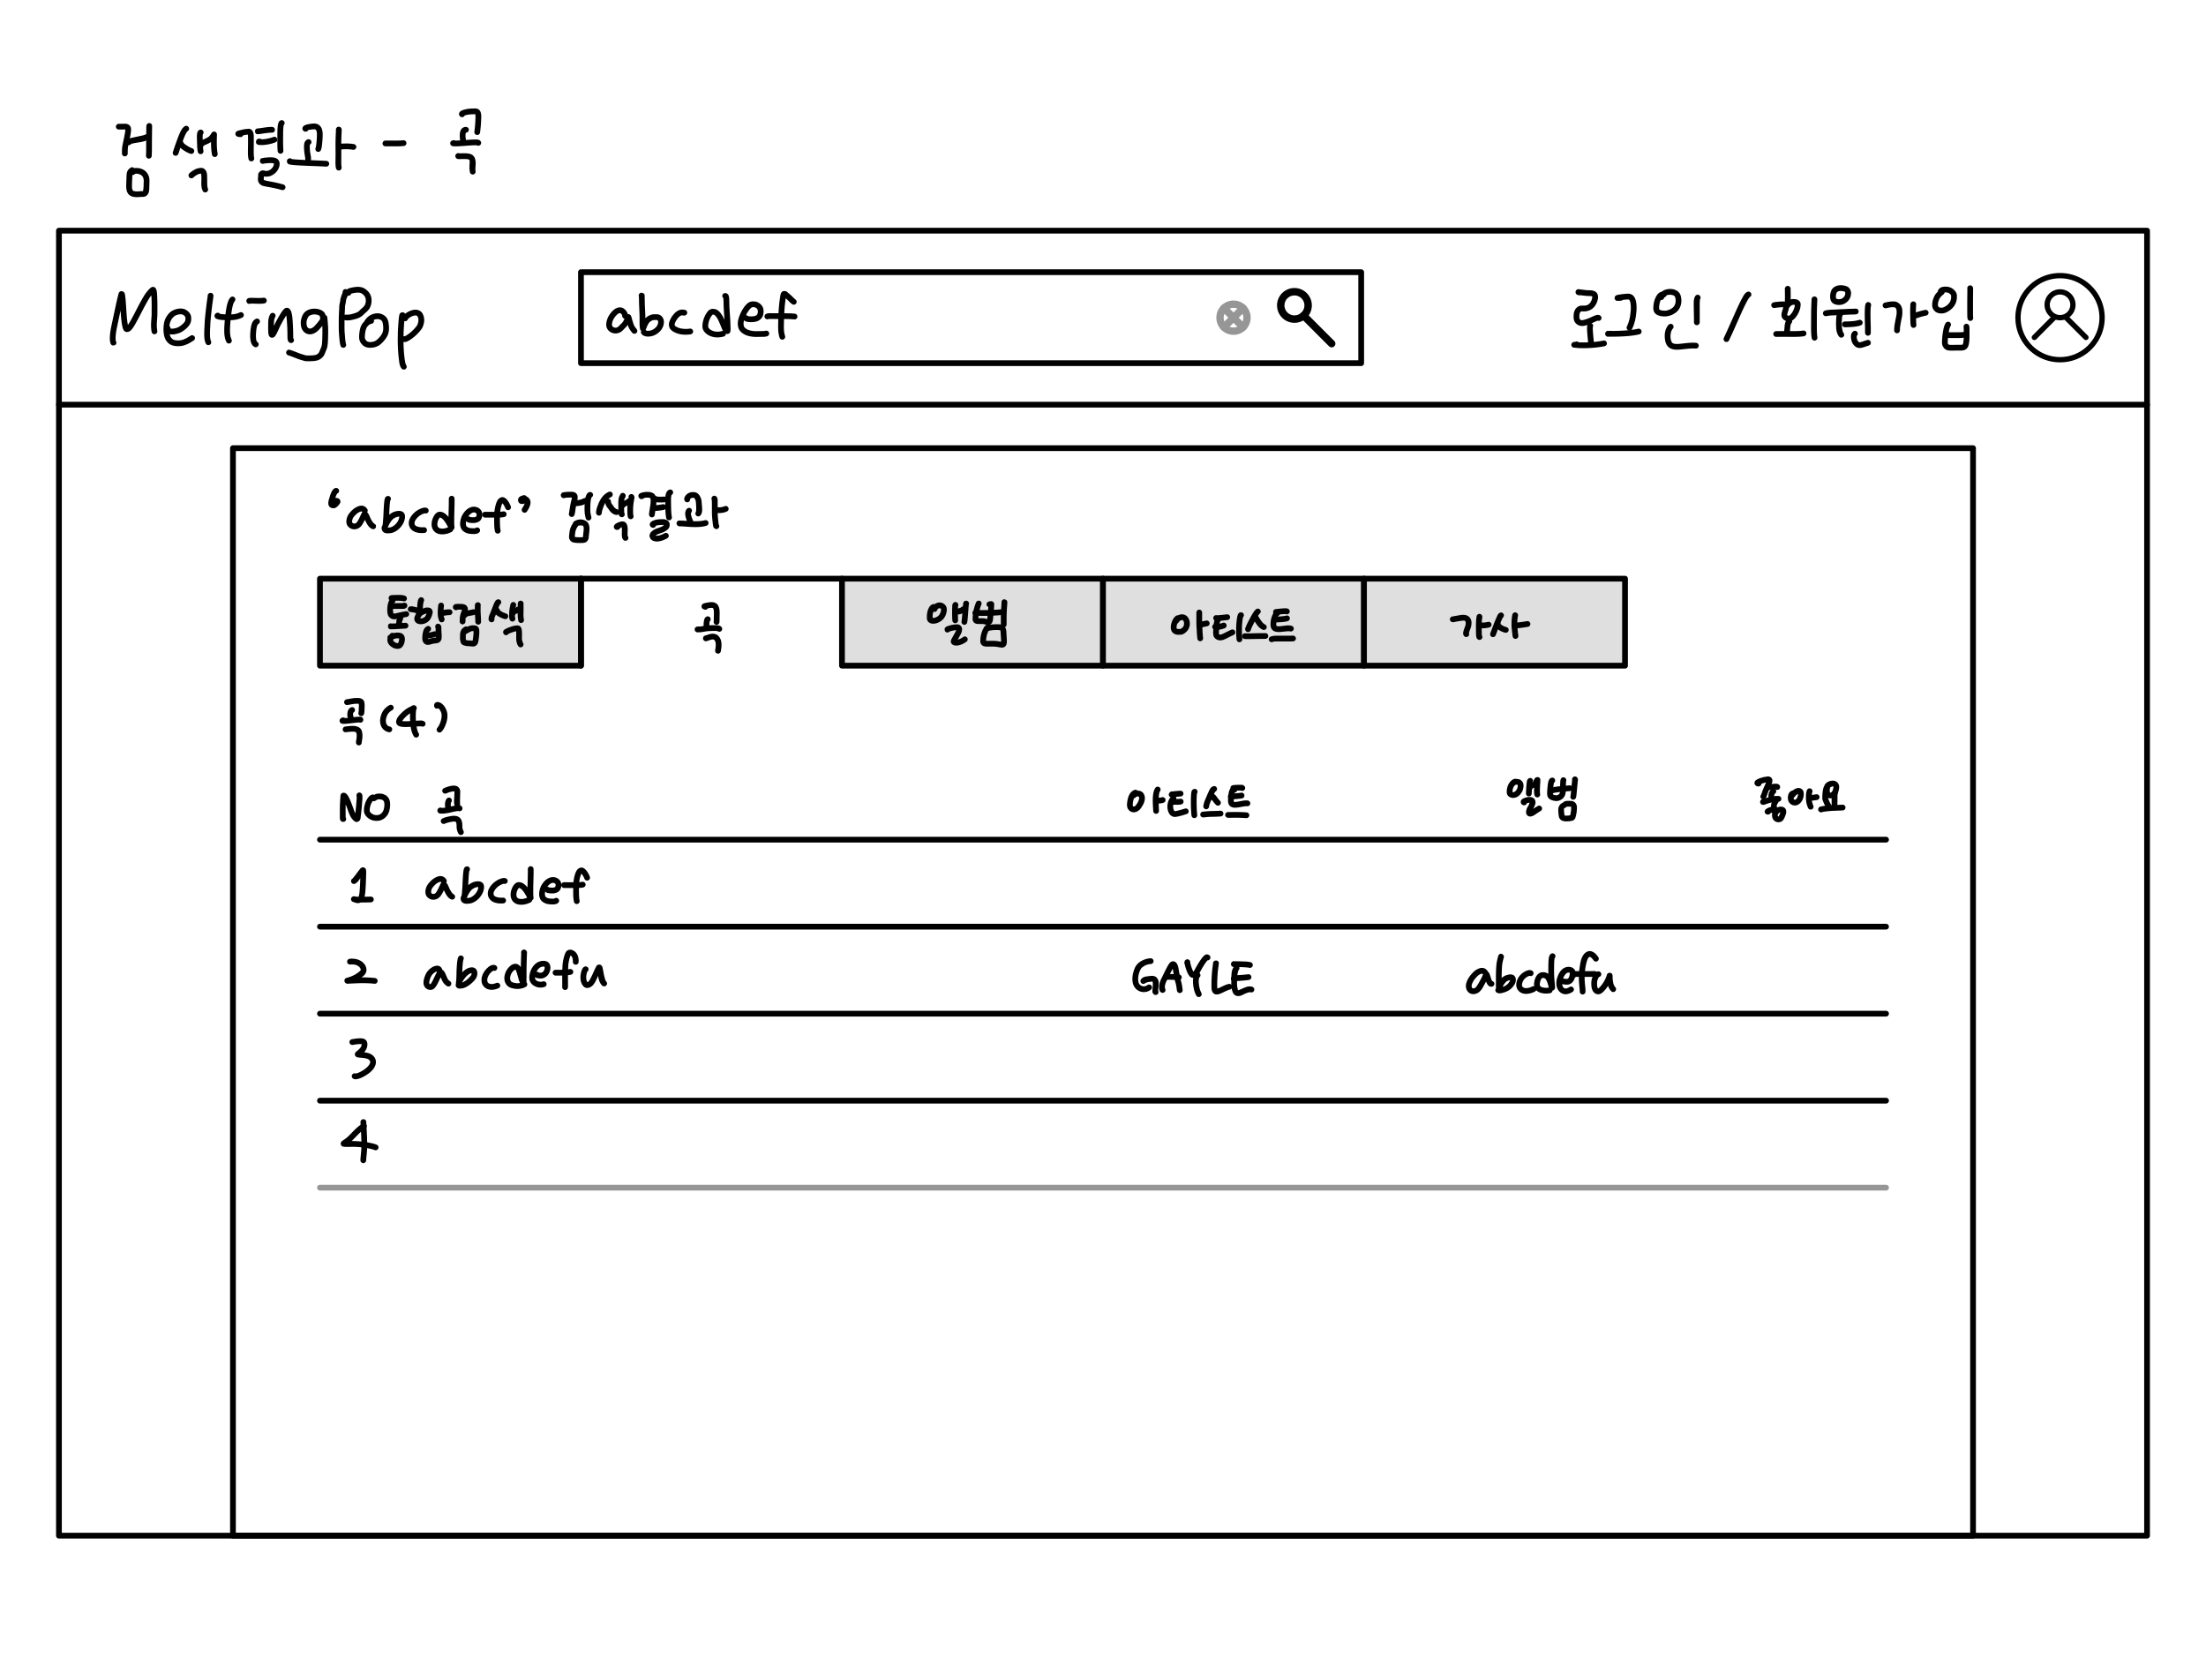
Index
Revision History
Menu Structure
List of Screen
Flowchart
Policy
Permission
✓ Wireframe
Validation
WIREFRAME – search-song.html

Slide 15
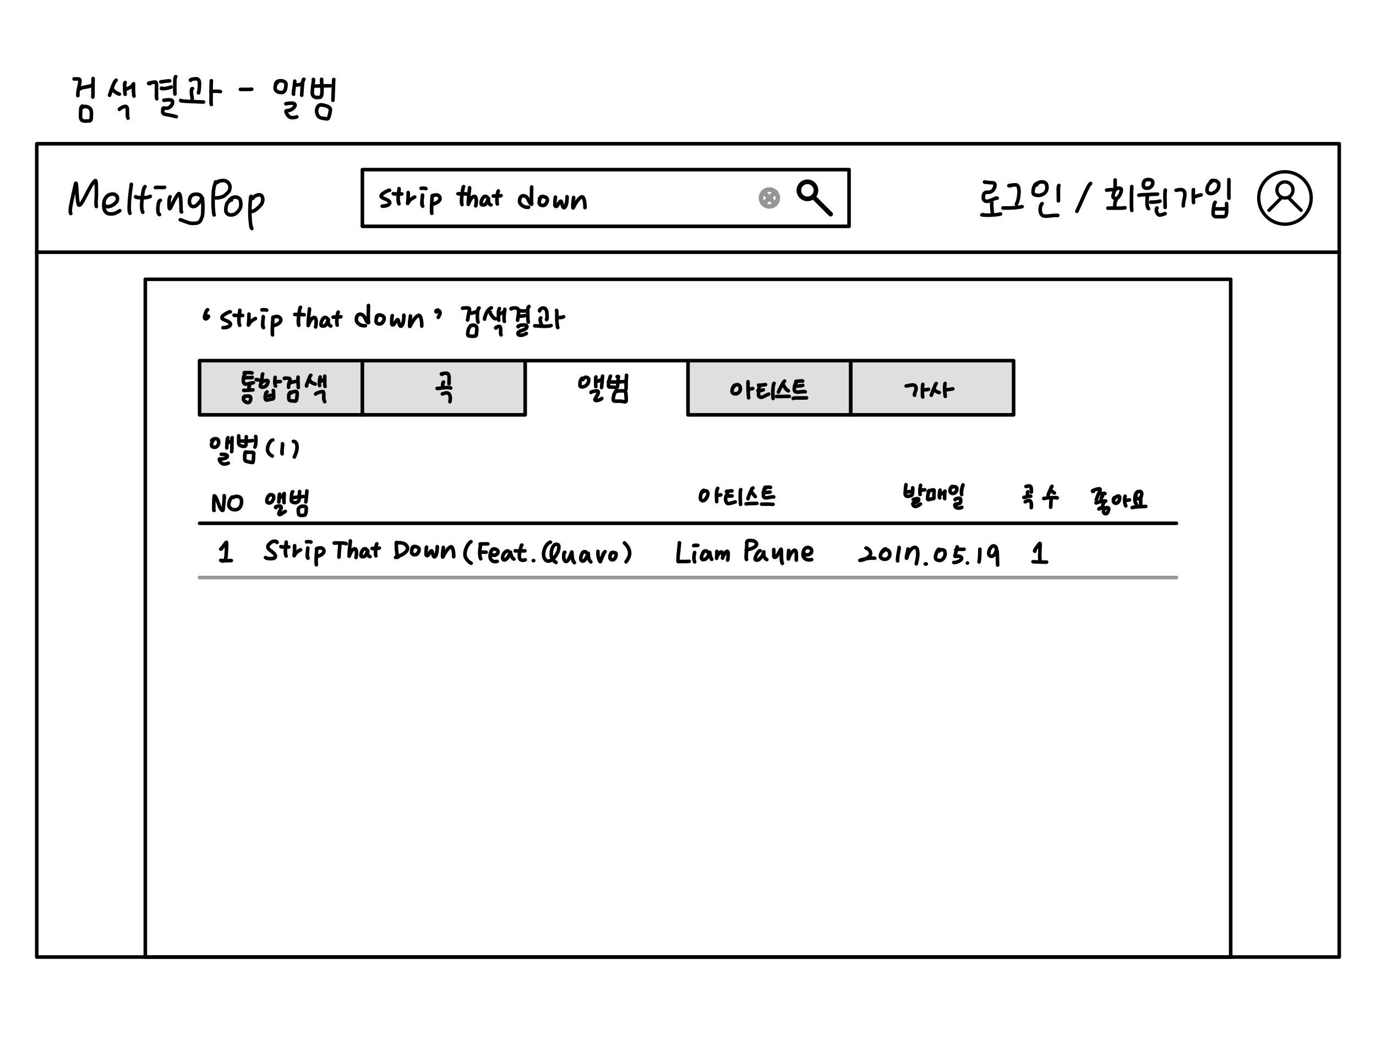
Index
Revision History
Menu Structure
List of Screen
Flowchart
Policy
Permission
✓ Wireframe
Validation
WIREFRAME – search-album.html

Slide 16
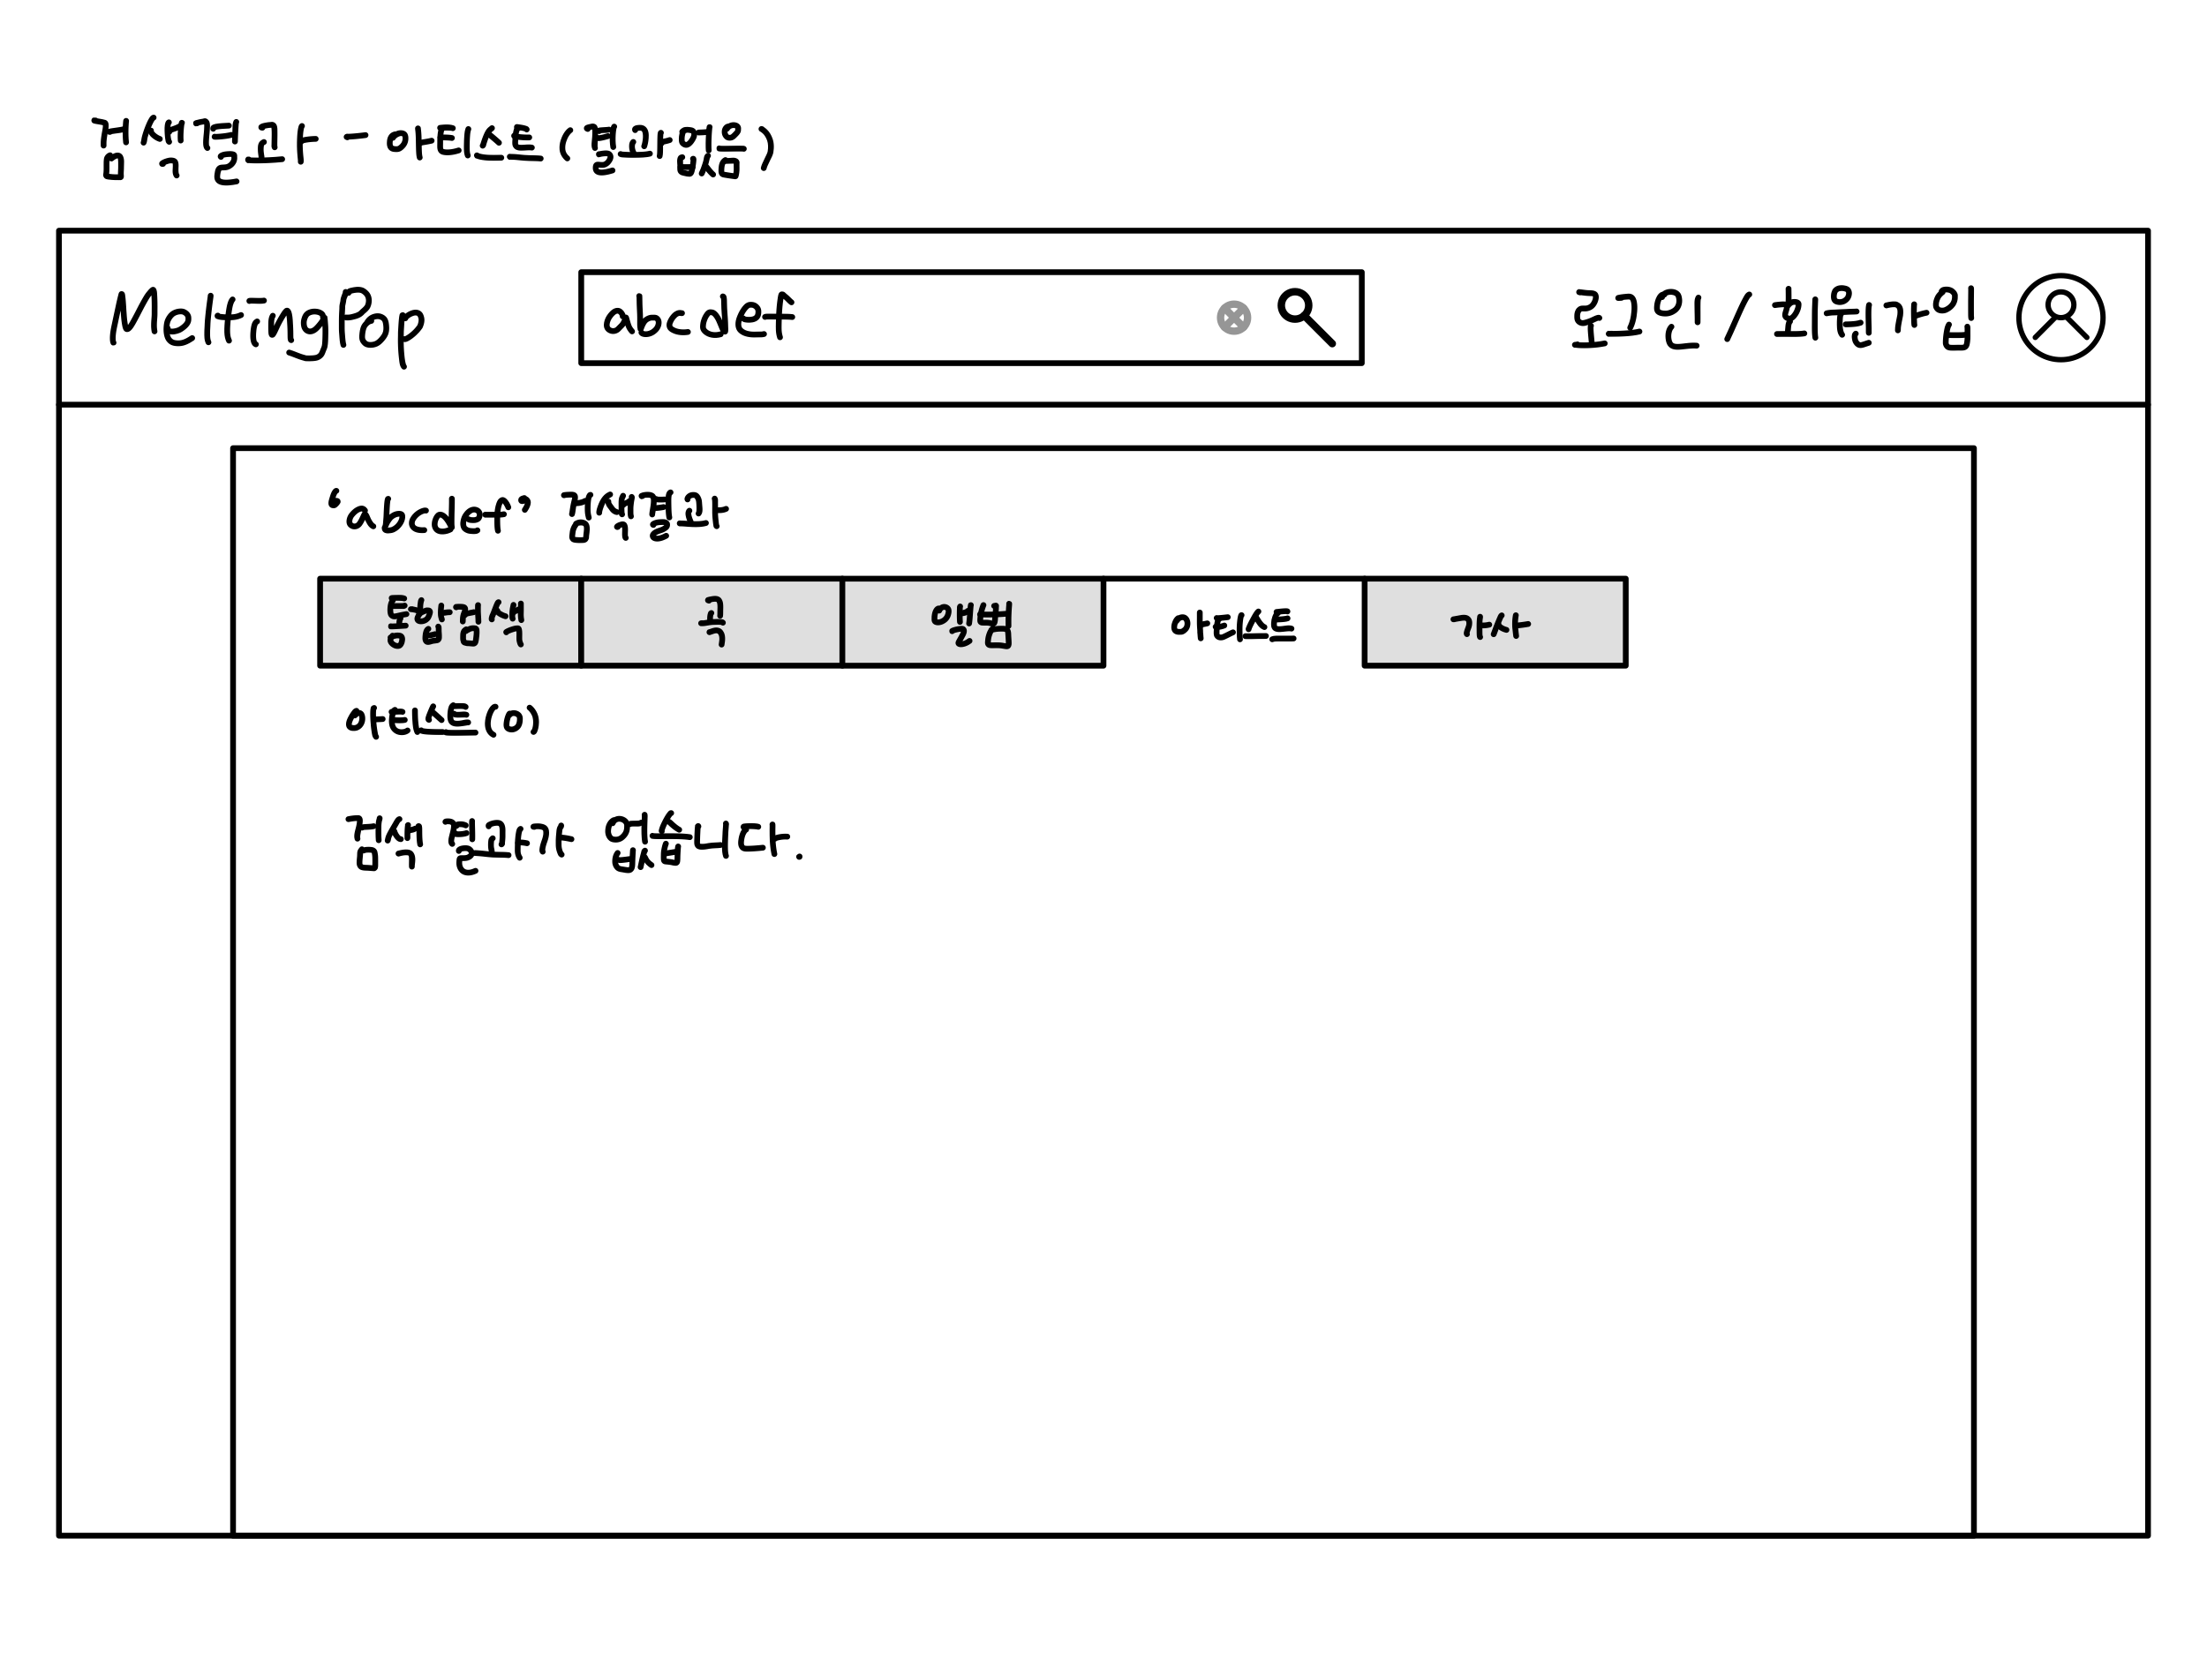
Index
Revision History
Menu Structure
List of Screen
Flowchart
Policy
Permission
✓ Wireframe
Validation
WIREFRAME – search-aritst.html

Slide 17
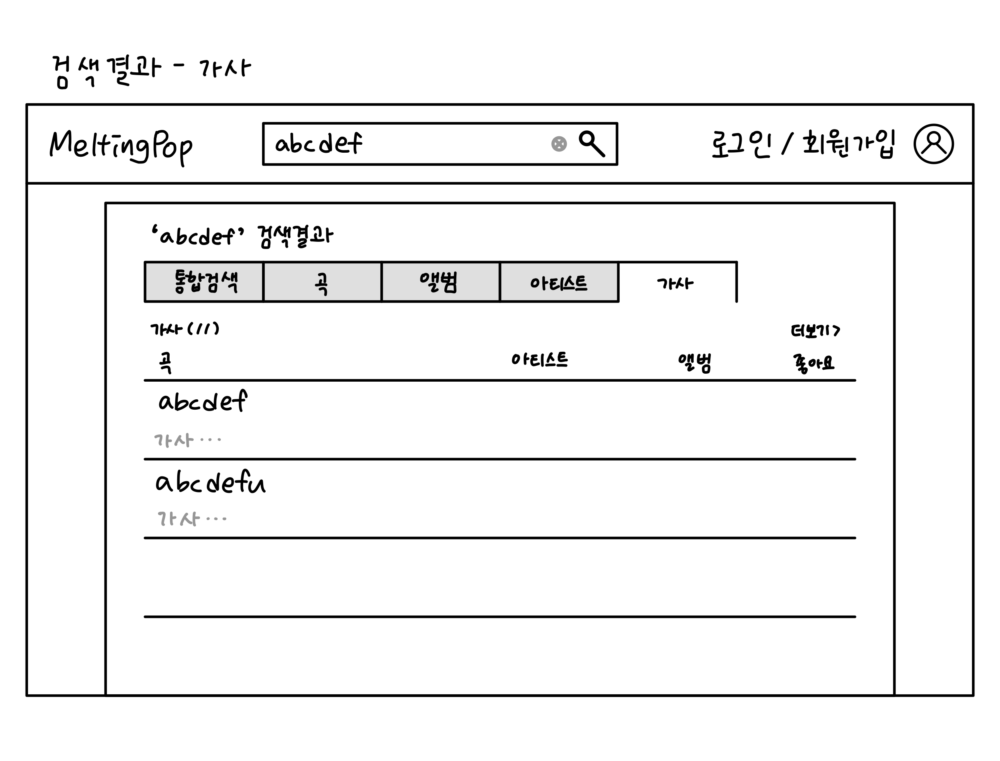
Index
Revision History
Menu Structure
List of Screen
Flowchart
Policy
Permission
✓ Wireframe
Validation
WIREFRAME – search-lyrics.html

Slide 18
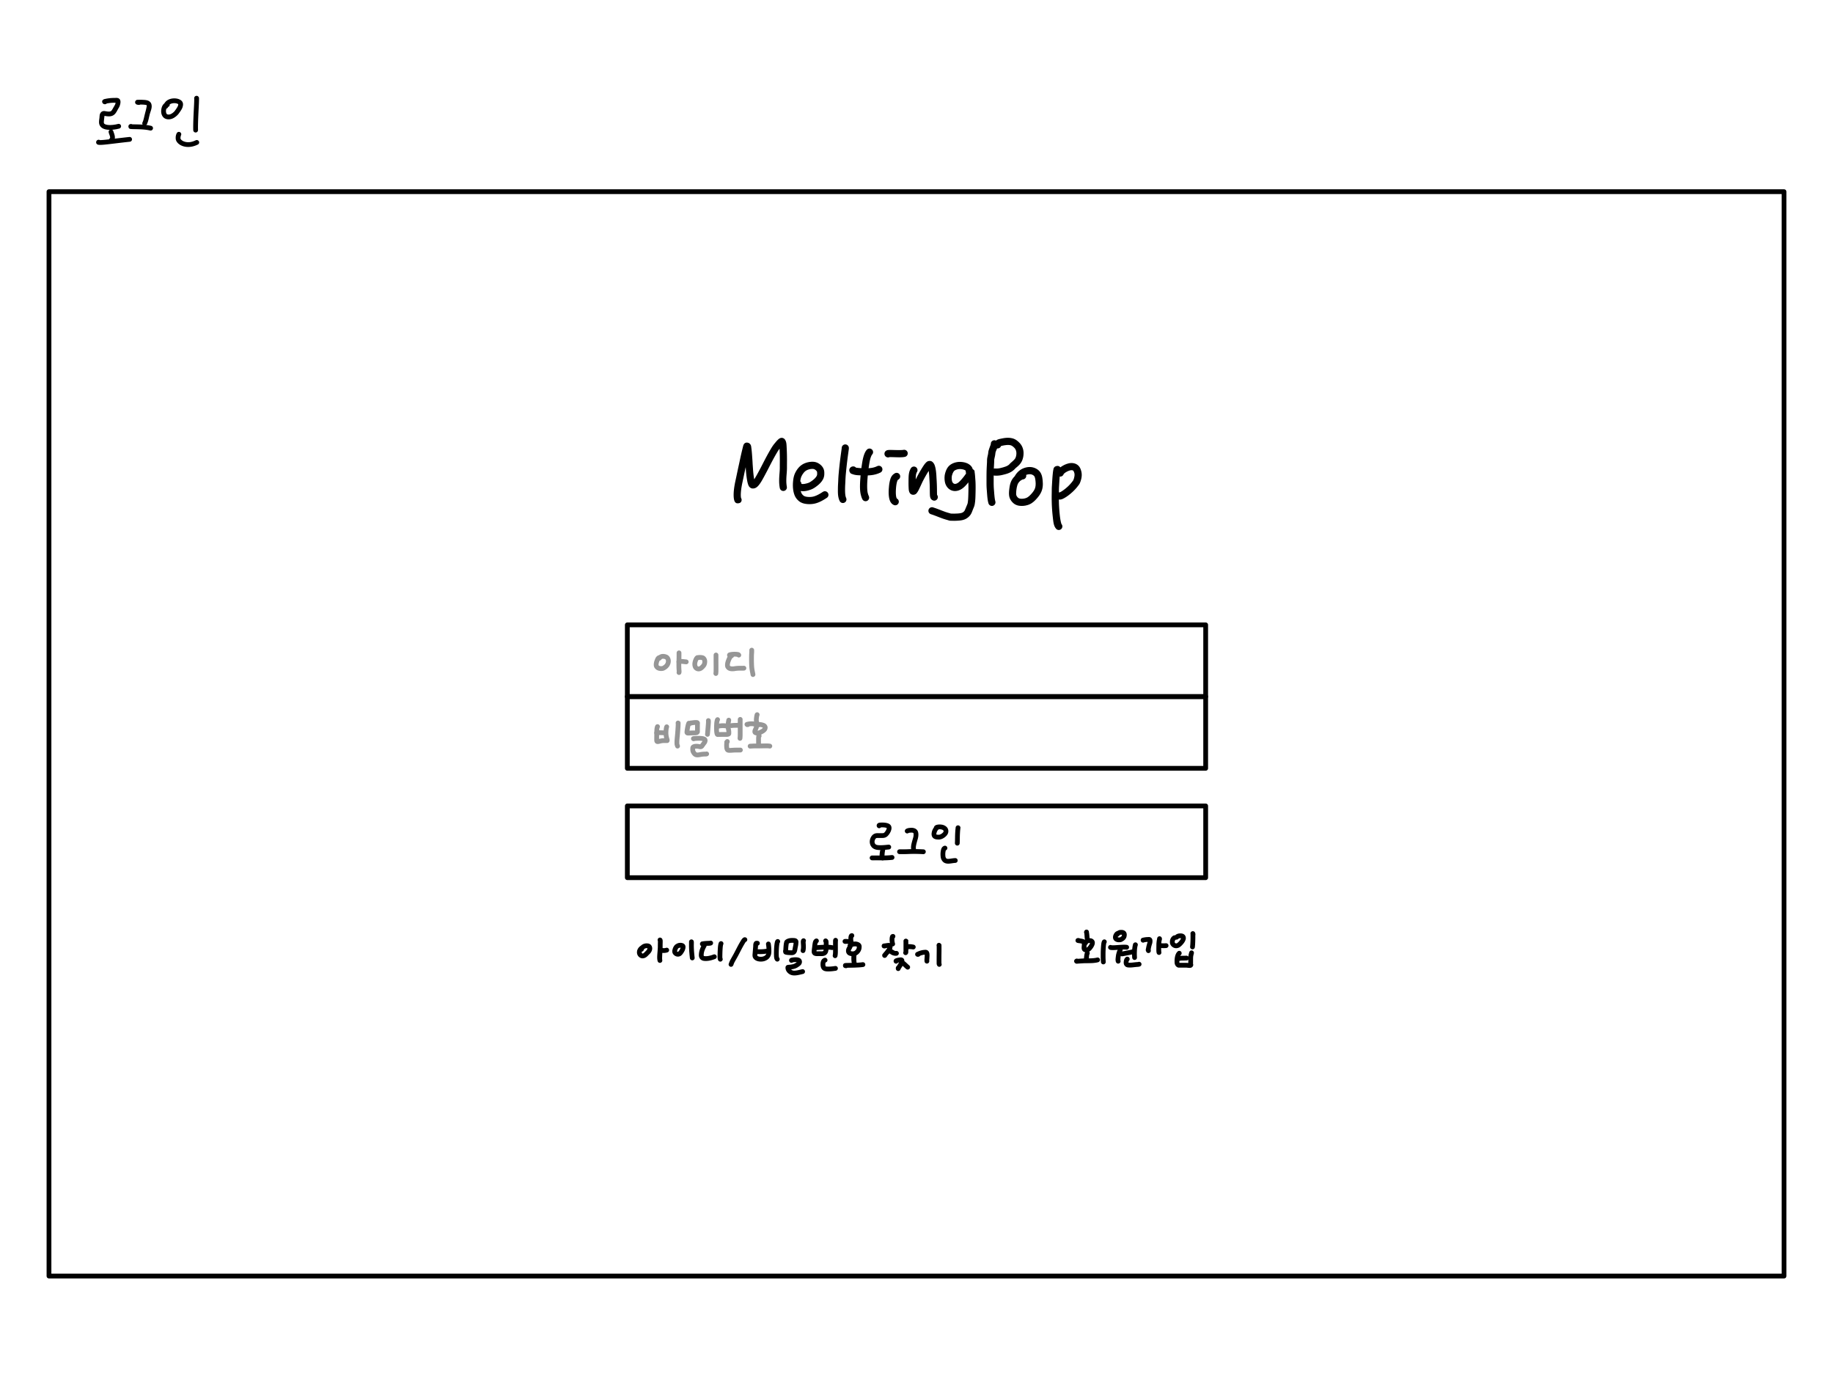
Index
Revision History
Menu Structure
List of Screen
Flowchart
Policy
Permission
✓ Wireframe
Validation
WIREFRAME – login.html

Slide 19
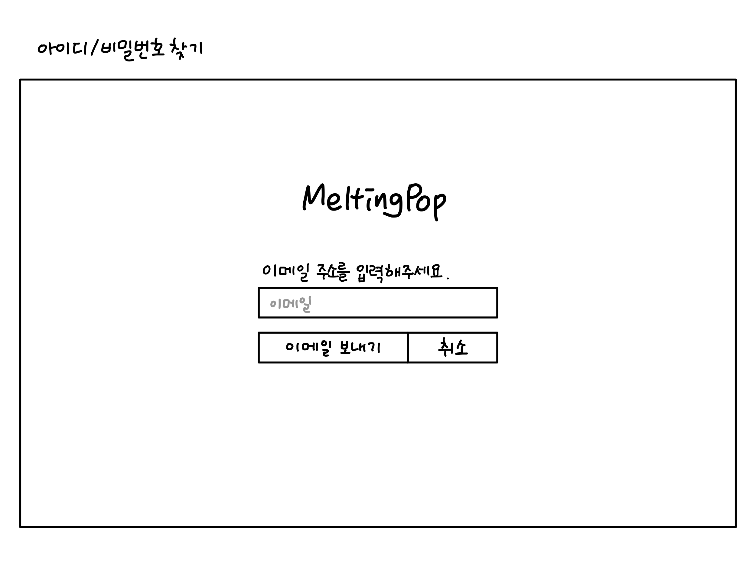
Index
Revision History
Menu Structure
List of Screen
Flowchart
Policy
Permission
✓ Wireframe
Validation
WIREFRAME – forgot-pw.html

Slide 20
Index
Revision History
Menu Structure
List of Screen
Flowchart
Policy
Permission
✓ Wireframe
Validation
WIREFRAME – join.html
Notes:
signin.html

Slide 21
Index
Revision History
Menu Structure
List of Screen
Flowchart
Policy
Permission
✓ Wireframe
Validation
WIREFRAME – updated-songs.html

Slide 22
Index
Revision History
Menu Structure
List of Screen
Flowchart
Policy
Permission
✓ Wireframe
Validation
WIREFRAME – new-songs.html

Slide 23
Index
Revision History
Menu Structure
List of Screen
Flowchart
Policy
Permission
✓ Wireframe
Validation
WIREFRAME – best-songs.html

Slide 24
Index
Revision History
Menu Structure
List of Screen
Flowchart
Policy
Permission
Wrieframe
✓ Validation
VALIDATION
빈 칸
Notes:
updatedSongs.html

Slide 25
Thank you

