Slide 1
Althea
Jehan Tremback & Justin Kilpatrick

Slide 2
Goals
Allow anyone who has a source of bandwidth and can distribute it to others to make a profit.
No centralized ISP business required.
Routers form an “incentivized mesh” network.

Slide 3
What is mesh
A network which automatically routes packets along the best path. In Althea, price is taken into consideration as well.
Not only for radio.
Not only house-to-house.
Efficient networks are small world networks.

Slide 4
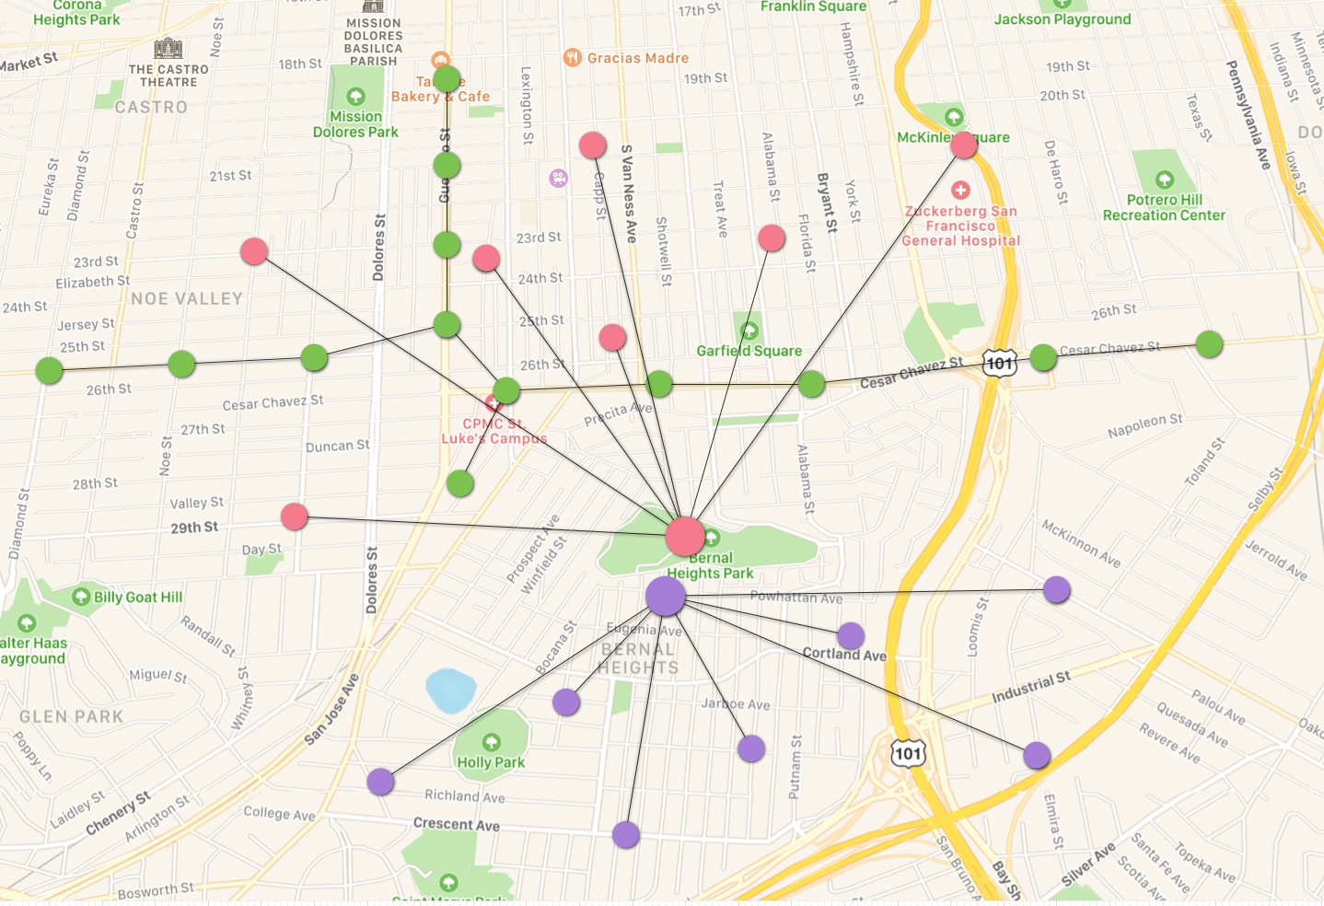
Small world network

Slide 5
Varied physical connections

Slide 6
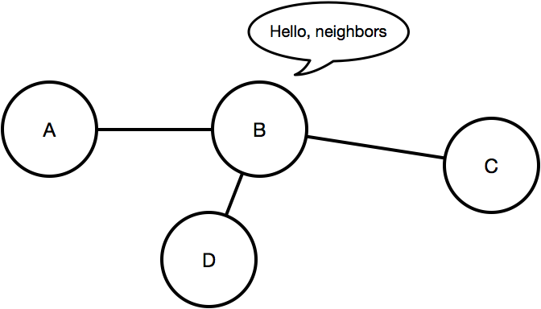

Slide 7
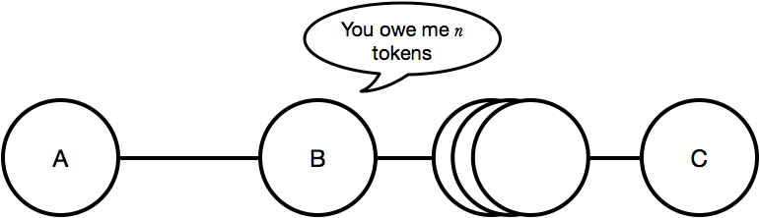
Nodes charge each other for forwarding

Slide 8
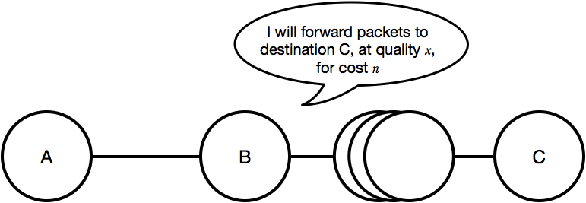
Distance-vector with additional price field

Slide 9
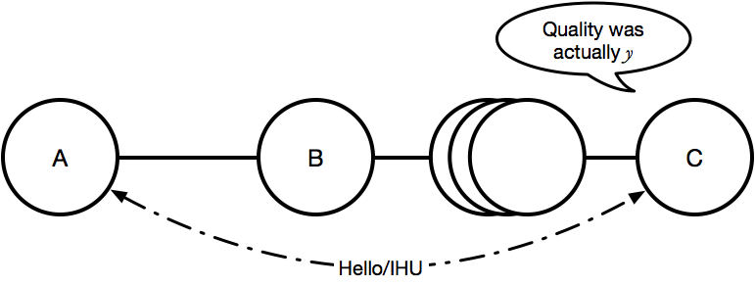
Quality estimation with destination to verify
neighbor’s accuracy

Slide 10
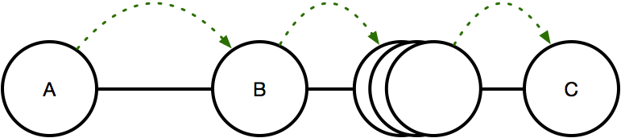
User node pays upstream

Slide 11
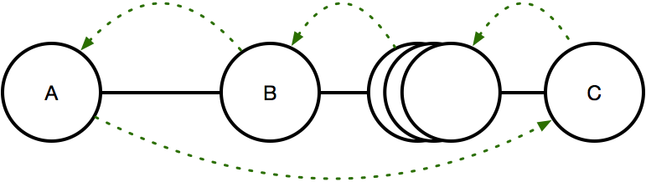
Exit node pays downstream on behalf of user node

Slide 12
Apartment buildings
Can often access commercial-grade fiber.
Lots of profit margin with 100+ tenants.
Althea can function here as a sort of “ISP in a box”, allowing the building owner to make profit that otherwise would have gone to an ISP.

Slide 13
Mesh cooperatives
People that live in an area banding together to improve access.
Not as widespread or successful as wireless ISPs.
Bring a much-needed community element to help support an incentivized mesh network.

Slide 14
Wireless ISPs
Subscribers usually have line of sight to tower.
Subscriber’s neighbors may not, but require ISP to support hardware on someone else’s property.
Althea allows ISP’s service to be resold without having to invest in or support links between houses.
Althea allows multiple ISPs to mesh together to fight the big guys.

Slide 15
www.altheamesh.com
www.github.com/althea-mesh

