Slide 2
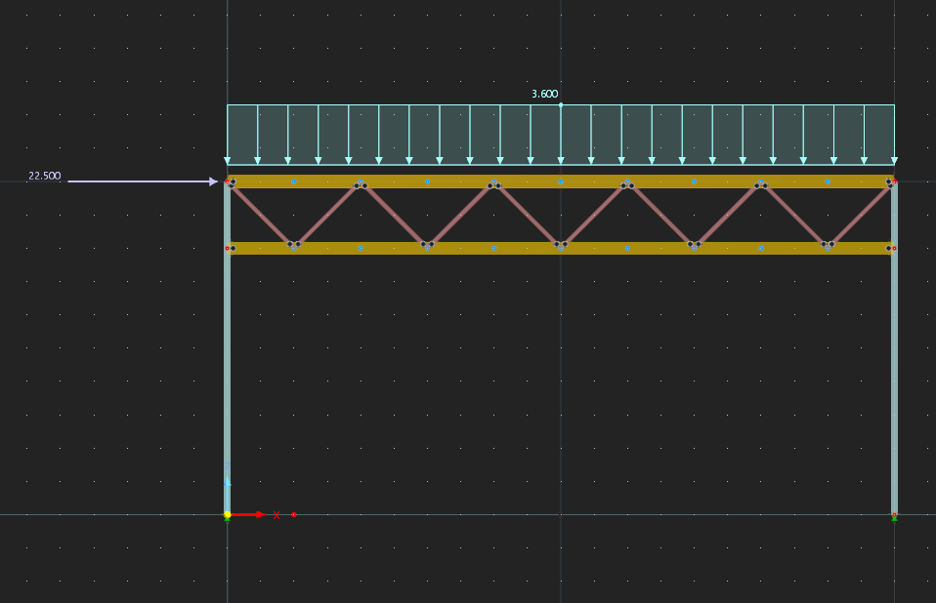
Tests - Truss

Slide 3
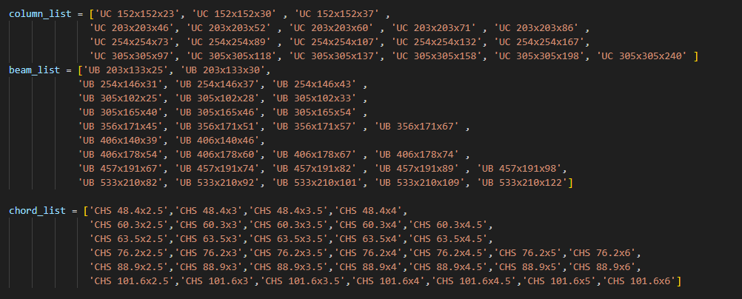
Input

Slide 4
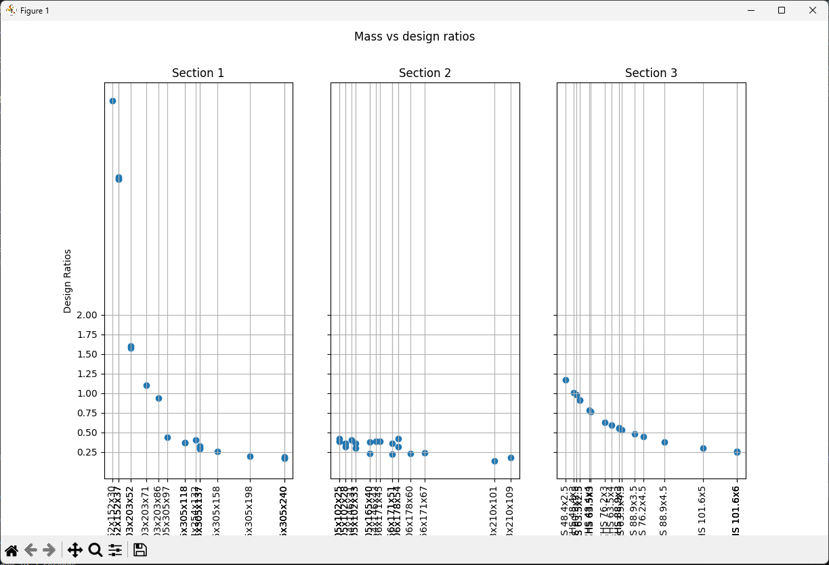
Results – About 20 Random analyses (5 mins)

Slide 5
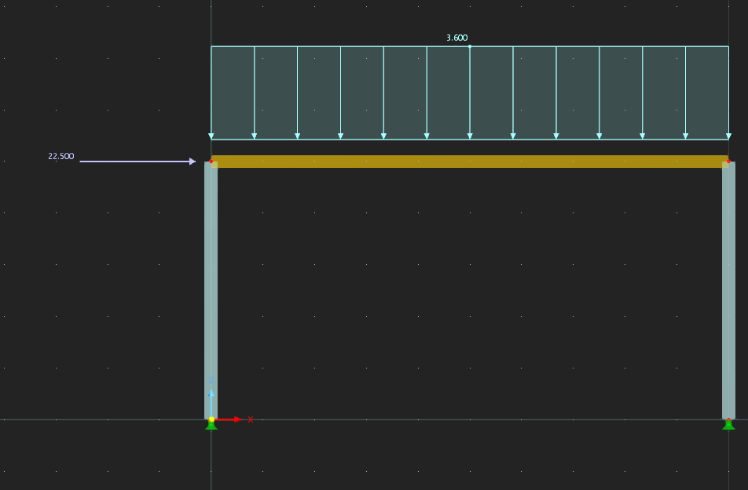
Tests - Portal

Slide 6
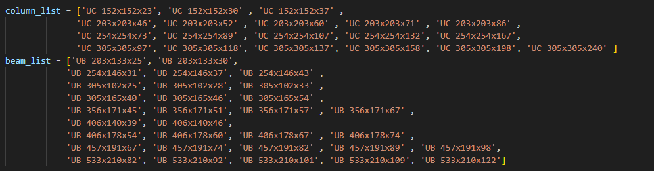
Input

Slide 7
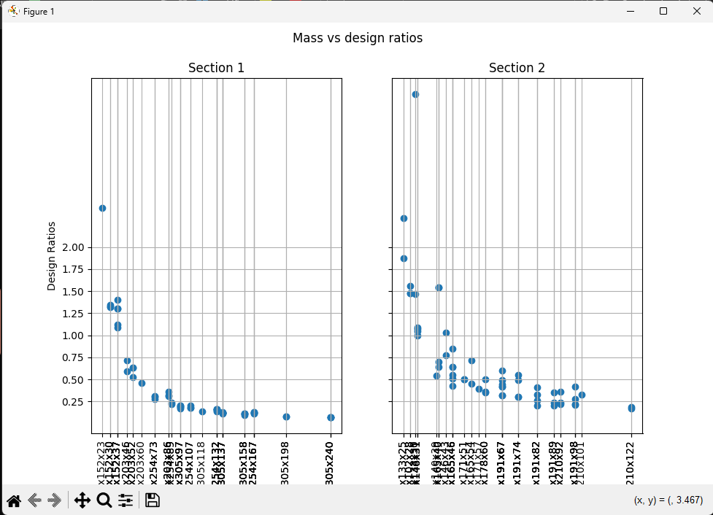
Results – Random analyses (60 analyses – 10 mins)

