Slide 1
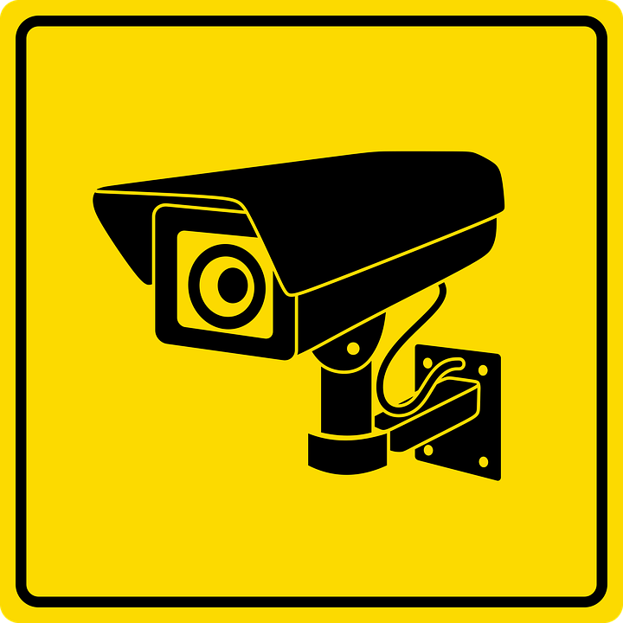
SURVEILLER
Security and Safety guaranteed

Slide 2
Problem Description
The increasing crimes in cities causes a sense of fear in the people. Automated CCTV systems that help detecting the criminal location as well as detecting weapons to help in alerting the authorities immediately. The system developed will be used by the authorities incharge.

Slide 3
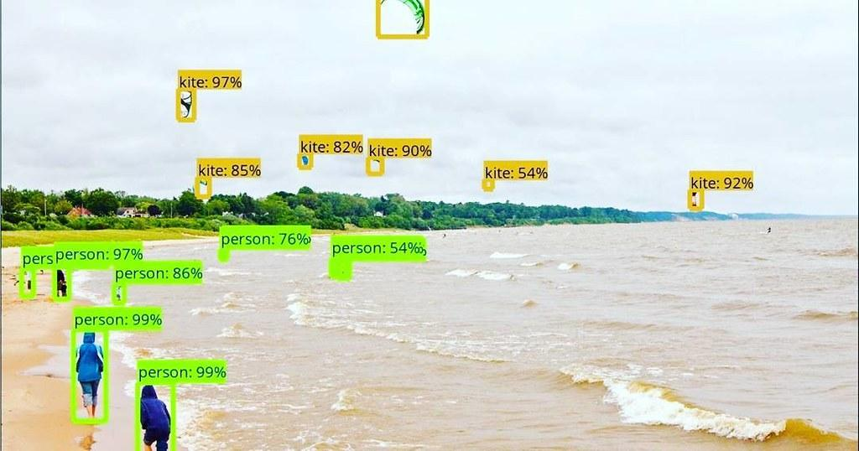
THE RECORDINGS GOT FROM THE CCTV FOOTAGE WILL BE USED TO CARRY OUT OBJECT DETECTION AND EXTRACT THE OBJECTS SUCH AS PEOPLE, GUNS, KNIFES.

Slide 4
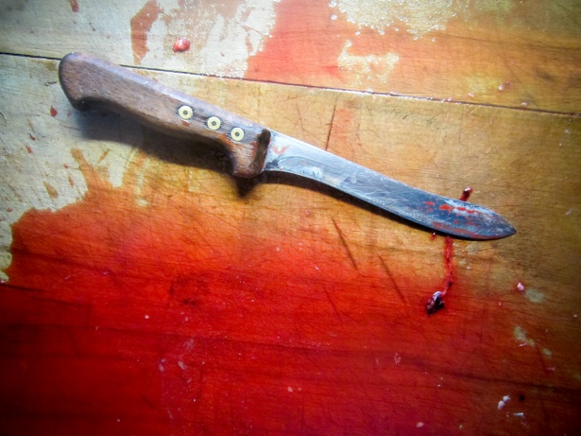
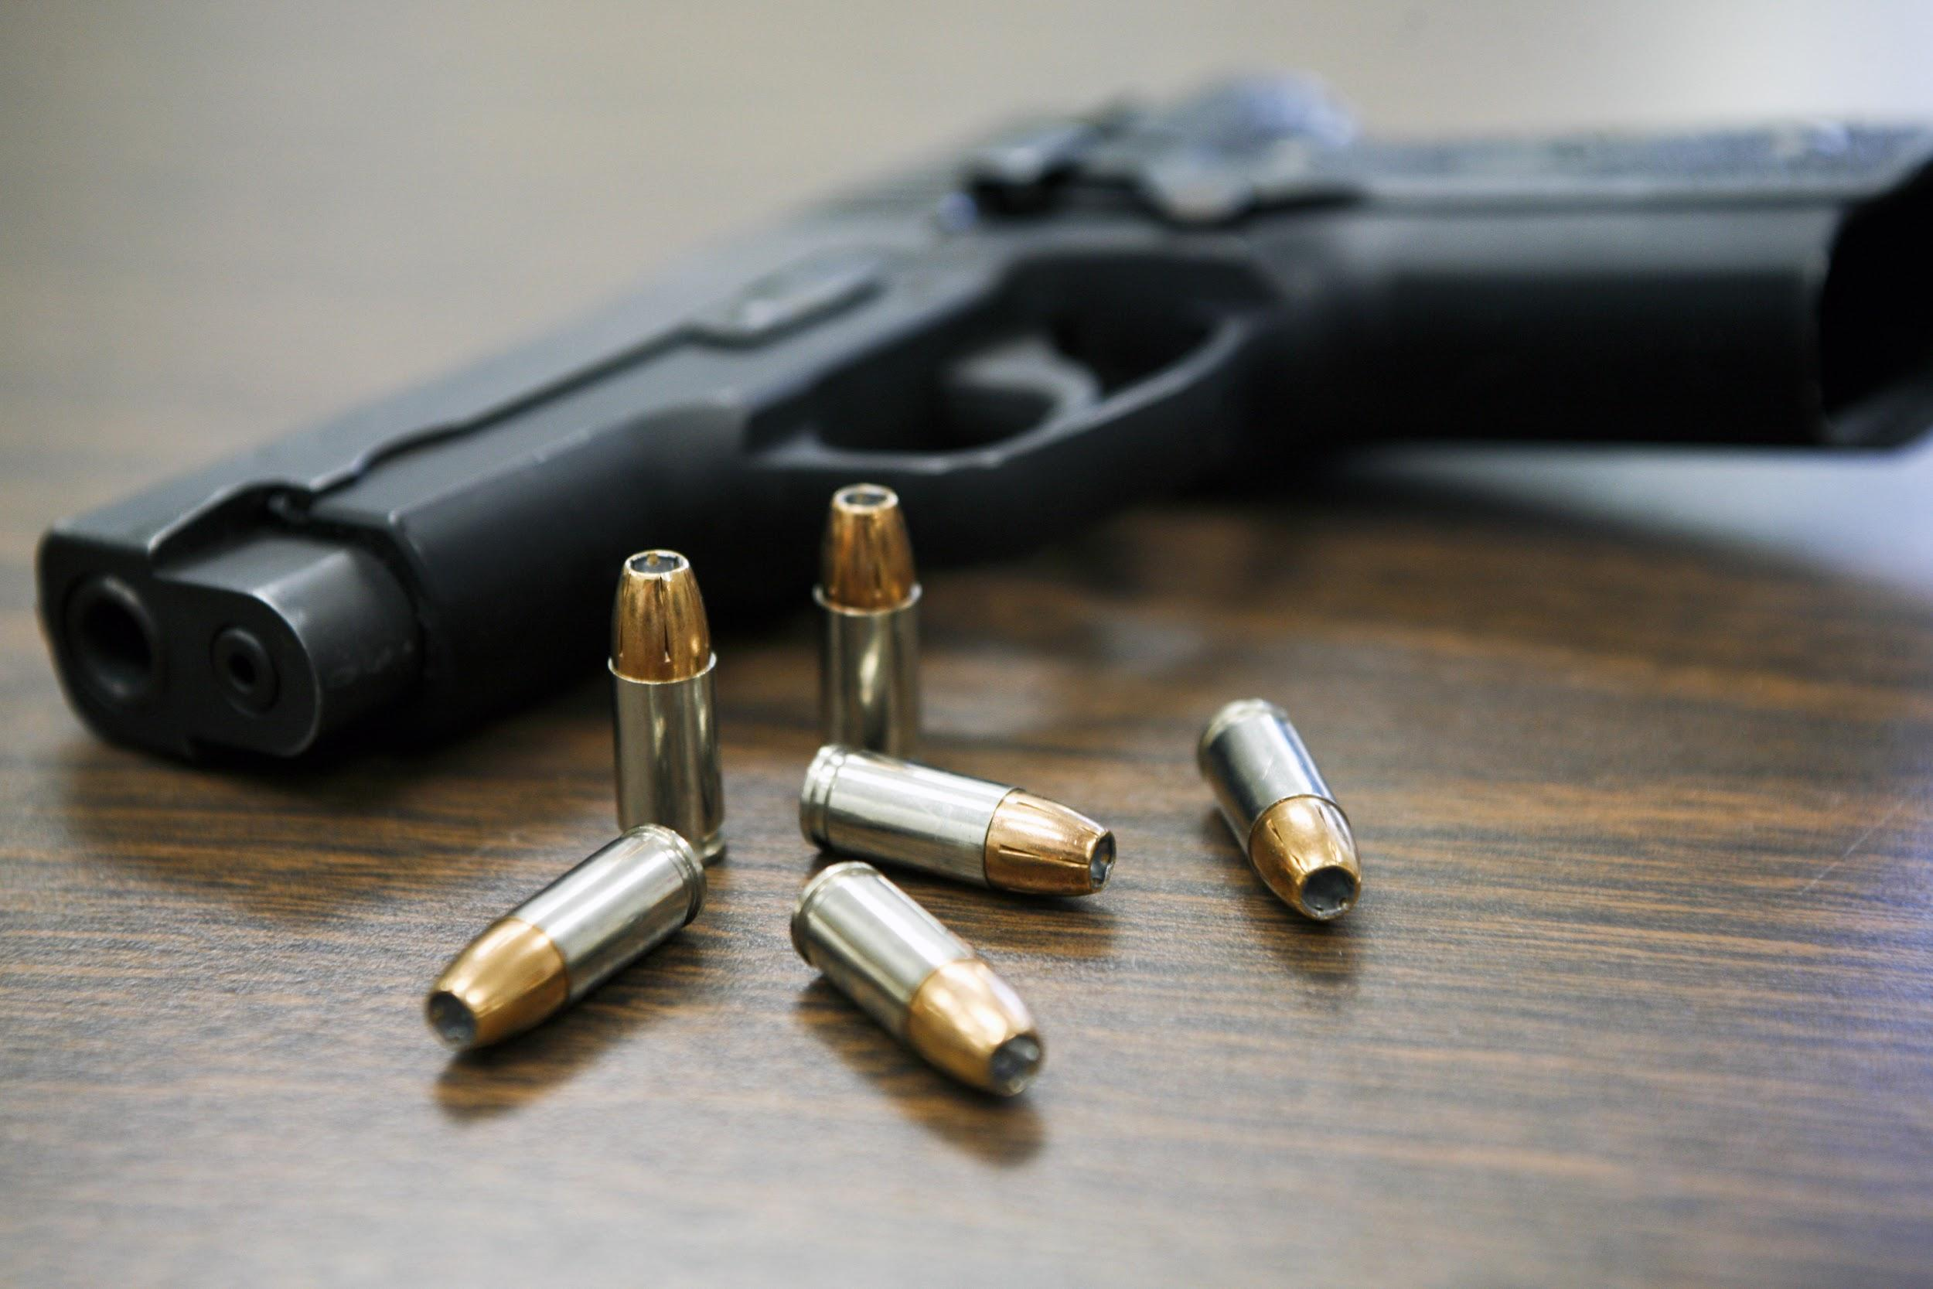
If weapons or knifes are detected by the object detector the web-application will alert the higher authorities with the image of the person holding the object and the camera location.

Slide 5
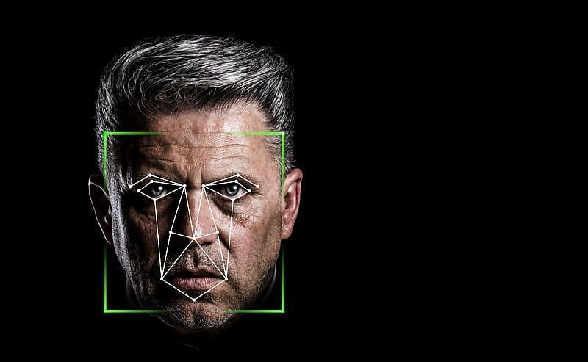
The persons extracted by the object detection model will undergo facial recognition and identify whether the person is a criminal or not using the criminal database.

Slide 6

The web application will be provide tracking of the particular criminal and give the live changes in his location. Thus the criminal can be tracked with ease.

Slide 7
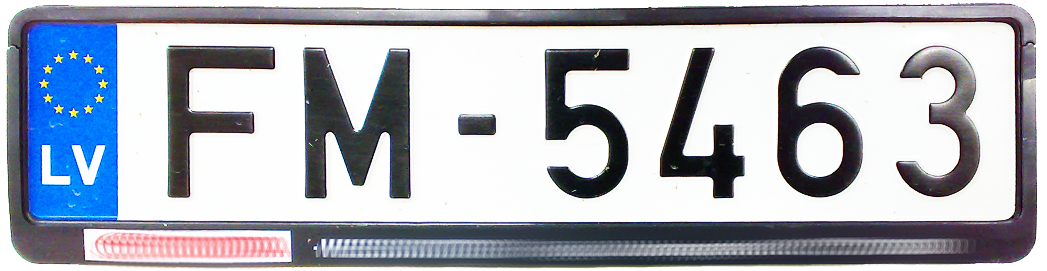
The system is also integrated with vehicle number plate recognition tracking to provide better security.

Slide 8
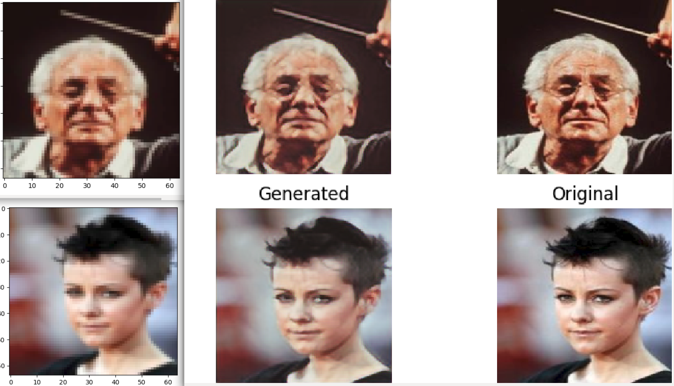
Enhanced Super Resolution

Slide 9








Slide 10
THANKS

