Slide 1
Super Market sales
Analyse des ventes d’un super macher au mynamar

Slide 2
Introduction

Slide 3
Étapes
Nettoyage
Analyse exploratoire
Data processing / Feature engineering
Clustering
Recommendations

Slide 4
1. Nettoyage

Slide 5
2. Analyse exploratoire

Slide 6
3. Data processing / Feature engineering

Slide 7
2. Analyse exploratoire

Slide 8
4. Customer Segmentation
Objectif : Segmenter les clients afin d’offrir des services personnalisés
Méthode : Utiliser l’algorithe KMeans

Slide 9
4. Customer Segmentation (suite)
Résultats
Segment 0:
- Unit Price Mean: 0.50
- Quantity Mean: 0.50
- Total Mean: 0.30
- Rating Mean: 8.92
- Gender Mean: 0.49
Segment 1:
- Unit Price Mean: 0.52
- Quantity Mean: 0.52
- Total Mean: 0.33
- Rating Mean: 4.89
- Gender Mean: 0.49
Segment 2:
- Unit Price Mean: 0.50
- Quantity Mean: 0.48
- Total Mean: 0.29
- Rating Mean: 6.82
- Gender Mean: 0.51

Slide 10
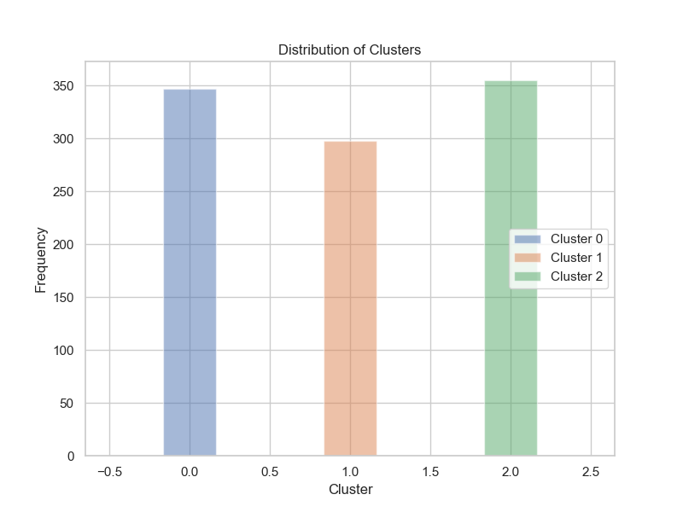
4. Customer Segmentation (suite)

Slide 11
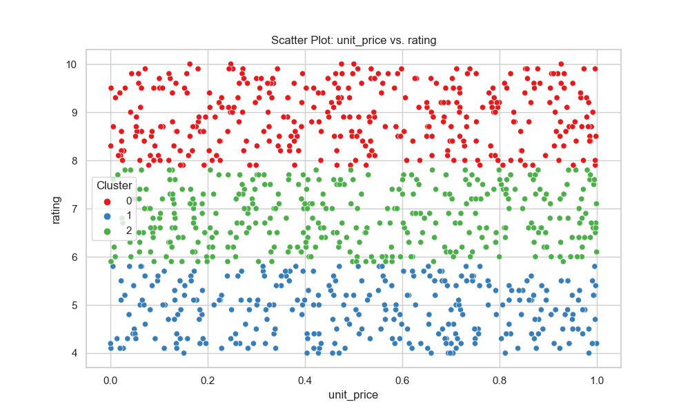
4. Customer Segmentation (suite)

Slide 12
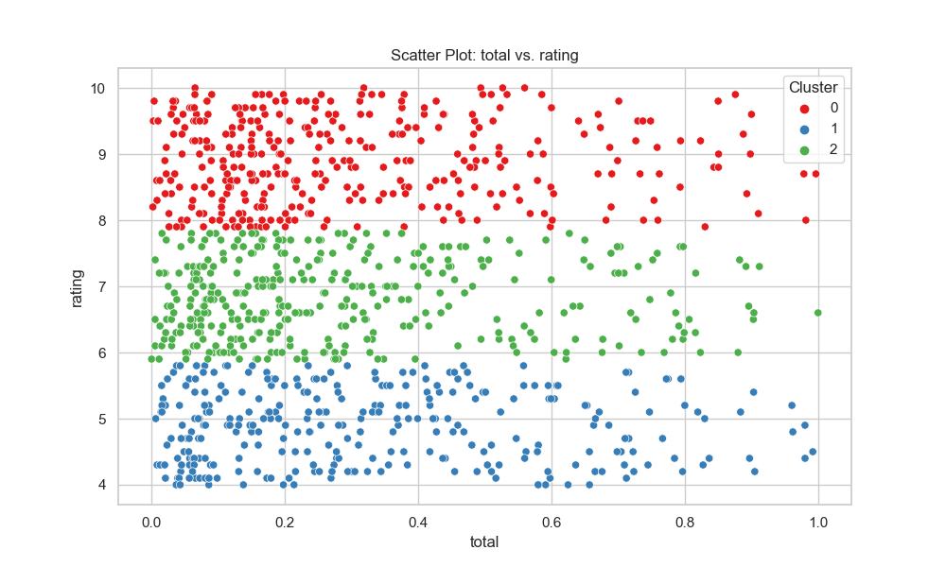
4. Customer Segmentation (suite)

Slide 13
5. Recommendation
Marketing personnalisé pour les individus ayant les caractéristiques du

