Slide 1

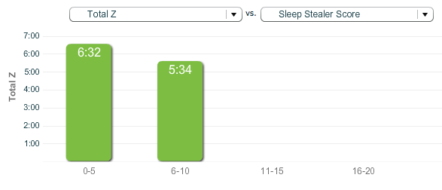
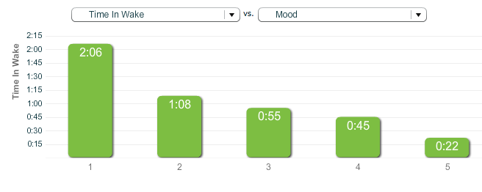
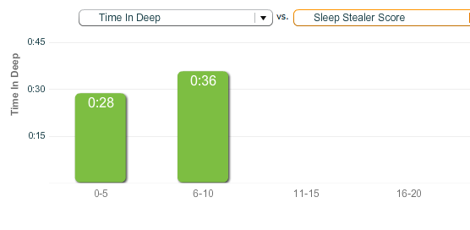
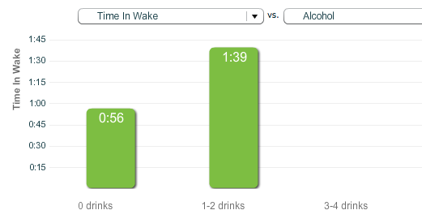
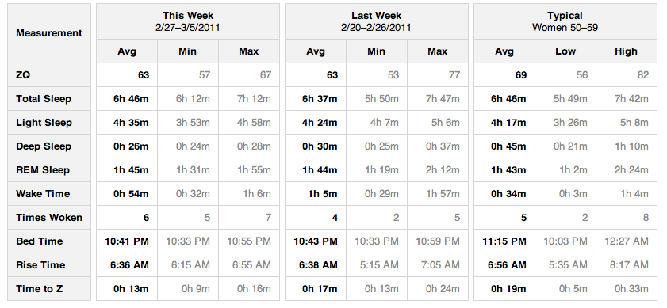
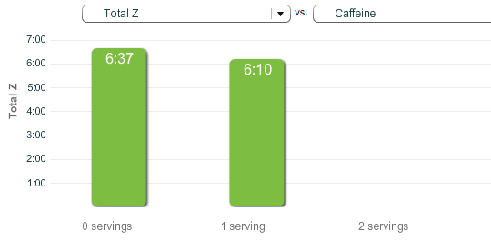
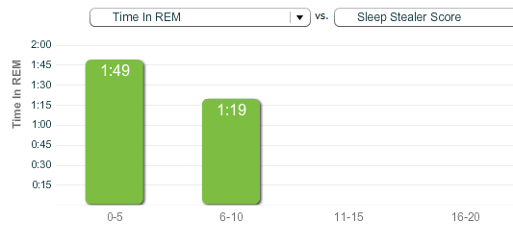
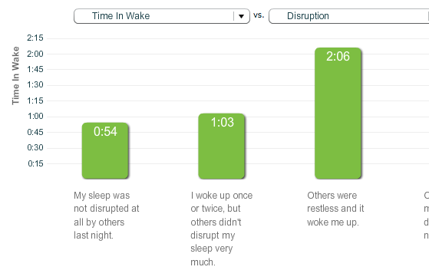
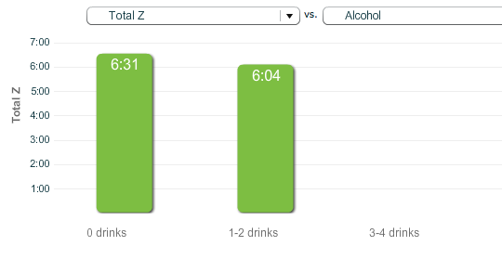
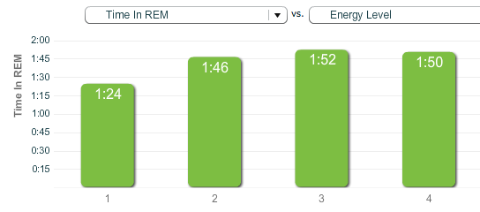
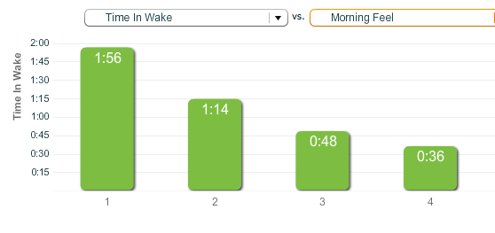
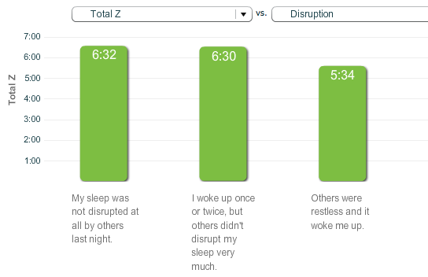
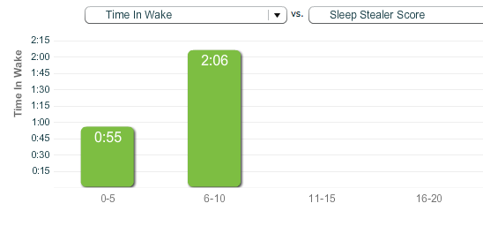
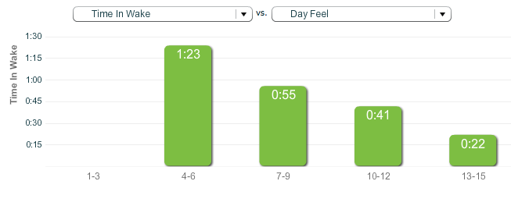
Sleep Improvement using Zeo Sleep Monitor
Christine Peterson
Chairman, Personalized Life Extension Conference & President, Foresight Institute
The right amount of high-quality sleep is critical for health and longevity. The Zeo Personal Sleep Monitor is a device worn during sleep that measures timing and duration of the different stages of sleep (deep, REM, etc.). This experiment tracked sleep quality vs. caffeine, alcohol, restlessness of partner, etc. One result: confirmation that reduction of caffeine late in the day makes a difference, which led to successful behavior change.
CONTACT
peterson@lifeextensionconference.com
See website http://www.lifeextensionconference.com
Next conference is Spring 2012; send us your email address to be notified of date and location here in the SF Bay Area

