Slide 1
Why Quantified Self Matters
Seth Roberts
Tsinghua University & UC Berkeley
Beijing Quantified Self Conference
13 December 2012

Slide 2
My Acne Experiment
Counted number of pimples each morning
Doctor had prescribed tetracycline. Took tetracycline but still had acne
Varied amount (pills/day) of tetracycline, eventually went to zero/day
Number of pimples didn’t change

Slide 3
Acne Lessons
Basic: tetracycline didn’t work
Bigger: my doctor was wrong
Even bigger: Can self-experiment improve on expert advice?

Slide 4
Examples
morning Vitamin D & sleep
Shangri-La Diet
flaxseed oil & balance
flaxseed oil & arithmetic speed
butter & arithmetic speed
morning faces & mood

Slide 5
Morning Vitamin D & Sleep
Tara Grant had poor sleep
I told her sleep controlled by sunlight exposure. Sunlight at night bad
Sunlight creates Vitamin D. She was taking Vitamin D at night. Is Vitamin D at night like sunlight at night?
She started taking Vitamin D only in morning. Her sleep suddenly got much better

Slide 6
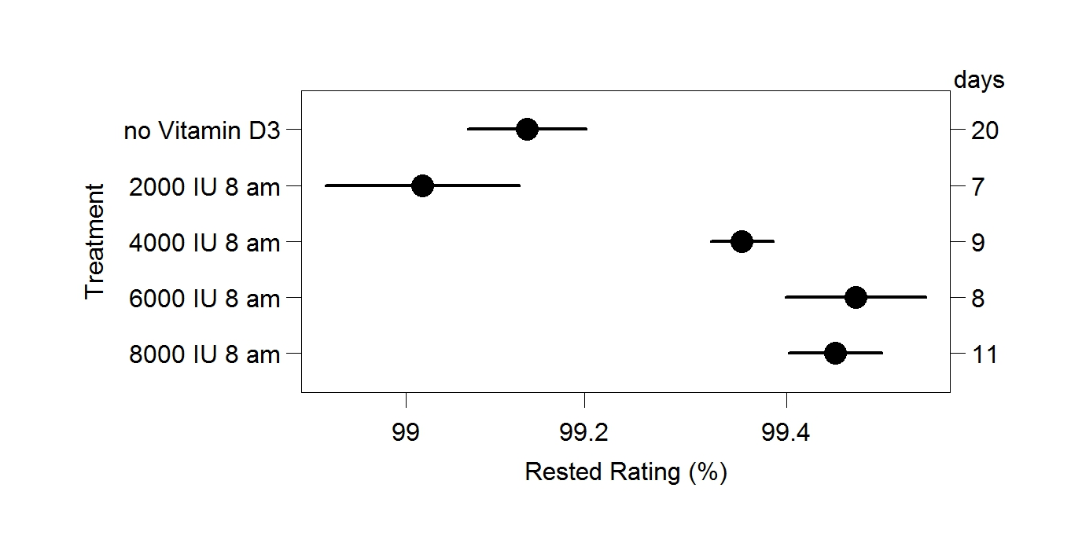
Morning Vitamin D & Sleep

Slide 7
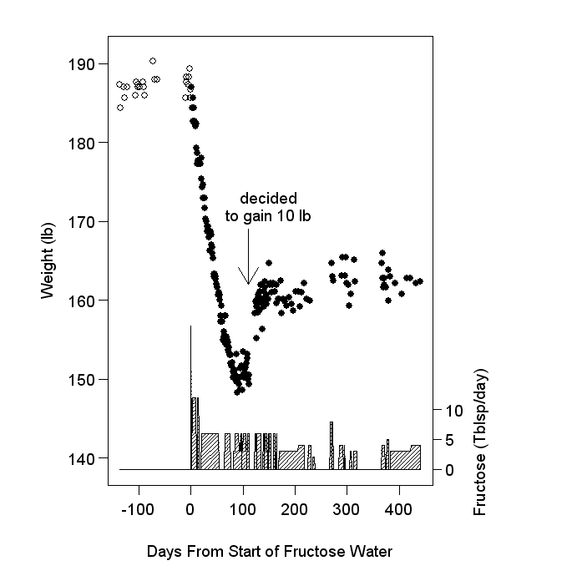
Shangri-La Diet

Slide 8
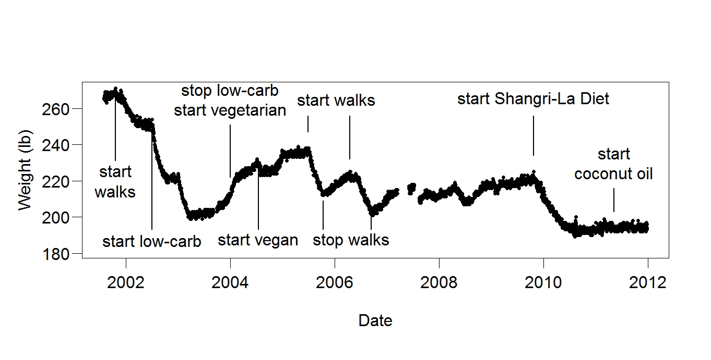
Shangri-La Diet

Slide 9
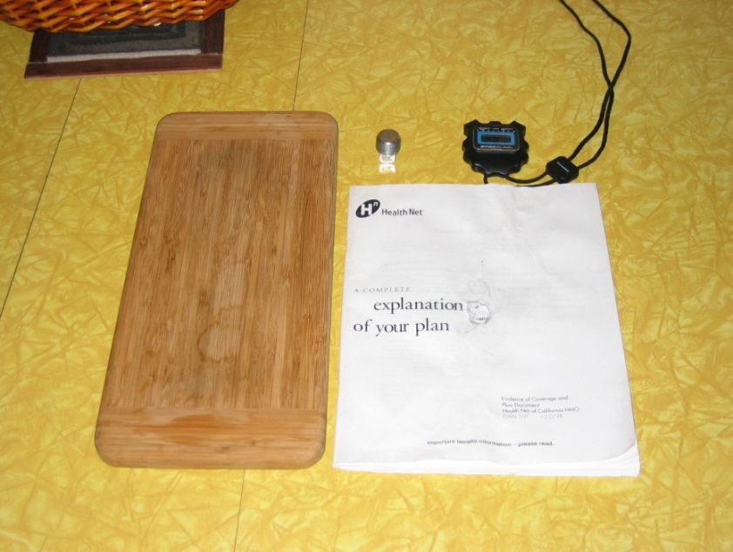
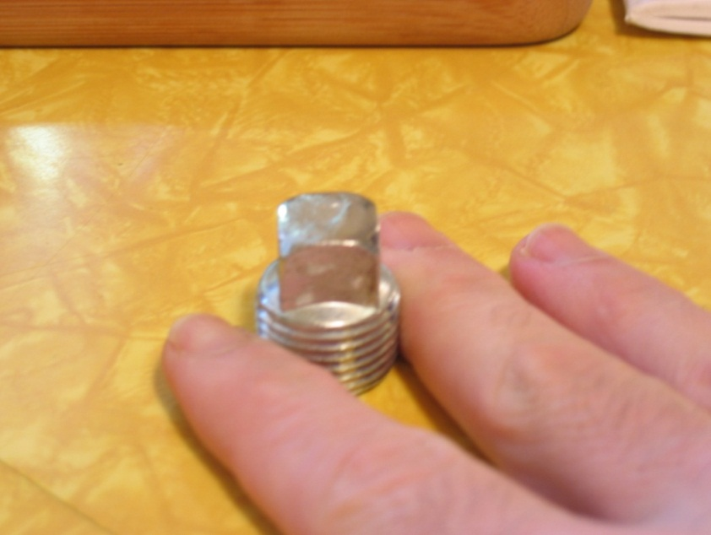
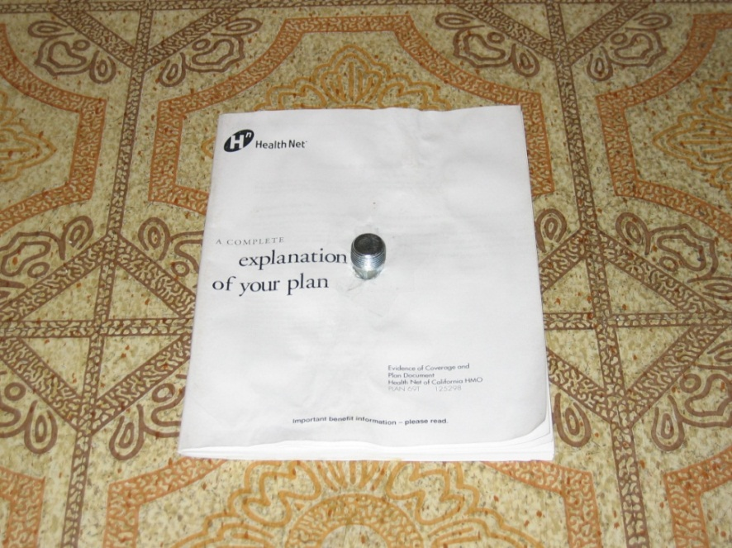
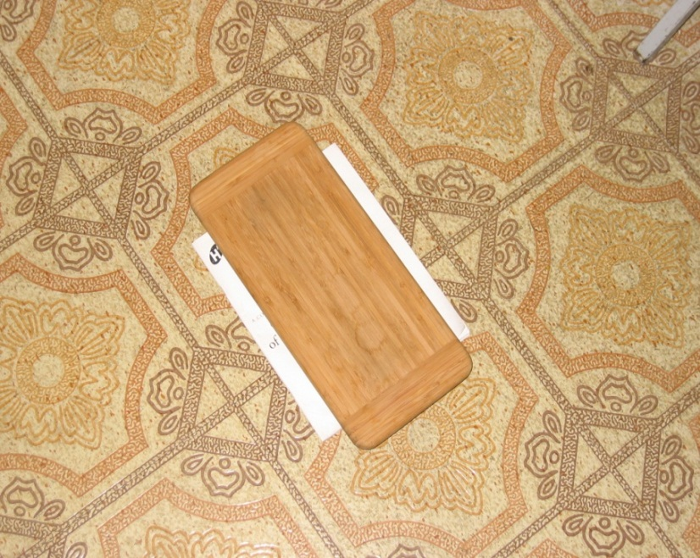
Flaxseed Oil & Balance
Notes:
9

Slide 10
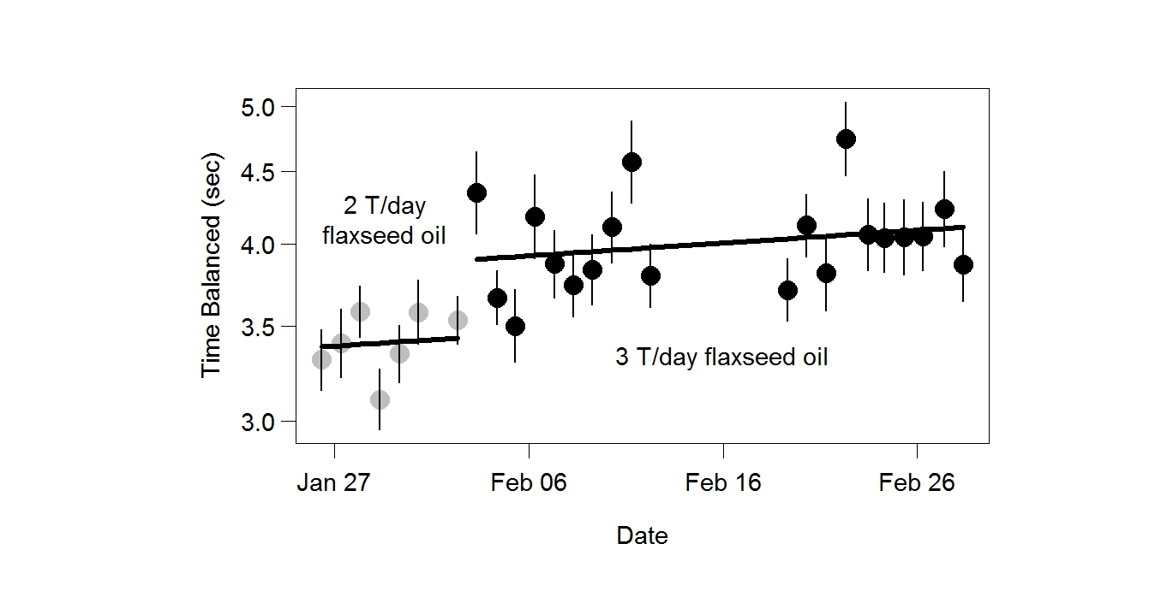
Flaxseed Oil & Balance

Slide 11
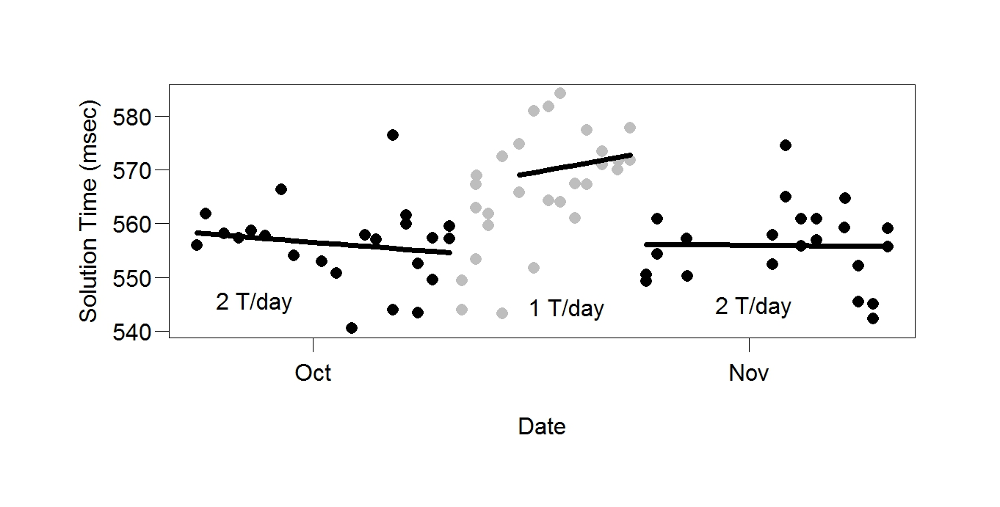
Flaxseed Oil & Arithmetic Speed

Slide 12
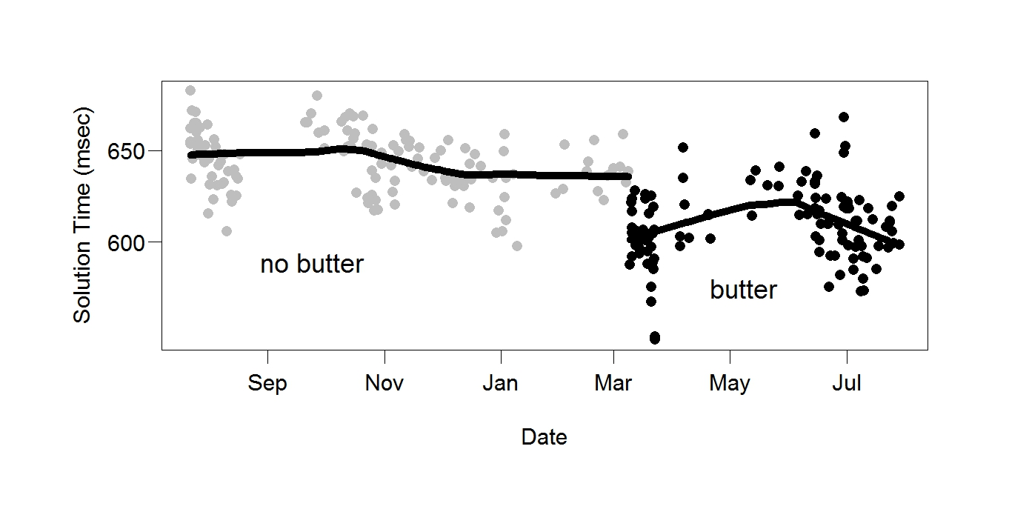
Butter & Arithmetic Speed

Slide 13
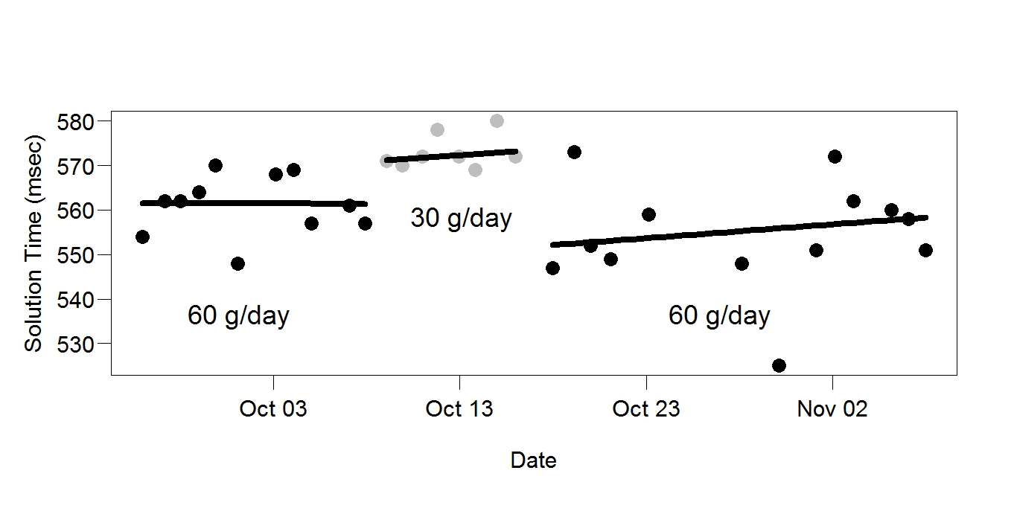
Butter & Arithmetic Speed

Slide 14
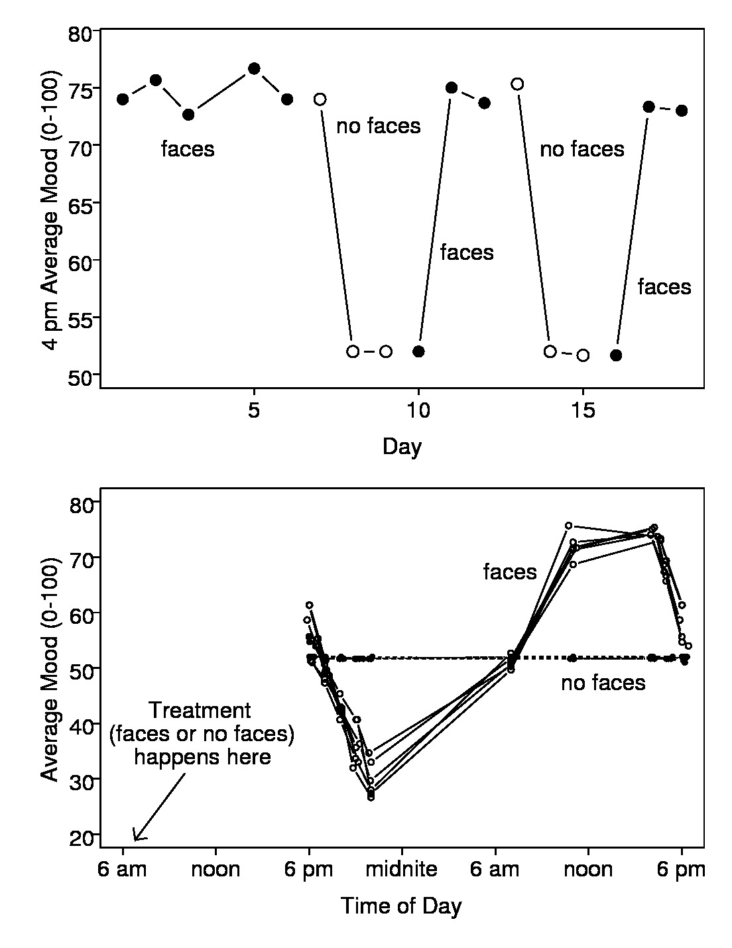
Morning Faces & Mood

Slide 15
Morning Faces & Mood
Not as crazy as it sounds
Strong correlation between depression and insomnia
Effect of faces (happy, eager, serene) opposite to main symptoms of depression (unhappy, reluctant, irritable)

Slide 16
Personal Science (my method) versus Professional Science
 | Personal Science | Professional Science
Fast | Yes | No
Cheap | Yes | No
Surprises helpful | Often | Rarely
Scientist’s health at stake | Yes | No
Freedom | Yes | No

Slide 17
Why QS Matters
Supports personal science
Encourages learning from data rather than trusting experts
what I did = Advanced QS. Examples show what a difference it can make

