Slide 1
The Rise of Personal Science: Discoveries about Acne, Blood Sugar, Mood, Weight Loss, Sleep, and Brain Function
Seth Roberts
Tsinghua University, UC Berkeley

Slide 2
A is for Acne
Seth Roberts: Some medicines don’t work
Martha Rotter: Everyone’s different

Slide 3
Personal Science = Science Done to Help Yourself
Main point: Can improve on expert advice and professional science

Slide 4
Outline of Talk
Examples of Personal Science
Blood Sugar
Mood
Weight Loss
Sleep
Brain Function
Discussion
Why is Personal Science Powerful?
What Will Happen?

Slide 5
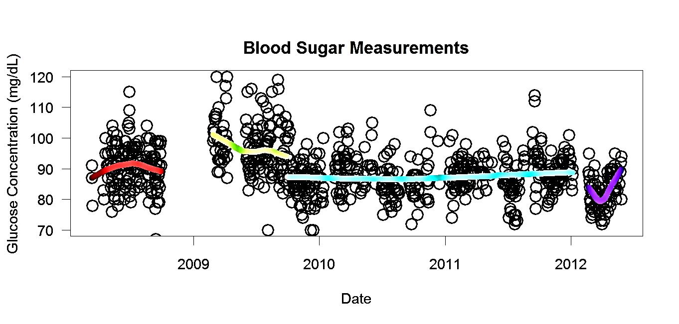
Blood Sugar

Slide 6
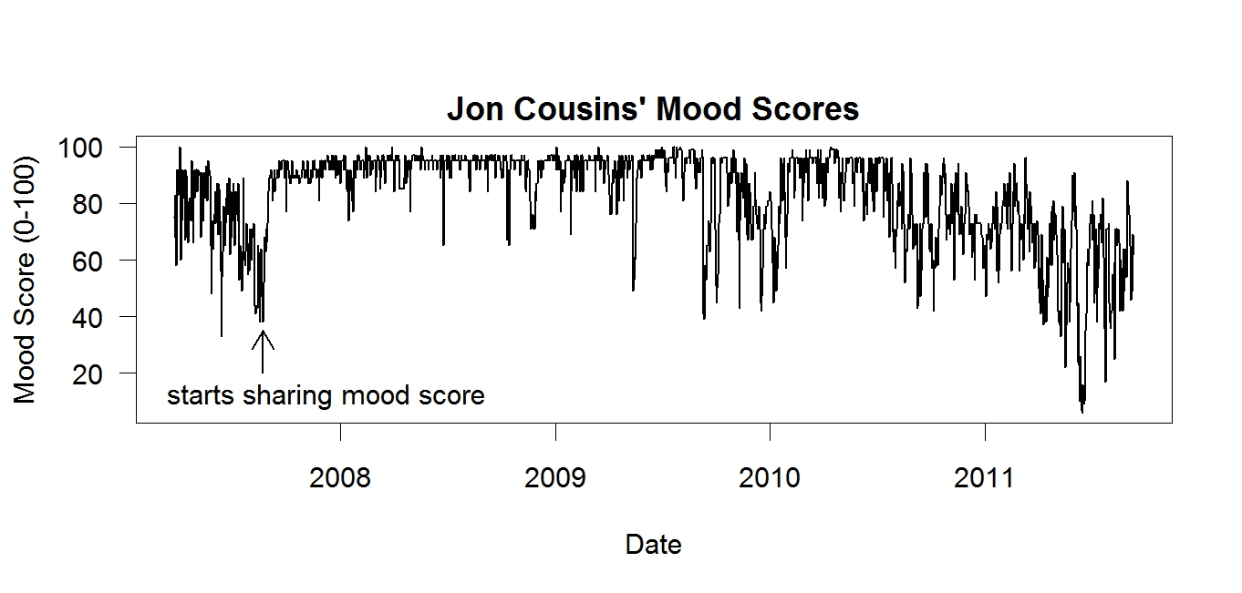
Mood Sharing and Mood

Slide 7
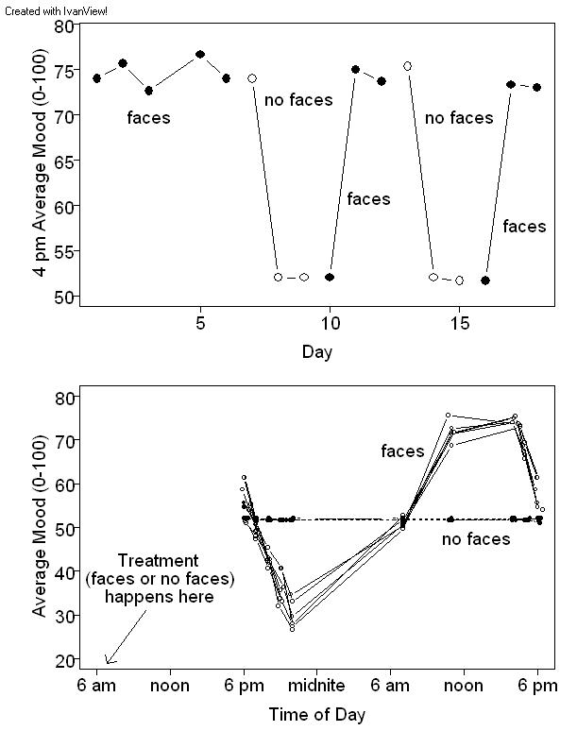
Morning Faces and Mood

Slide 8
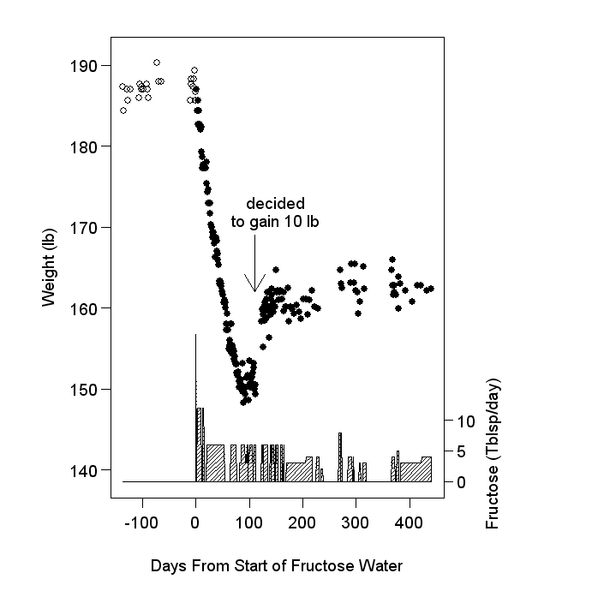
Sugar Water and Weight

Slide 9
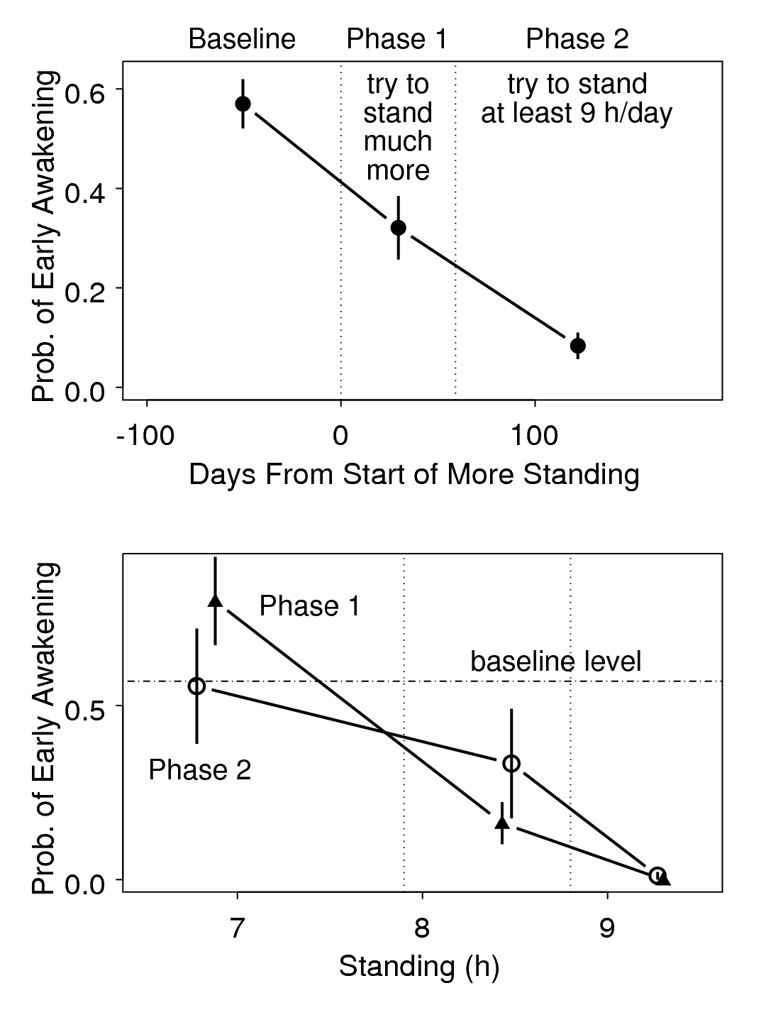
Standing and Sleep

Slide 10
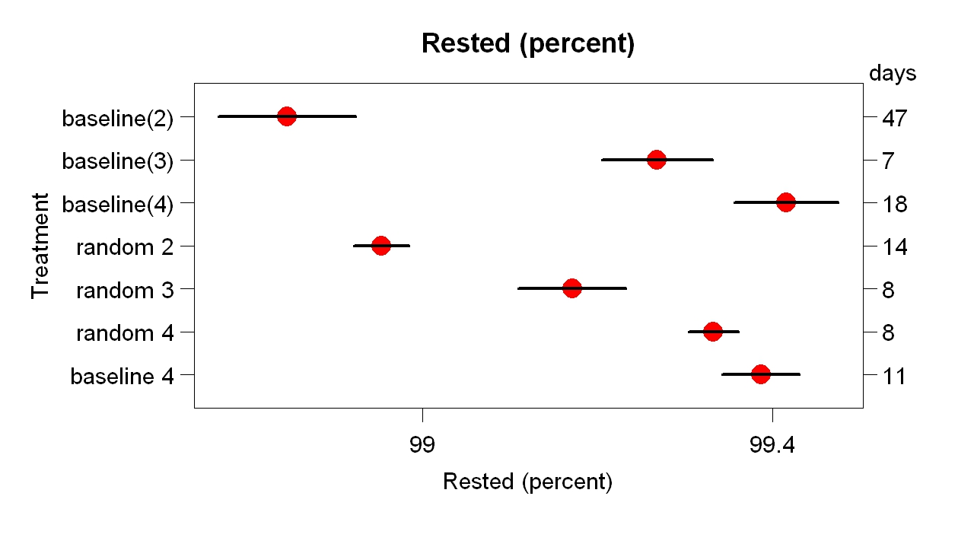
One-Leg Standing and Sleep

Slide 11
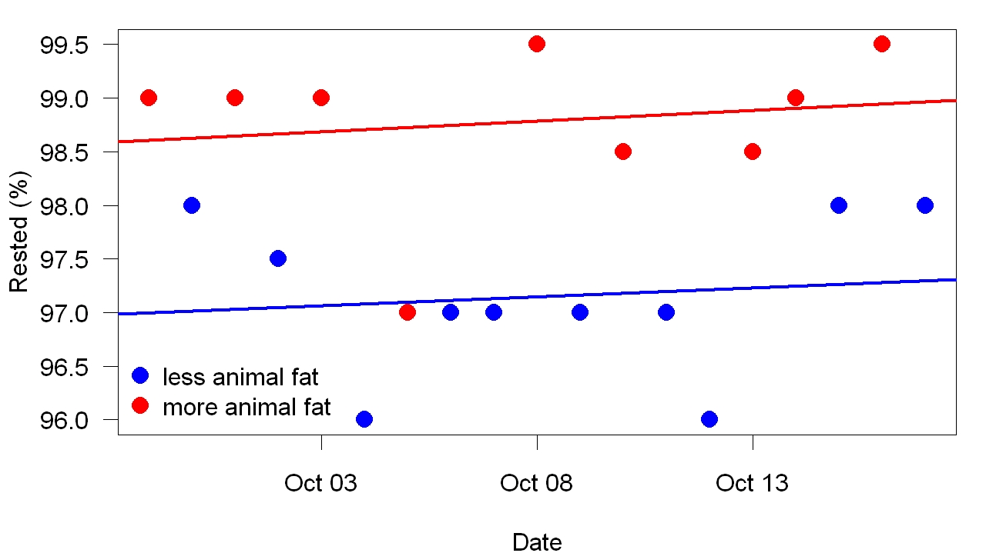
Pork Fat and Sleep

Slide 12
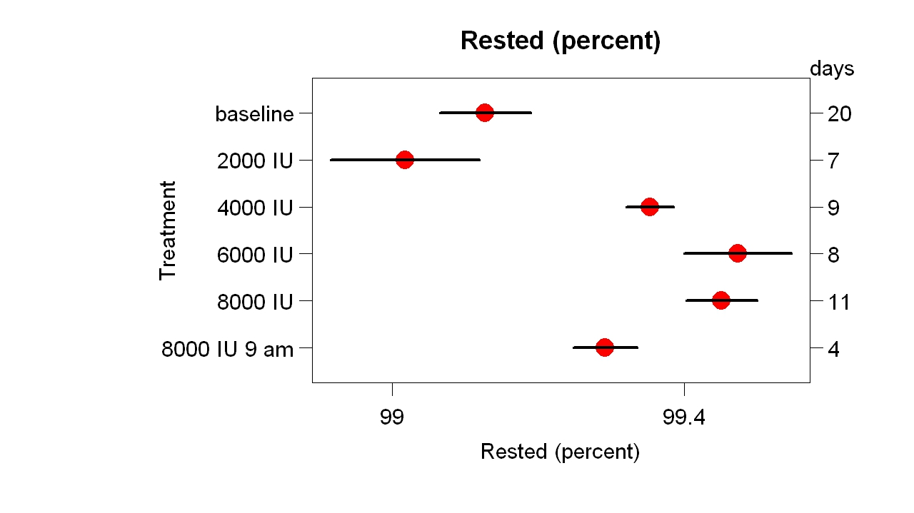
Vitamin D3 and Sleep

Slide 13
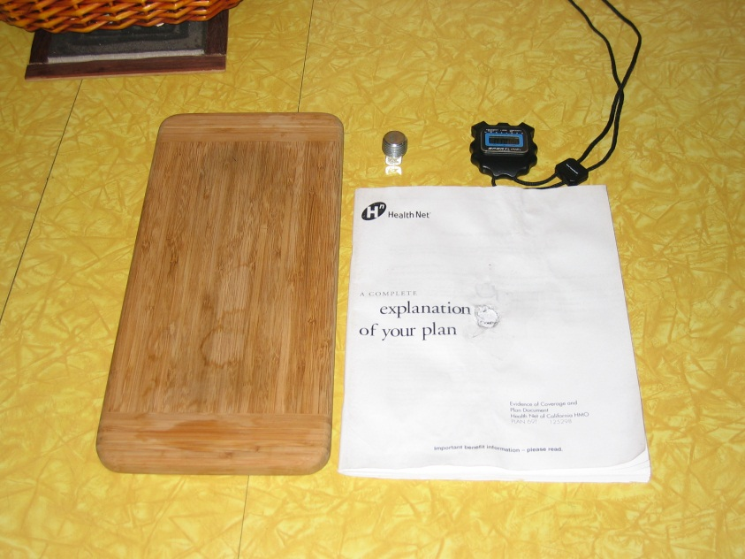
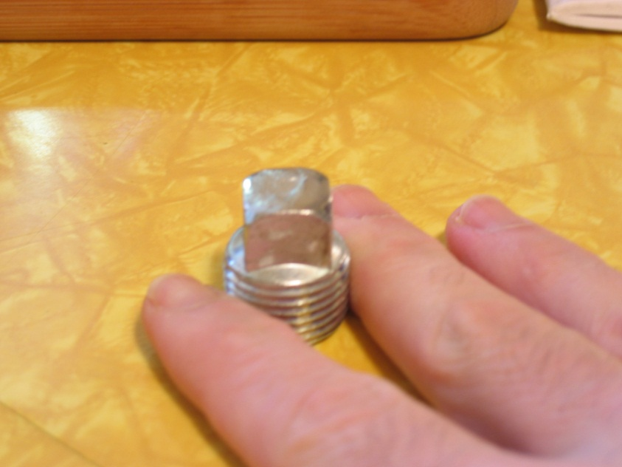
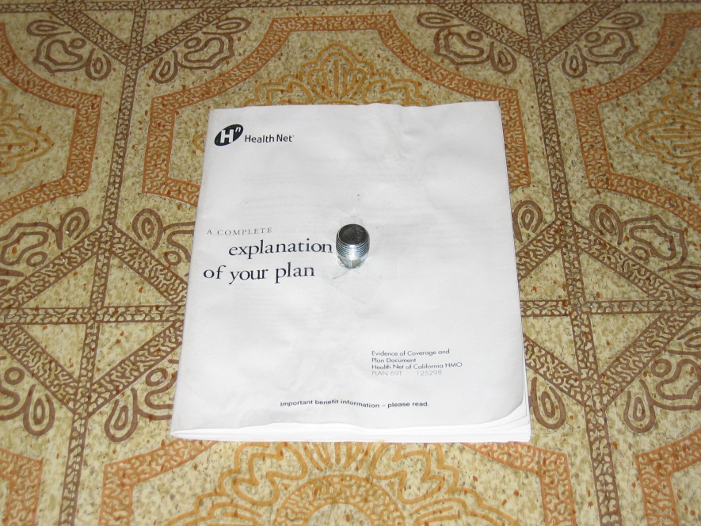
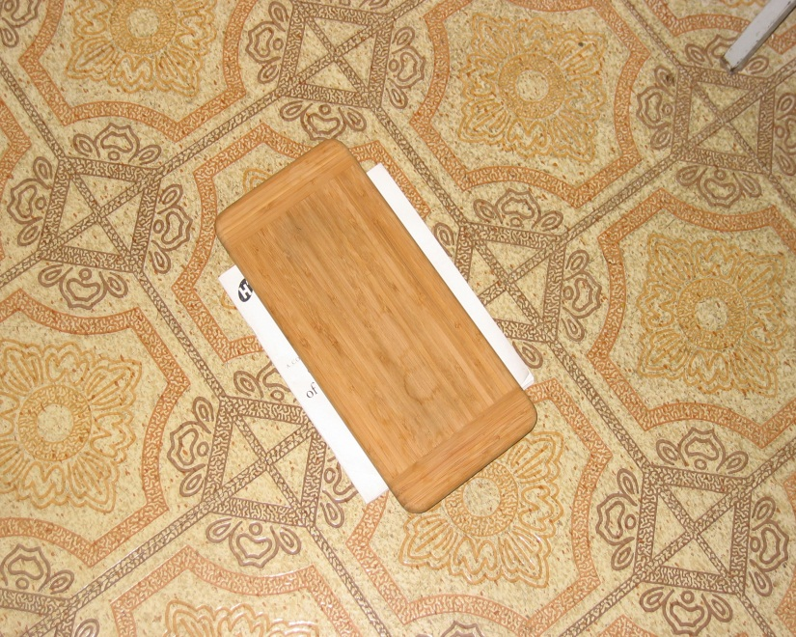
Flaxseed Oil and Brain Function (1 of 5)

Slide 14
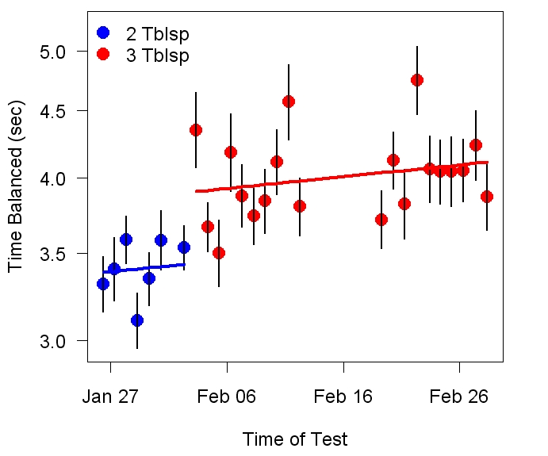
Flaxseed Oil and Brain Function (2 of 5)

Slide 15
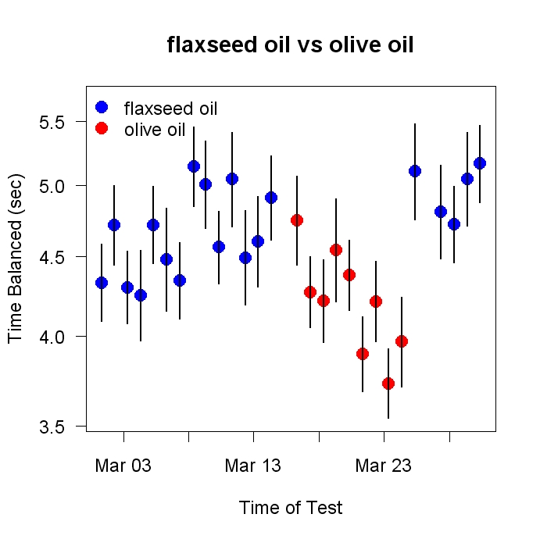
Flaxseed Oil and Brain Function (3 of 5)

Slide 16
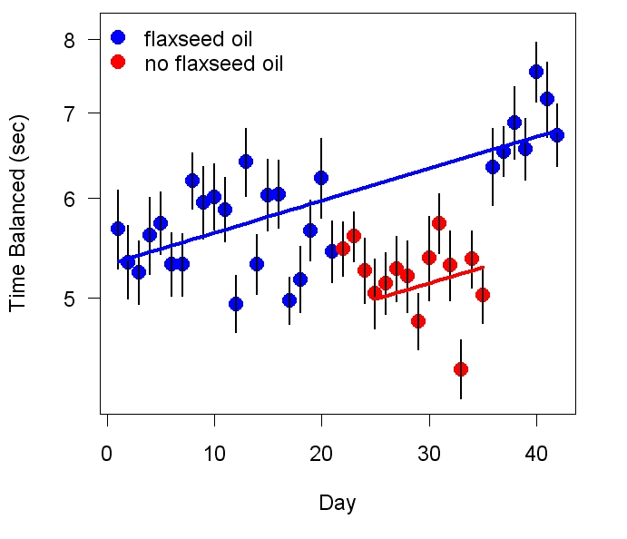
Flaxseed Oil and Brain Function (4 of 5)

Slide 17
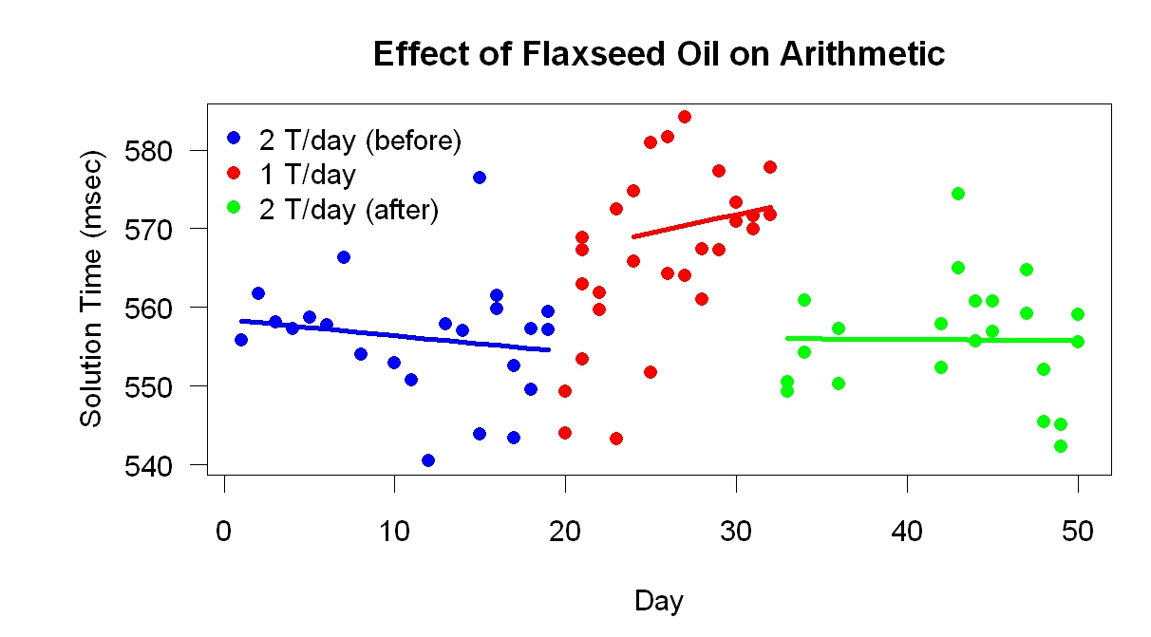
Flaxseed Oil and Brain Function (5 of 5)

Slide 18
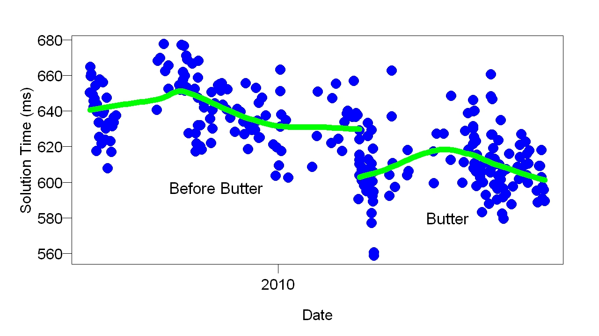
Butter and Brain Function (1 of 3)

Slide 19
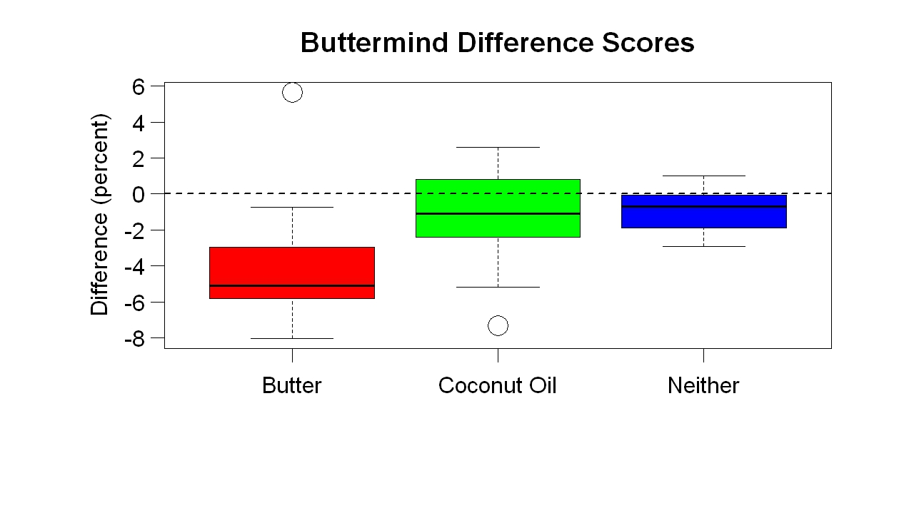
Butter and Brain Function (2 of 3)

Slide 20
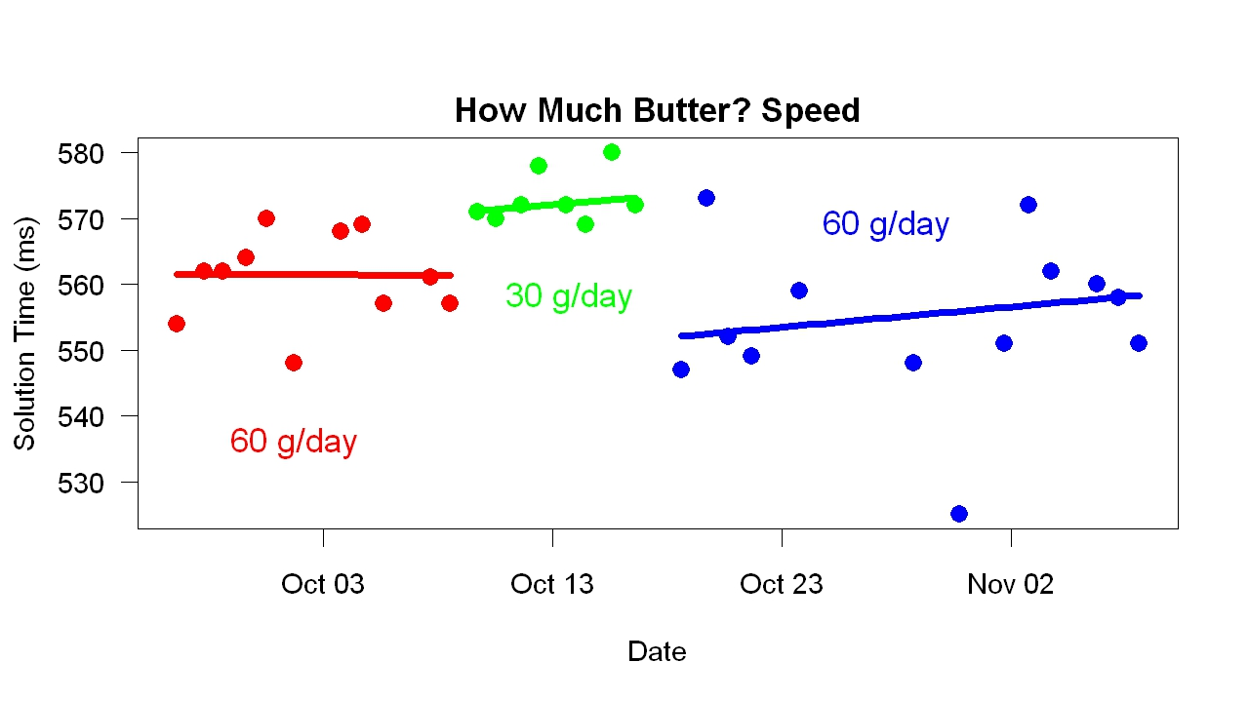
Butter and Brain Function (3 of 3)

Slide 21
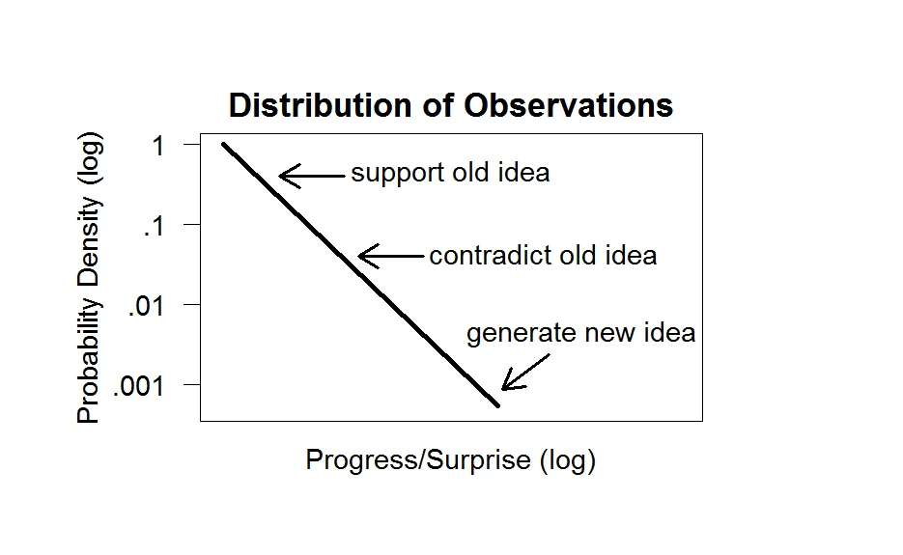
Why is Personal Science Powerful? (1 of 3)

Slide 22
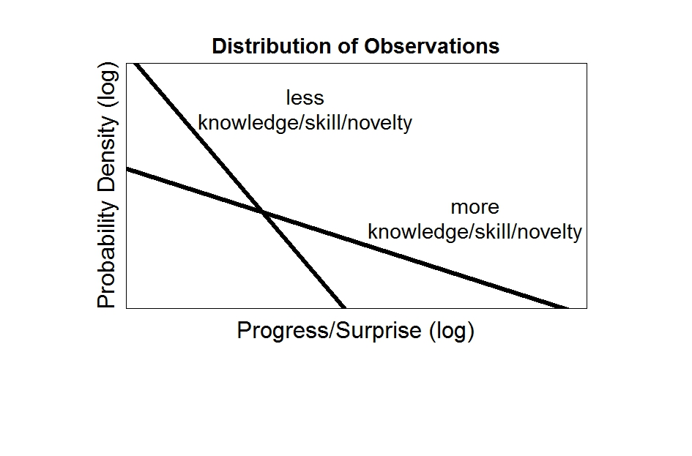
Why is Personal Science Powerful? (2 of 3)

Slide 23
Why is Personal Science Powerful? (3 of 3)
Personal scientists are more free than professional scientists
Professional scientists want to publish, keep job, get raise, win awards, please colleagues, get grants, follow institutional rules
Personal scientists only want better health

Slide 24
What Will Happen?
Non-scientists are gaining ability to do science (= knowledge x skill x novelty)
Literacy alone useless. Must have (a) stuff worth reading that (b) ordinary people can get
Personal science will spread because science is becoming easier AND because (a) there is stuff worth learning that (b) ordinary people can learn

Slide 25
Conclusions
Personal science can improve on expert advice and professional science
… partly because personal scientists have more freedom than professional scientists
Personal science will spread because there is stuff worth learning that ordinary people can learn

