Slide 1
Lessons From
Self-Experimentation:
Substance & Method
Seth Roberts
UC Berkeley
www.sethroberts.net
blog.sethroberts.net
9 January 2007

Slide 2
The third feature of organic systems of production [ = farming] is that experiments to devise better production methods are inherently difficult [compared to inorganic systems of production]. In a cotton mill, for example, controlled experiments can be done in changing manufacturing methods. Spindle speeds can be increased by 10% and the resulting changes in production costs observed immediately. But in agriculture observing the effect of any change is difficult. – G. Clark, Farewell to Alms (2007), pp. 292-3.

Slide 3
Outline of Talk
Findings (substance)
  breakfast & sleep
  morning faces & mood
  sugar water & weight
Methodological Lessons

Slide 4
Breakfast & Sleep:
Personal Background
For years I woke up too early.
Self-experimentation had helped me reduce my acne; might help here, I thought
Tried many things that didn’t help
Finally something made a difference: in the wrong direction

Slide 5
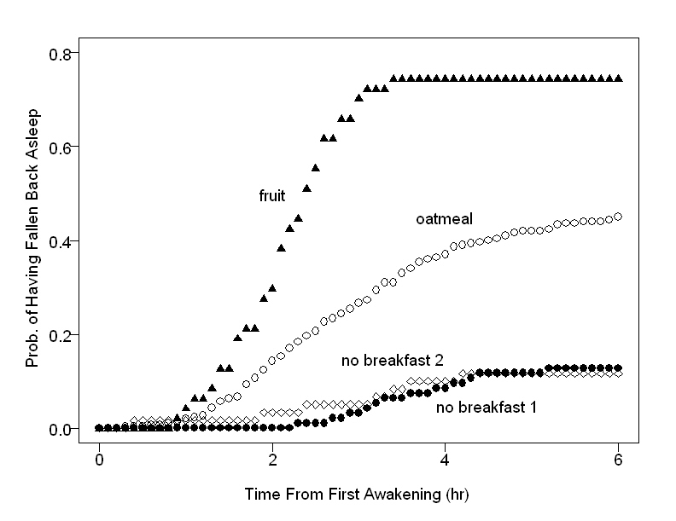

Slide 6
Breakfast & Sleep:
Scientific Background
Anticipatory activity well-known & well-established in mammals, birds & fish
Similar timing, rate of disappearance, and sufficient foods
Bottom line: A human example of an effect often seen in animals. Not trivial: Contradicted common advice to eat breakfast.

Slide 7
Faces & Mood:
Personal Background
Elimination of breakfast didn’t eliminate early awakening
Pointed me toward differences between modern life & Stone-Age life
One difference: Stone-Age man woke up & chatted with neighbors. I lived alone.
Use-of-time study suggested that watching TV resembled human contact

Slide 8
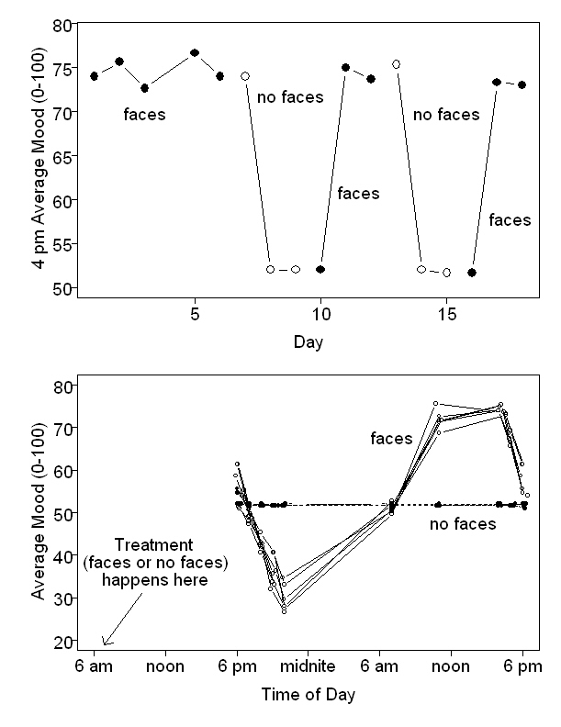

Slide 9
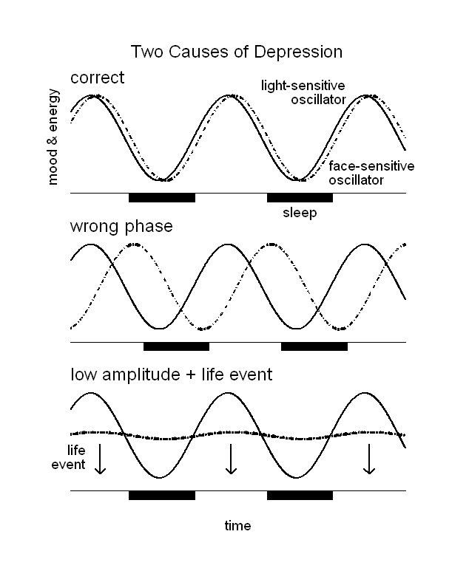

Slide 10
Morning Faces & Mood:
Scientific Background
Symptoms of depression opposite to effect of faces
Depression & insomnia closely associated
Depression often gets better as day goes on
Distinction between endogenous & reactive depression

Slide 11
Sugar Water & Weight: Personal Background
Lectured on weight control in Psych 1
Used lecture conclusion to lose weight
Came up with new theory of weight control
Less useful than expected
Paris experience

Slide 12
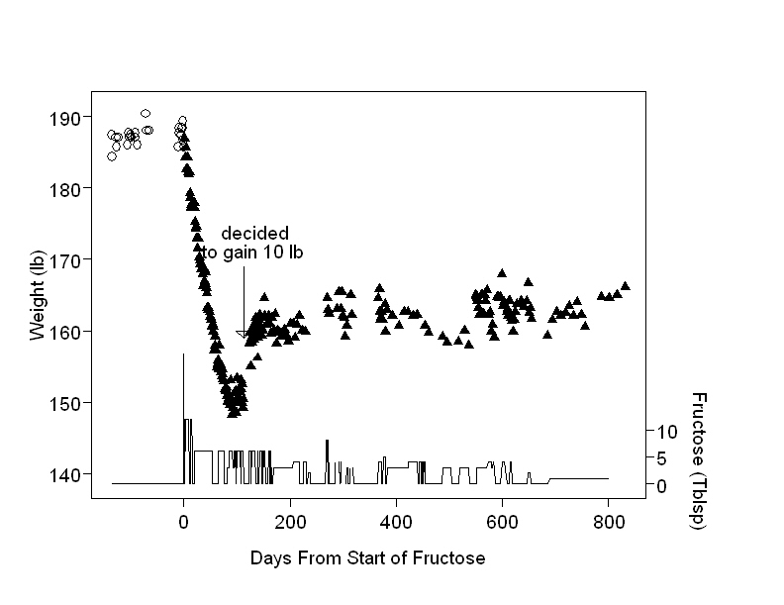

Slide 13
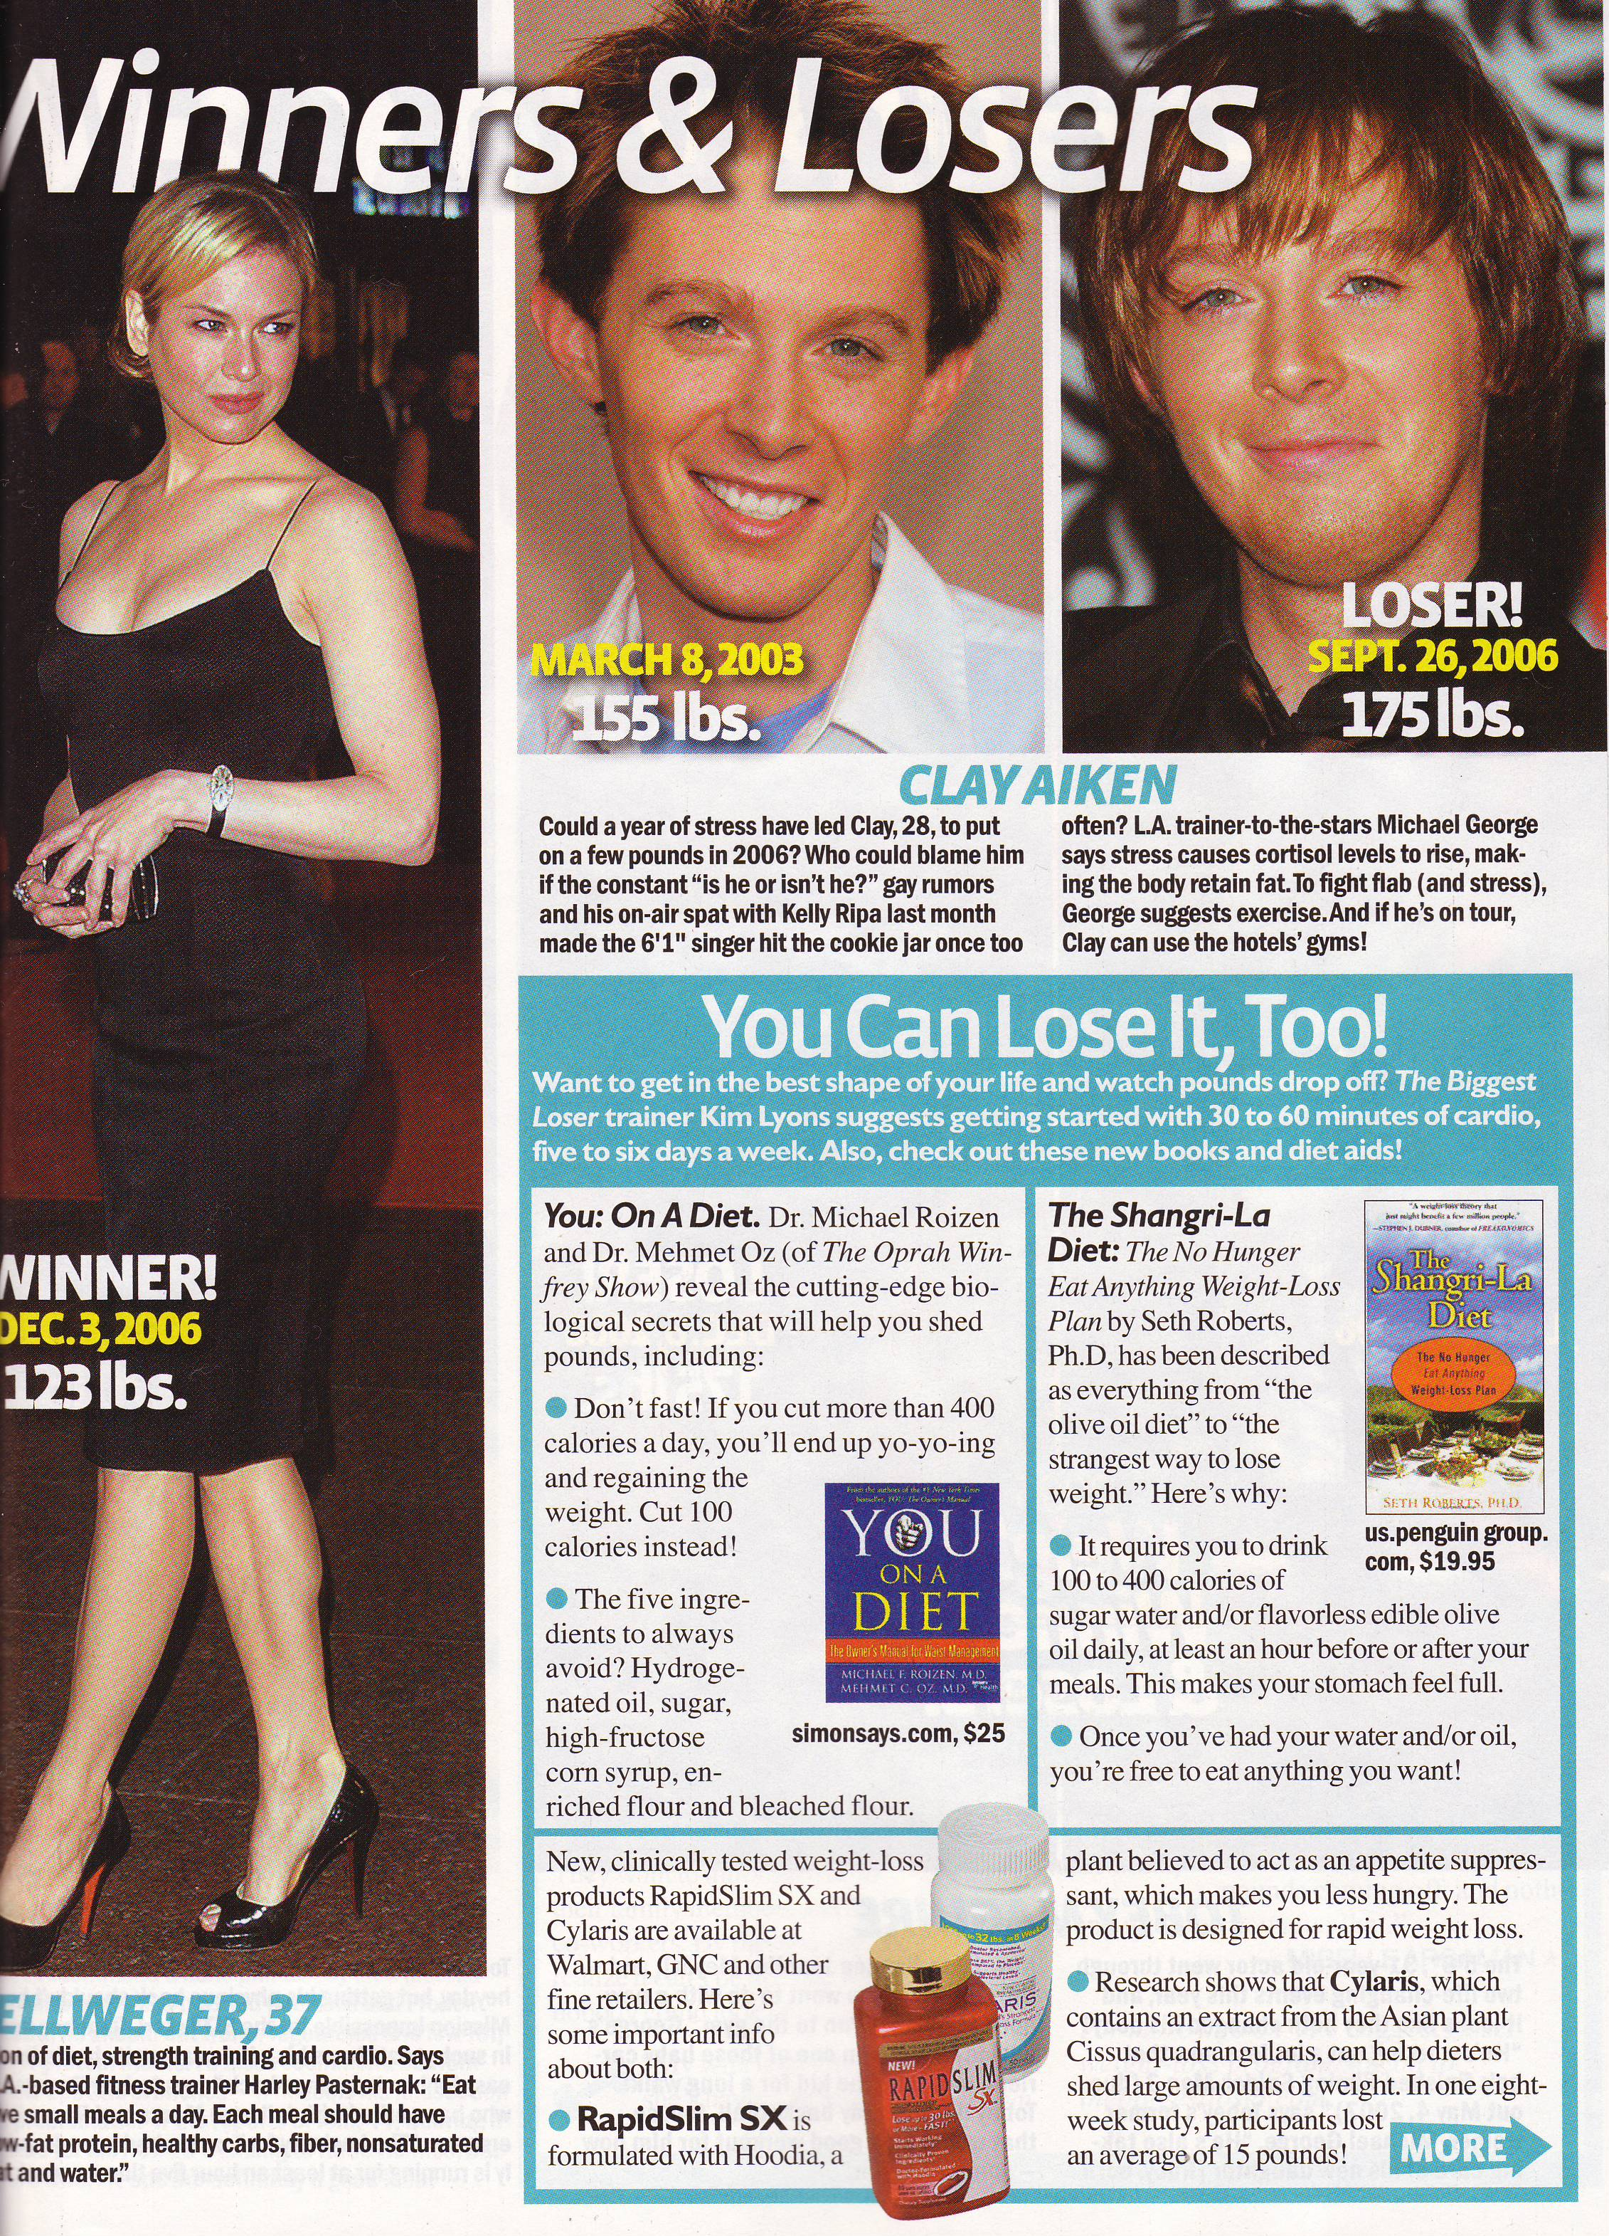

Slide 14
Sugar Water & Weight: Scientific Background
Evidence for body-fat set point
Cabanac: Bland food causes effortless weight loss
Ramirez: Effects of saccharine depend on prior experience

Slide 15
Methodological Lessons
The real lessons. Nothing I knew in advance.
Applicable beyond self-experimentation
Not lessons like: Self-experimentation is fast & flexible.
Usually we learn from failure. I expected failure, learned from success.

Slide 16
1. Do Something
Sleep research started because no alternative
Seemed hopeless
Weight research also seemed hopeless, until I came up with new theory. Even then, stalled.
The missing idea: Failure is good.

Slide 17
2. Keep Doing Something
Took years.
Continued not because of detectable progress but because no alternative
Was making progress without knowing it
Effective science can resemble drudgery: elimination of many alternatives, one by one

Slide 18
3. Be Minimal
Do easiest study that makes progress
Whenever I broke this rule, something went wrong
The more complex the study, the more untested assumptions (which are often wrong)
Most professional scientists don’t grasp this rule, in my experience

Slide 19
4. Serious defects in how science is usually done
Amateur w/ zero resources made 2 significant discoveries in areas (obesity, depression) with enormous funding
This shouldn’t happen if funds & resources used well

Slide 20
5. Serious strengths in how science is usually done
My work has had practical benefits
Heavily based on conventional science, both substance and method
Substance: Ramirez & Cabanac did brilliant work
Method: used standard experimental designs, common data analysis tools

Slide 21
Parable of the Power Saw
Science is a mix of tools, culture, and human nature (faith-based beliefs)
Power saw: 1. Tool. 2. Job. 3. Profession. 4. Religion
Scientific tools follow similar trajectory
Dark Age Ahead: lone graduate student does better than CDC

Slide 22
6. Curiosity helps
“Chance favors the prepared mind”
Mood research benefited greatly from teaching introductory psychology
Weight control theory required knowledge of 2 non-adjacent fields: weight control & animal learning

Slide 23
7. Publish in open-access journal
More crassly: Publicize your work
Open access helped publicize this work
Digital food chain

Slide 24
Main Methodological Points
Do something
Keep doing something
Be minimal
Use standard tools (e.g., graph your data)
Don’t listen to naysayers (“don’t do X”)
Help others learn what you’ve done

