Slide 1
Where Do New Responses Come From?
Seth Roberts & Afshin Gharib
UC Berkeley & Dominican College of California
May 2005

Slide 2
Outline of talk
Question: What controls the variation from which reward selects?
Experiment 1: a mystery
Experiment 2: wrong answer
Experiment 3: right answer?
Experiment 4: yes, right answer
Overall conclusions

Slide 3
instrumental learning = variation + selection

Slide 4
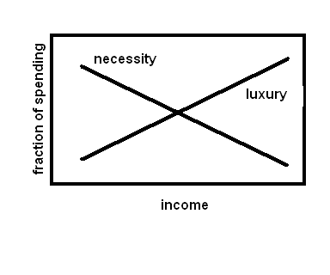
Variation: necessity or luxury?

Slide 5
Two Plausible Answers
Necessity. Required for learning.
Luxury. Variation is costly.

Slide 6
Factual Background
Variation of form increases during extinction (i.e., as income declines). But there are many differences between training and extinction.

Slide 7
How this work began
Measured bar-press duration (how long the rat holds down the bar) with peak procedure
Surprising result: Sharp increase in middle of trial, triggered by absence of reward
Not due to frustration (another surprise)

Slide 8
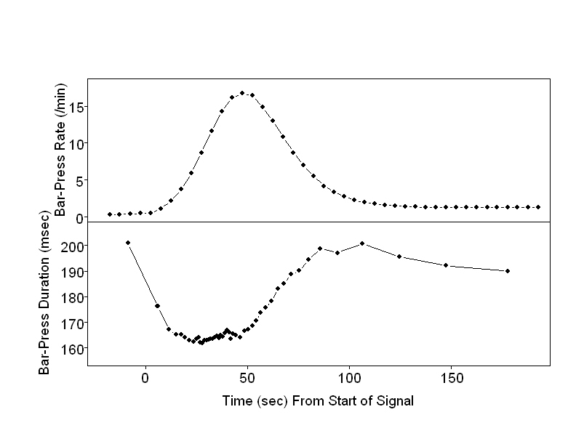
Expt 1: Peak Procedure

Slide 9
Expt 1: Why did bar-press duration increase?
Increase was large (25%) and very clear (t = 18).
For years, assumed that increase was due to frustration – failure to get expected food. Frustration studied in many runway studies by Amsel. Rats run faster after failure to get expected food.
Submitted paper to JEP:ABP with this explanation. Editor suggested we do another experiment.

Slide 10
Expt 2: Test of frustration explanation
Tried to do simplest possible experiment that would show effect of frustration on bar-press duration.
Rats press bar for low probability of reward (food). Now and then, light turned on. 1st bar press turns off light. On 80% of trials, food given; on 20% of trials, no food given.
Non-reward at end of trial should produce frustration. We compared bar-press duration after reward and non-reward.

Slide 11
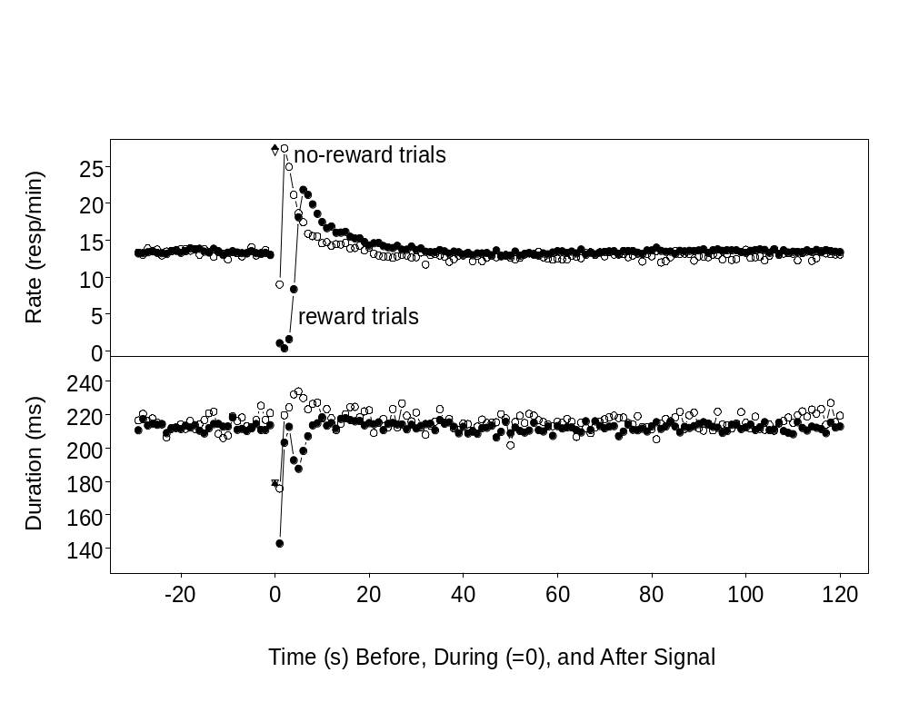
Expt 2: Effect of reward omission

Slide 12
Expt 2: Conclusion
Omission of expected reward produced small, short-lived increase in bar-press duration. Much different than peak-procedure results.
Peak-procedure results not due to frustration.

Slide 13
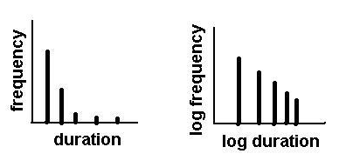
Distribution of bar-press durations: straight line on log-log coordinates

Slide 14
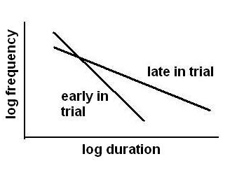
Change in distribution of bar-press durations during peak-procedure trial

Slide 15
New Explanation of Increase in Bar-Press Duration
Distribution change = increase in variability
Variability increased when rat figured out there would be no reward on that trial
Instance of general rule: less expectation of reward, more variation in response form. Rule makes sense: less expectation of reward, less lost by “wrong answers”
Test of rule: change expectation of reward in a different way

Slide 16
Experiment 3: Test new explanation
Purpose: test prediction that less expectation of food produces more variation of bar-press duration
Procedure: 2 signals (light and sound) with high & low probability of reward. Trials separated by intertrial interval (iti).
Prediction: Pattern of variation:
high-food signal < low-food signal < iti

Slide 17
Details of Procedure of Experiment 3
Subjects: 14 rats
Both signals: Trial starts with signal onset. End of trial “primed” each second with probability 1/60. After end of trial primed, next bar press ends trial (turns off signal).
High-food signal: all trials end with food
Low-food signal: trials end with food with probability 100% (1st phase), 50% (2nd phase), or 25% (3rd phase).
Intertrial intervals: 60 sec long.

Slide 18
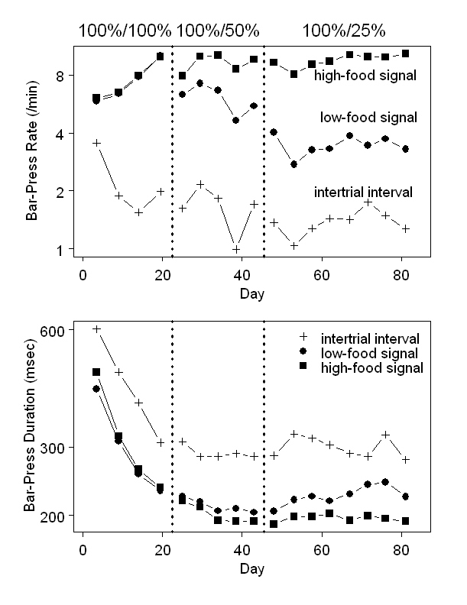

Slide 19
Results of Experiment 3
Predictions confirmed but . . .
Effects smaller than expected.
Realized that variable-interval schedule causes probability of reward to depend on time since last bar press: the longer the time, the greater the probability of reward.
If rats measured time since last bar press, they could adjust expectation of reward

Slide 20
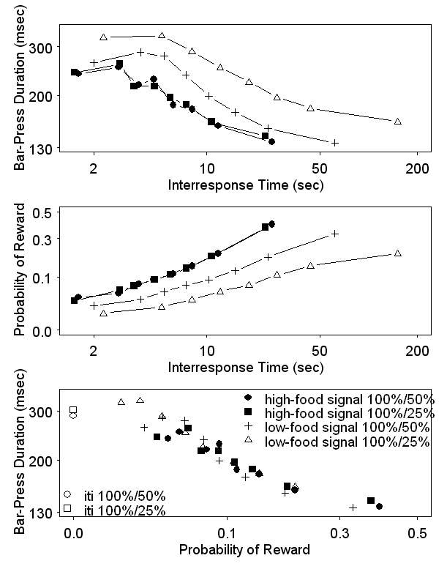

Slide 21
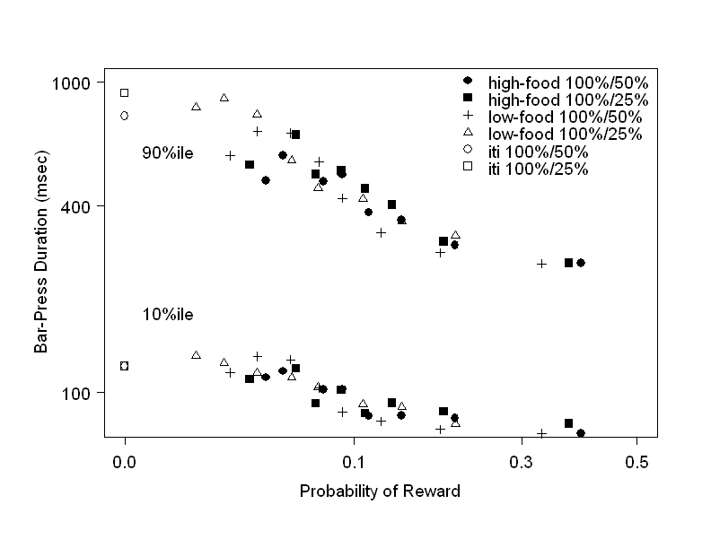
Variability of bar-press durations depends on probability of reward

Slide 22
More results of Experiment 3
Bar-press durations in all conditions well-predicted by probability of reward of each bar-press
The lower the probability of reward, the greater the variation in duration

Slide 23
Experiment 4: Test new explanation again
Purpose: retest rule (less expectation of food causes more variation in bar-press duration) taking into account that rats can measure time between bar presses
Procedure: Basic plan same as Expt 1: 2 signals (light and sound) with high & low probability of reward. Signals separated by intertrial interval (iti).
Prediction: Pattern of variation:
high-food signal < low-food signal < iti

Slide 24
Details of Procedure of Experiment 4
Subjects: 14 rats of Experiment 1
Both signals: Main difference from Expt 1: Trial ends with probability 25% after each bar press.
High-food signal: all trials end with food
Low-food signal: trial ends with food with probability 100% (1st phase) or 25% (2nd phase)
Intertrial intervals: 60 sec long.

Slide 25
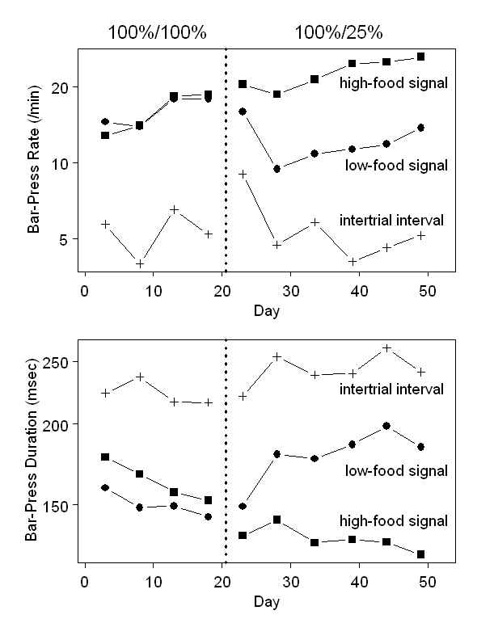

Slide 26
Results of Experiment 4
Predictions confirmed
Large effect of reward probability on bar-press duration (high-food signal vs low-food signal, t = 6)
Duration effect as clear as rate effect (high-food signal vs low-food signal, t = 6)

Slide 27
Overall Conclusions I
Experiments 3 & 4 support general rule suggested by Experiments 1 & 2: less expectation of reward, more variation of form
Variation behaves like a necessity, not a luxury. And variation is a necessity: without it, no learning.

Slide 28
Overall Conclusions II
Easy to measure variation, at least in this situation. No need for special equipment.
Variation – the importance of variation – has a funny way of being overlooked. Staddon, Neuringer, and Balsam stand out as exceptions. Not just psychology: economics, too. Not just academia: business, too.

