Slide 1
Java calculator via mvc
By casey hayes

Slide 2
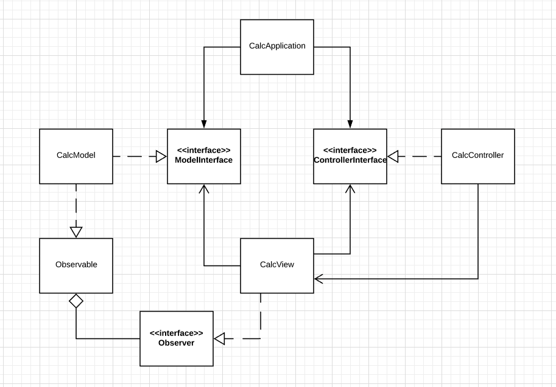

Slide 3
View
Draw the calculator
Add event listeners to buttons, but let the Controller handle them
Expose the displayed “result” field by getters/setters
Use Observer to update with the calculation

Slide 4
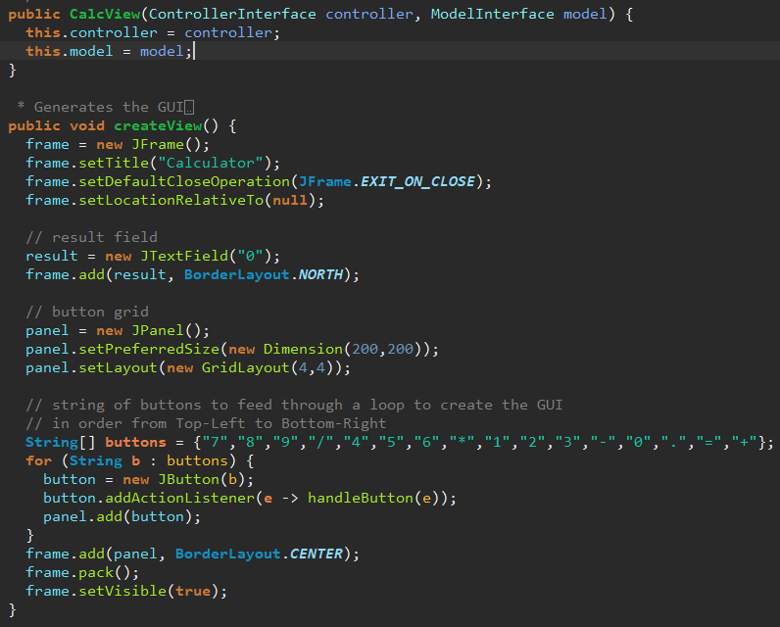

Slide 5
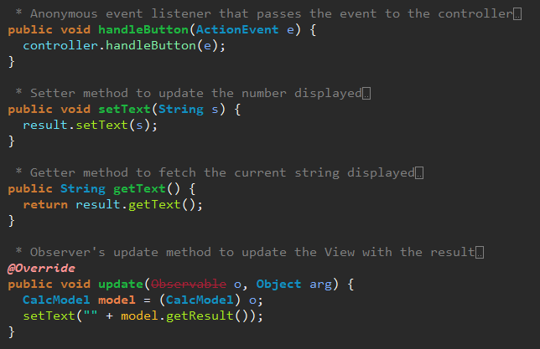

Slide 6
Controller
Register the View as an Observer of the Model
Determine how to handle button presses
Pass operation to model for calculation

Slide 7
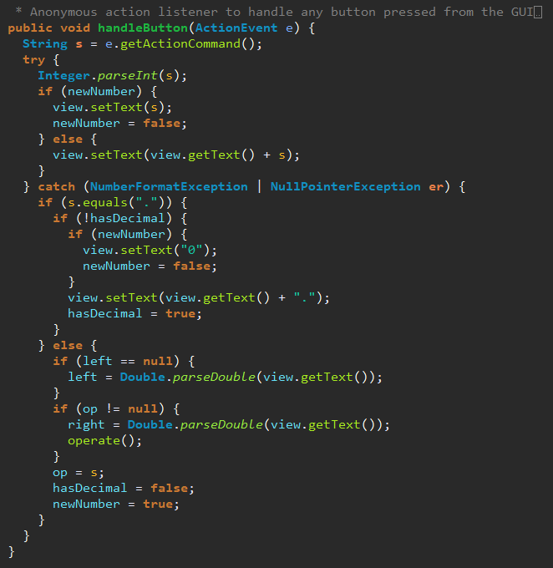
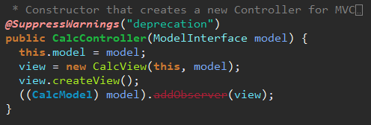
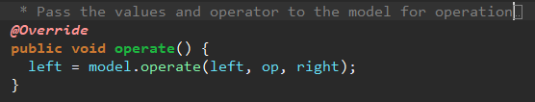

Slide 8
Model
Perform a calculation based on two numbers and an operator
Notify observers

Slide 9
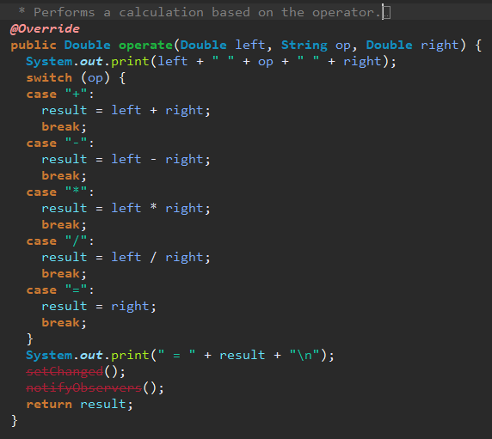

Slide 10
Questions?

