Slide 1
Java calculator via mvc
By casey hayes

Slide 2


Slide 3
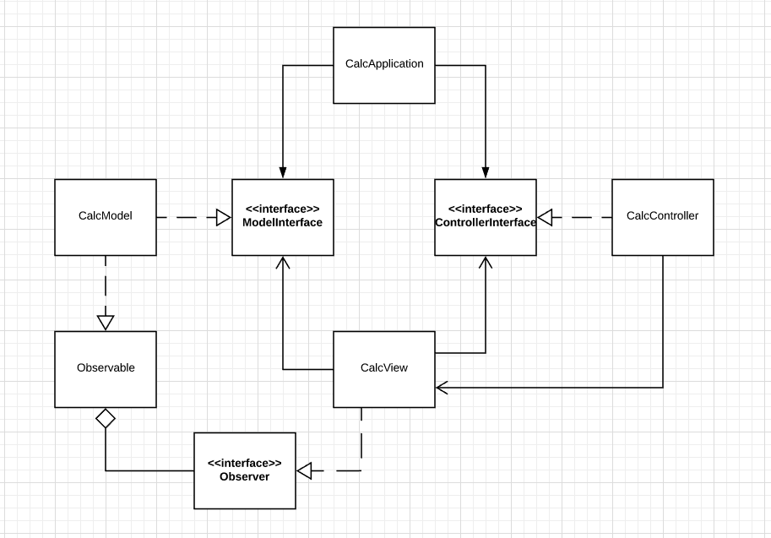
Notes:
Strategy pattern through using a Model and Controller interface
Observer pattern using Java’s own classes

Slide 4
View
Draw the calculator
Add event listeners to buttons, but let the Controller handle them
Expose the displayed “result” field by getters/setters
Use Observer to update with the calculation
Notes:
Note that there is no responsibility for logic, that’s to be handled elsewhere

Slide 5
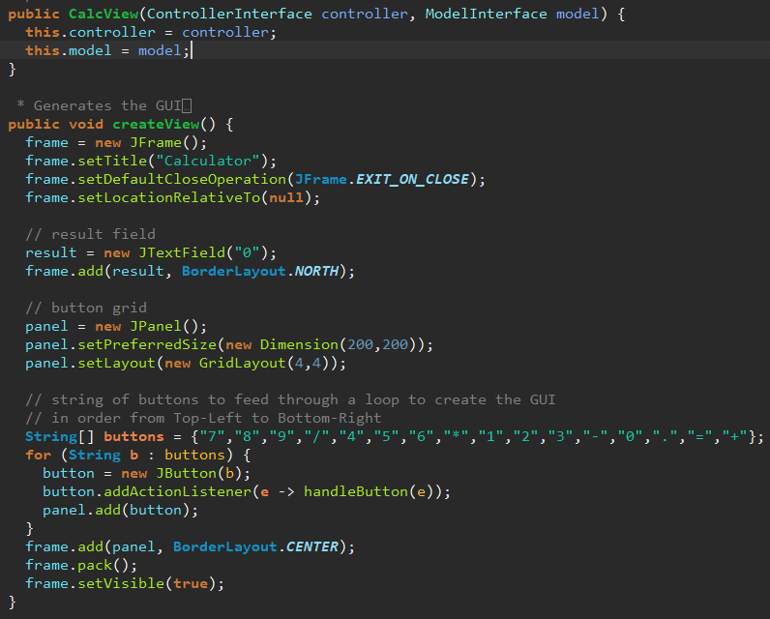
Notes:
Constructor takes the interfaces
GUI is created when called by the Controller
Action Listeners are added in the FOR loop but will be handled by the Controller

Slide 6
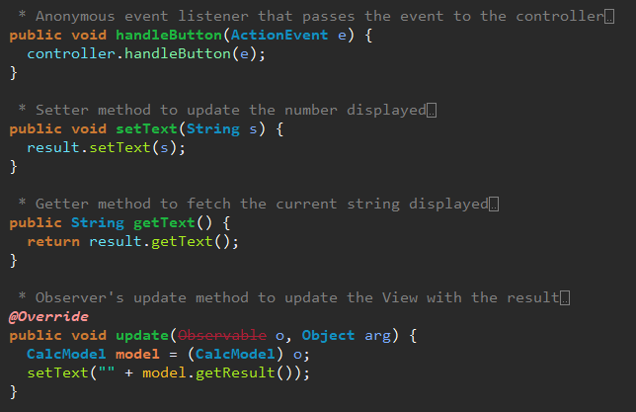

Slide 7
Controller
Register the View as an Observer of the Model
Determine how to handle button presses
Pass operation to model for calculation

Slide 8
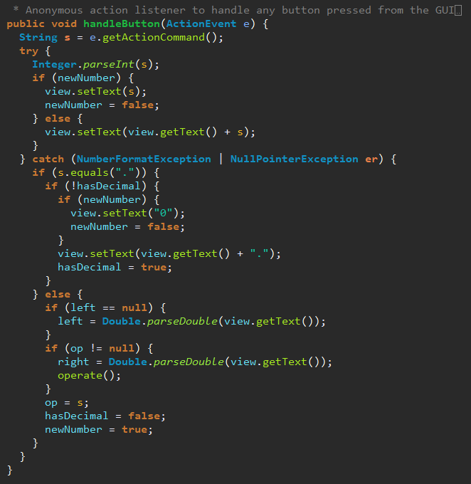
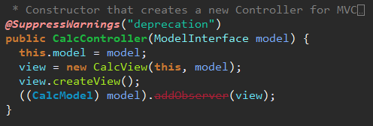
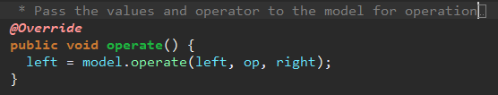

Slide 9
Model
Perform a calculation based on two numbers and an operator
Notify observers

Slide 10
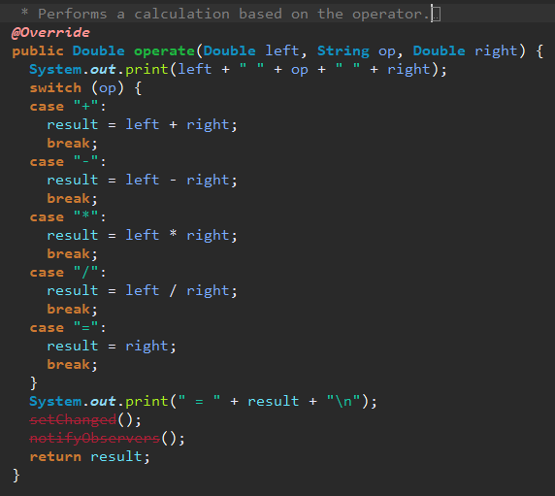

Slide 11
Questions?

